Slide 1
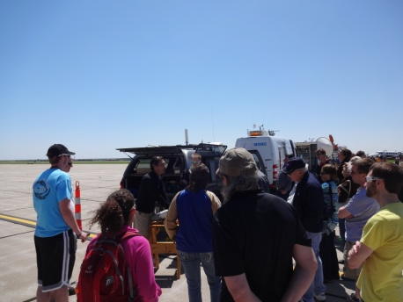
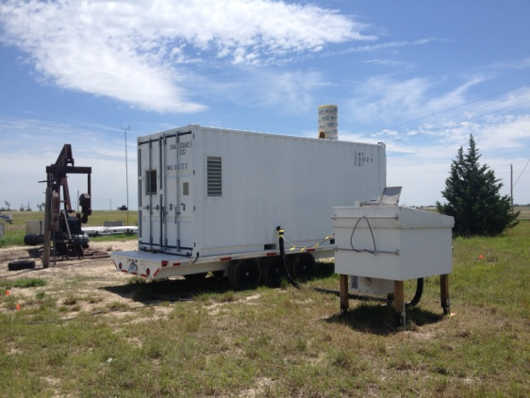
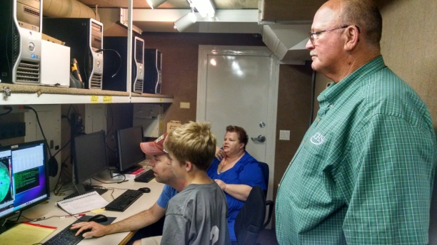
EOL Data at PECAN Tammy M. Weckwerth, Mike Dixon, Bill Brown, Scott Spuler and Bob Rilling NCAR/EOL
Scott Ellis giving S-Pol tour
WV DIAL at FP3
Tim Lim doing MGAUS outreach
S-Pol
4 ISS (FP-3, FP-4, FP-5, MISS)
Water Vapor DIAL
Regional 3-D radar mosaic
PECAN Science Meeting, 19 September 2016

Slide 2
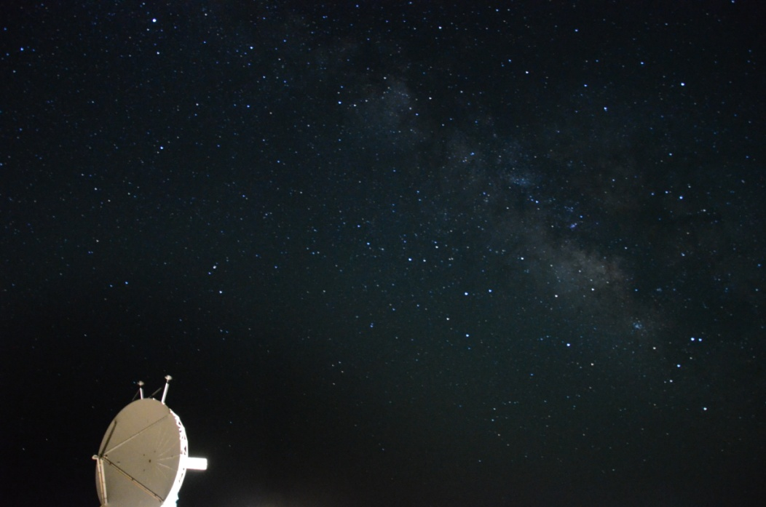
S-Pol Data
Photo by Scott Ellis (NCAR)
S-Pol ops
Up 28 May-4 June
Down 4-7 June
7-9 June intermittent ops
Down 9-12 June
Up 12 June-16 July 2015
Corrected for low noise power, clutter, reflectivity bias, Zdr bias based on temperature
Multiple fields in data archive, including Z, V, SW, NCP, ZDR, LDR, RhoHV, PhiDP, PID, rain rates, AIQ, NIQ, CPA, CMD
S-Pol User’s Guide: https://www.eol.ucar.edu/content/s-pol-users-guide-pecan
S-Pol quick look images: field catalog or https://www.eol.ucar.edu/rsf/image_archive/pecan/spol/
Show 16 July 00-10 UTC

Slide 3
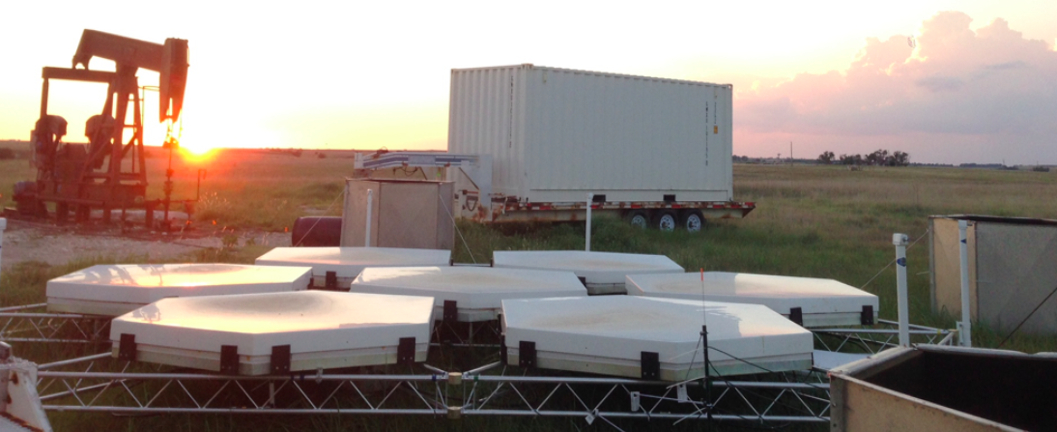
ISS Data
FP-3 (Ellis, KS): 449 MHz wind profiler + sfc met + GPS
FP-4 (Minden, NE): 915 MHz wind profiler + soundings + sfc met with fluxes + ceilometer + GPS
FP-5 (Brewster, KS): 915 MHz wind profiler + soundings + sfc met with fluxes + GPS
MISS: 915 MHz wind profiler + soundings + sfc met
All data in PECAN data archive except GPS: http://www.suominet.ucar.edu/data.html
EOL/ISS: https://www.eol.ucar.edu/content/pecan-iss
Show summary plots

Slide 4
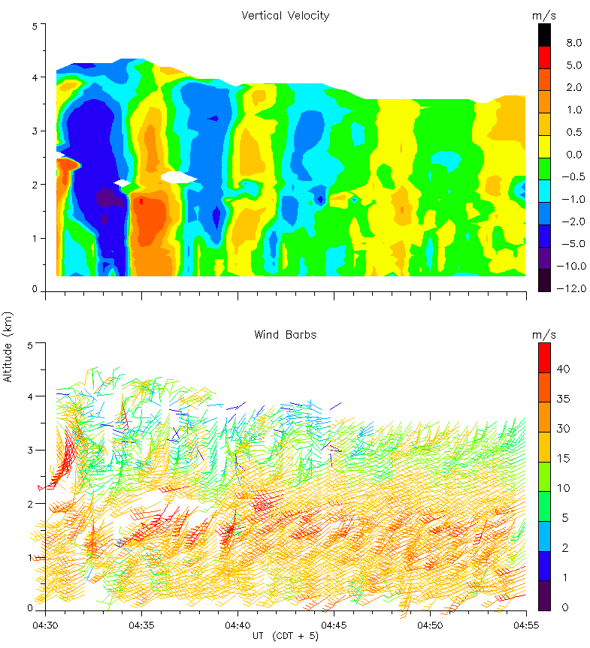
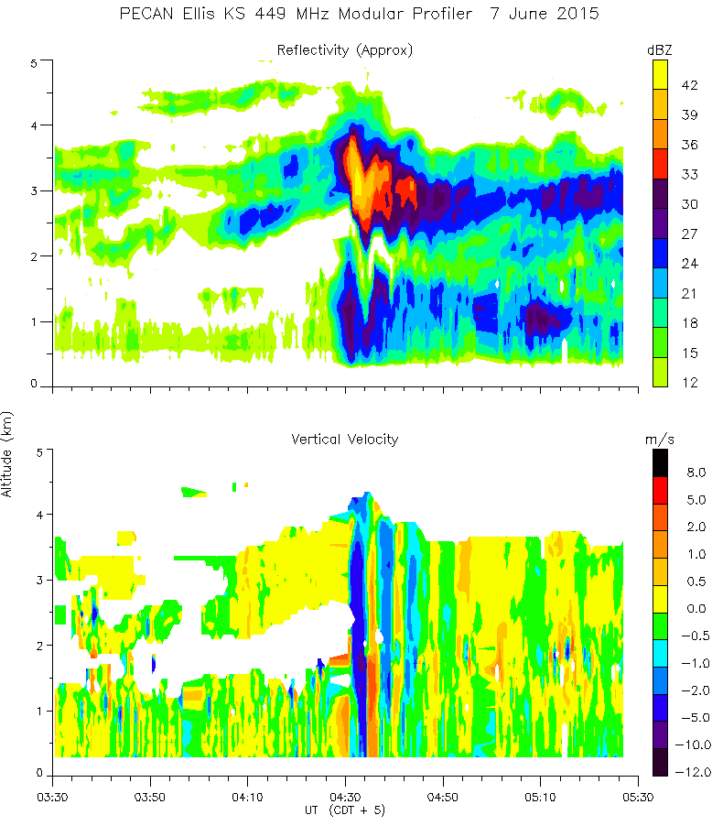
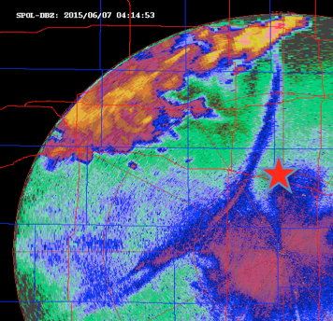
UFO 1: Bore
Generated by convection in western KS. Wave vert vel up to 5 m/s with gusts up to 45 m/s and rotating winds aloft.
Courtesy Bill Brown (NCAR)

Slide 5
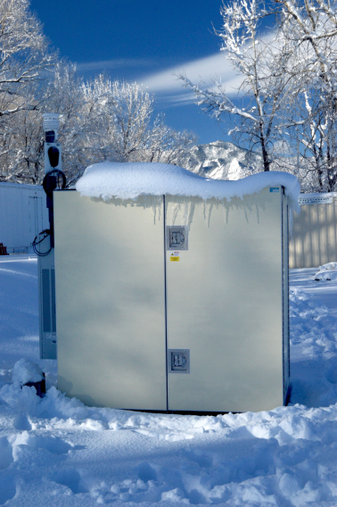
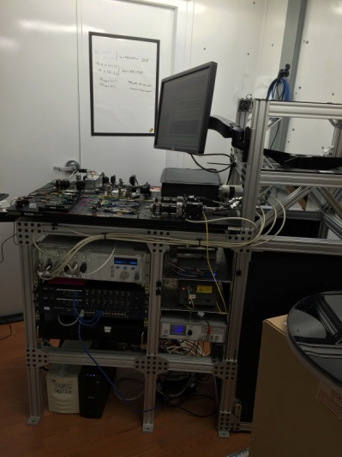
Water Vapor DIAL
5 min/150 m resolution
Relative backscatter (0-12 km) and absolute humidity (0-6 km)
Unattended and operational 99% during PECAN!
DIAL now
DIAL at PECAN

Slide 6
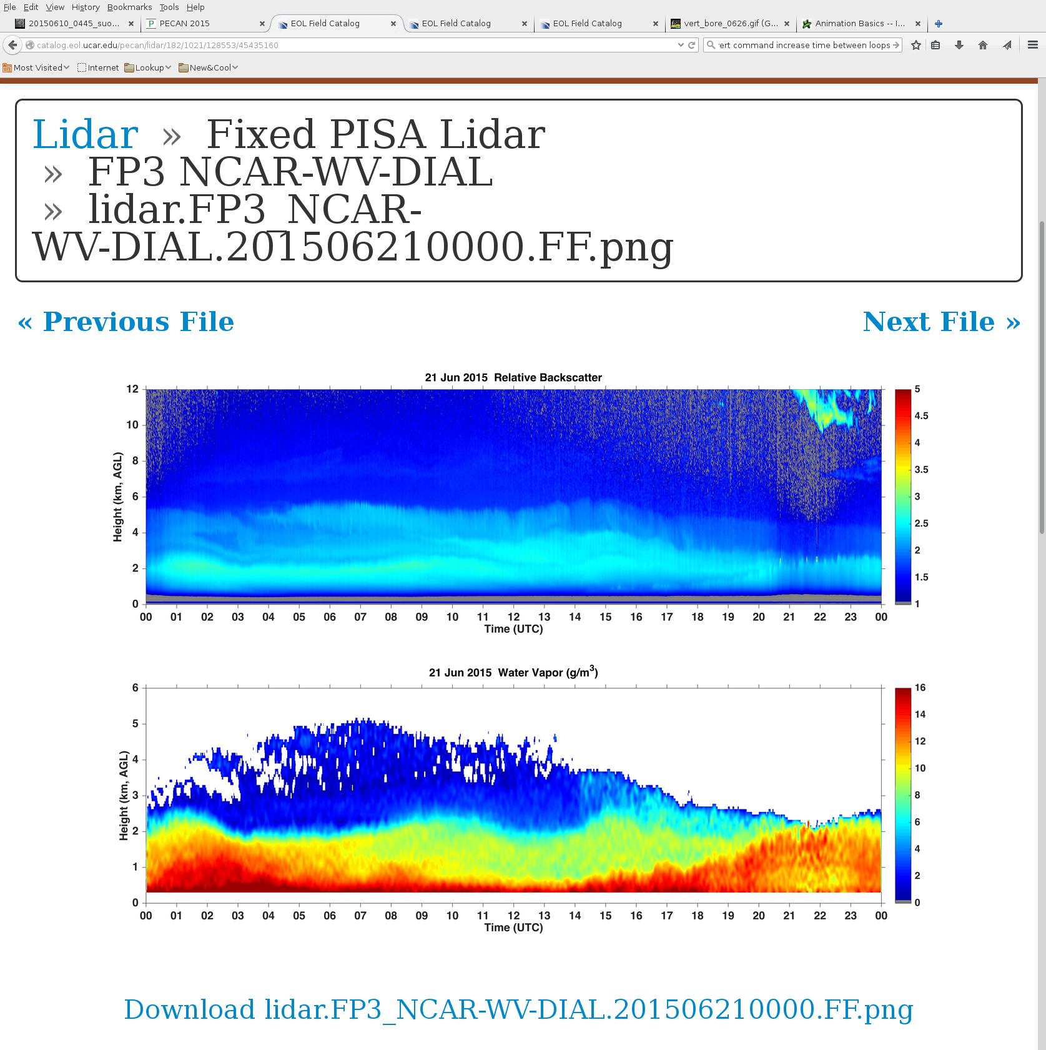
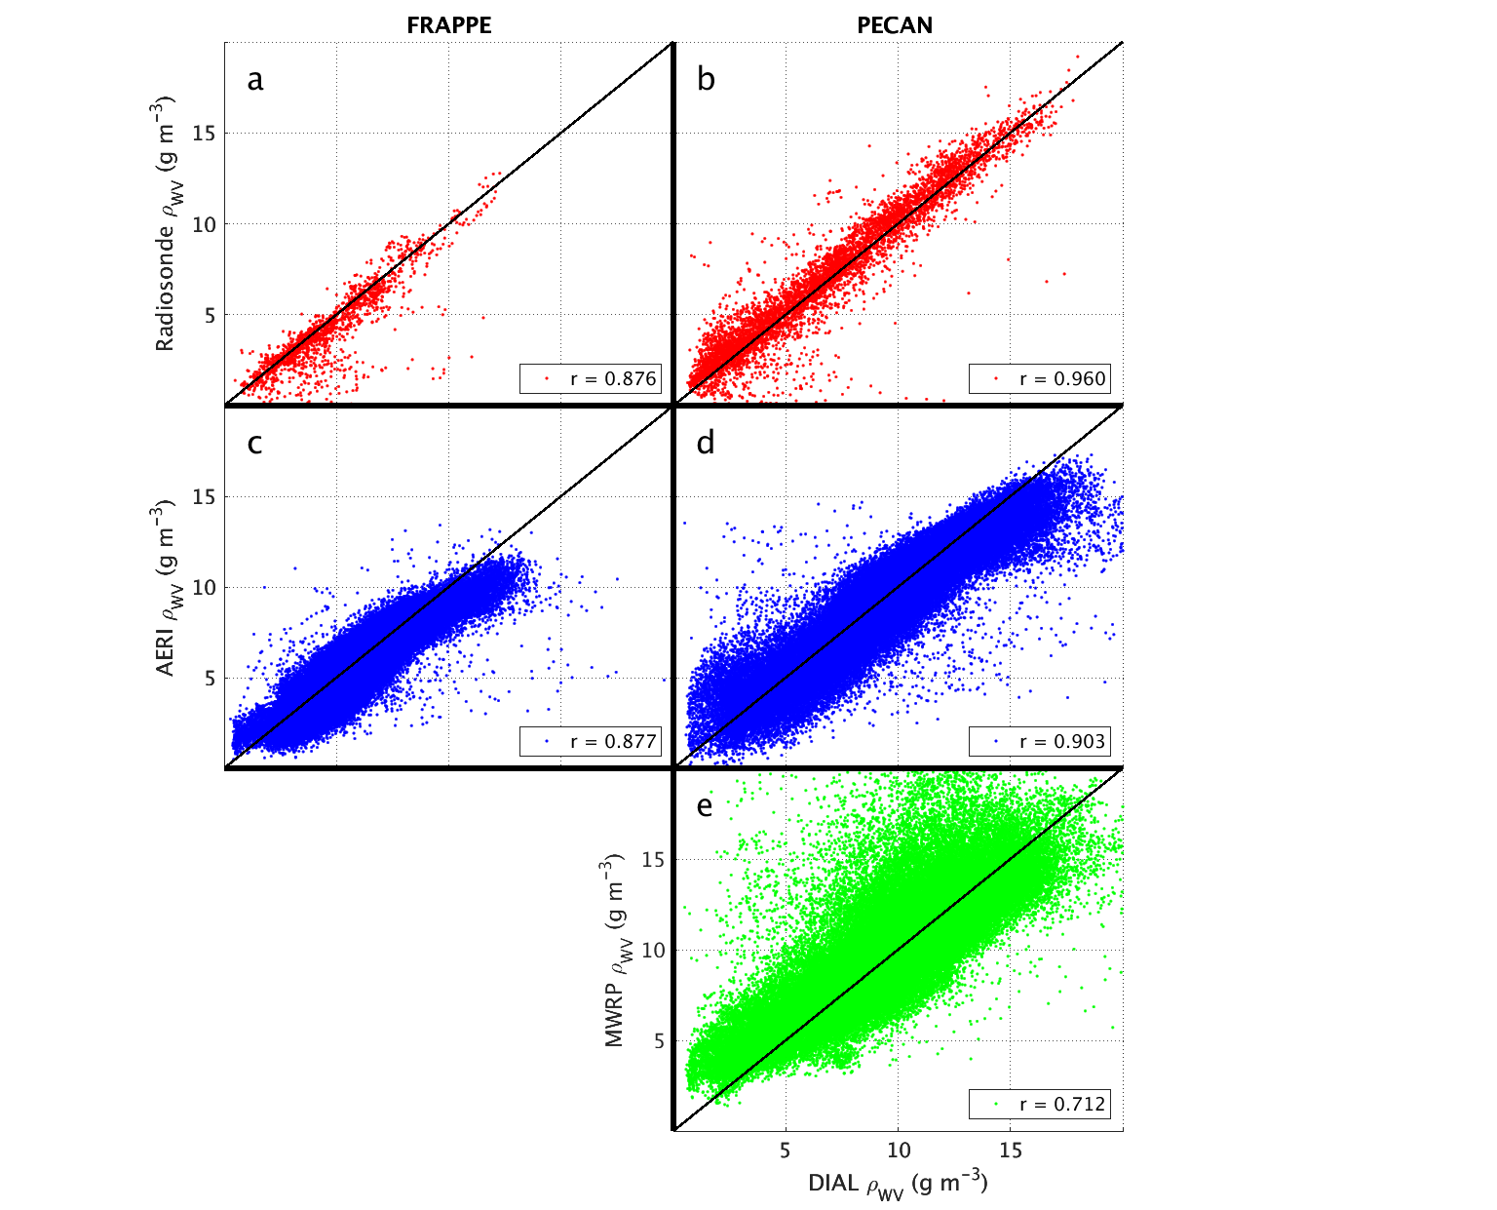
Water Vapor DIAL on 21 June
Numerous aerosol layers
Large-scale wave motions
Nocturnal BL
CBL growth
Paper showing validation of water vapor data by comparing with soundings, AERI, MWRP and GPS receivers (Weckwerth, Weber, Turner, Spuler, 2016 JTECH in press)

Slide 7
Radar Mosaics from EOL
19 NEXRADs + S-Pol
3-D gridded mosaic
Δx= Δy= Δz=250-500 m
Z, V, SW, ZDR, Rho_hv, PID, and QPE fields (rain rates + various accumulations)

Slide 8
EOL Instruments
S-Pol
https://www.eol.ucar.edu/content/s-pol-users-guide-pecan
ISS
https://www.eol.ucar.edu/content/pecan-iss
WV-DIAL
https://www.eol.ucar.edu/instruments/wvdial

Slide 9
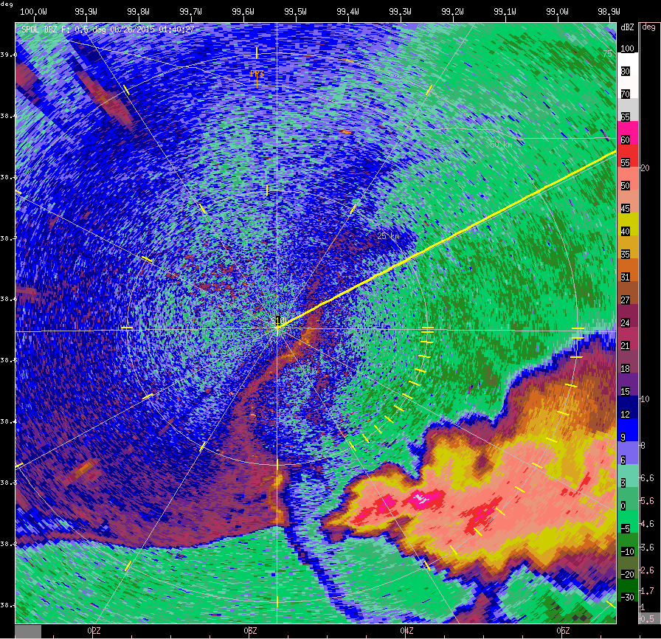
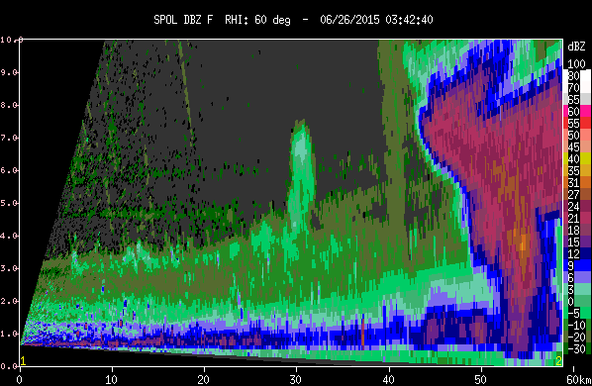
Bore and CI from S-Pol
S-Pol reflectivity 0130-0530 UTC, every 10 min
Bore initiates new convection at 0323 UTC

Slide 10
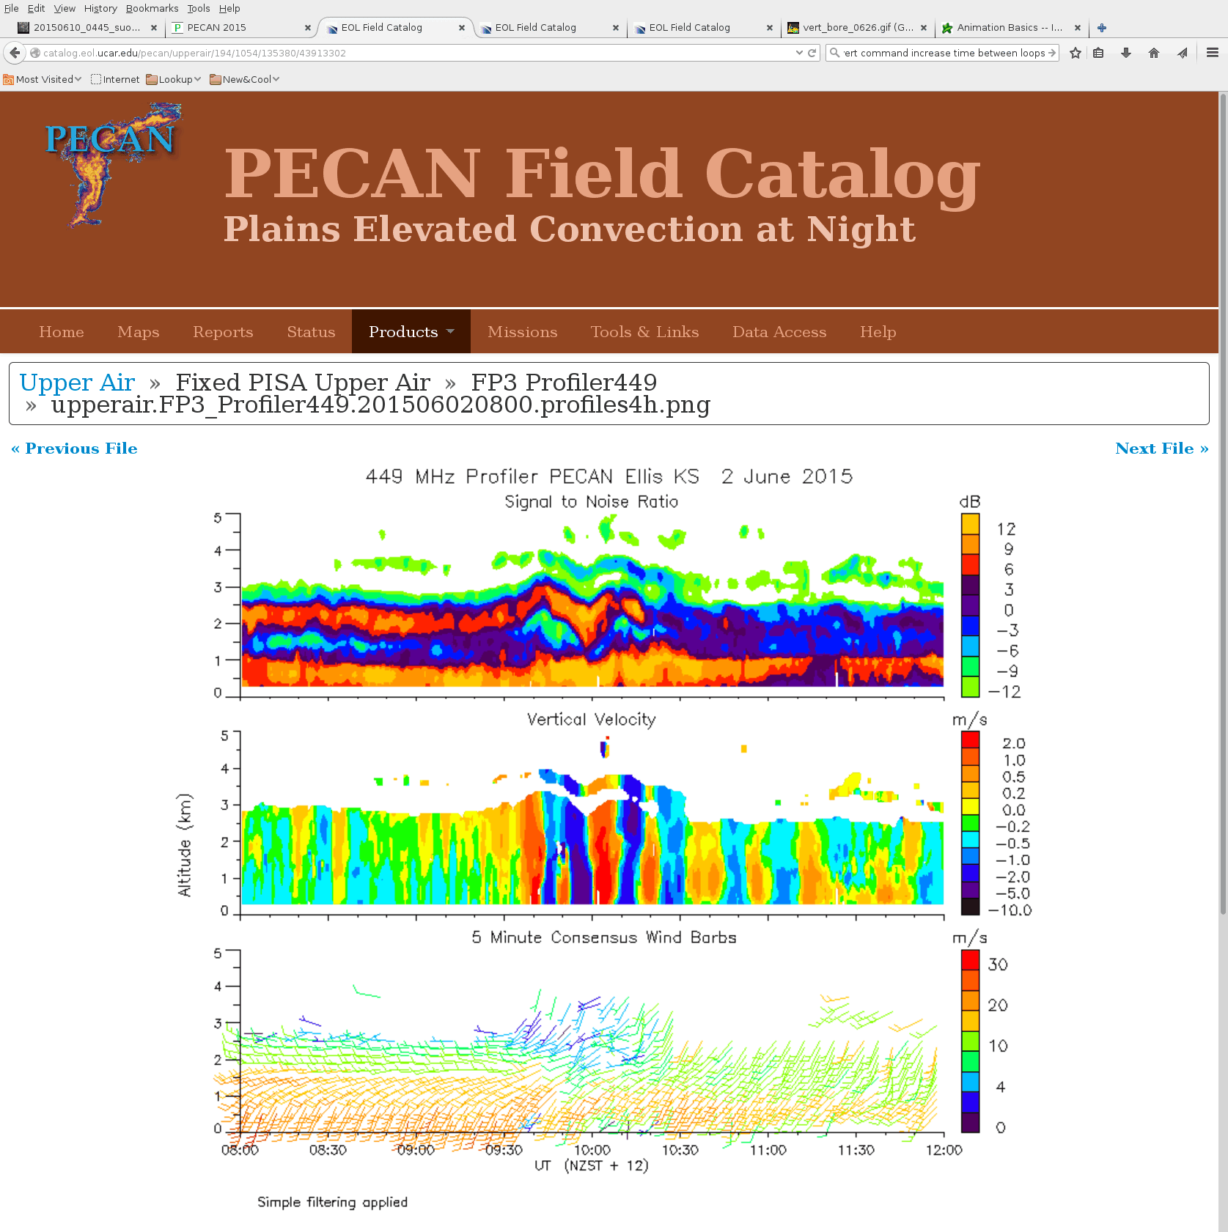
Bore Observed by 449 MHz Profiler
Continuous wind profiles
Data to >3 km; often to 5 km
LLJ and wave structures

Slide 11
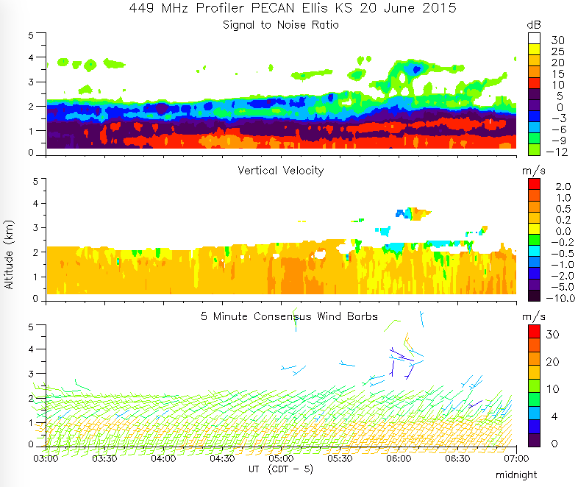
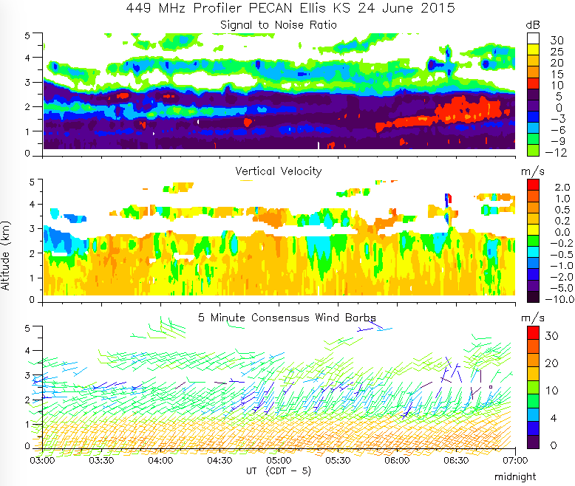
Low Level Jet
Modular Profiler often saw persistent updrafts during LLJ.
May be upslope flow, although not clearly correlated with speed, perhaps orographic wave

Slide 12
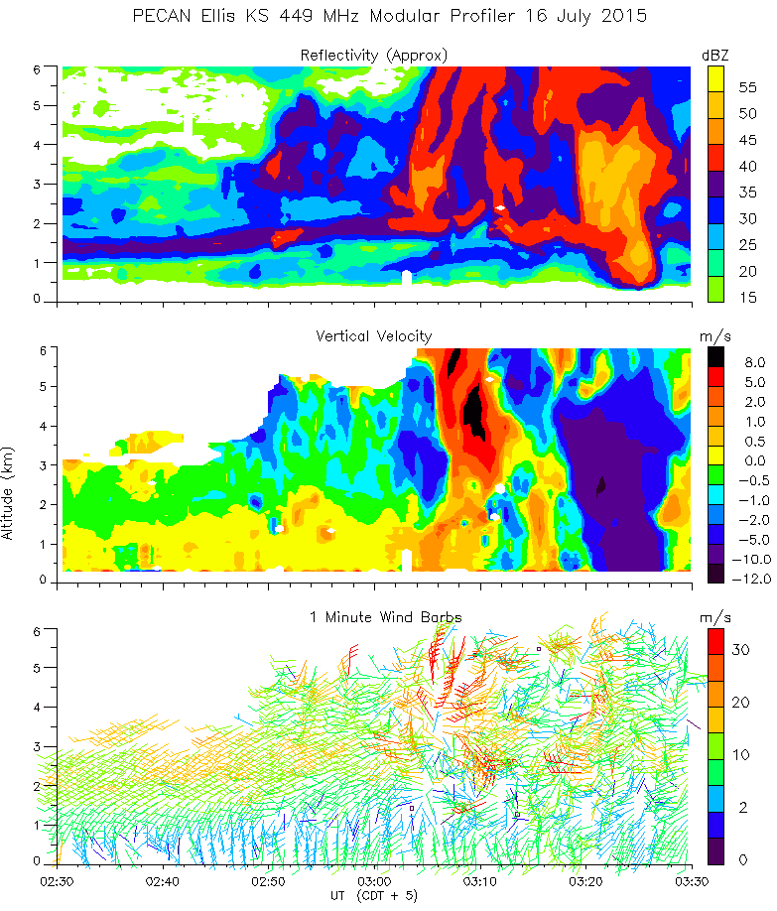
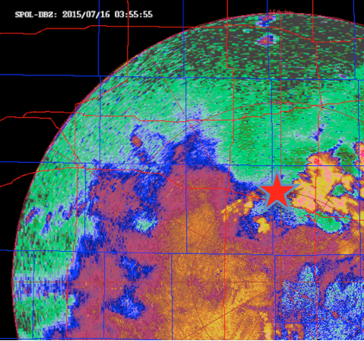
IOP31 MCS
Cell passed over with strong updraft ~10m/s and 40 m/s gusts.
Strong Updraft
Gusts
Courtesy Bill Brown (NCAR)

Slide 13
Issues : technical
Ellis KS (FP3):
Modular Profiler - RASS lock-ups
Surface winds - occasionally striated
Minden NE (FP4):
Air Conditioner
Brewster (FP5):
Unsteady power - brown-out and failure
Data manager computer - power issue
915 MHz Profiler - dropout
Sodar - failed
Solar Radiation - dropout reset
Surface wind directions
MISS & MGAUS (MP4):
Trailer lights failure
Generator failure
Equipment overheating

Slide 14
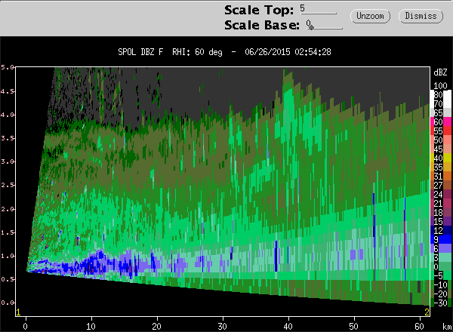
Bore Generation Captured by S-Pol
S-Pol radial velocity 0130-0530 UTC on 26 June 2015, every 10 min
What causes bore initiation?
Apparently changes orientation

