Slide 1
Current State of Processing of the PECAN Microphysics Dataset
Greg M. McFarquhar¹, Daniel M. Stechman¹, Robert M. Rauber¹, Robert A. Black² and Brian F. Jewett¹
¹University of Illinois at Urbana-Champaign, Urbana, IL
²National Oceanic and Atmospheric Administration – Hurricane Research Division, Miami, FL

Slide 2
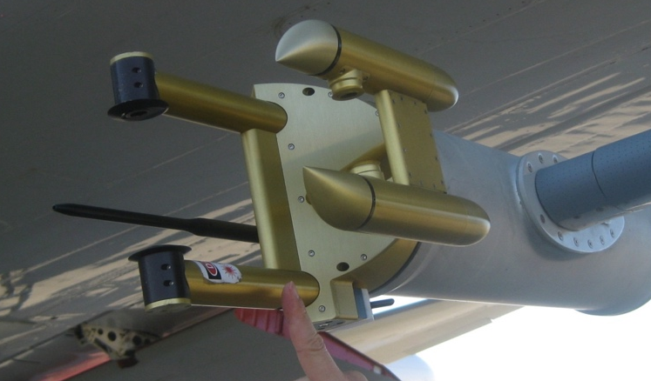
Instrumentation: Imaging Probes
Cloud Imaging Probe (CIP)
64 laser diodes with 25 µm resolution
(~125 µm to 1600 µm)
Good quality data
Precipitation Imaging Probe (PIP)
64 laser diodes with 100 µm resolution
(~0.6 mm to 6.4 mm)
Data quality not as good, but some data recoverable
Notes:
150 um chosen as lower bound because there are many uncertainties concerning the validity of particles smaller than this
e.g., Shattered particles
PIP probe was also used, though there were lots of fogging problems.
→We’re carefully assessing the reliability of this data and working to incorporate it into future analyses.

Slide 3
Instrumentation: Droplet Probes
Cloud Droplet Probe (CDP)
Size measured by forward scattering of light (2 μm to 50 μm)
Cloud Aerosol Spectrometer (CAS)
Size measured by forward scattering of light
(0.53 to 50 μm)
These data can be trusted for liquid droplets
Notes:
150 um chosen as lower bound because there are many uncertainties concerning the validity of particles smaller than this
e.g., Shattered particles
PIP probe was also used, though there were lots of fogging problems.
→We’re carefully assessing the reliability of this data and working to incorporate it into future analyses.

Slide 4
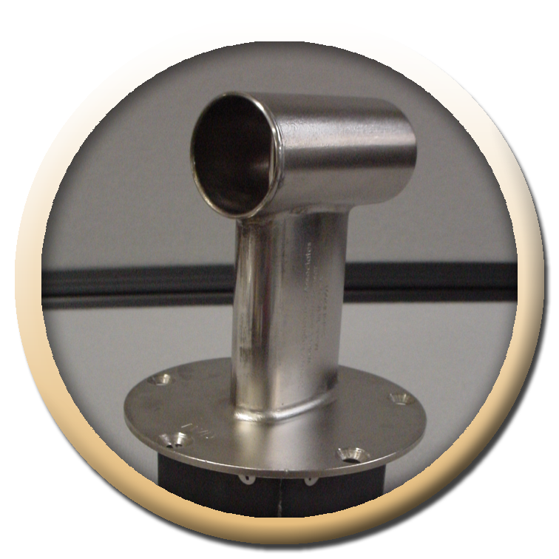
Instrumentation: Hot Wire Probes
SEA hot-wire probe
Directly measures LWC
0-10 g/m³ for airspeeds < 150 m/s
Notes:
150 um chosen as lower bound because there are many uncertainties concerning the validity of particles smaller than this
e.g., Shattered particles
PIP probe was also used, though there were lots of fogging problems.
→We’re carefully assessing the reliability of this data and working to incorporate it into future analyses.

Slide 5
Processing Optical Array Probe Data
Use UIOPS (University of Illinois Optical Array Probe Processing Software)
Three primary steps in UIOPS:
Process raw binary image data, and convert to netCDF
Reject particles & determine morphology of each particle
Calculate 1-second particle size distributions (PSDs) and bulk microphysical quantities

Slide 6
Quality Control
Following particles are rejected:
Shattered artifacts
Short interarrival time suggests shattered artifact
Out of focus particles
Often yields “hollow” particles due to probe depth of field limitations
“Streakers” and stuck bits

Slide 7
Calculated Quantities
Size Distribution Bulk Properties
Total number concentration
Total extinction
Total ice water content
Total reflectivity
Effective radius
Median mass dimension
Mass-weighted terminal velocity
Precipitation rate
Particle-by-Particle Properties
Maximum dimension
Projected area
Aspect ratio
Area ratio
Estimated mass
Identified habit

Slide 8
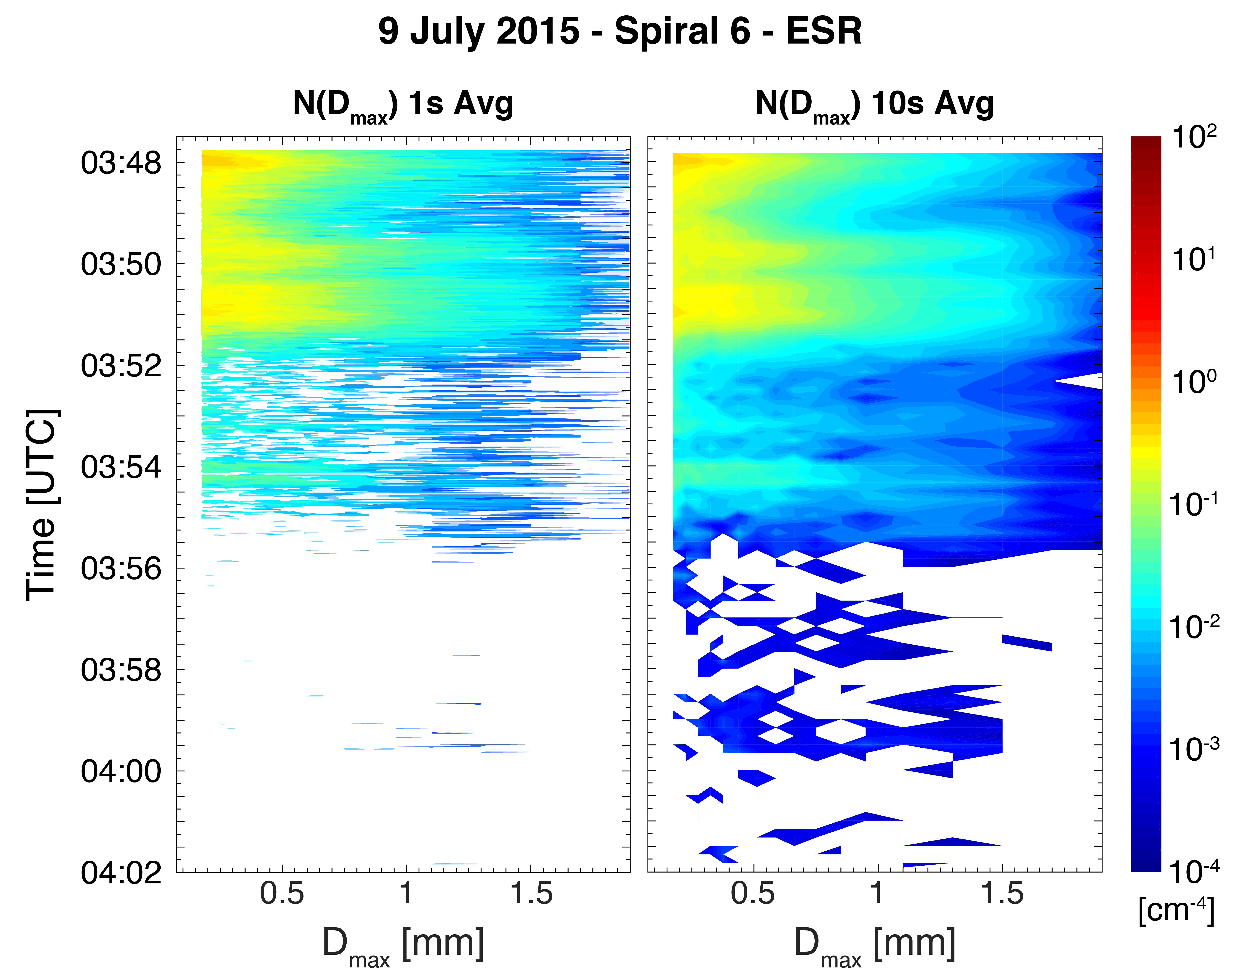
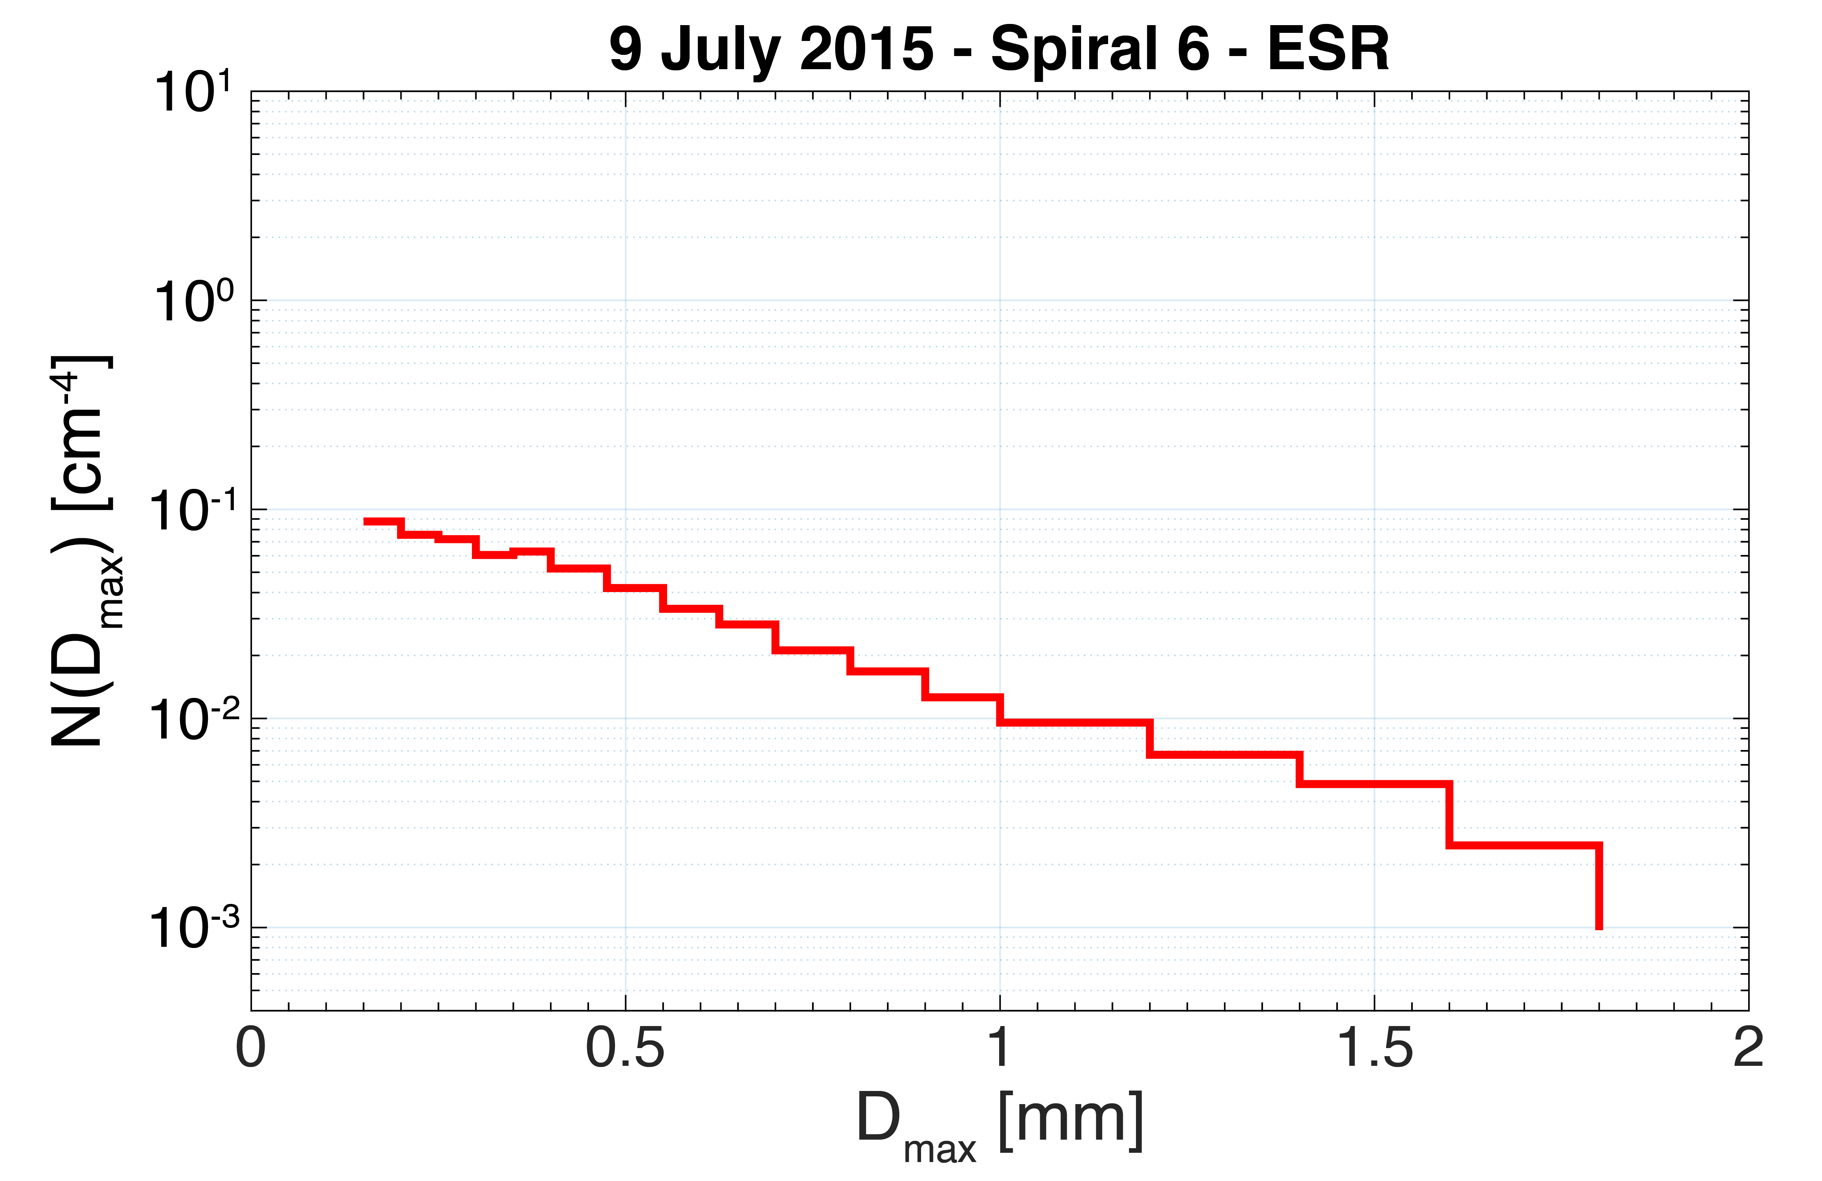
Size Distribution Data
1-sec averages for archived data
We suggest using at least 5-sec average for statistical significance

Slide 9
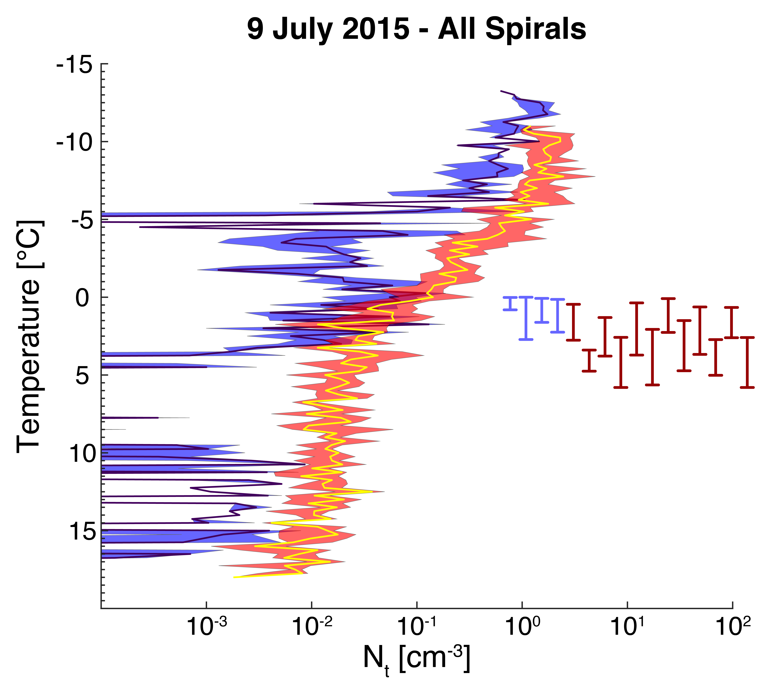
Total Number Concentration

Slide 10
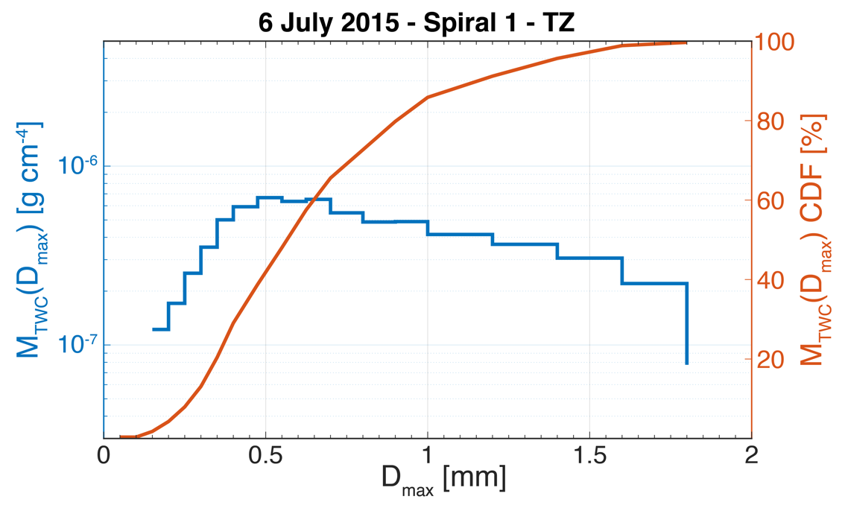
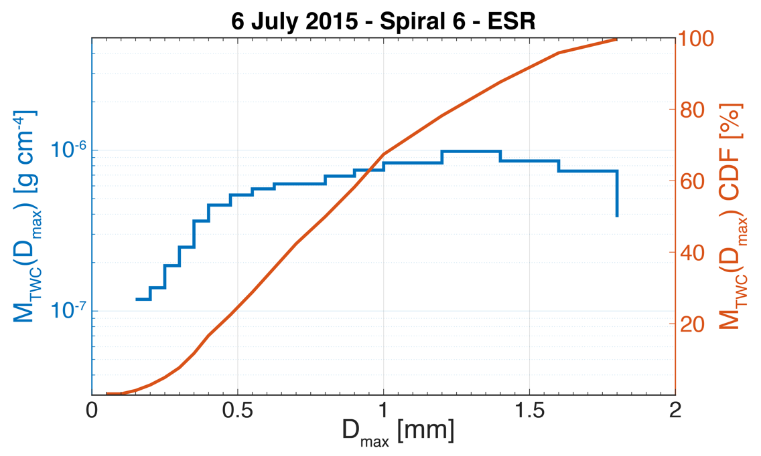
Mass Distribution Functions
Need PIP data for a complete analysis

Slide 11
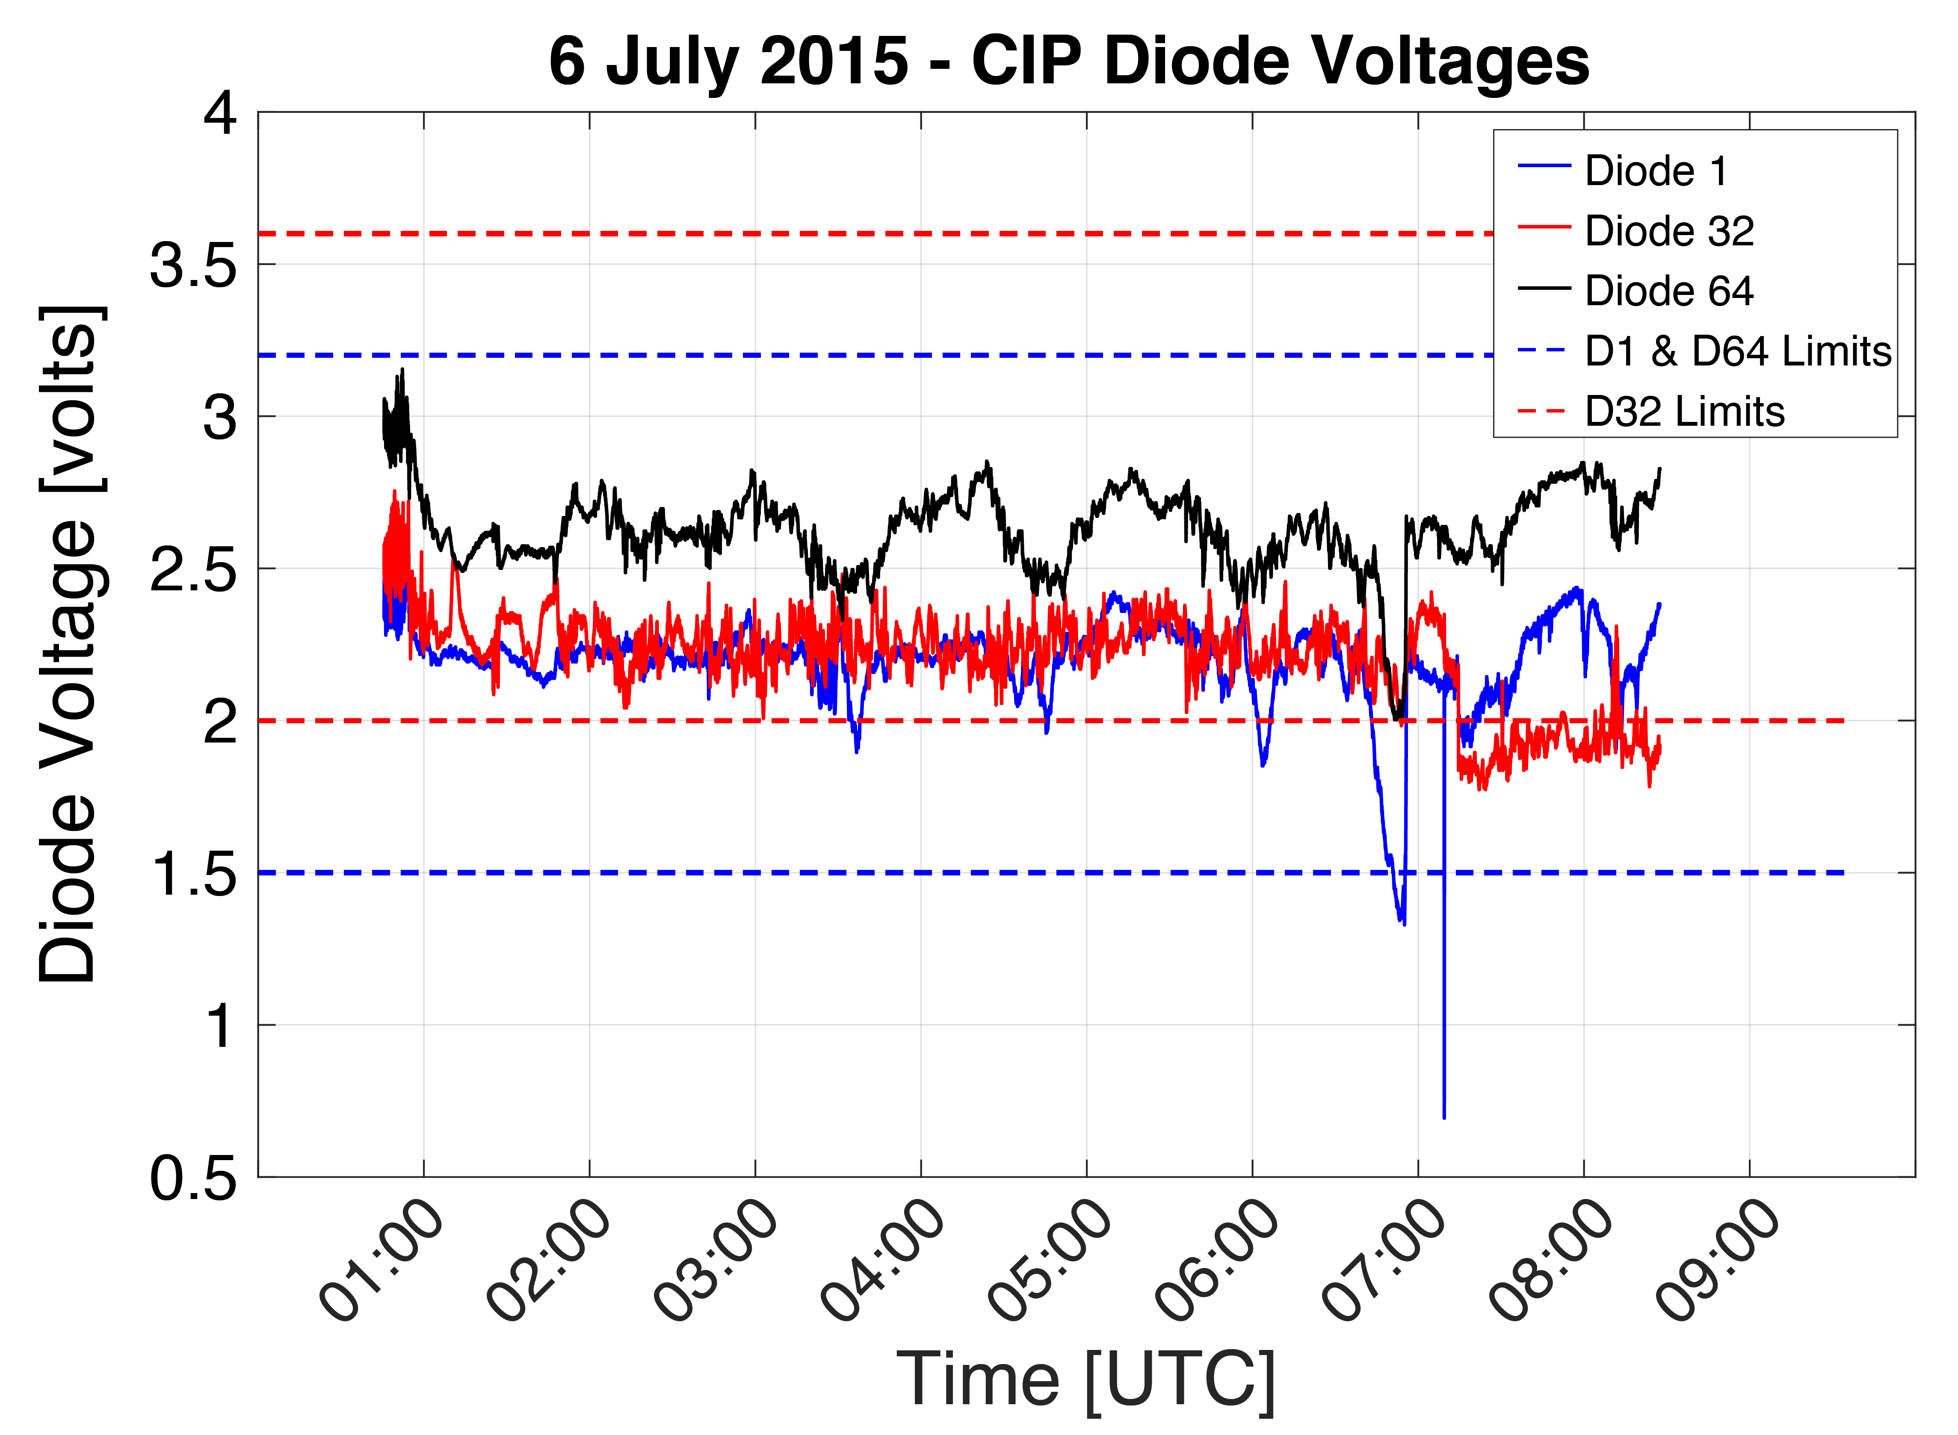
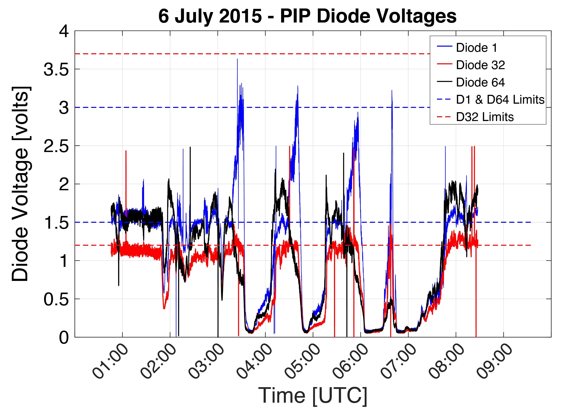
PIP Data Quality
Fogging and/or icing caused data quality issues and at times complete failure of PIP
Good Data (CIP)
Partially Corrupt Data (PIP)

Slide 12
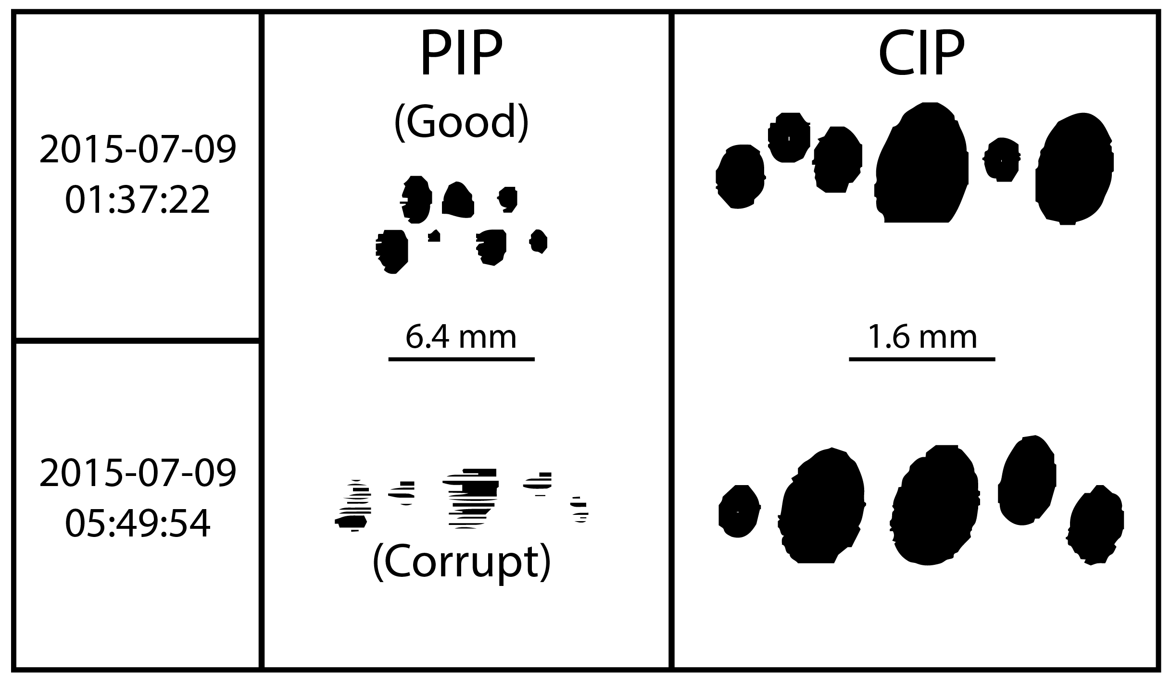
PIP Data Quality
We will be analyzing the PIP data on a second-by-second basis to determine which periods contain usable data

Slide 13
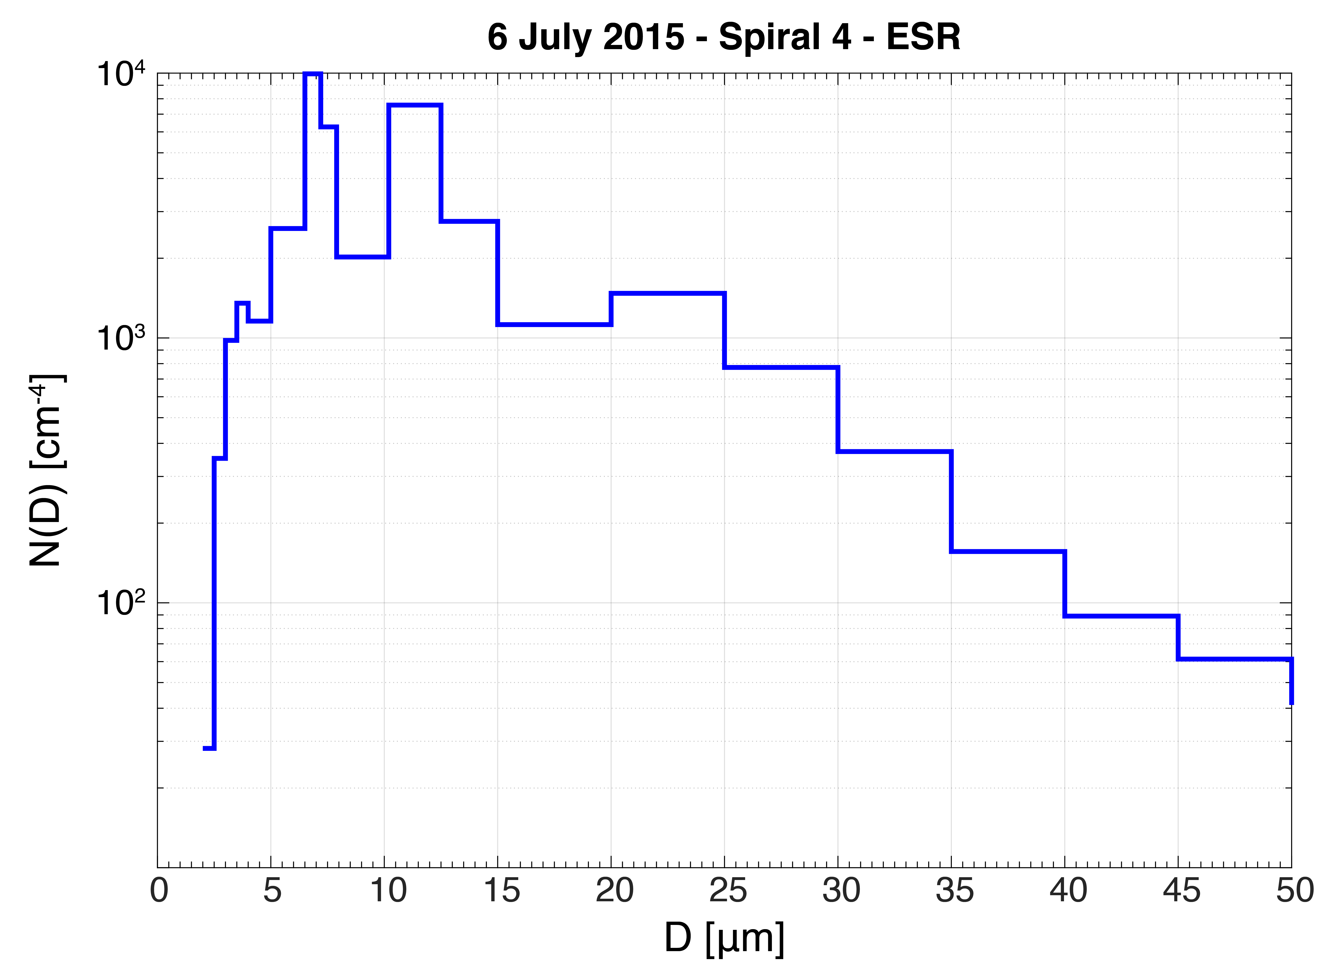
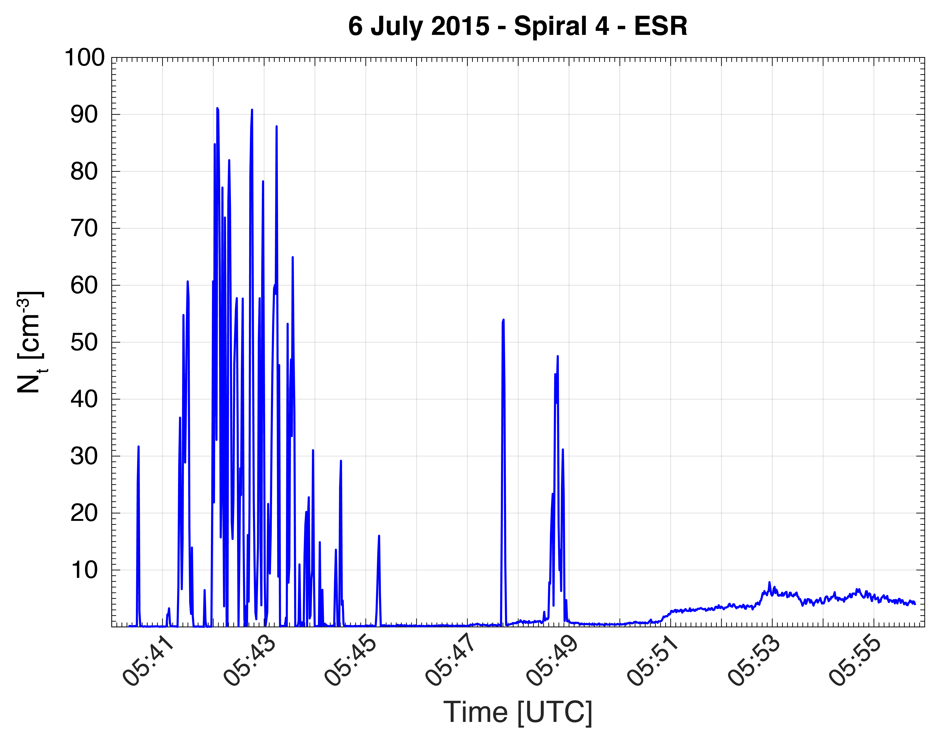
CAS Probe

Slide 14
Representative Particle Images
Images of all particles will be available on archive as function of time
For spirals, we will generate plots showing selected images binned by temperature

Slide 15
PECAN Spirals
P | P | ! | X
Complete – Ready for Archive | Ready to Produce | Incomplete – Pending PIP QC | No Data
20150617 - IOP 11
Spiral # | CIP PbP Data | CIP SD Data | CIP Rep. Particle Plot | PIP PbP Data | PIP SD Data | PIP Rep. Particle Plot
1 | P | P | P | ! | ! | !
2 | P | P | P | ! | ! | !
3 | P | P | P | ! | ! | !
4 | P | P | P | ! | ! | !
5 | P | P | P | ! | ! | !
6 | P | P | P | ! | ! | !
7 | P | P | P | ! | ! | !
20150706 - IOP 20
Spiral # | CIP PbP Data | CIP SD Data | CIP Rep. Particle Plot | PIP PbP Data | PIP SD Data | PIP Rep. Particle Plot
1 | P | P | P | ! | ! | !
2 | P | P | P | ! | ! | !
3 | P | P | P | ! | ! | !
4 | P | P | P | ! | ! | !
5 | P | P | P | ! | ! | !
6 | P | P | P | ! | ! | !
7 | P | P | P | ! | ! | !
20150620 - UFO 4
Spiral # | CIP PbP Data | CIP SD Data | CIP Rep. Particle Plot | PIP PbP Data | PIP SD Data | PIP Rep. Particle Plot
1 | P | P | P | ! | ! | !
2 | P | P | P | ! | ! | !
3 | P | P | P | ! | ! | !
4 | P | P | P | ! | ! | !
5 | P | P | P | ! | ! | !
6 | P | P | P | ! | ! | !
20150709 - IOP 21
Spiral # | CIP PbP Data | CIP SD Data | CIP Rep. Particle Plot | PIP PbP Data | PIP SD Data | PIP Rep. Particle Plot
1 | P | P | P | ! | ! | !
2 | P | P | P | ! | ! | !
3 | P | P | P | ! | ! | !
4 | P | P | P | ! | ! | !
5 | P | P | P | ! | ! | !
6 | P | P | P | ! | ! | !
7 | P | P | P | ! | ! | !
8 | P | P | P | ! | ! | !
9 | P | P | P | ! | ! | !
10 | P | P | P | ! | ! | !
11 | P | P | P | ! | ! | !
12 | P | P | P | ! | ! | !
13 | P | P | P | ! | ! | !
14 | P | P | P | ! | ! | !
15 | P | P | P | ! | ! | !
16 | P | P | P | ! | ! | !
20150701 – IOP 17
Spiral # | CIP PbP Data | CIP SD Data | CIP Rep. Particle Plot | PIP PbP Data | PIP SD Data | PIP Rep. Particle Plot
1 | P | P | P | ! | ! | !
20150702 – UFO 8A
Spiral # | CIP PbP Data | CIP SD Data | CIP Rep. Particle Plot | PIP PbP Data | PIP SD Data | PIP Rep. Particle Plot
1 | P | P | P | X | X | X
2 | P | P | P | X | X | X
3 | P | P | P | X | X | X
**No spirals during IOP 25, UFO 12, and IOP 27**

Slide 16
Archival
We will begin uploading QC’d data to the archive soon
(will be assigned a DOI)
Ready for upload to the data archive:
CIP particle-by-particle and size distribution data
Select representative particle image plots
No/limited processing:
PIP particle-by-particle and size distribution data
SEA, CAS, and CDP data
Raw CIP/PIP data
Not currently on the archive (obtained from NOAA HRD)
Should they be on archive?

Slide 17
Archival
Encourage collaborative use of the data
Looking for friendly users to use data in their investigations
→ Contact Greg McFarquhar if interested
mcfarq@illinois.edu

