Slide 1
Airborne Compact Raman Lidar (CRL) Data Collection during PECAN
Zhien Wang (zwang@uwyo.edu), Decheng Wu, Bart Geerts, Min Deng, and King Air team
University of Wyoming

Slide 2
University of Wyoming King Air Instrumentation
Compact Raman lidar (CRL, nadir): aerosol (LSR), water vapor and temperature
Wyoming Cloud Lidar (WCL, zenith): aerosol
In situ measurements
PCASP: Aerosol size distribution
Wind
Water vapor, state variables
pressure perturbations (differential GPS)

Slide 3
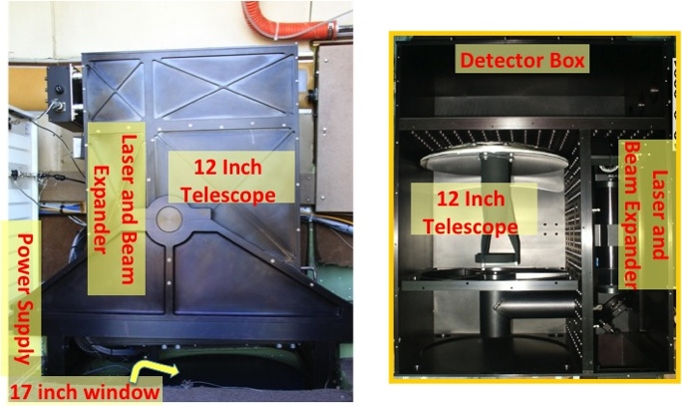
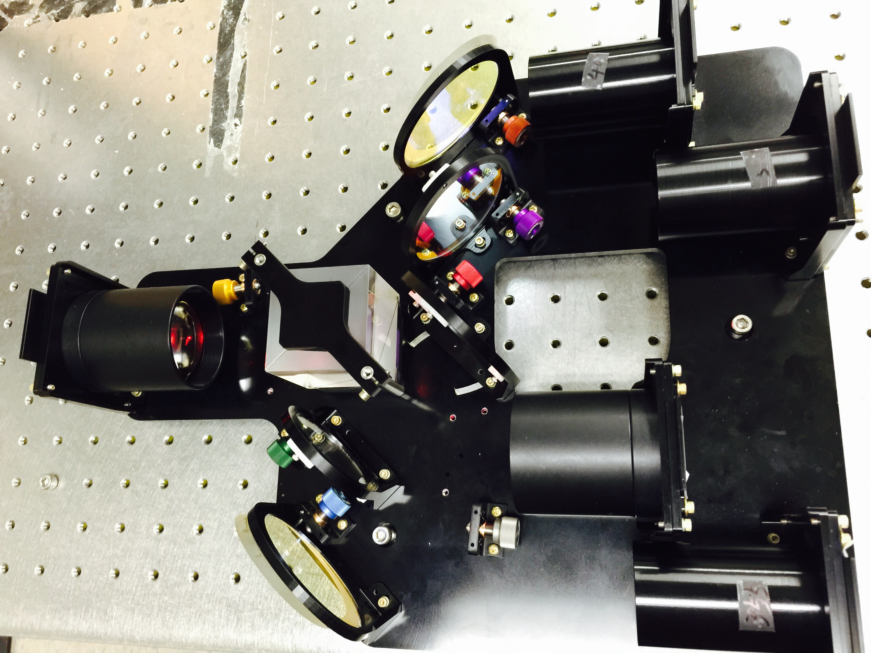
Compact Raman Lidar (CRL)
12 inch telescope
Laser: 50 mJ at 30 Hz
Added a Raman temperature channel for PECAN
Optimized for nighttime operations
12x18x5 inches
The new five channel receiver
CRL is a prototype for MARLi

Slide 4
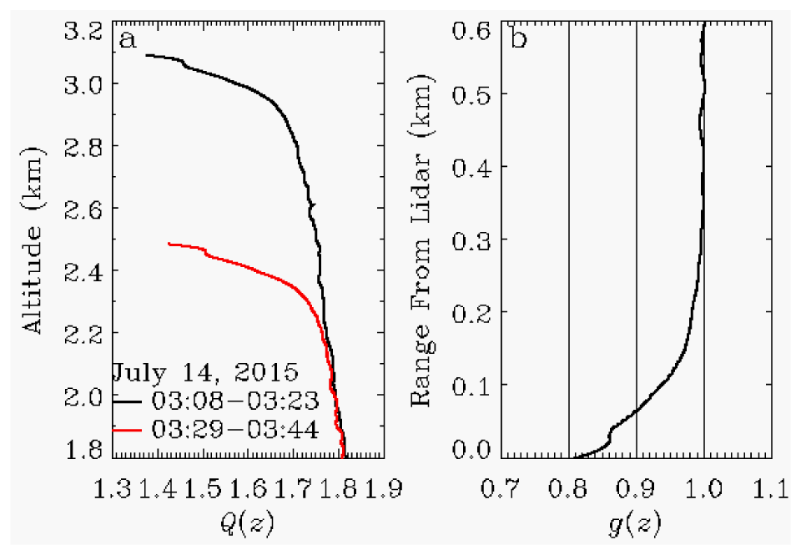
Data Processing
Calibrations: In situ measurements from designated flight patterns
Short-range overlap corrections:
Using clear sky for aerosol channels
Using stacked legs for water vapor and temperature channels
An example of determining overlap correction factor g(z) for temperature measurements based on measurements at ~3.1 km and ~2.5 km legs.
Wu et al., OE, 2016, A1210-A1223

Slide 5
Averaging and noise
Raw data resolution:
Δz ~ 0.6 m
Δx ~ 20-100 m
Averaging to suppress random noise.
uncertainties that arise from random noise in the lidar signals using different horizontal (Δx) and vertical (Δz) filters.

Slide 6
Averaging and Noise
100 km
best-estimate temperature
calibration uncertainty
noise uncertainty

Slide 7
Data Availability and Issues
No CRL temperature estimates before June 15.
due to an impedance mismatch issue (PMT)
One water vapor calibration coefficient was used for whole campaign.
Noise increases with range: CRL measurements beyond 2 km are noisy – requiring coarser averaging.

Slide 8
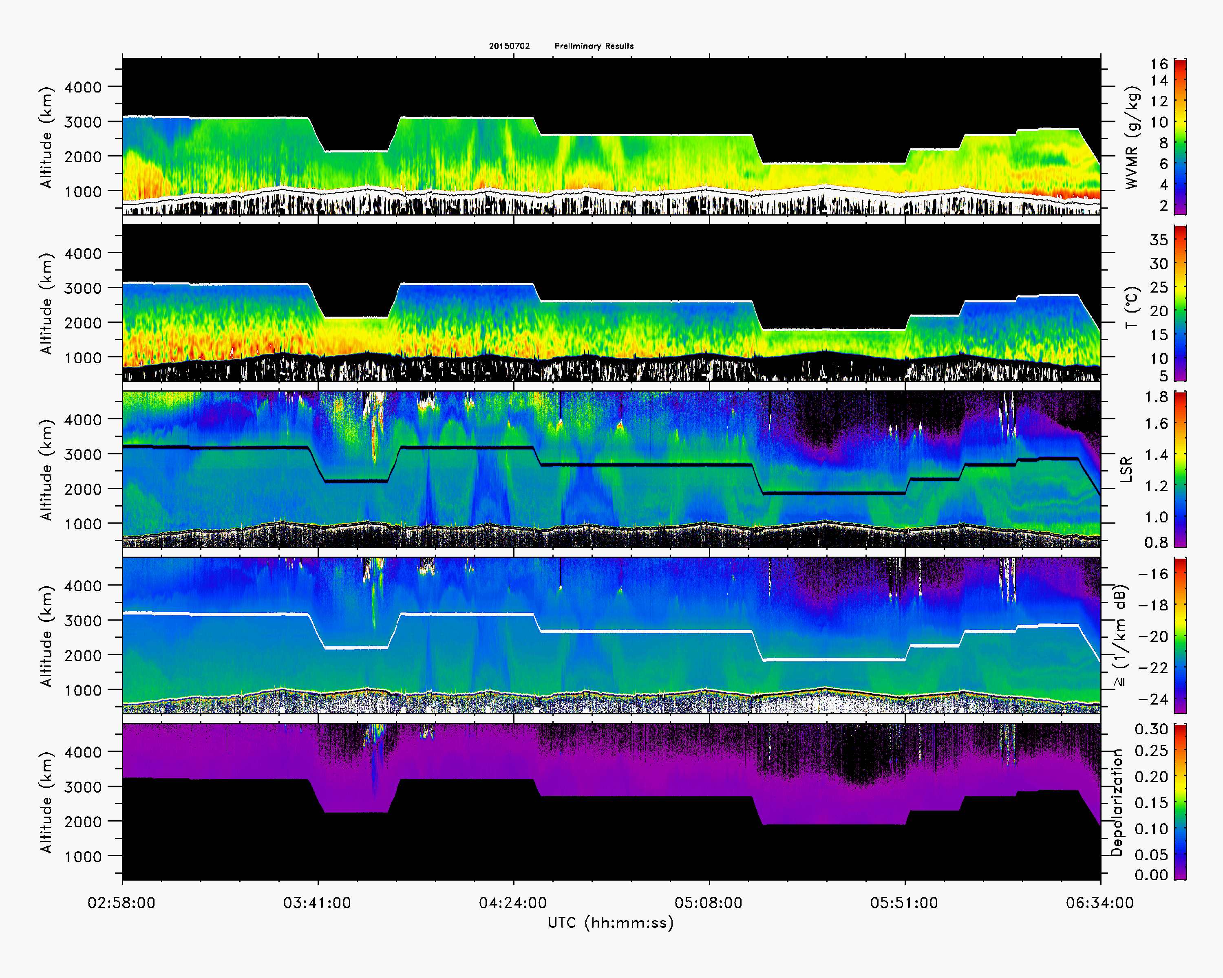
Combined WCL and CRL Measurements
2 July 2015
q_{v}
T
aerosol
Depolarization

Slide 9
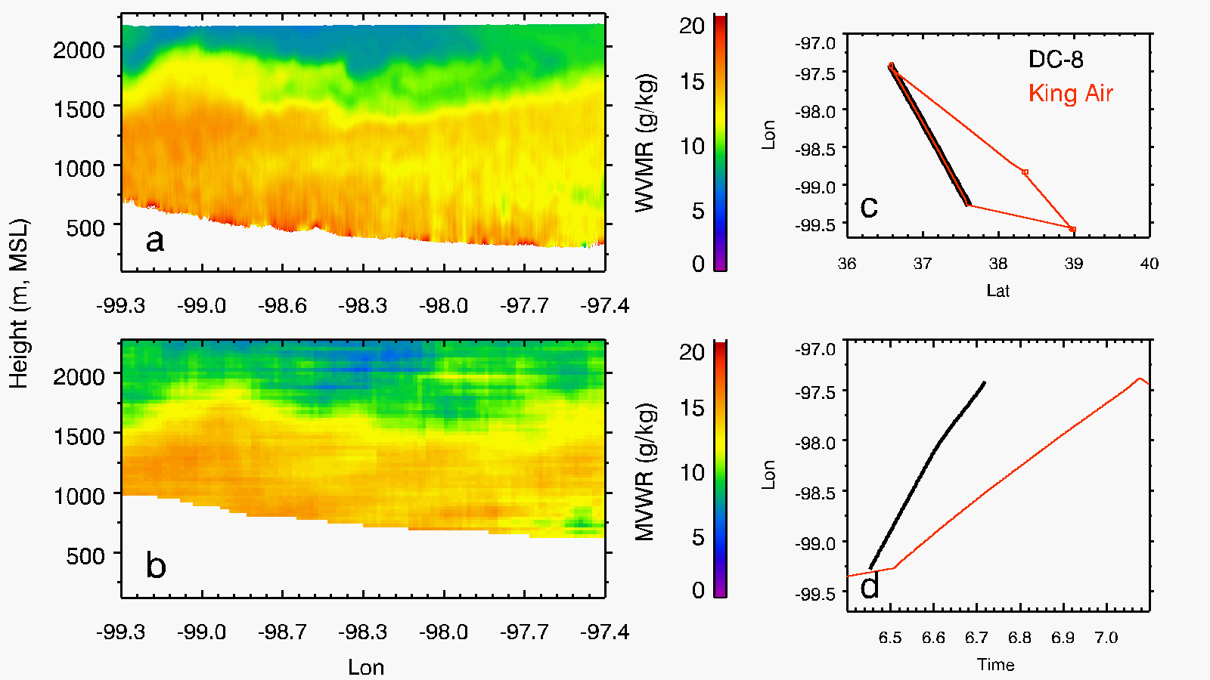
CRL and LASE: water vapor comparison
12 July 2015
FP3
CRL
FP2
FP1
LASE
CRL and LASE agree well; CRL reveals fine scale structures.

Slide 10
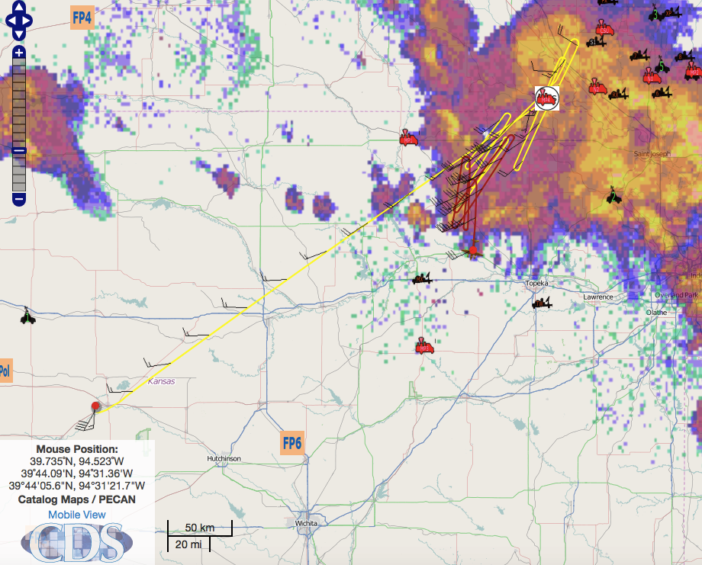
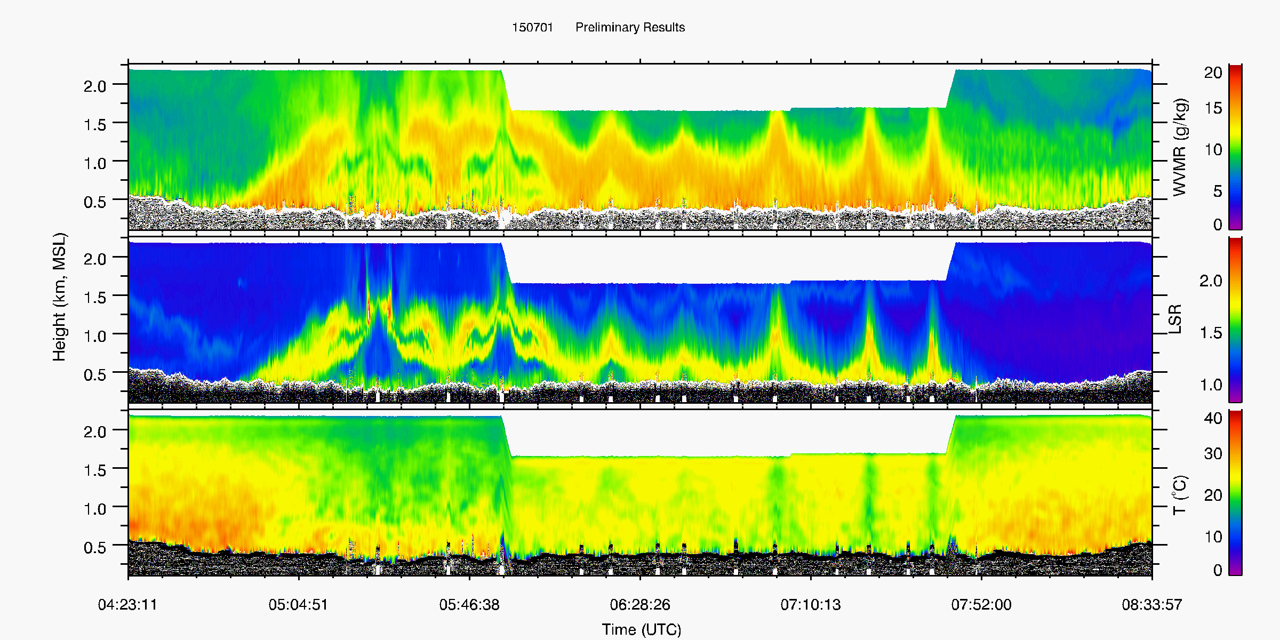
An Example of CRL Measurements
King Air sampling MCS inflow July 1, 2015
Water Vapor
Aerosol
Temperature

Slide 11
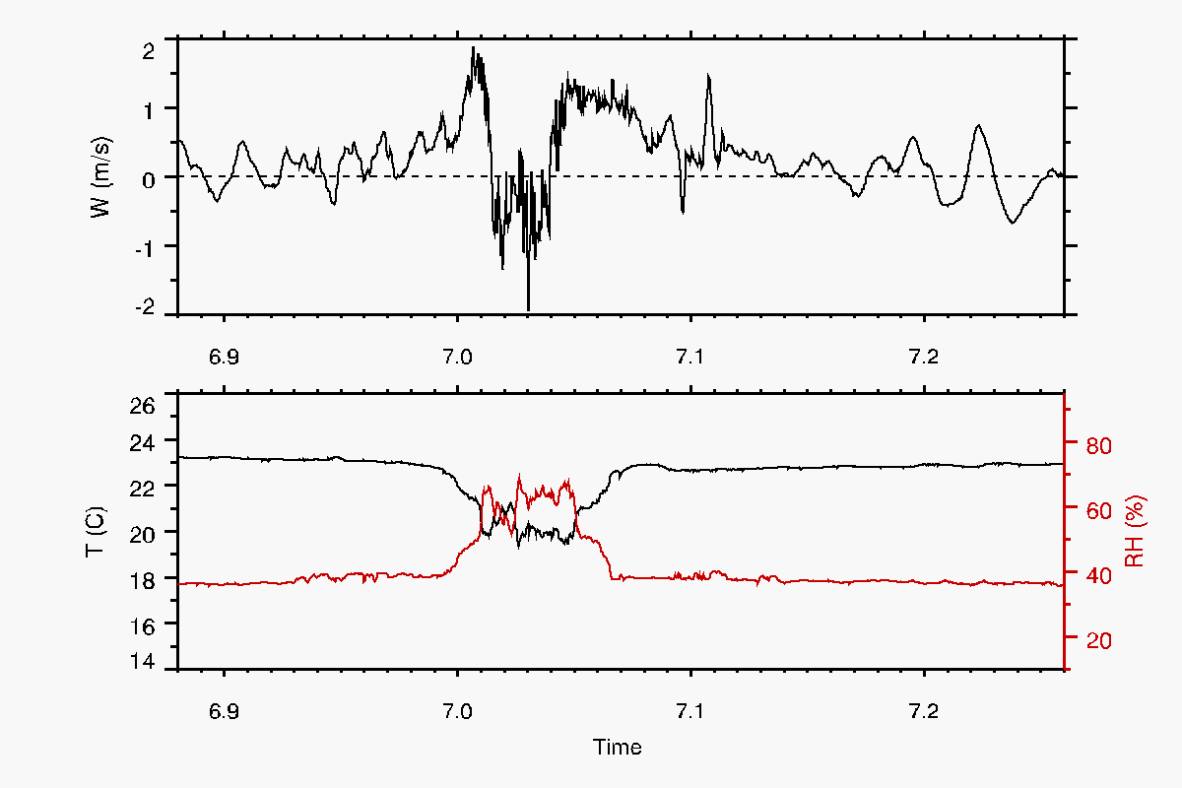
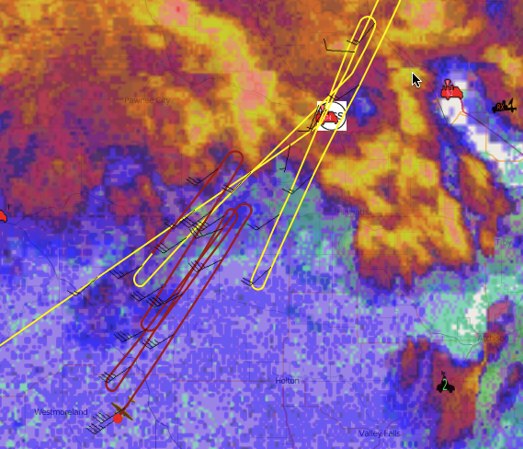
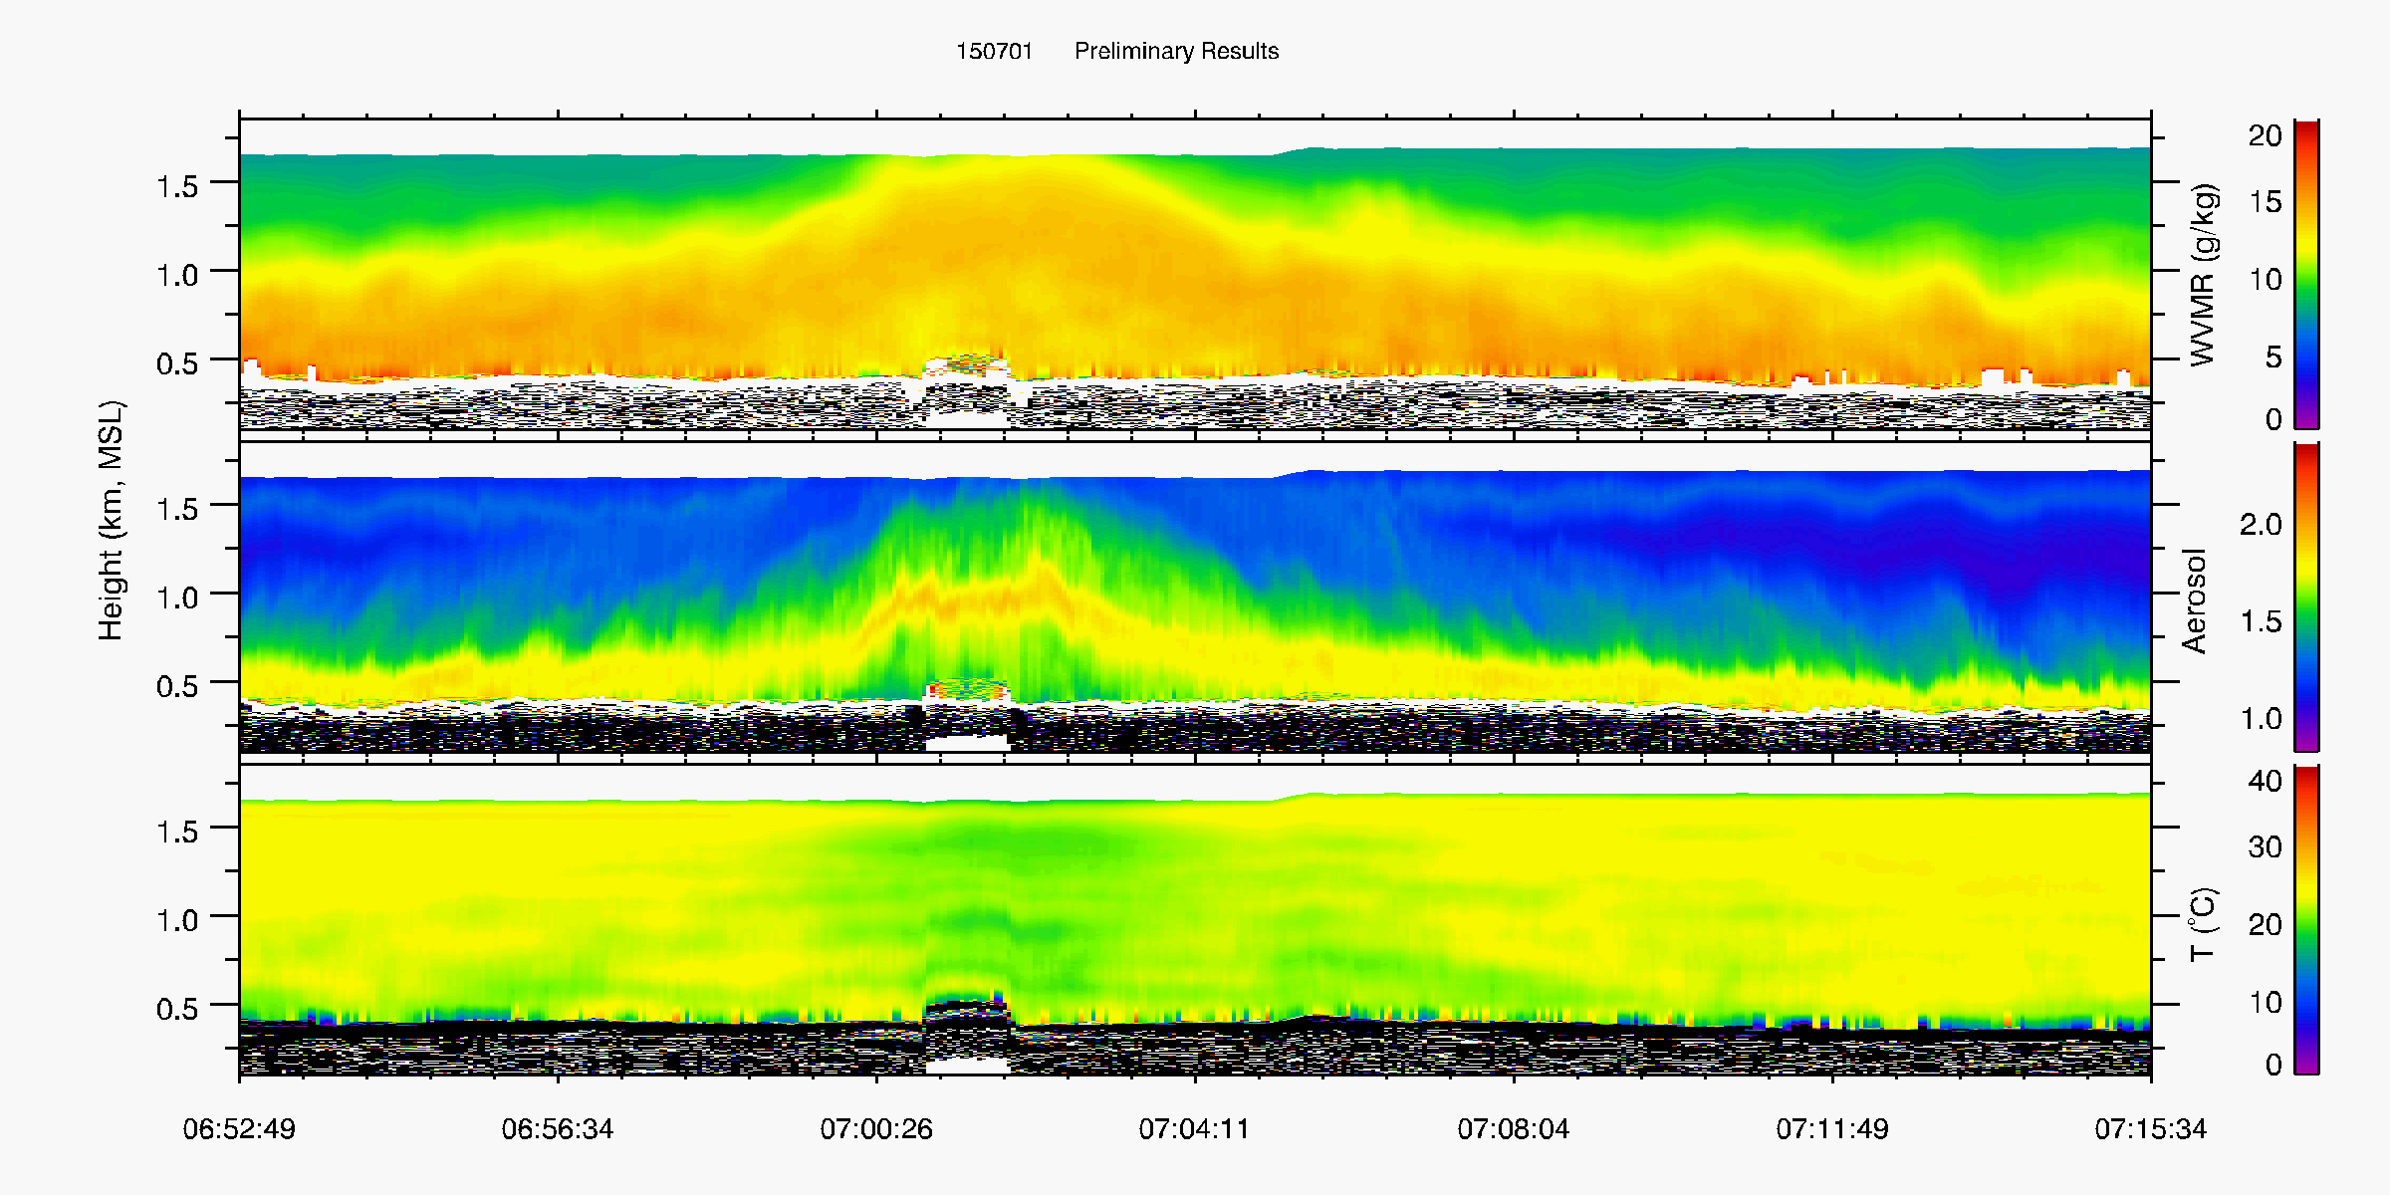
a zoom-in near the edge of cold pool
inbound leg
outbound leg
q_{v}
aerosol
T
Notes:
bore or gust front?

Slide 12
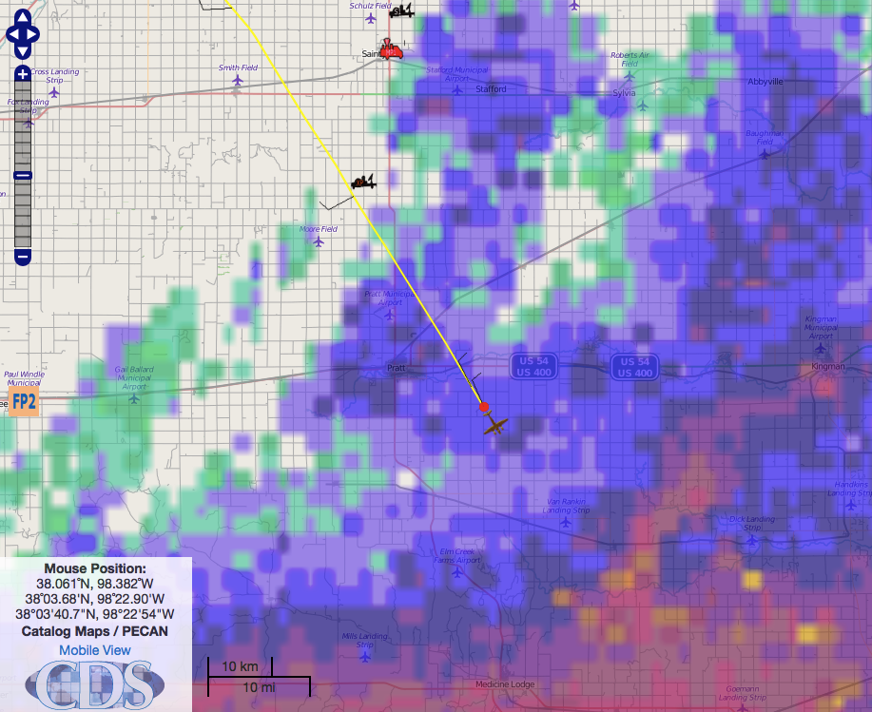
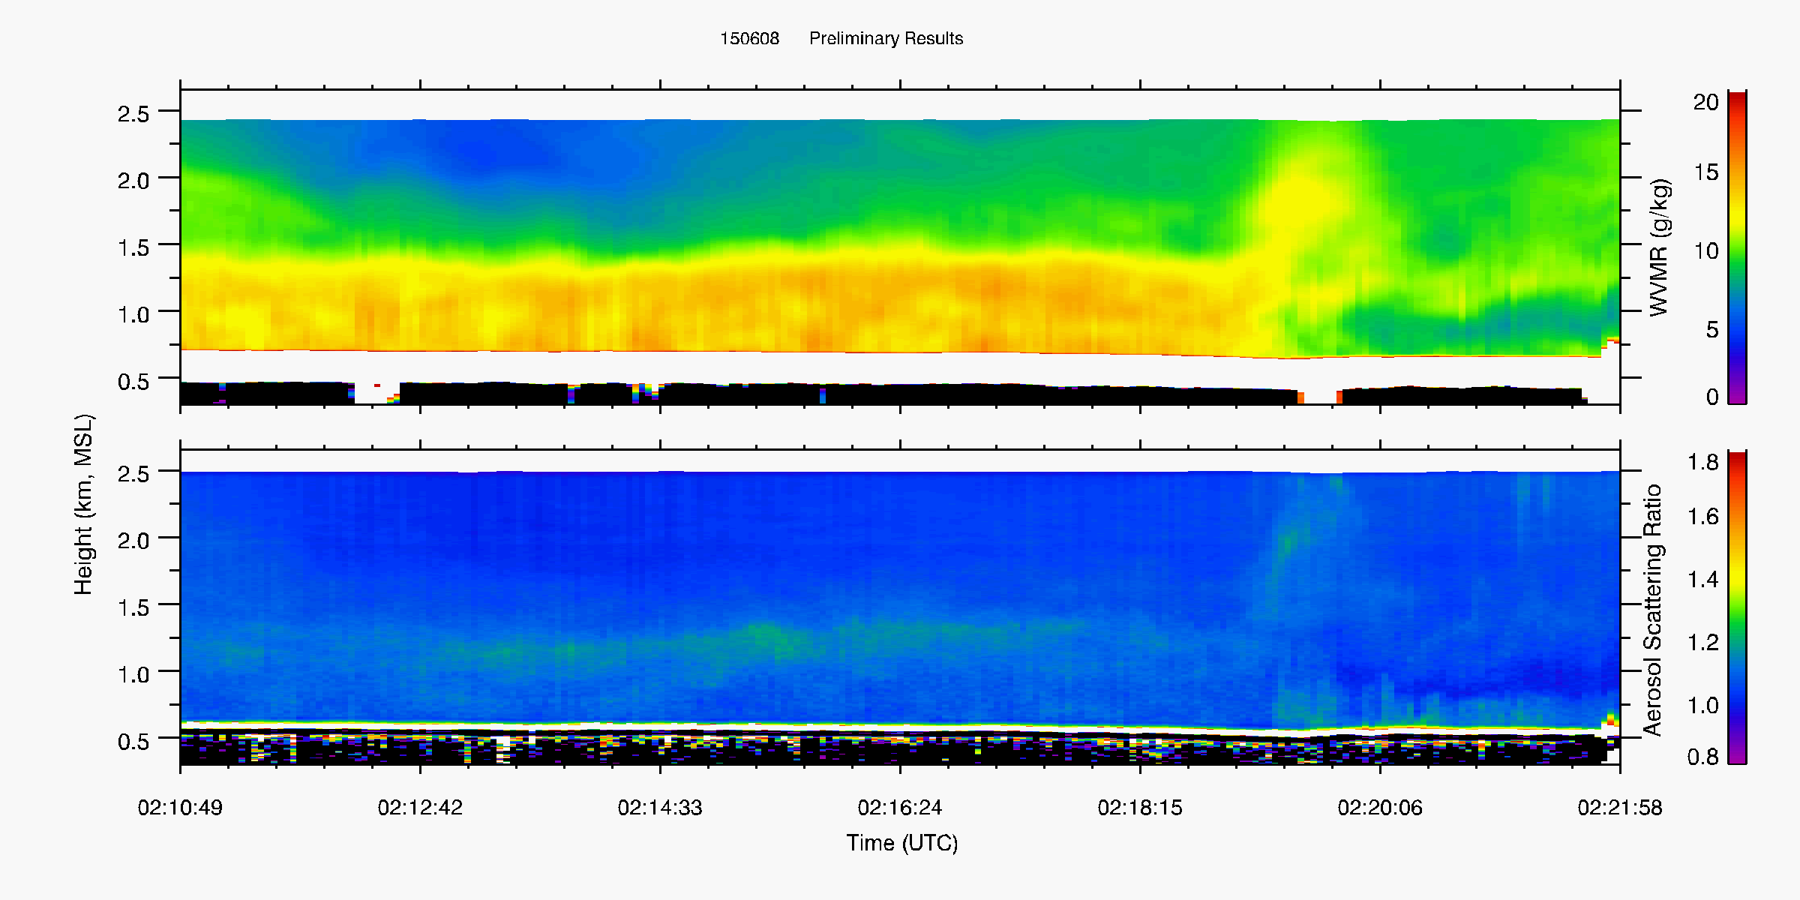
Convective Initiation
02:21
June 8, 2015
north
south
Notes:
Legs:
0-2:11
1-2:22
2-2:25
3-2:30
4-2:36
5-2:46

Slide 13
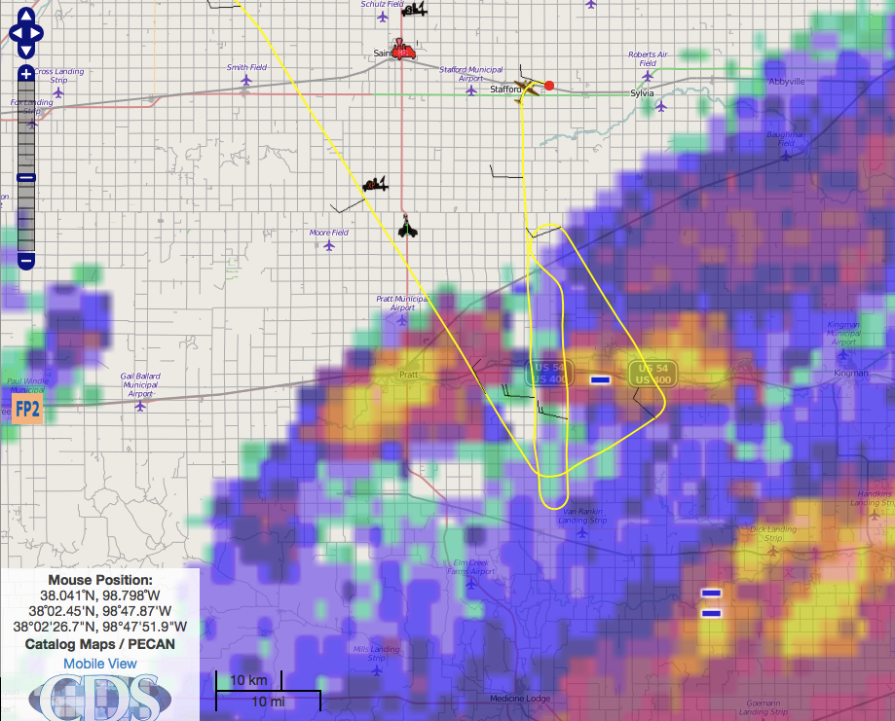
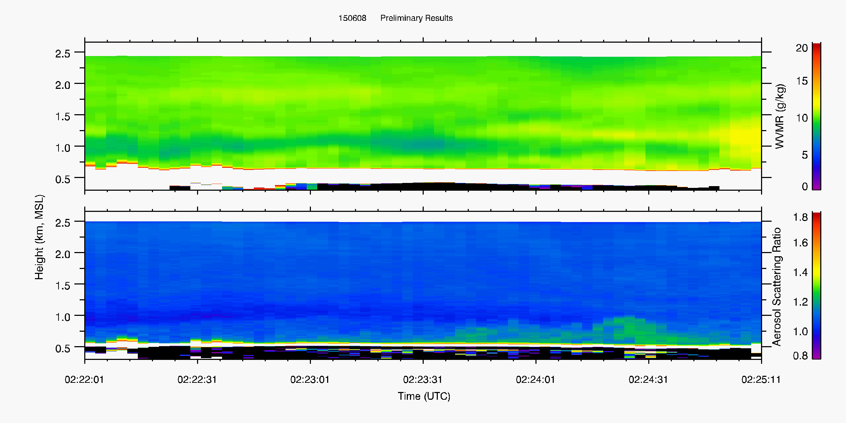
Convective Initiation
02:46
June 8, 2015
south side
Notes:
Legs:
0-2:11
1-2:22
2-2:25
3-2:30
4-2:36
5-2:46

Slide 14
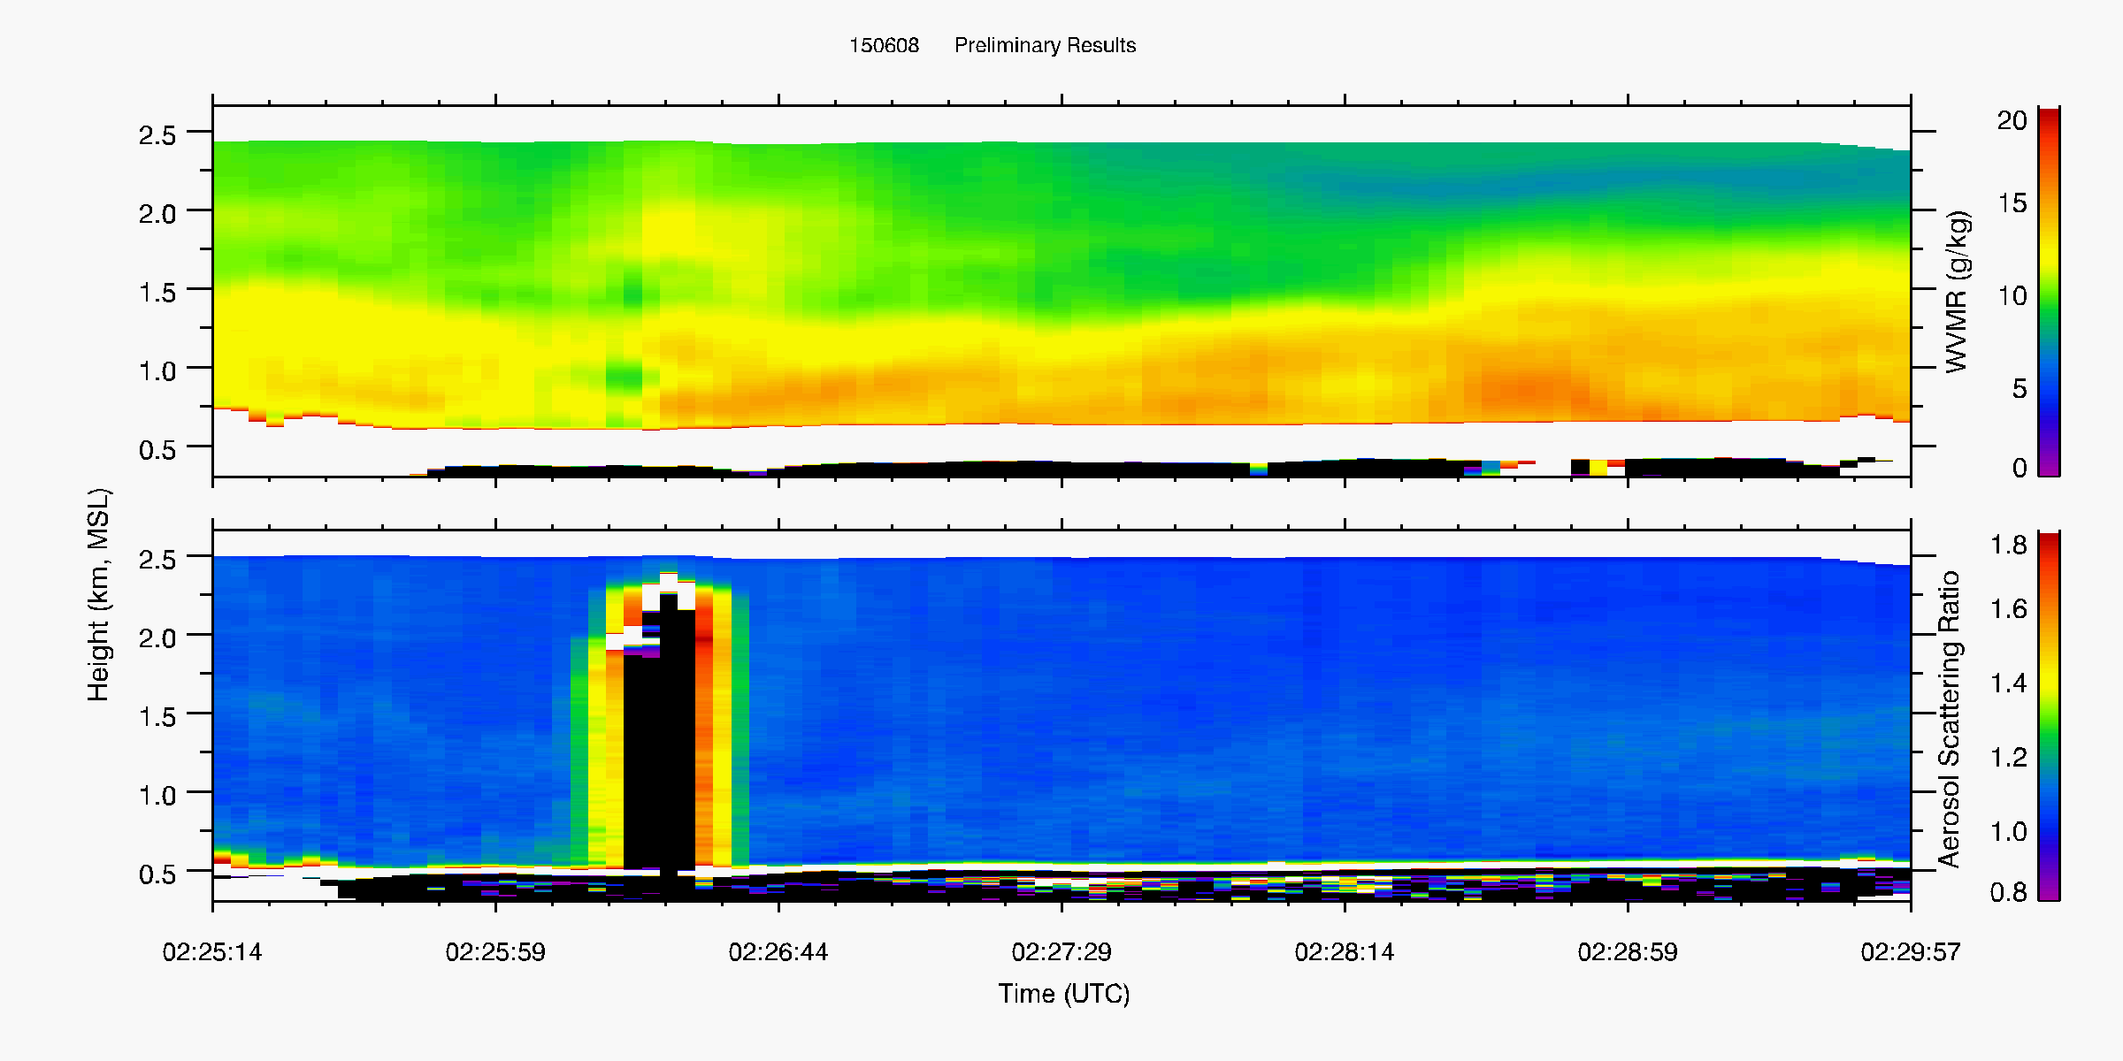
Convective Initiation
02:46
June 8, 2015
south
north
Notes:
Legs:
0-2:11
1-2:22
2-2:25
3-2:30
4-2:36
5-2:46

Slide 15
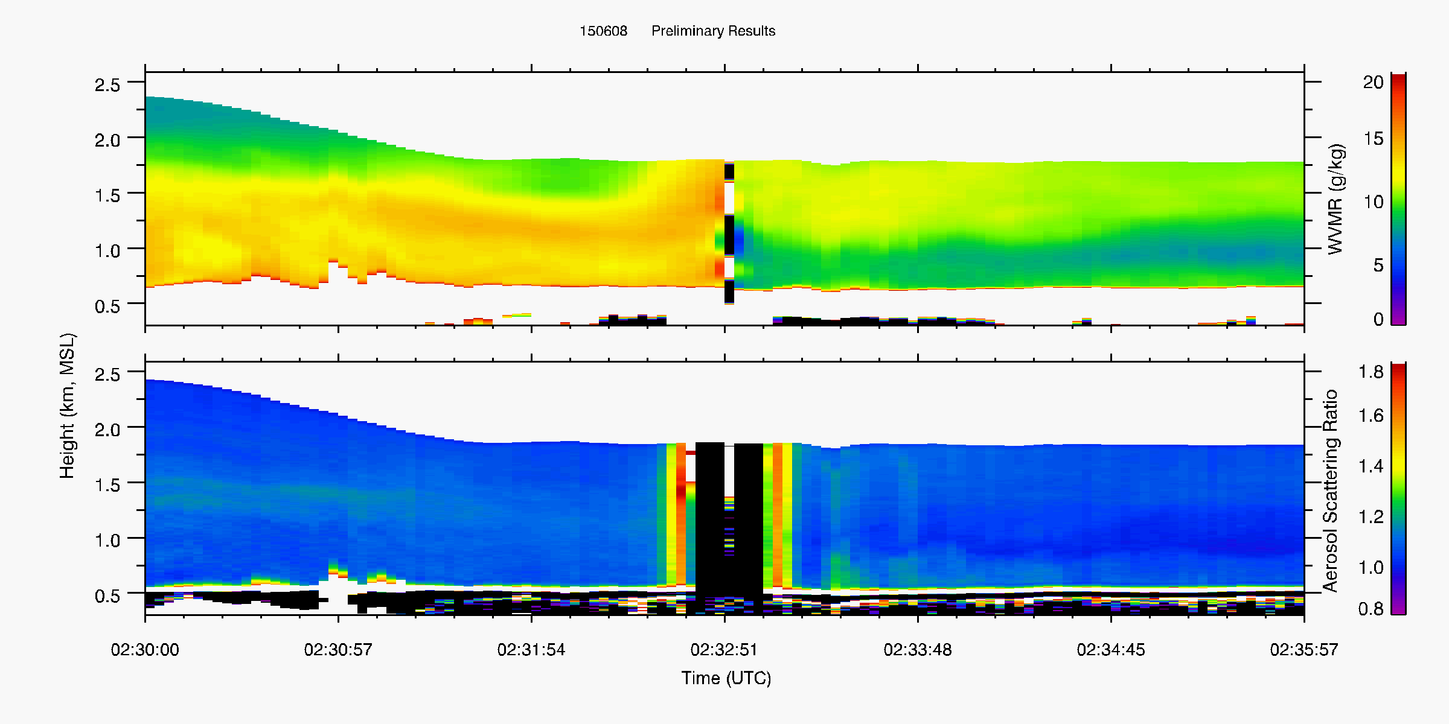
Convective Initiation
02:46
June 8, 2015
north
south
Notes:
Legs:
0-2:11
1-2:22
2-2:25
3-2:30
4-2:36
5-2:46

Slide 16
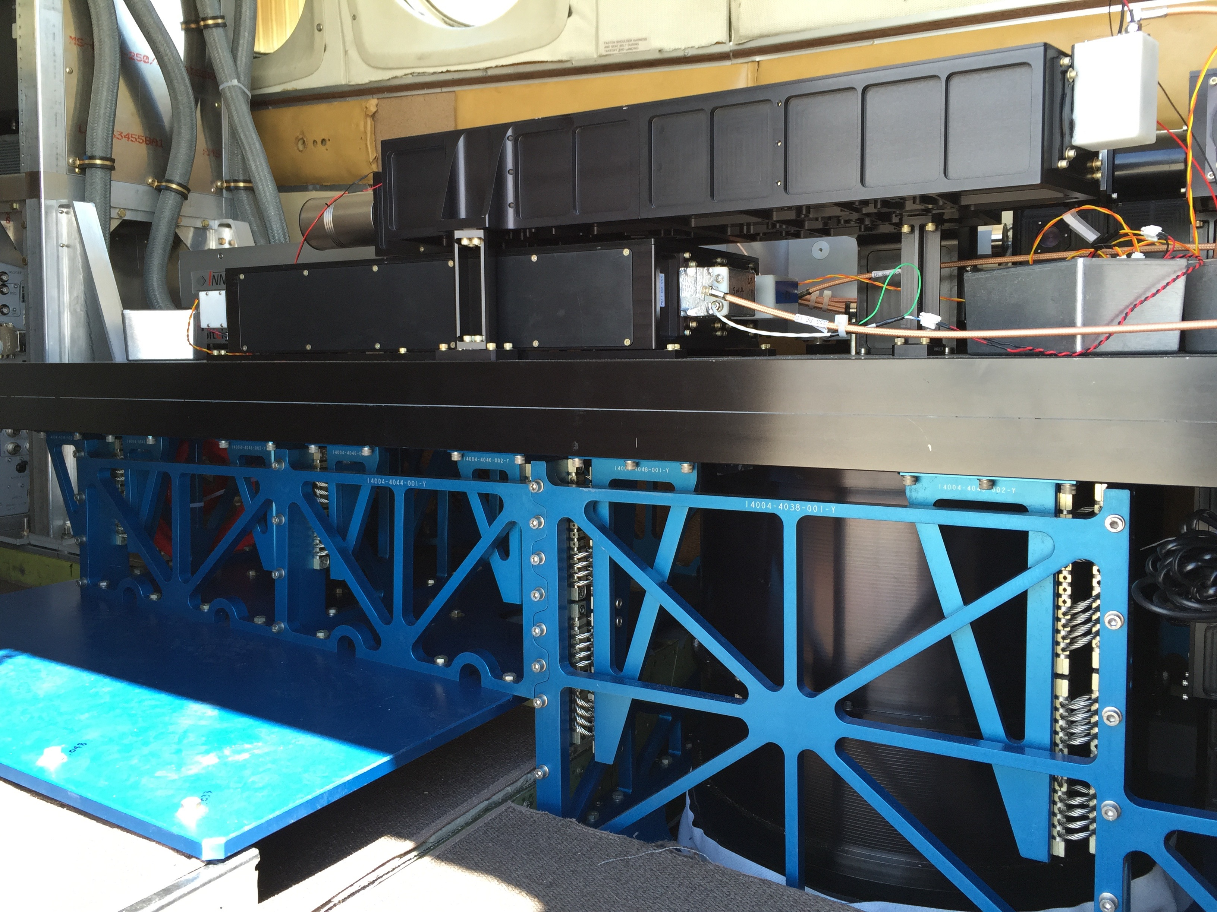
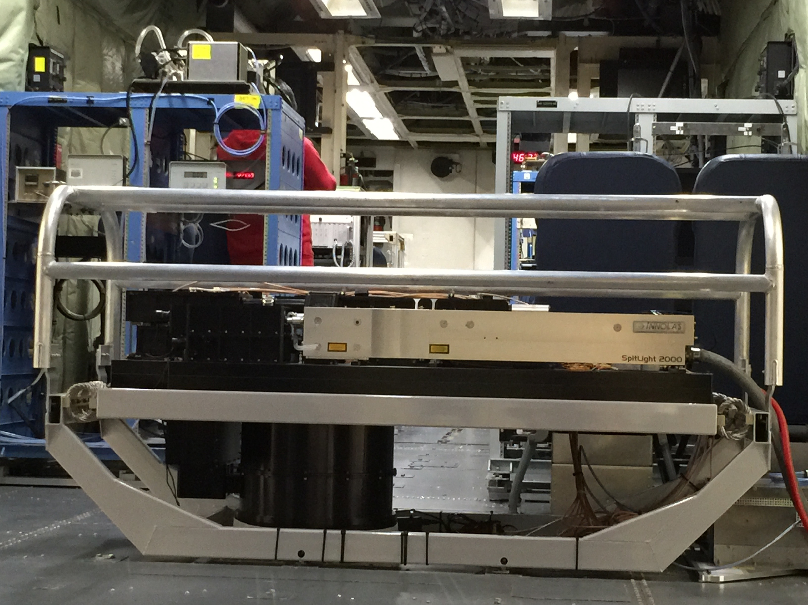
Multi-function Airborne Raman Lidar (MARLi)
Finished more than 40-hr testing flight on C-130 and King Air in summer, 2016

Slide 17
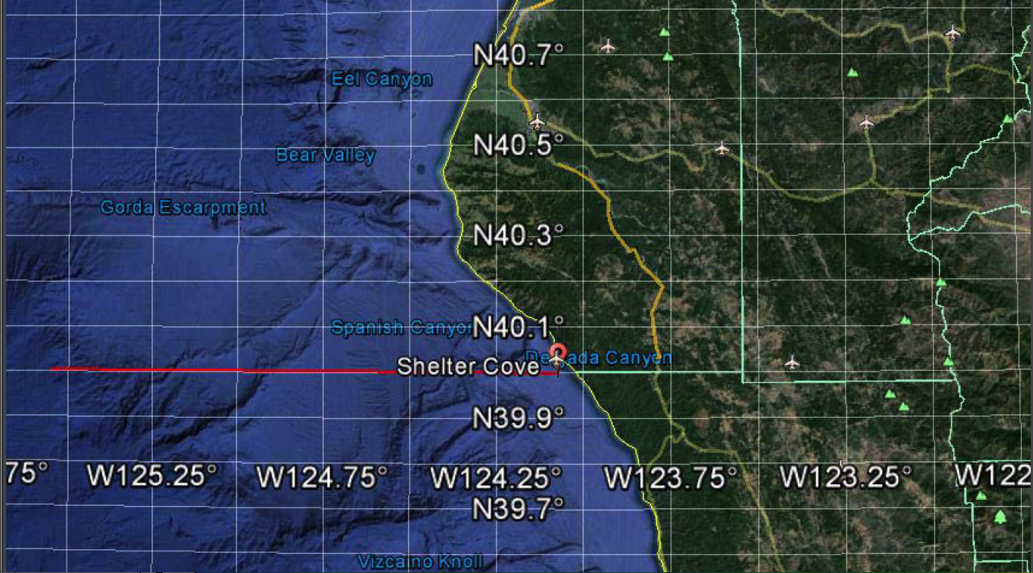
Coastal Atmospheric Boundary Layer Structure
California coast around Shelter Cove
Vertical sawtooth profiling to compare with in situ probes.
Different level legs for MARLi profiling
UWKA

Slide 18
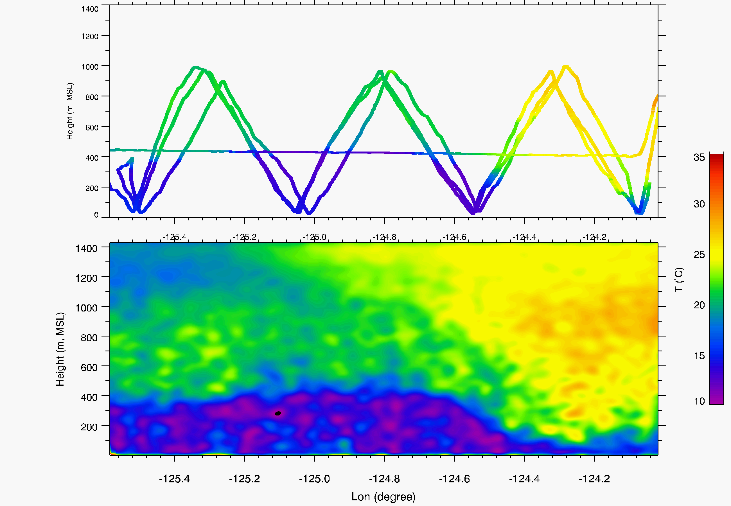
Comparison of Spatial Temperature Structure from in situ and MARLi
06/30/2016

Slide 19
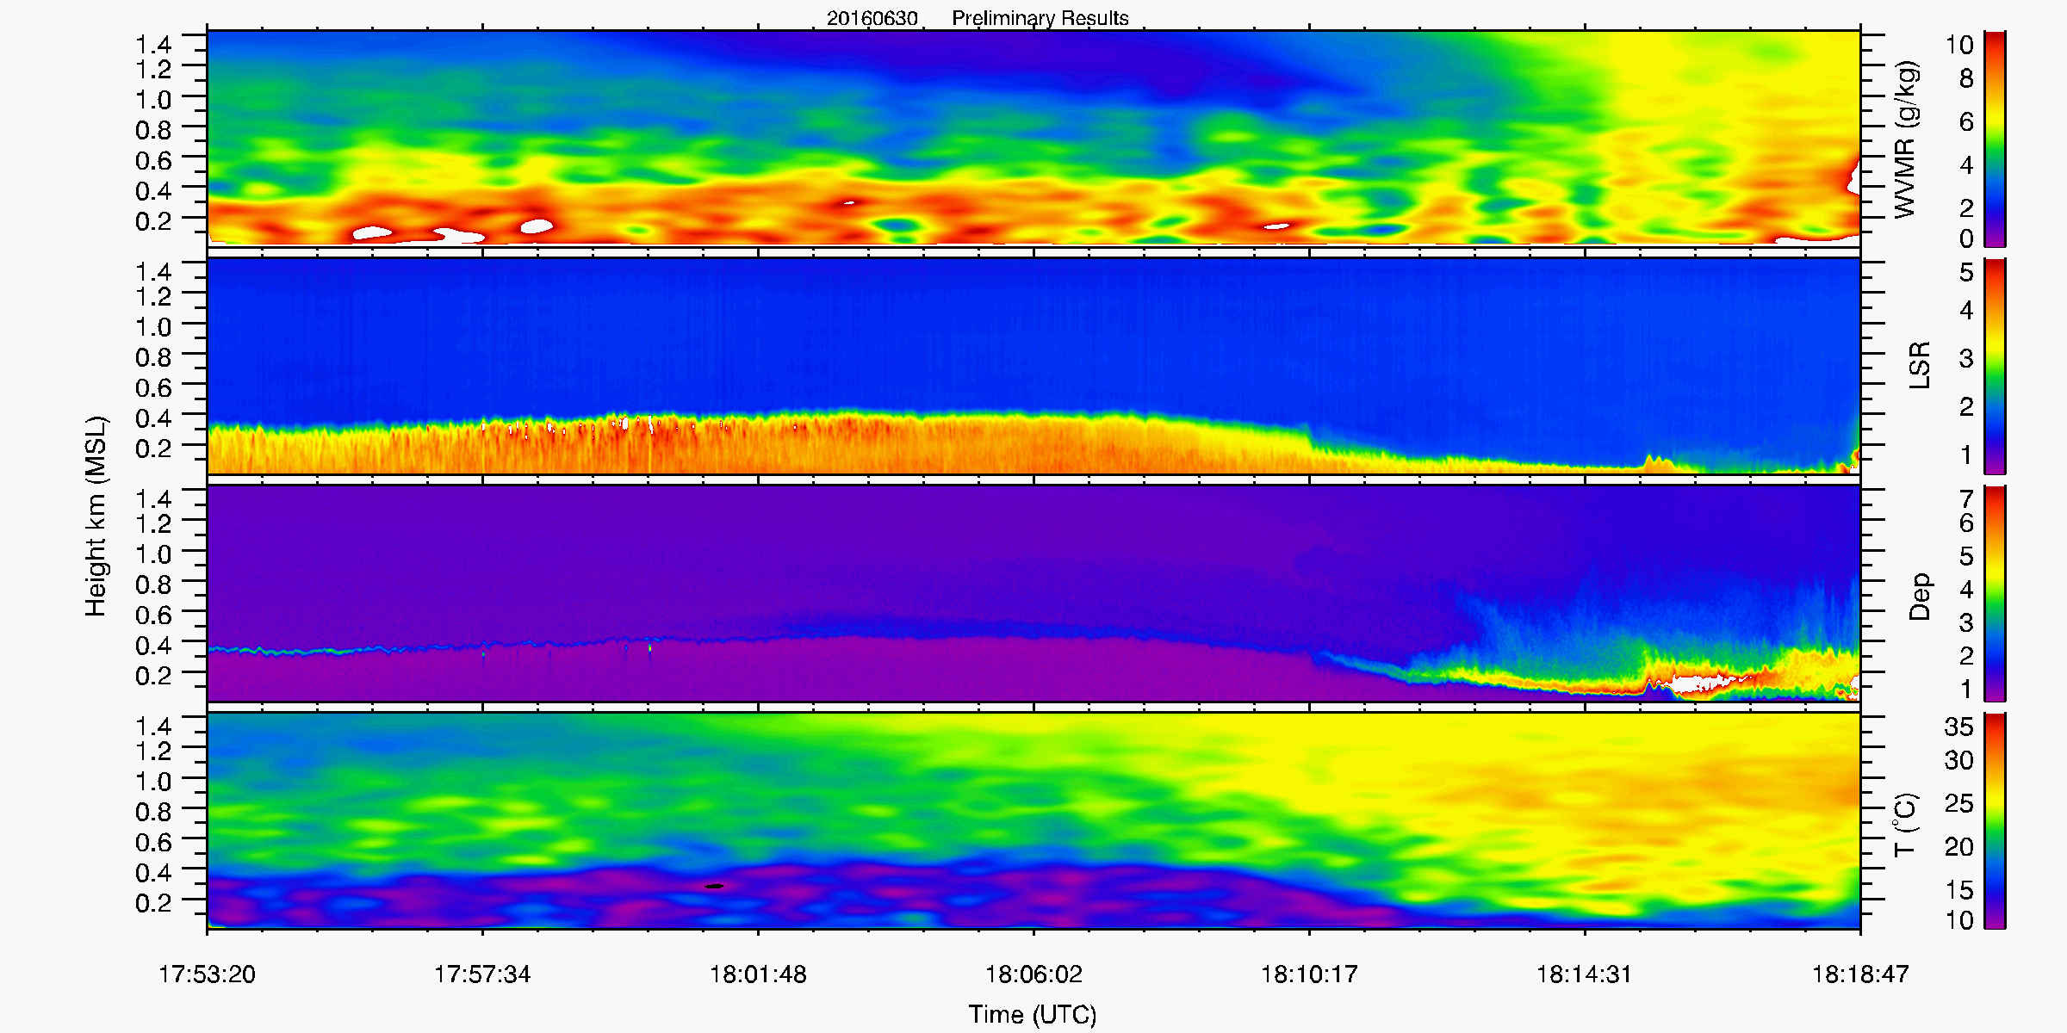
q_{v}
06/30/2016
aerosol
marine BL (optically clear)
Depolarization
T
Notes:
LSR (the ratio of total backscattering to molecular backscattering) represents aerosol loading.
Aerosol Dep shows sea salt crystallization and mixing.

Slide 20
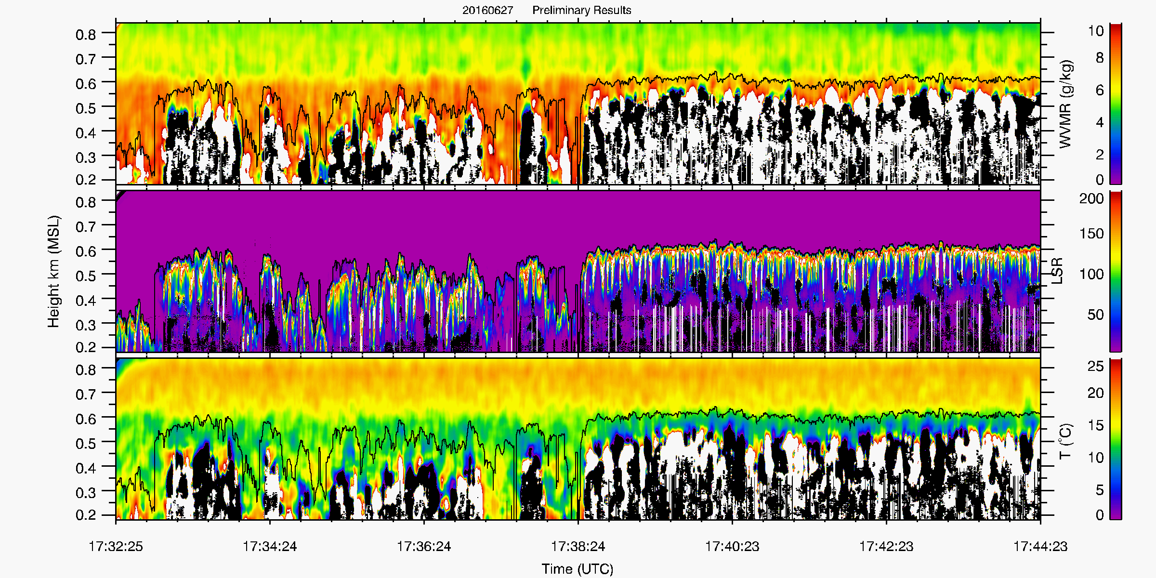
Fine-scale Water Vapor and temperature Structure above the Stratocumulus Cloud Top
Water Vapor
Cloud top
Aerosol/Cloud
Temperature
Notes:
The entrainment or mixing over stratocumulus cloud top is an important processes controlling cloud evolution. But the process is difficult to observe and poorly simulated in models.
MARLi example give above highlight the new measurement capability to provide fine scale temperature and water vapor measurements to visualize related processes.

Slide 21
Summary
CRL together with other King Air instruments offer a powerful dataset to study atmospheric boundary layer structure around storms.
If you have any special request, let us know.
MARLi is ready for deployments on UWKA and C-130.
Check out Guo Lin’s poster for more CRL measurements

