Slide 1
Some highlights of MIPS measurements during the PECAN field campaign Kevin Knupp University of Alabama in Huntsville

Slide 2
Research foci
Comparison of instruments to better understand differences in measurements of:
Horizontal wind (LLJ cases are most ideal)
915 MHz wind profiler, DWL, MAX radar, radiosonde, King Air
Vertical velocity, w (high amplitude w events in clear air (bores, density current)
DWL, 915, X-band profiling radar (XPR)
Bore science (collaboration)
CI (AET) case study (Brianna Lund poster)
Propagation of nocturnal MCS (bore vs. density current)

Slide 3
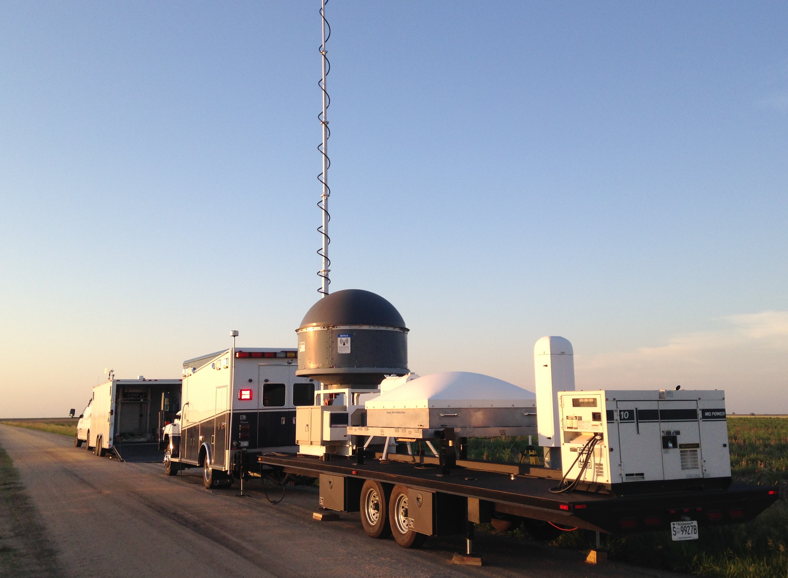
Mobile Integrated Profiling System (MIPS) – PECAN
10-m tower
MIPS-2
Doppler wind lidar (DWL)
MIPS-1
soundings
X-band profiling radar (XPR)
Doppler wind lidar (DWL)
915 MHz wind profiler
CL51 ceilometer
MIPS-2
Microwave profiling radiometer
(MPR)
MIPS-1
PECAN deployment

Slide 4
IOP 2 (6/3): LLJ cases, motivation and goals
Comparison of V_{h} measurements from:
MIPS 915 MHz wind profiler (915)
Doppler Wind Lidar (DWL)
MAX (located 3 km NNE)
Balloon soundings (in situ)
King Air (in situ)
Objective: Determine relative accuracy of wind measurements within the NBL by radar
Are insects (and other biological flyers) passive tracers?
Do radar measurements accurately represent air motion within the NBL

Slide 5
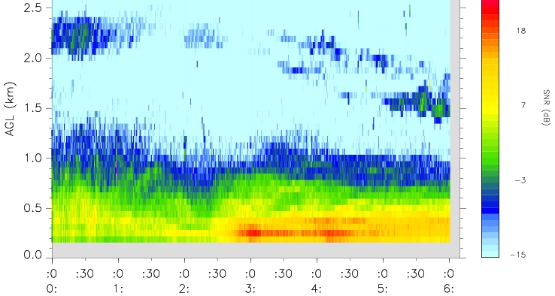
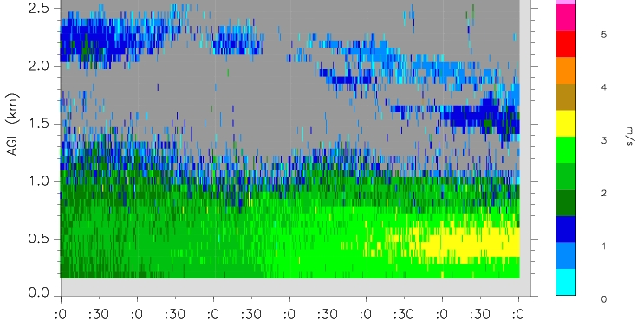
915 MHz wind profiler SNR and spectrum width (SW), 00-06 UTC:
SNR vertical gradient near 400 m AGL
Increasing SW with time, maximum near 450 m AGL

Slide 6
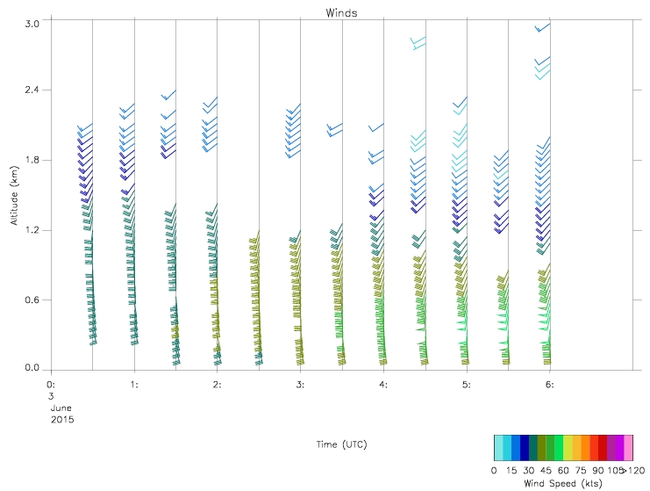
Time vs. height section of 915 conensus (30 min) winds

Slide 7
Wind speed (V_{h}) profile: DWL (red) vs. 915 (blue)
915 V_{h} 3-5 m/s greater below 500 m
915 V_{h} 2-4 m/s less above 600 m
Possible explanation:
Insects
Error in calculation
Difference in sampling volume
DWL consecutive profiles were quite consistent.
915 (0430-0500)
Wind speed (m/s)
DWL (0445 UTC)
(profiler mode, Elev = 45°)
Height (m AGL)

Slide 8
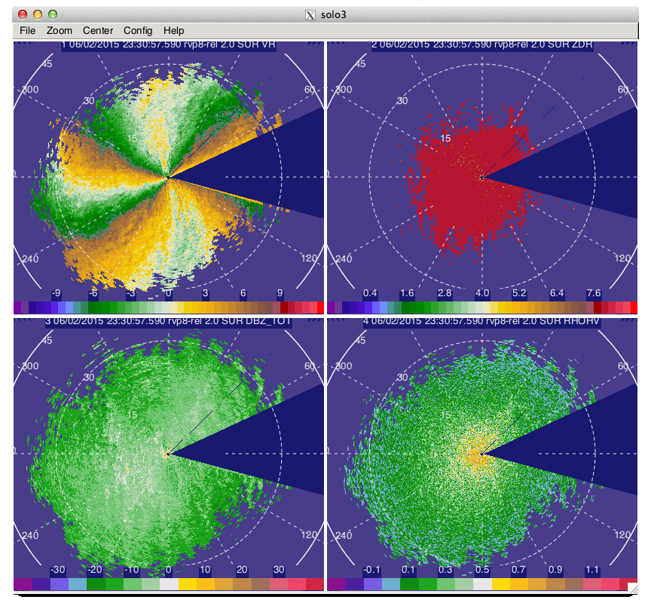
MAX PPI scans at 2.0°, 0530-0555 UTC
VR
Z_{DR}
Z_{e}
ρ_{hv}

Slide 9
Future work (IOP 2)
Compare 915 and DWL for the entire IOP
VAD analysis of MAX data (MAX was 3 km NNE of MIPS
Comparison with radiosondes from MIPS
Comparison with King Air flight level data

Slide 10
UFO 1 (6/7): Bore
High amplitude bore originated from high-based convection over NW KS and generated an eastward moving bore
MIPS measurements: DWL, 915, XPR and before/after soundings at 0437 (14 min before bore passage at 0451) and 0522 UTC (after vertical motion subsided)
Deep layer lifting indicated by the soundings

Slide 11
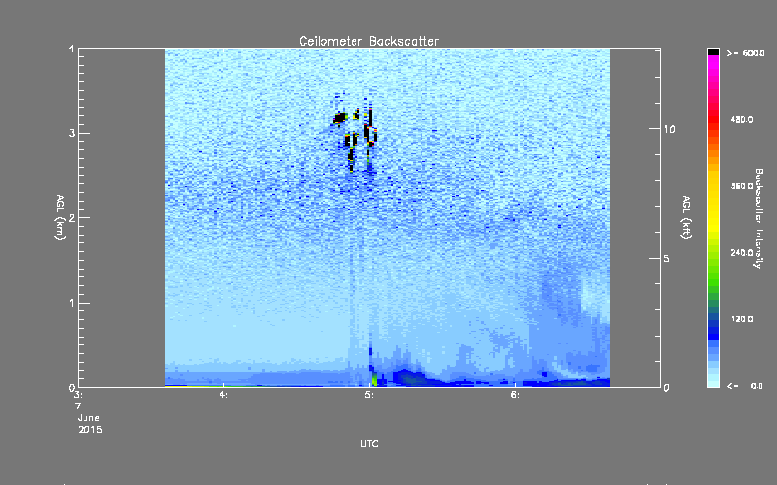
Ceilometer overview of bore initial and secondary updrafts
(0452 and 0500 UTC)
2 hr

Slide 12
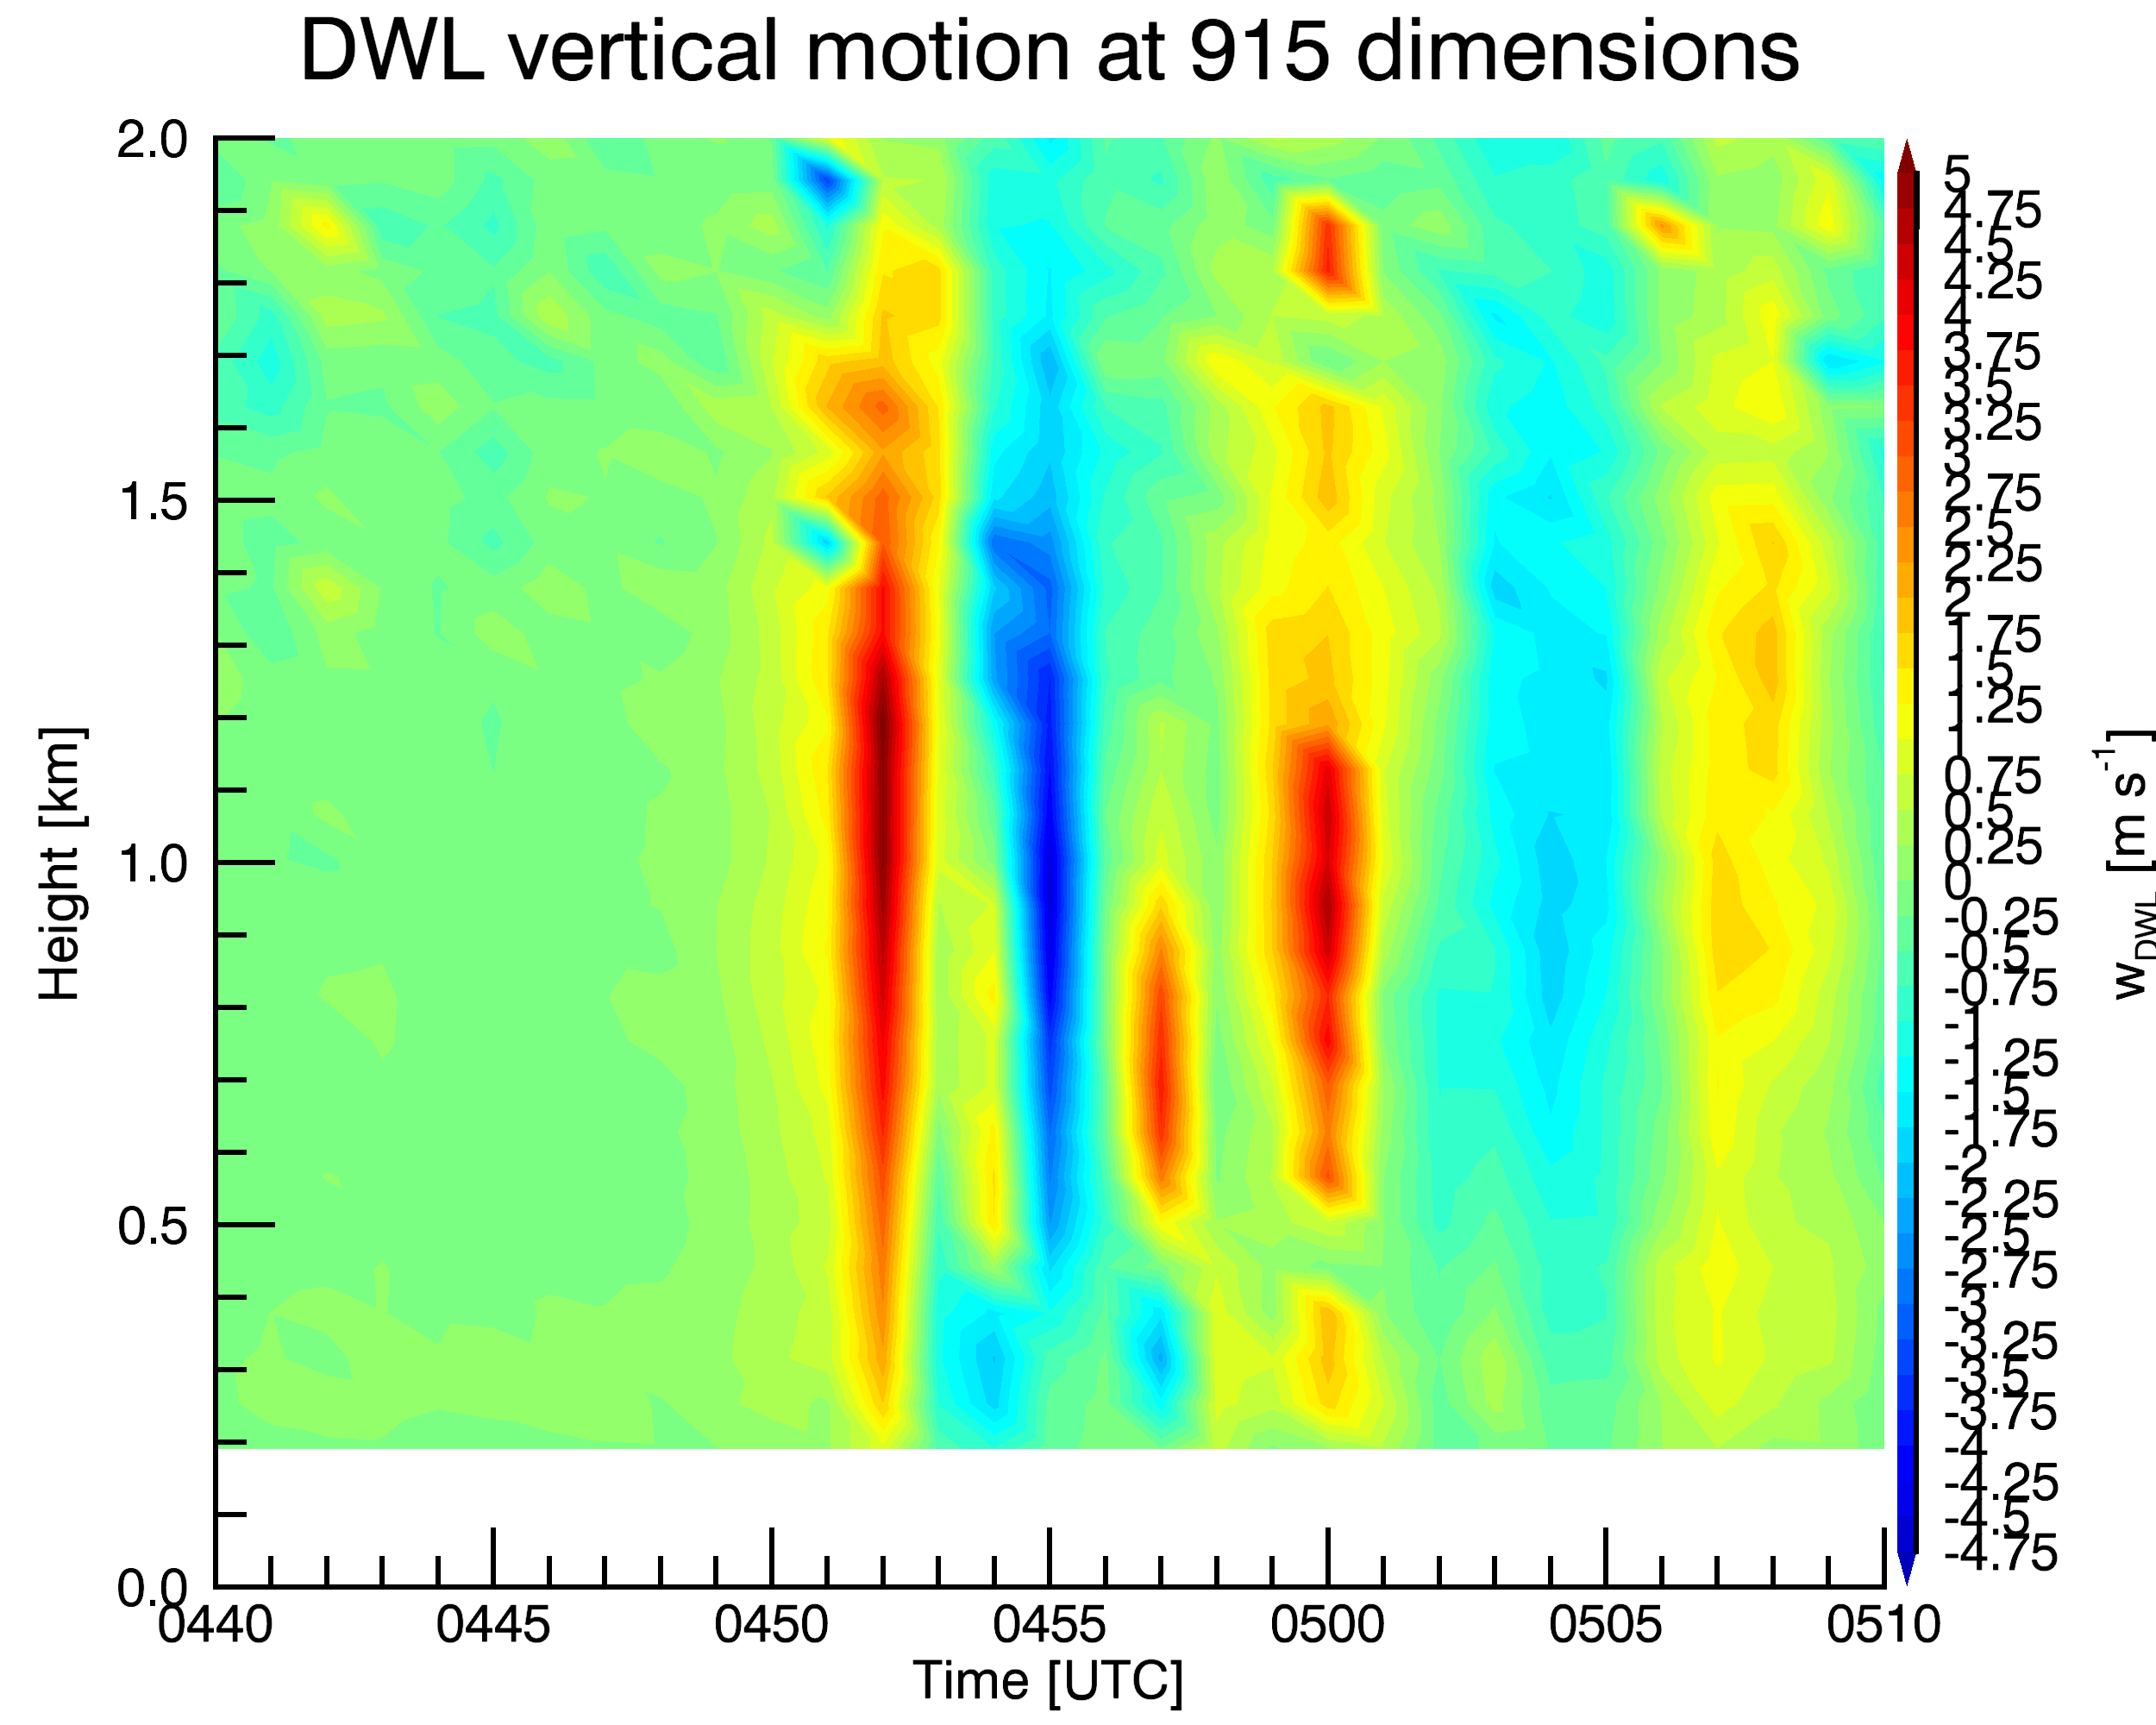
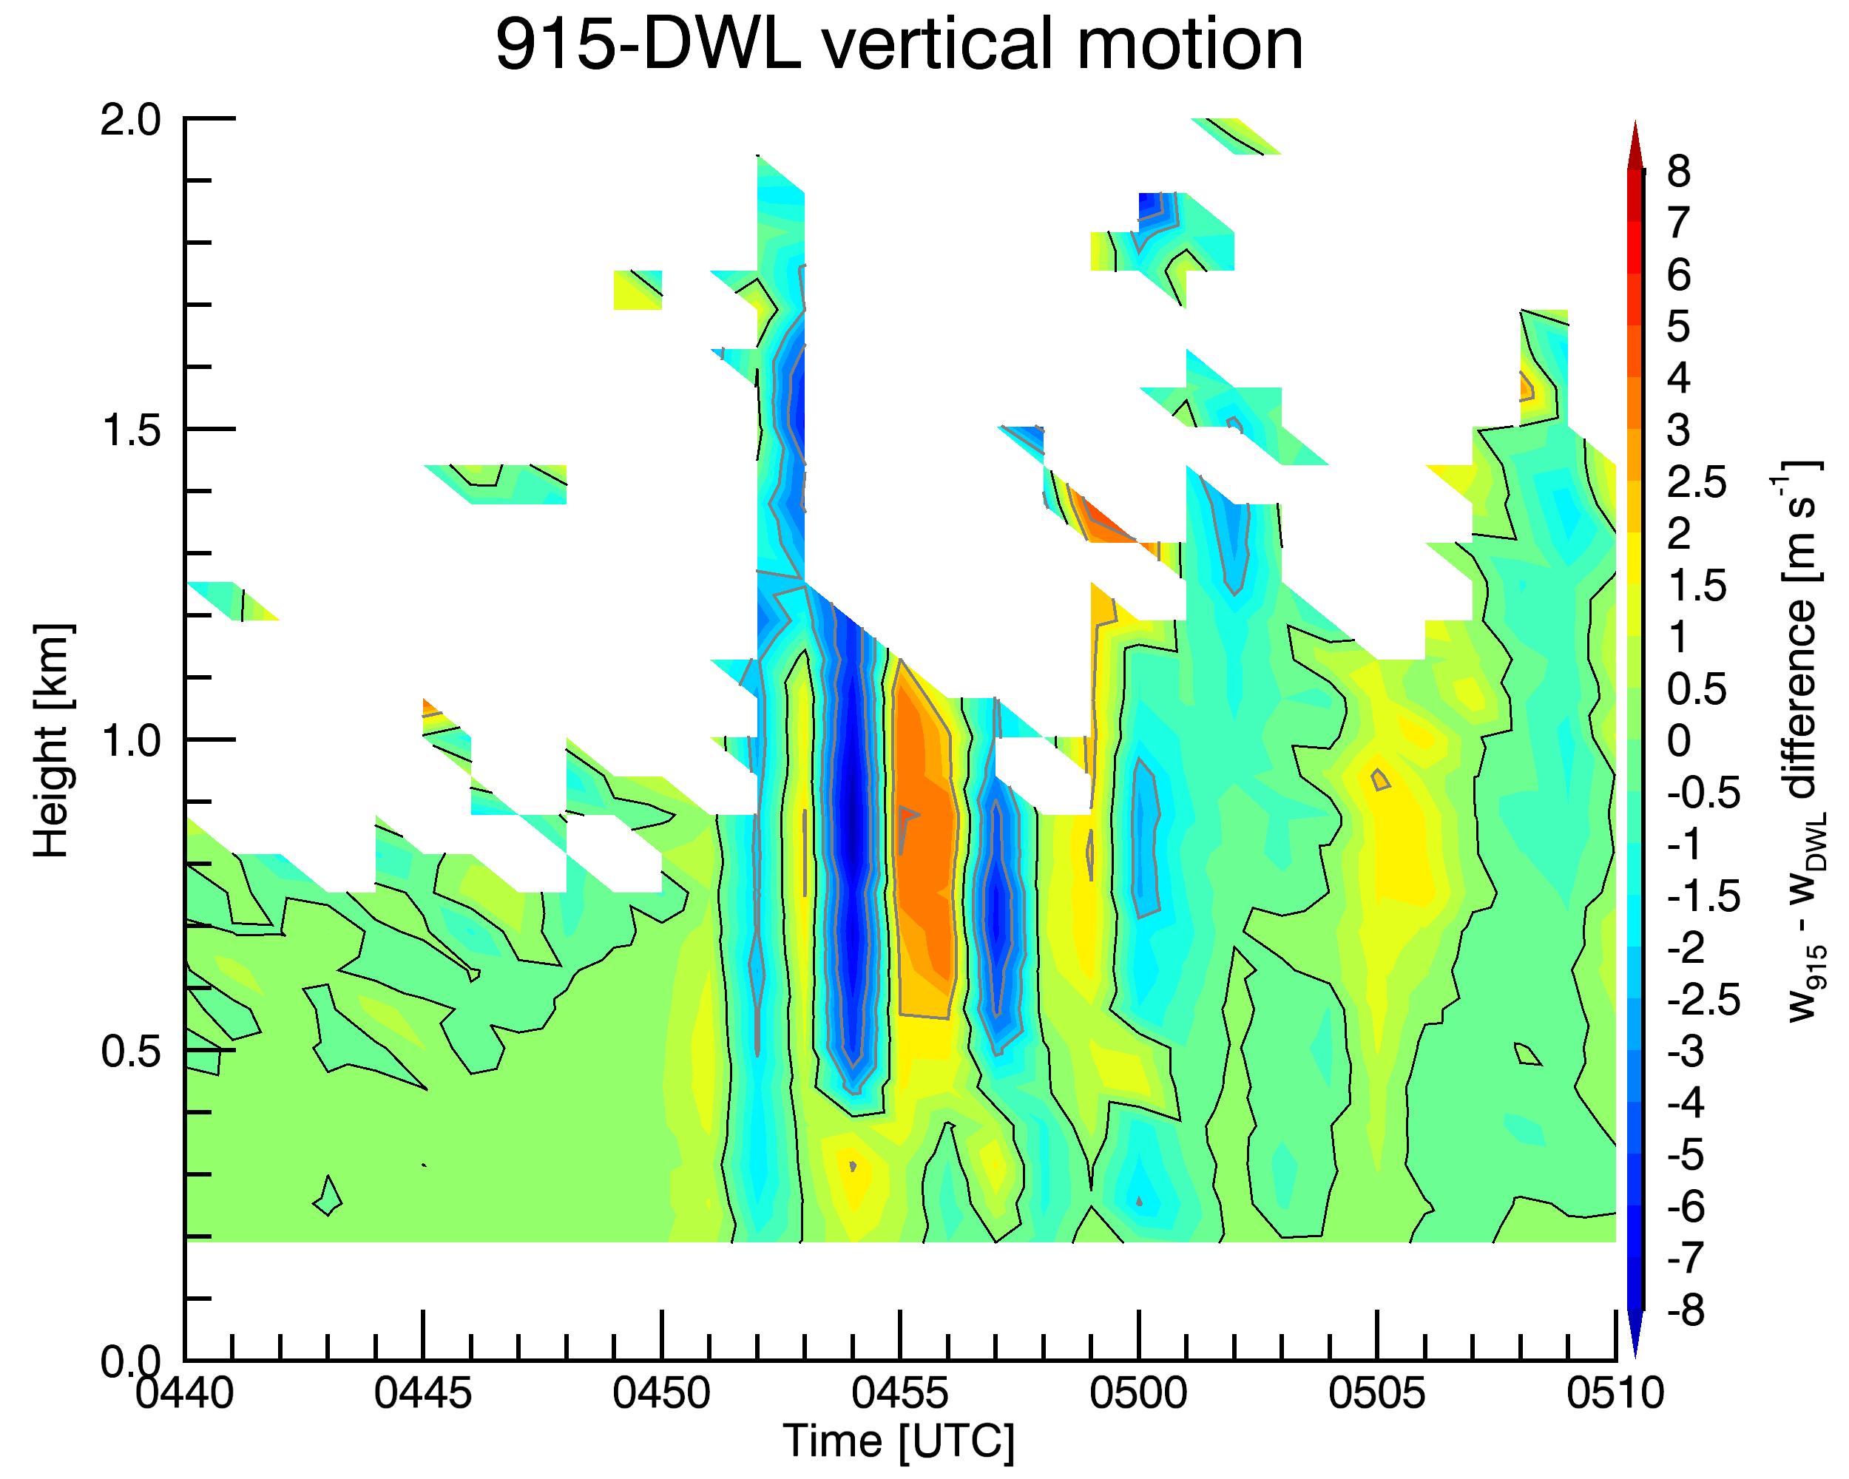
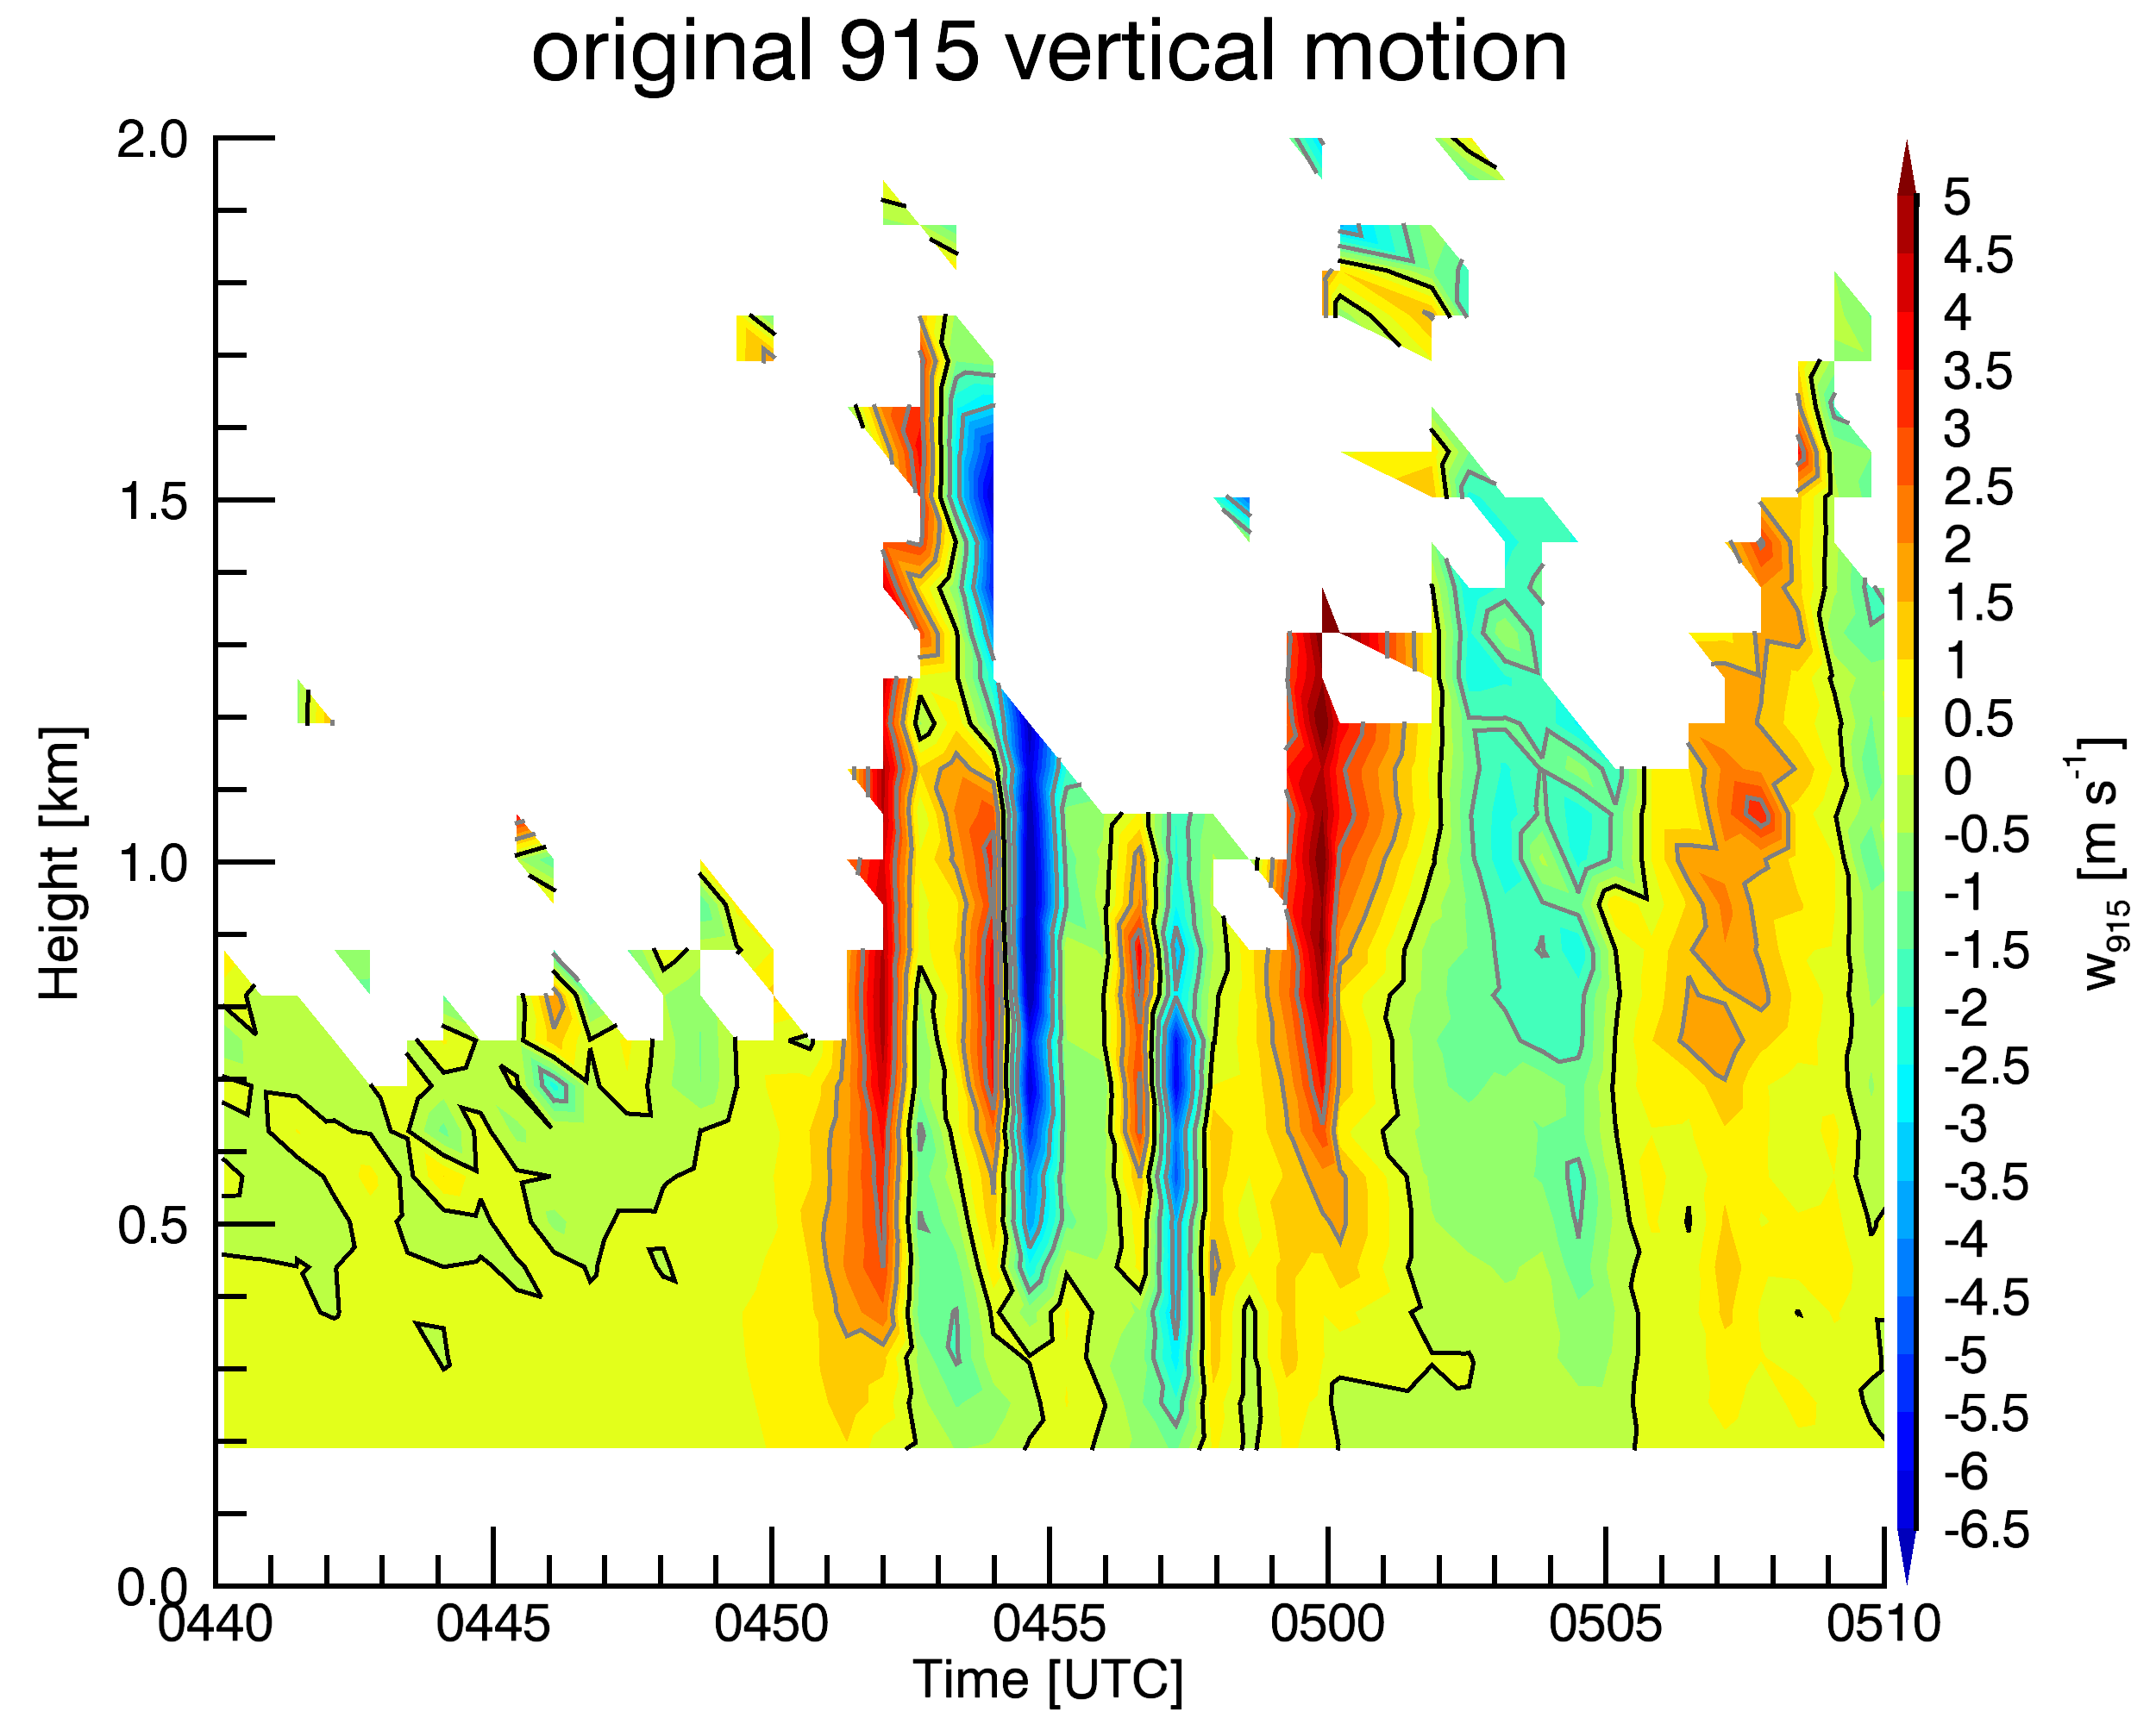
Comparison of w from DWL and 915:
DWL
915
Difference
915 underestimates w (for this and other cases)
DWL
Difference: 915 - DWL
915

Slide 13
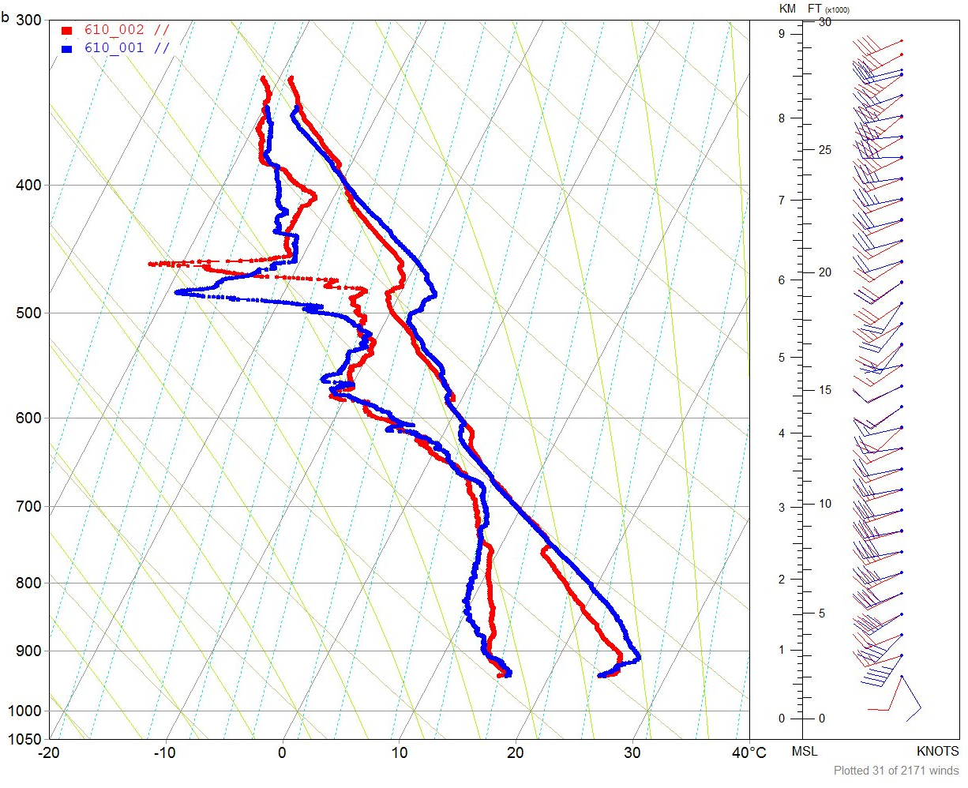
Deep layer lifting is clear shown in T inversion and T_{d} minimum above 500 mb
0437 – blue
0522 - red
Ascent of 300-400 m
Complex pattern of vertical displacements
But very little change in T/Td at with the 750-550 mb layer
Cooling and moistening below 750 mb
~800 m lift implied

Slide 14
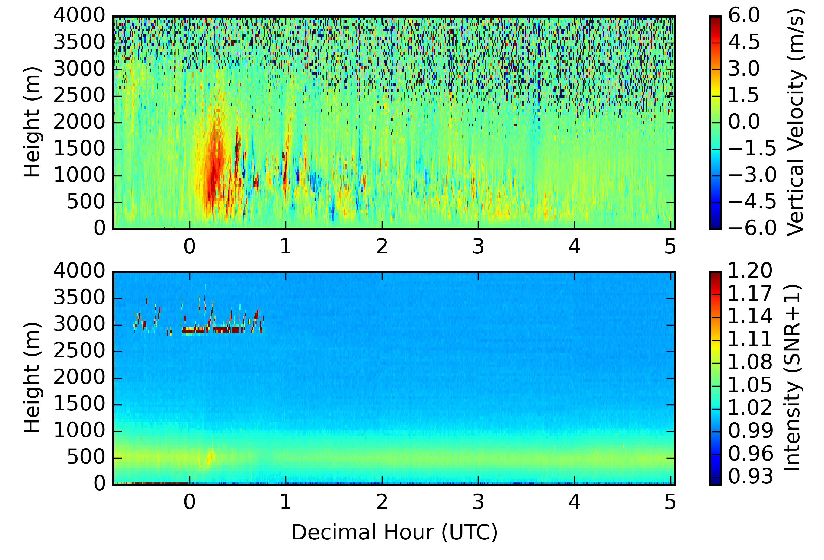
UFO 6 (6/20): AET CI
MIPS sampled passage of cold front accompanied by sustained upward motion associated with CI
Refer to poster by Brianna Lund
w (DWL)
Sustained w’² into
the NBL cycle
SNR (DWL)
clouds

Slide 15
IOP 13 (6/22) LLJ
LLJ with embedded wave activity
Surface winds increased during the nocturnal cycle at the MP2 site (western most)
LLJ induced wind storm produced surface winds perhaps exceeding 20 m/s (close to severe storm) around 1030 Z near Wakeeney and to the east

Slide 16
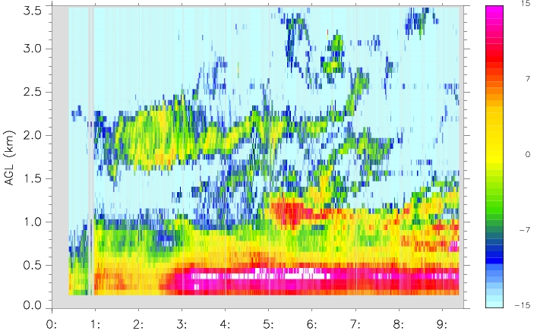
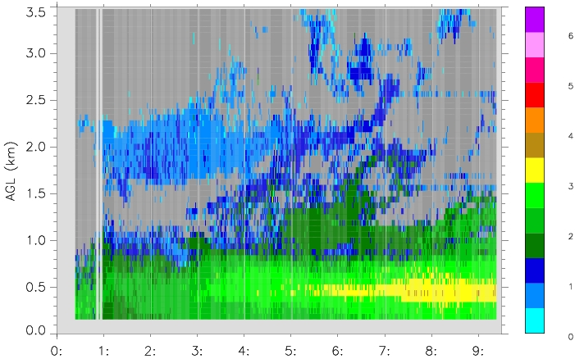
915 MHz wind profiler
SNR
Increase at low levels early on (insects)
Presence of backscatter above the residual layer
SW
Increase in SW below 1 km

Slide 17
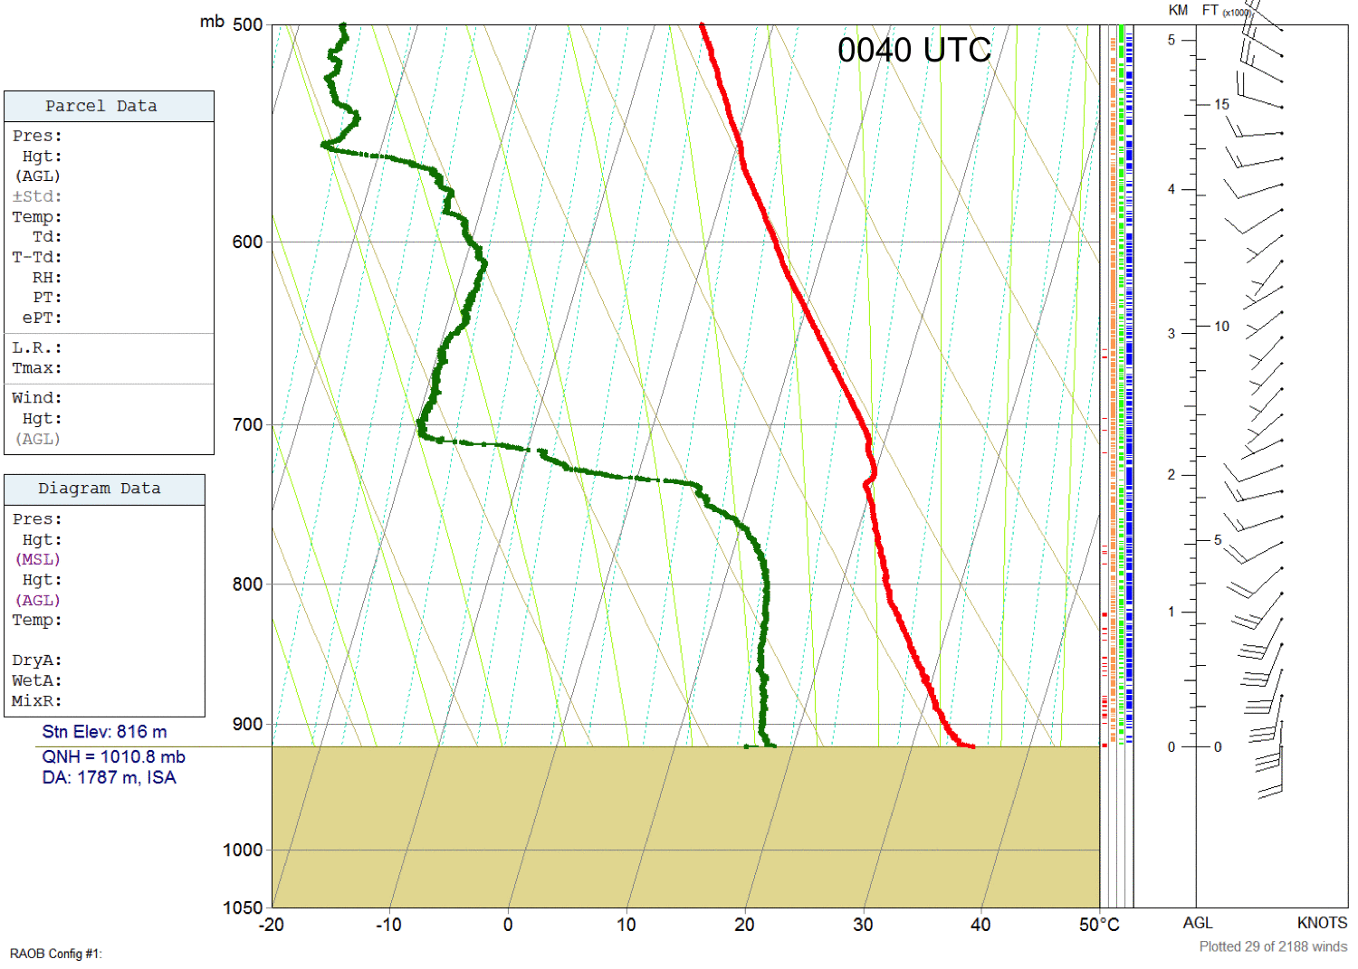
Soundings to 500 mb

Slide 18
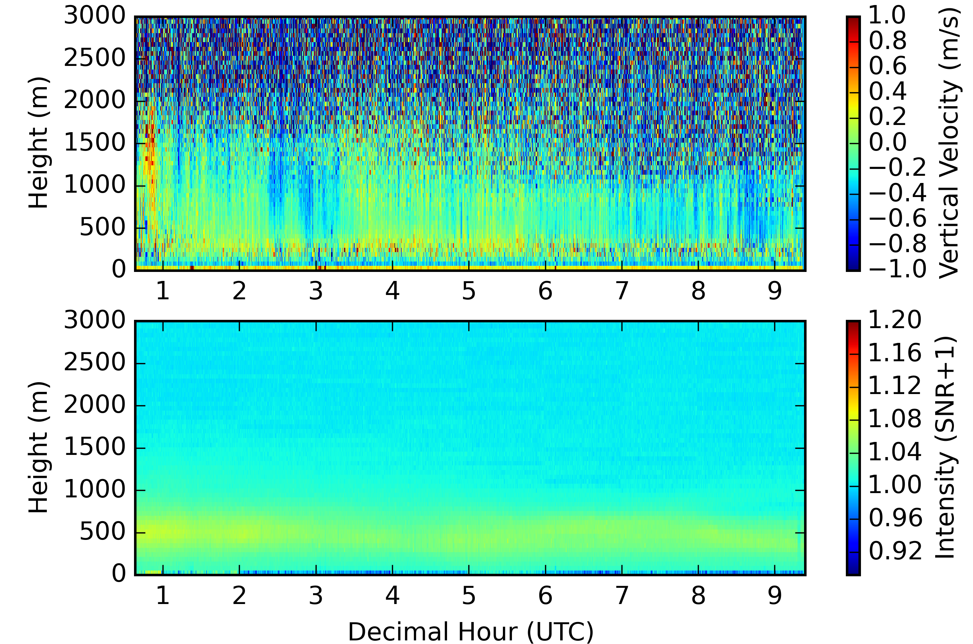
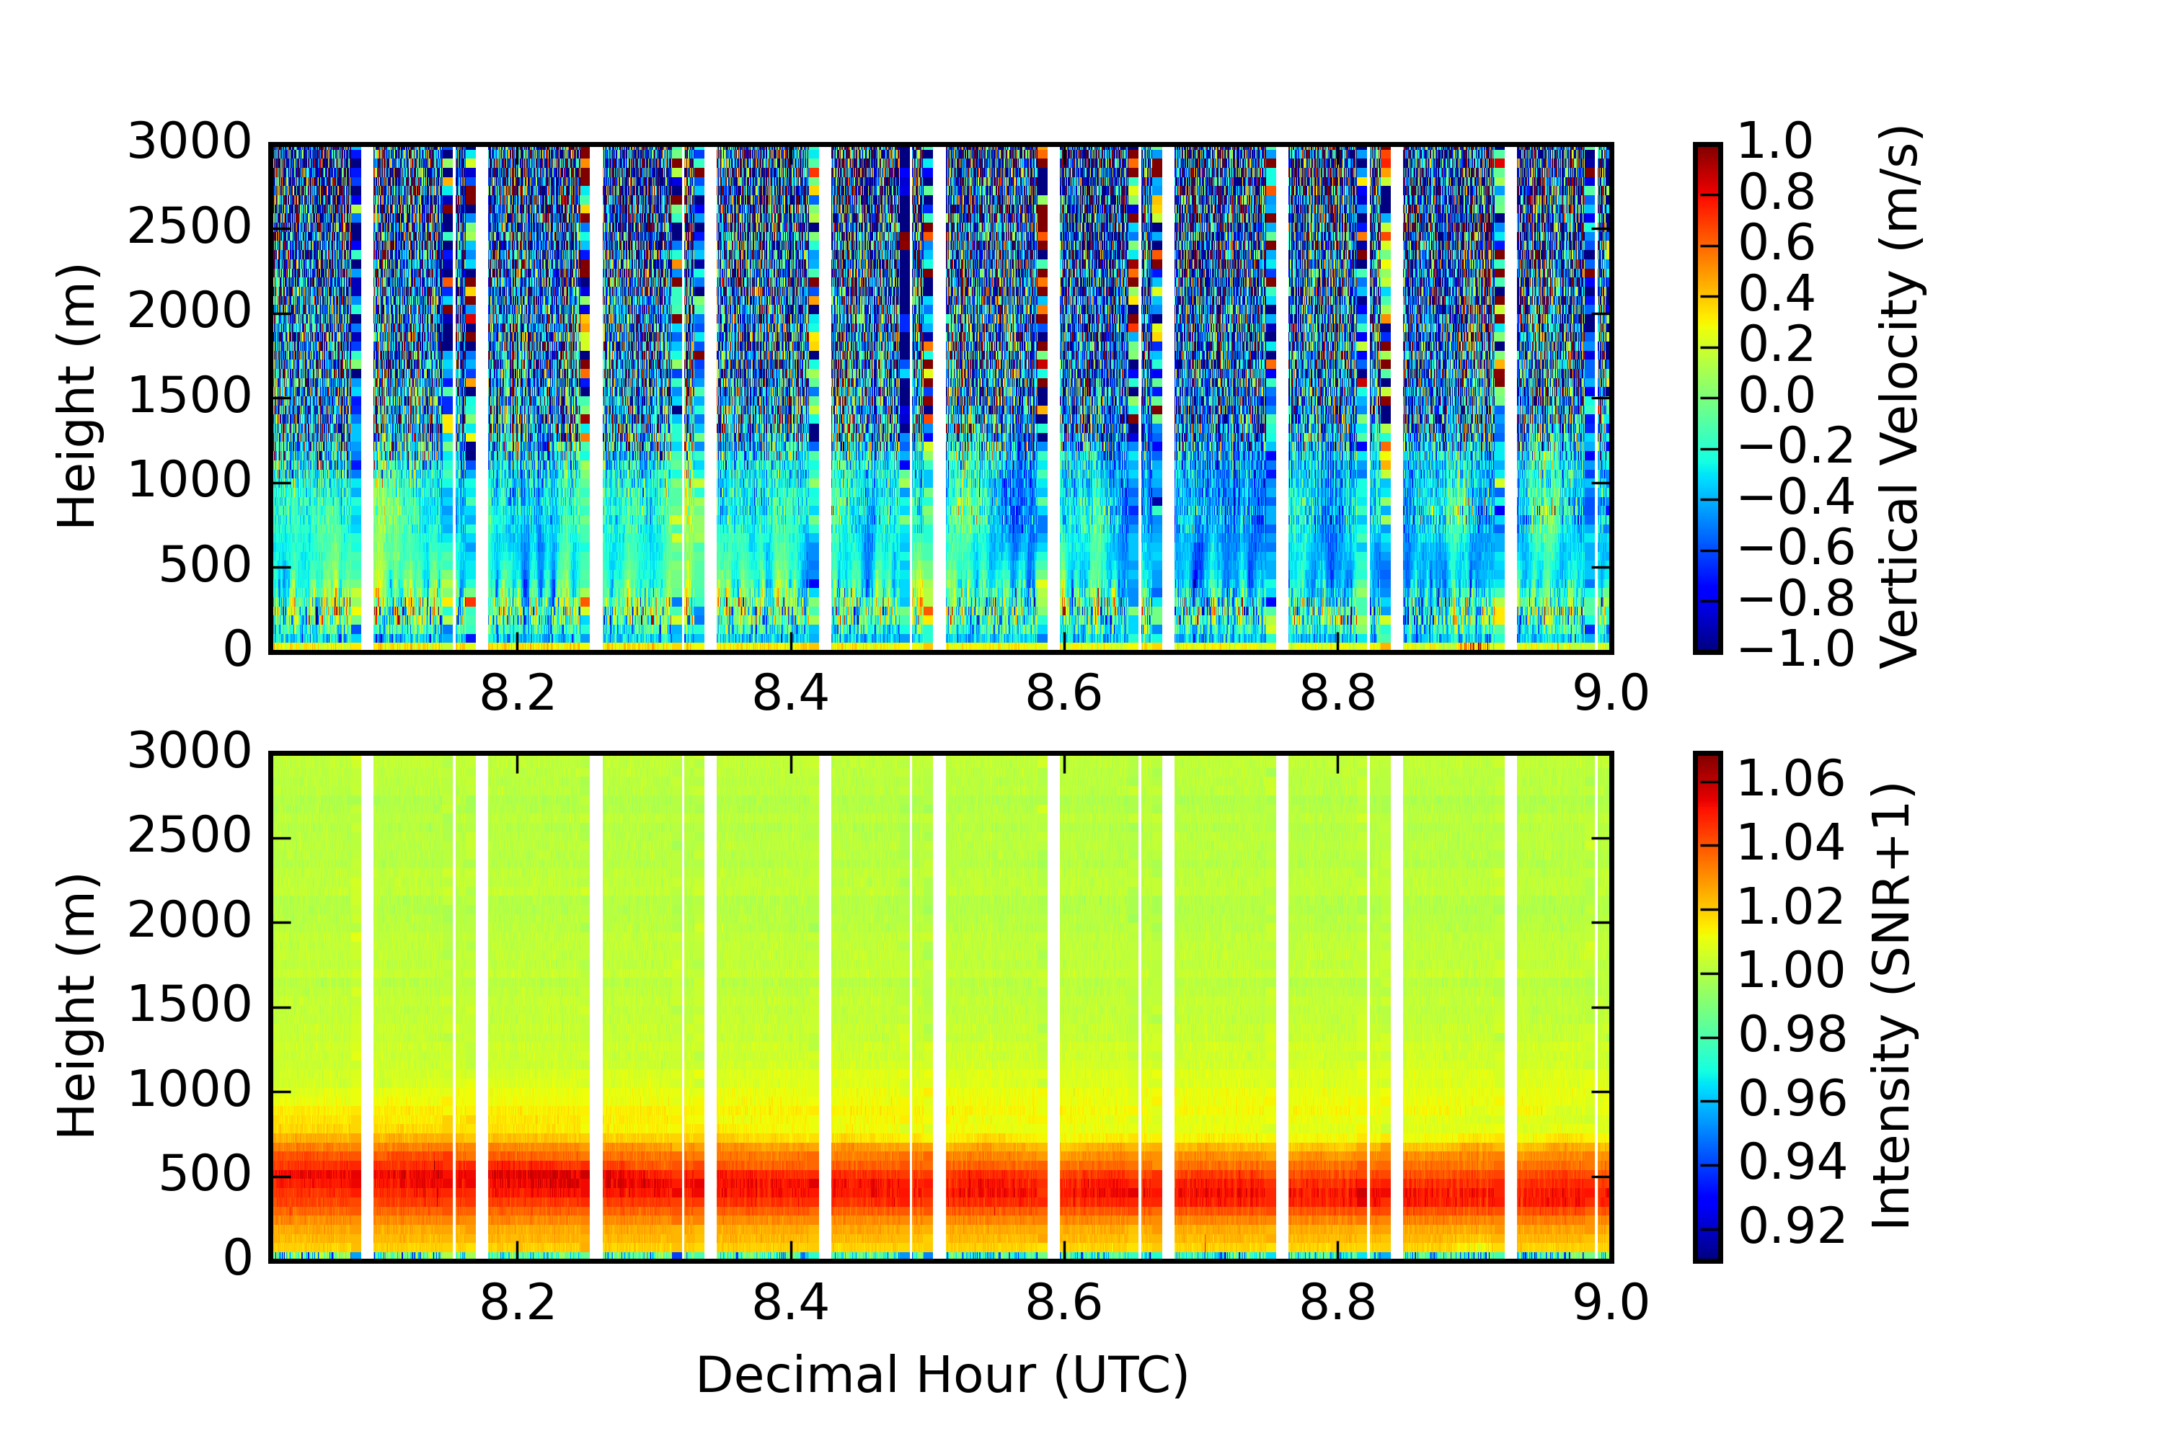
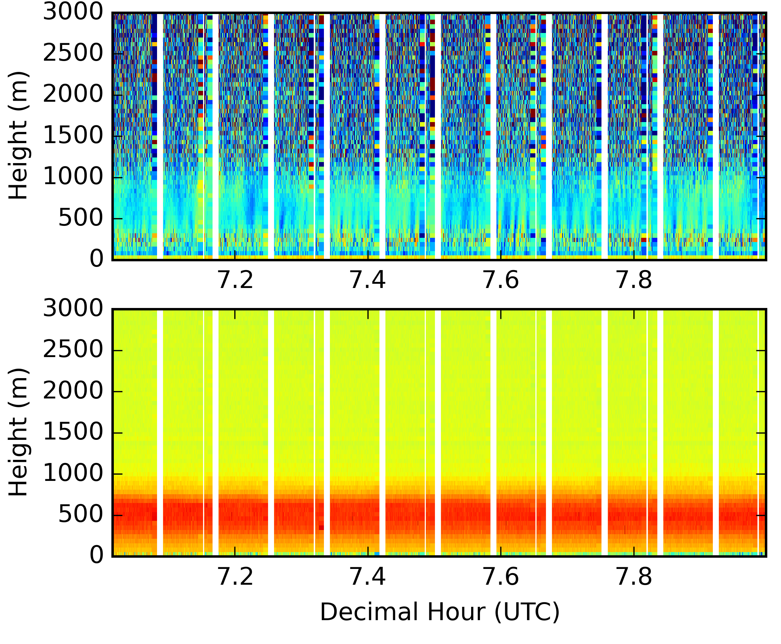
Doppler Wind Lidar (0030-0930)
Doppler Wind Lidar (0700-0800)
Doppler Wind Lidar (0800-0900)

Slide 19
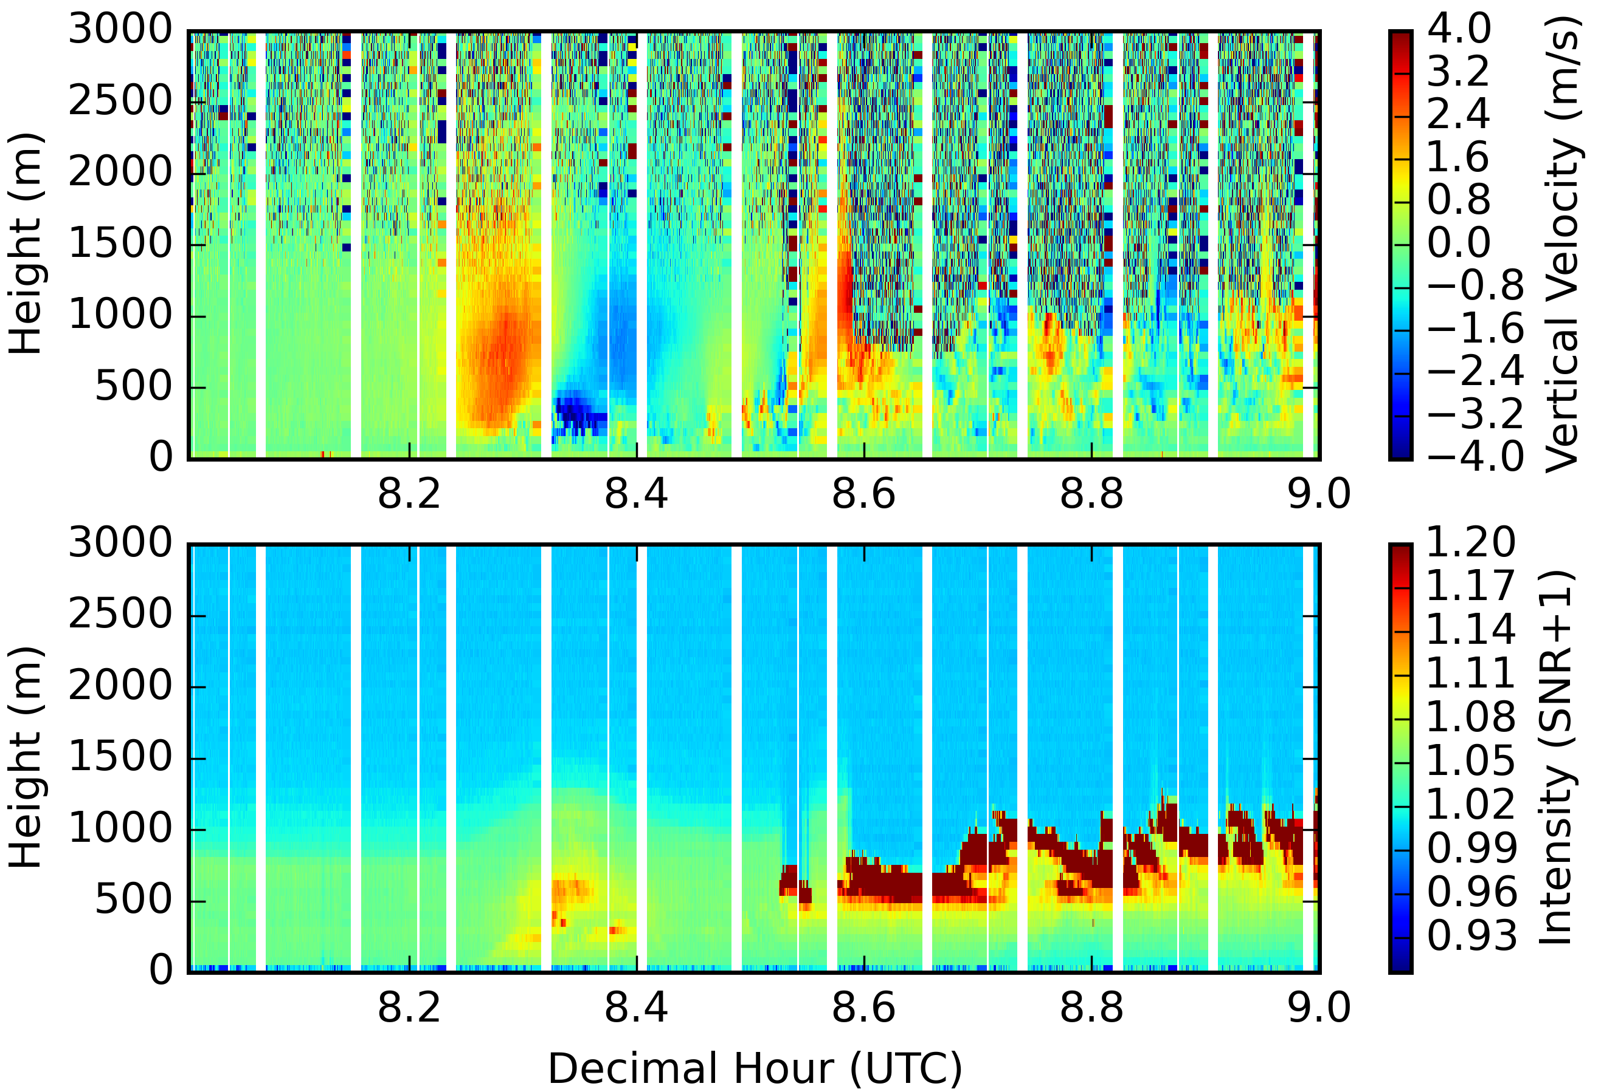
IOP 25 (7/11): Bore in N KS (Phillipsburg)
Undular bore, 2 primary waves: first developed no clouds, the second had a well defined cloud field which persisted after bore passage
W (DWL)
SNR (DWL)

Slide 20
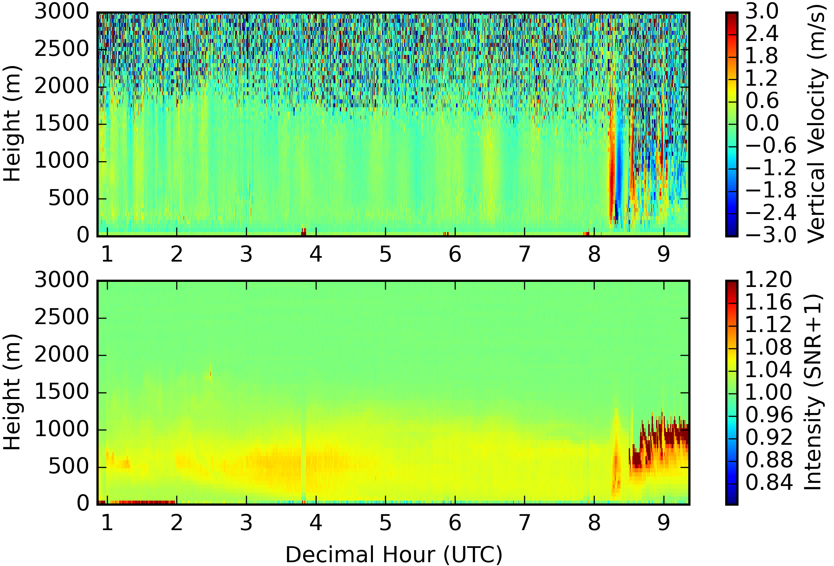
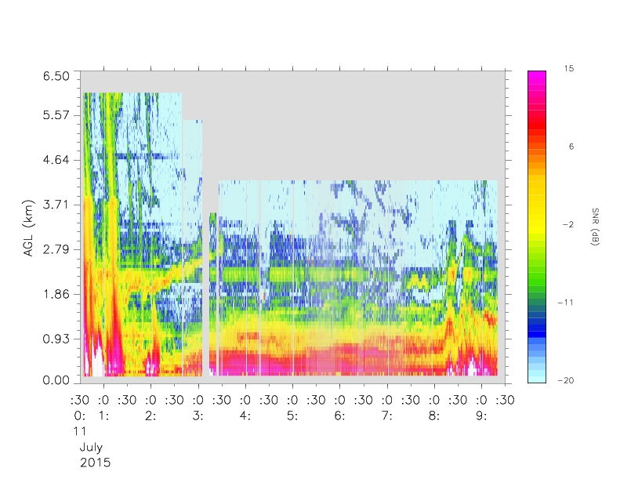
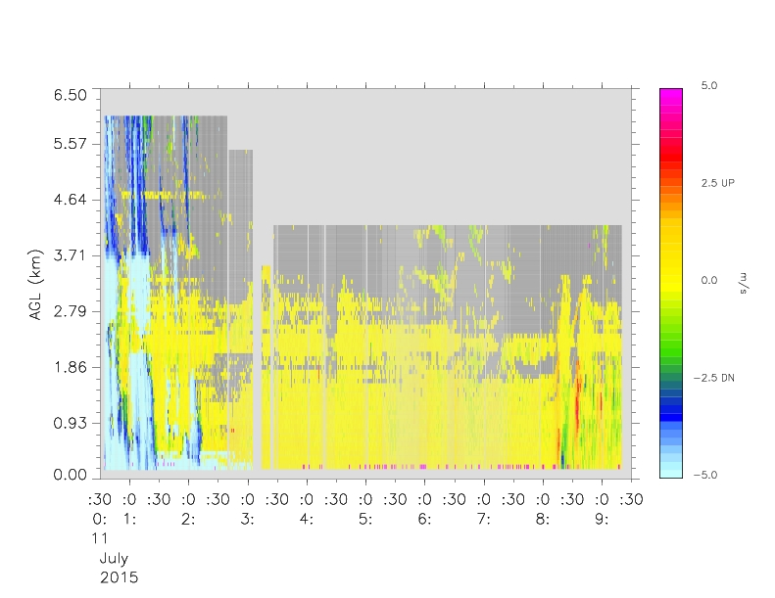
Long time series from MIPS
Ceilometer backscatter
DWL (w, top; and SNR, bottom)
915 SNR
915 W
b
a
c
d

Slide 21
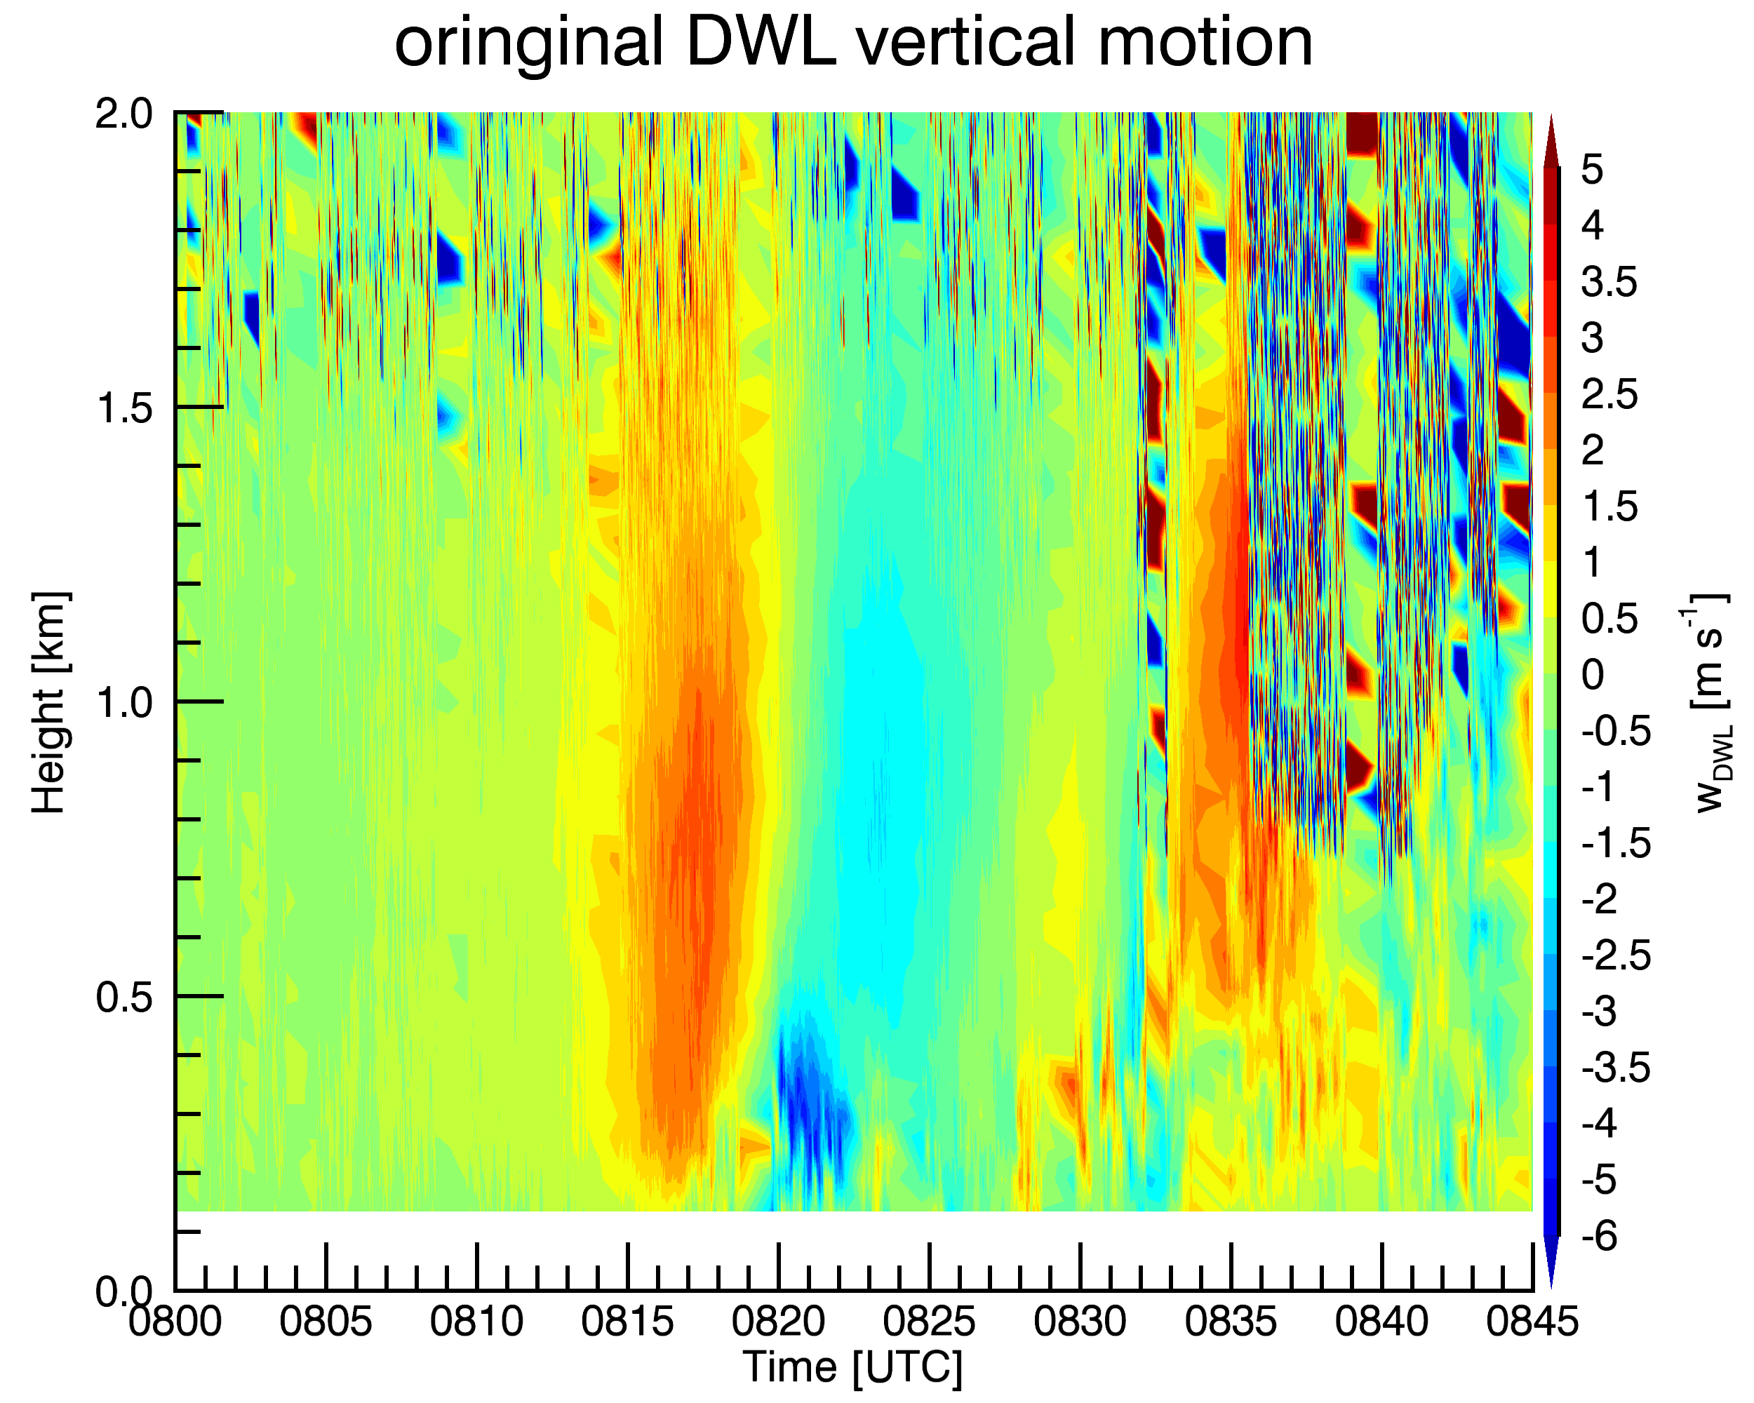
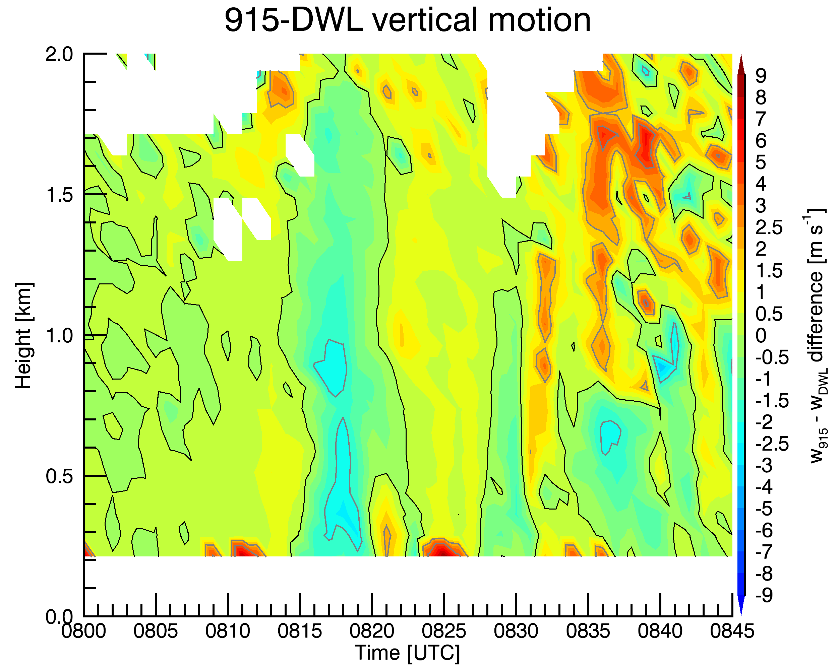
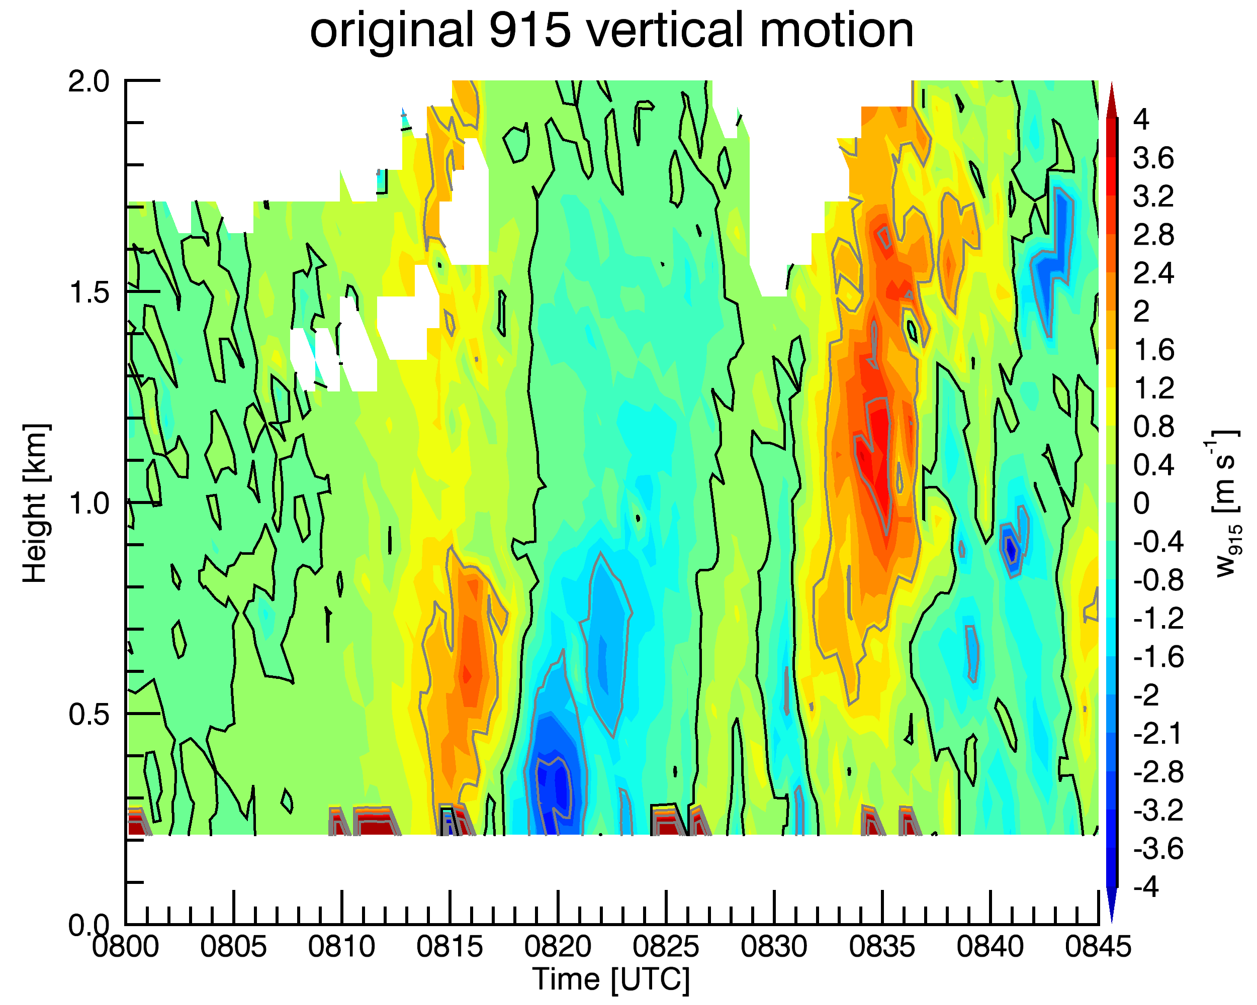
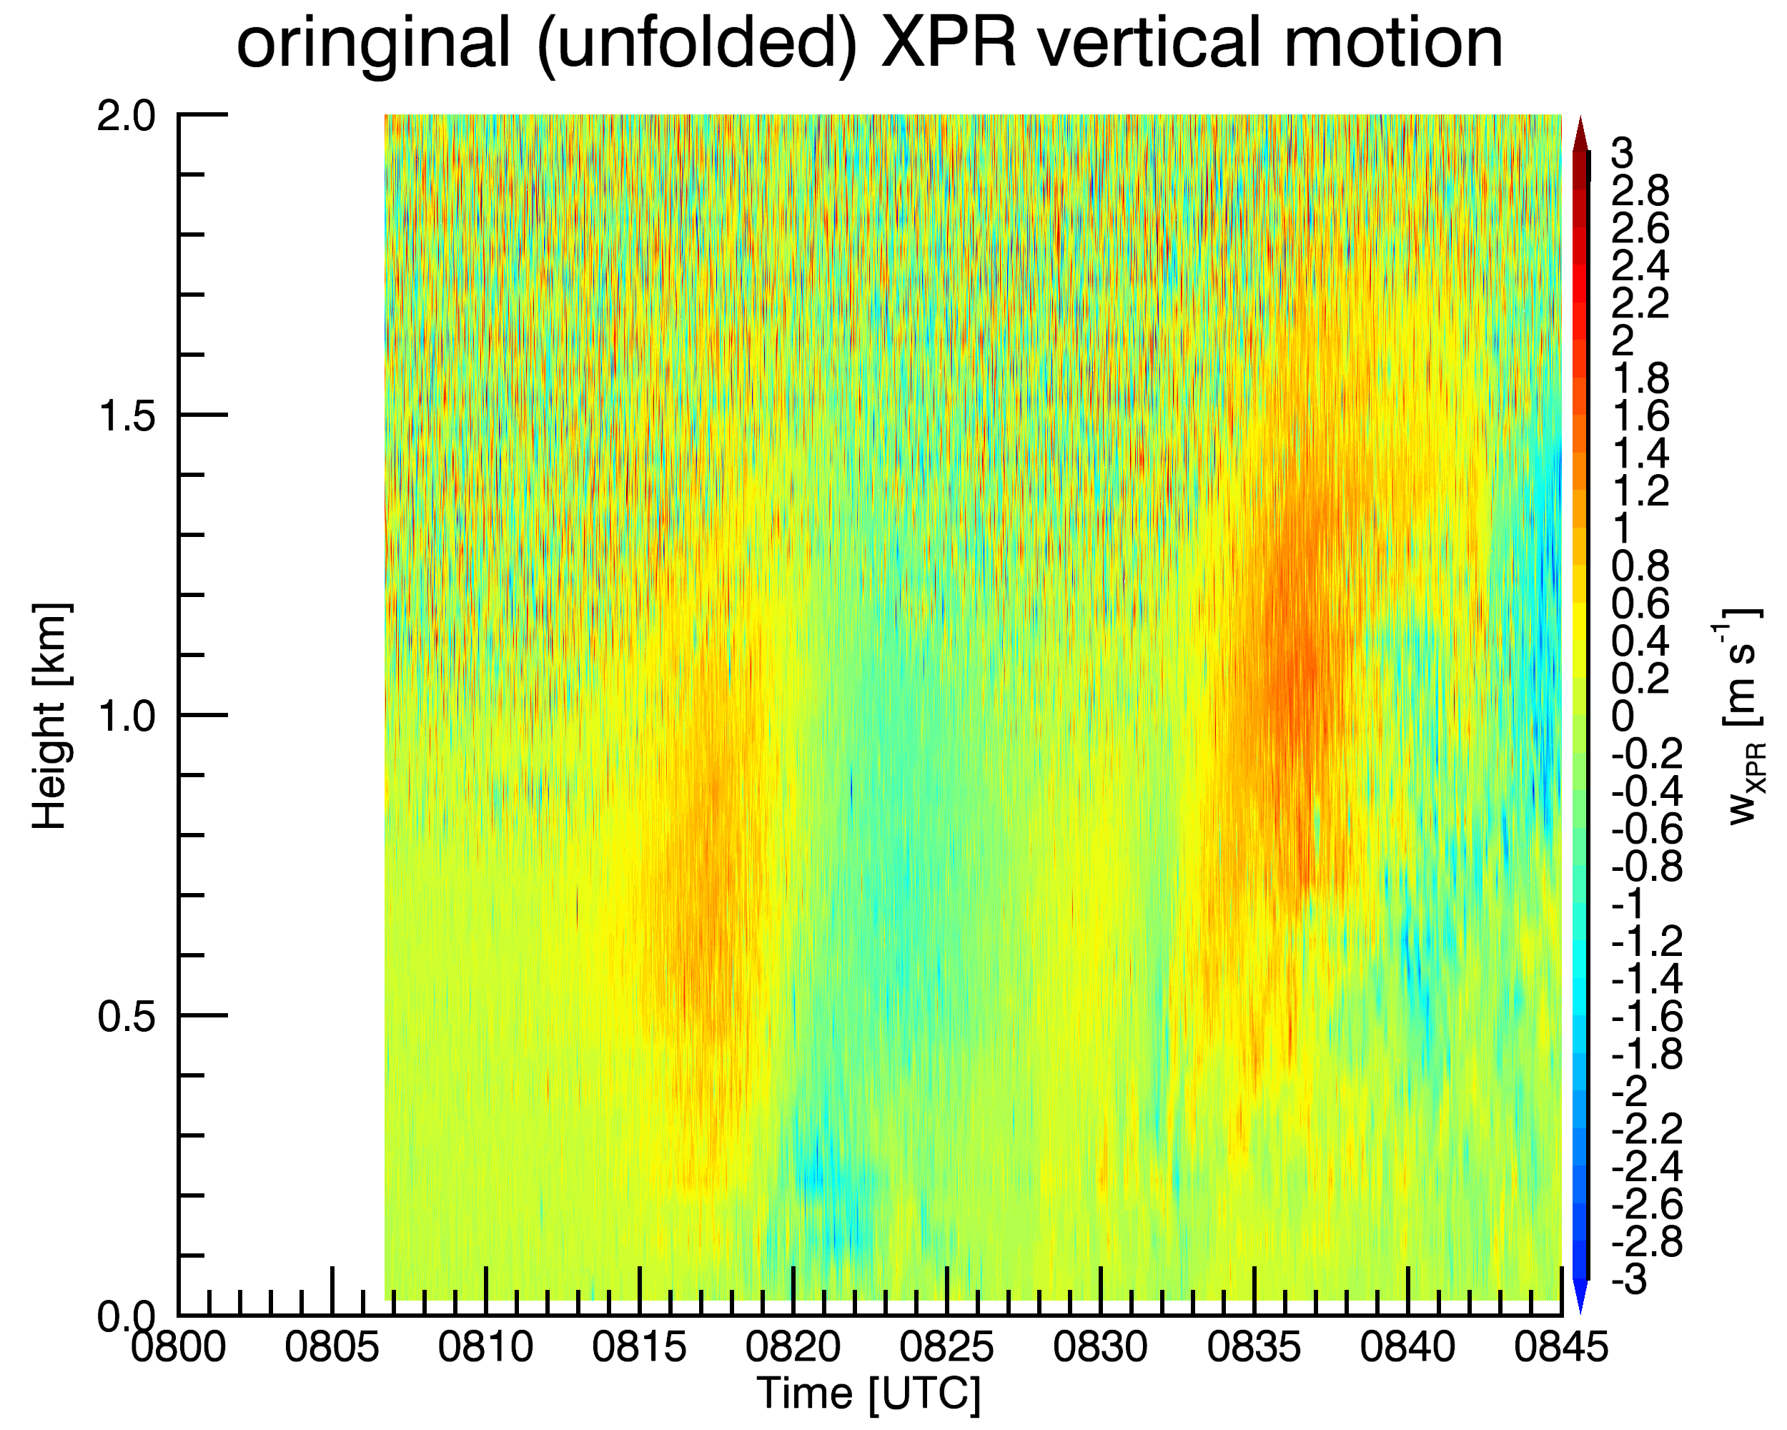

Slide 22
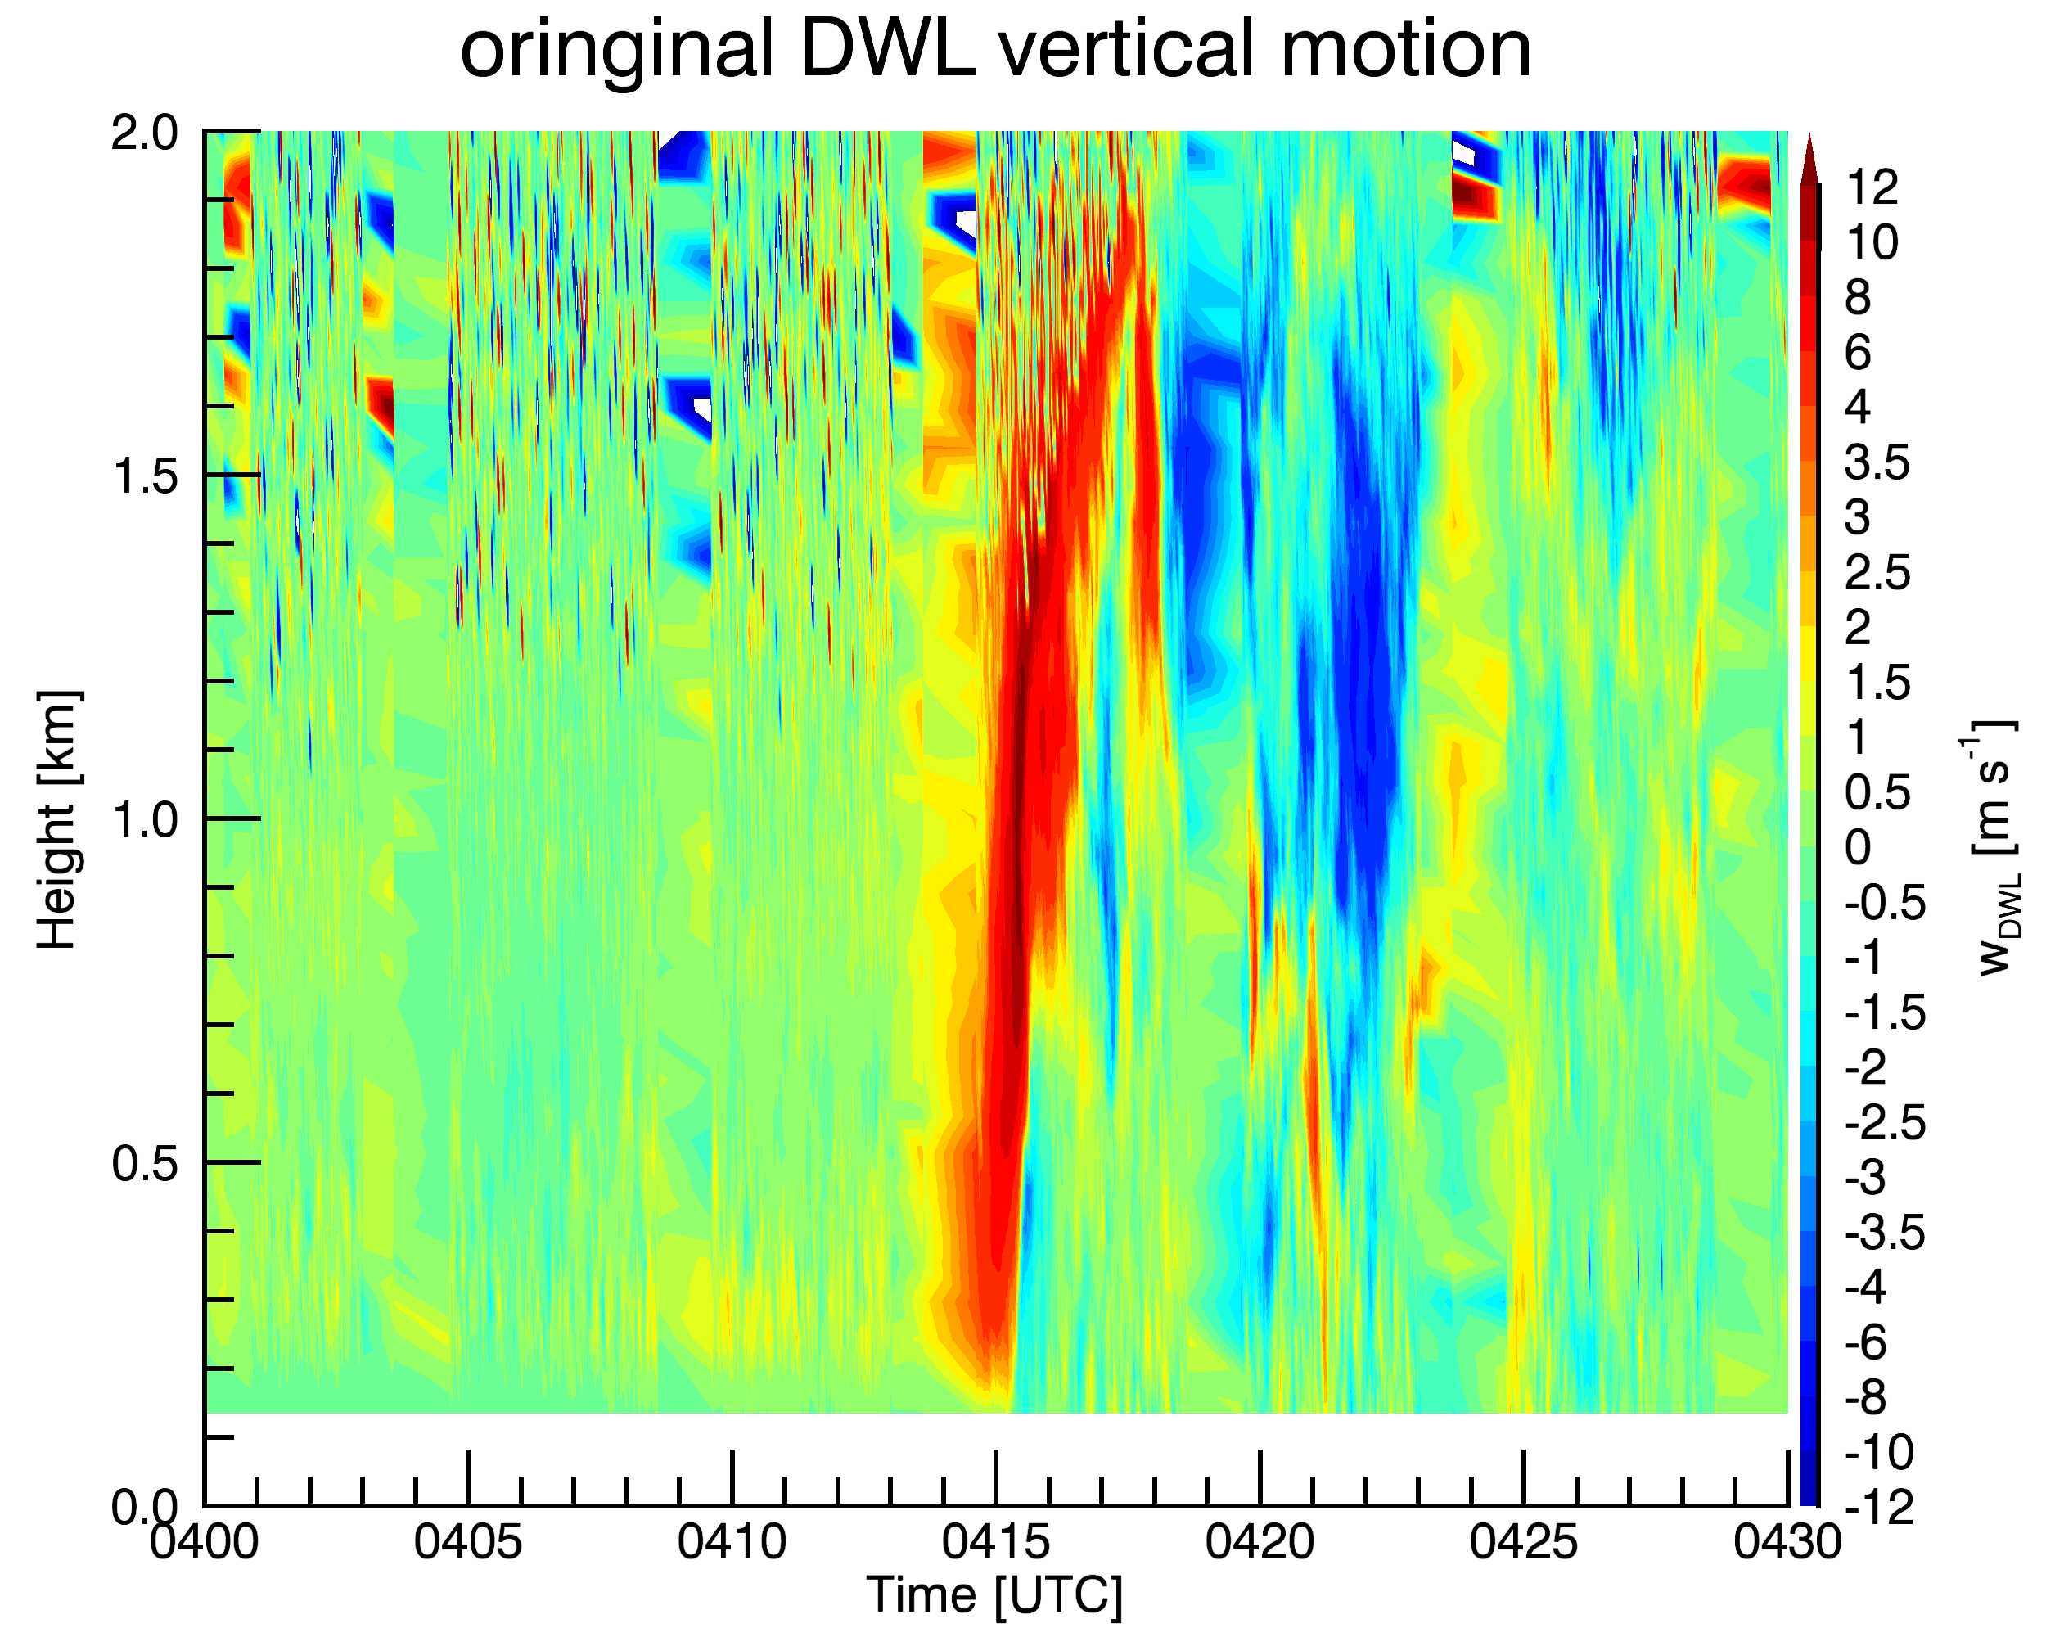
IOP 30 (7/15): Gust front / bore hybrid at McCook
Passage at 0415 UTC
Narrow, deep updraft (~2 min duration, 2 km deep), maximum of 12 m s⁻¹
Turbulent region behind front
Secondary ascent after 0423 UTC
Continuous initiation of shallow precipitating convection occurred behind the front (bore-like behavior)
Raw DWL w at 1 Hz sampling

Slide 23
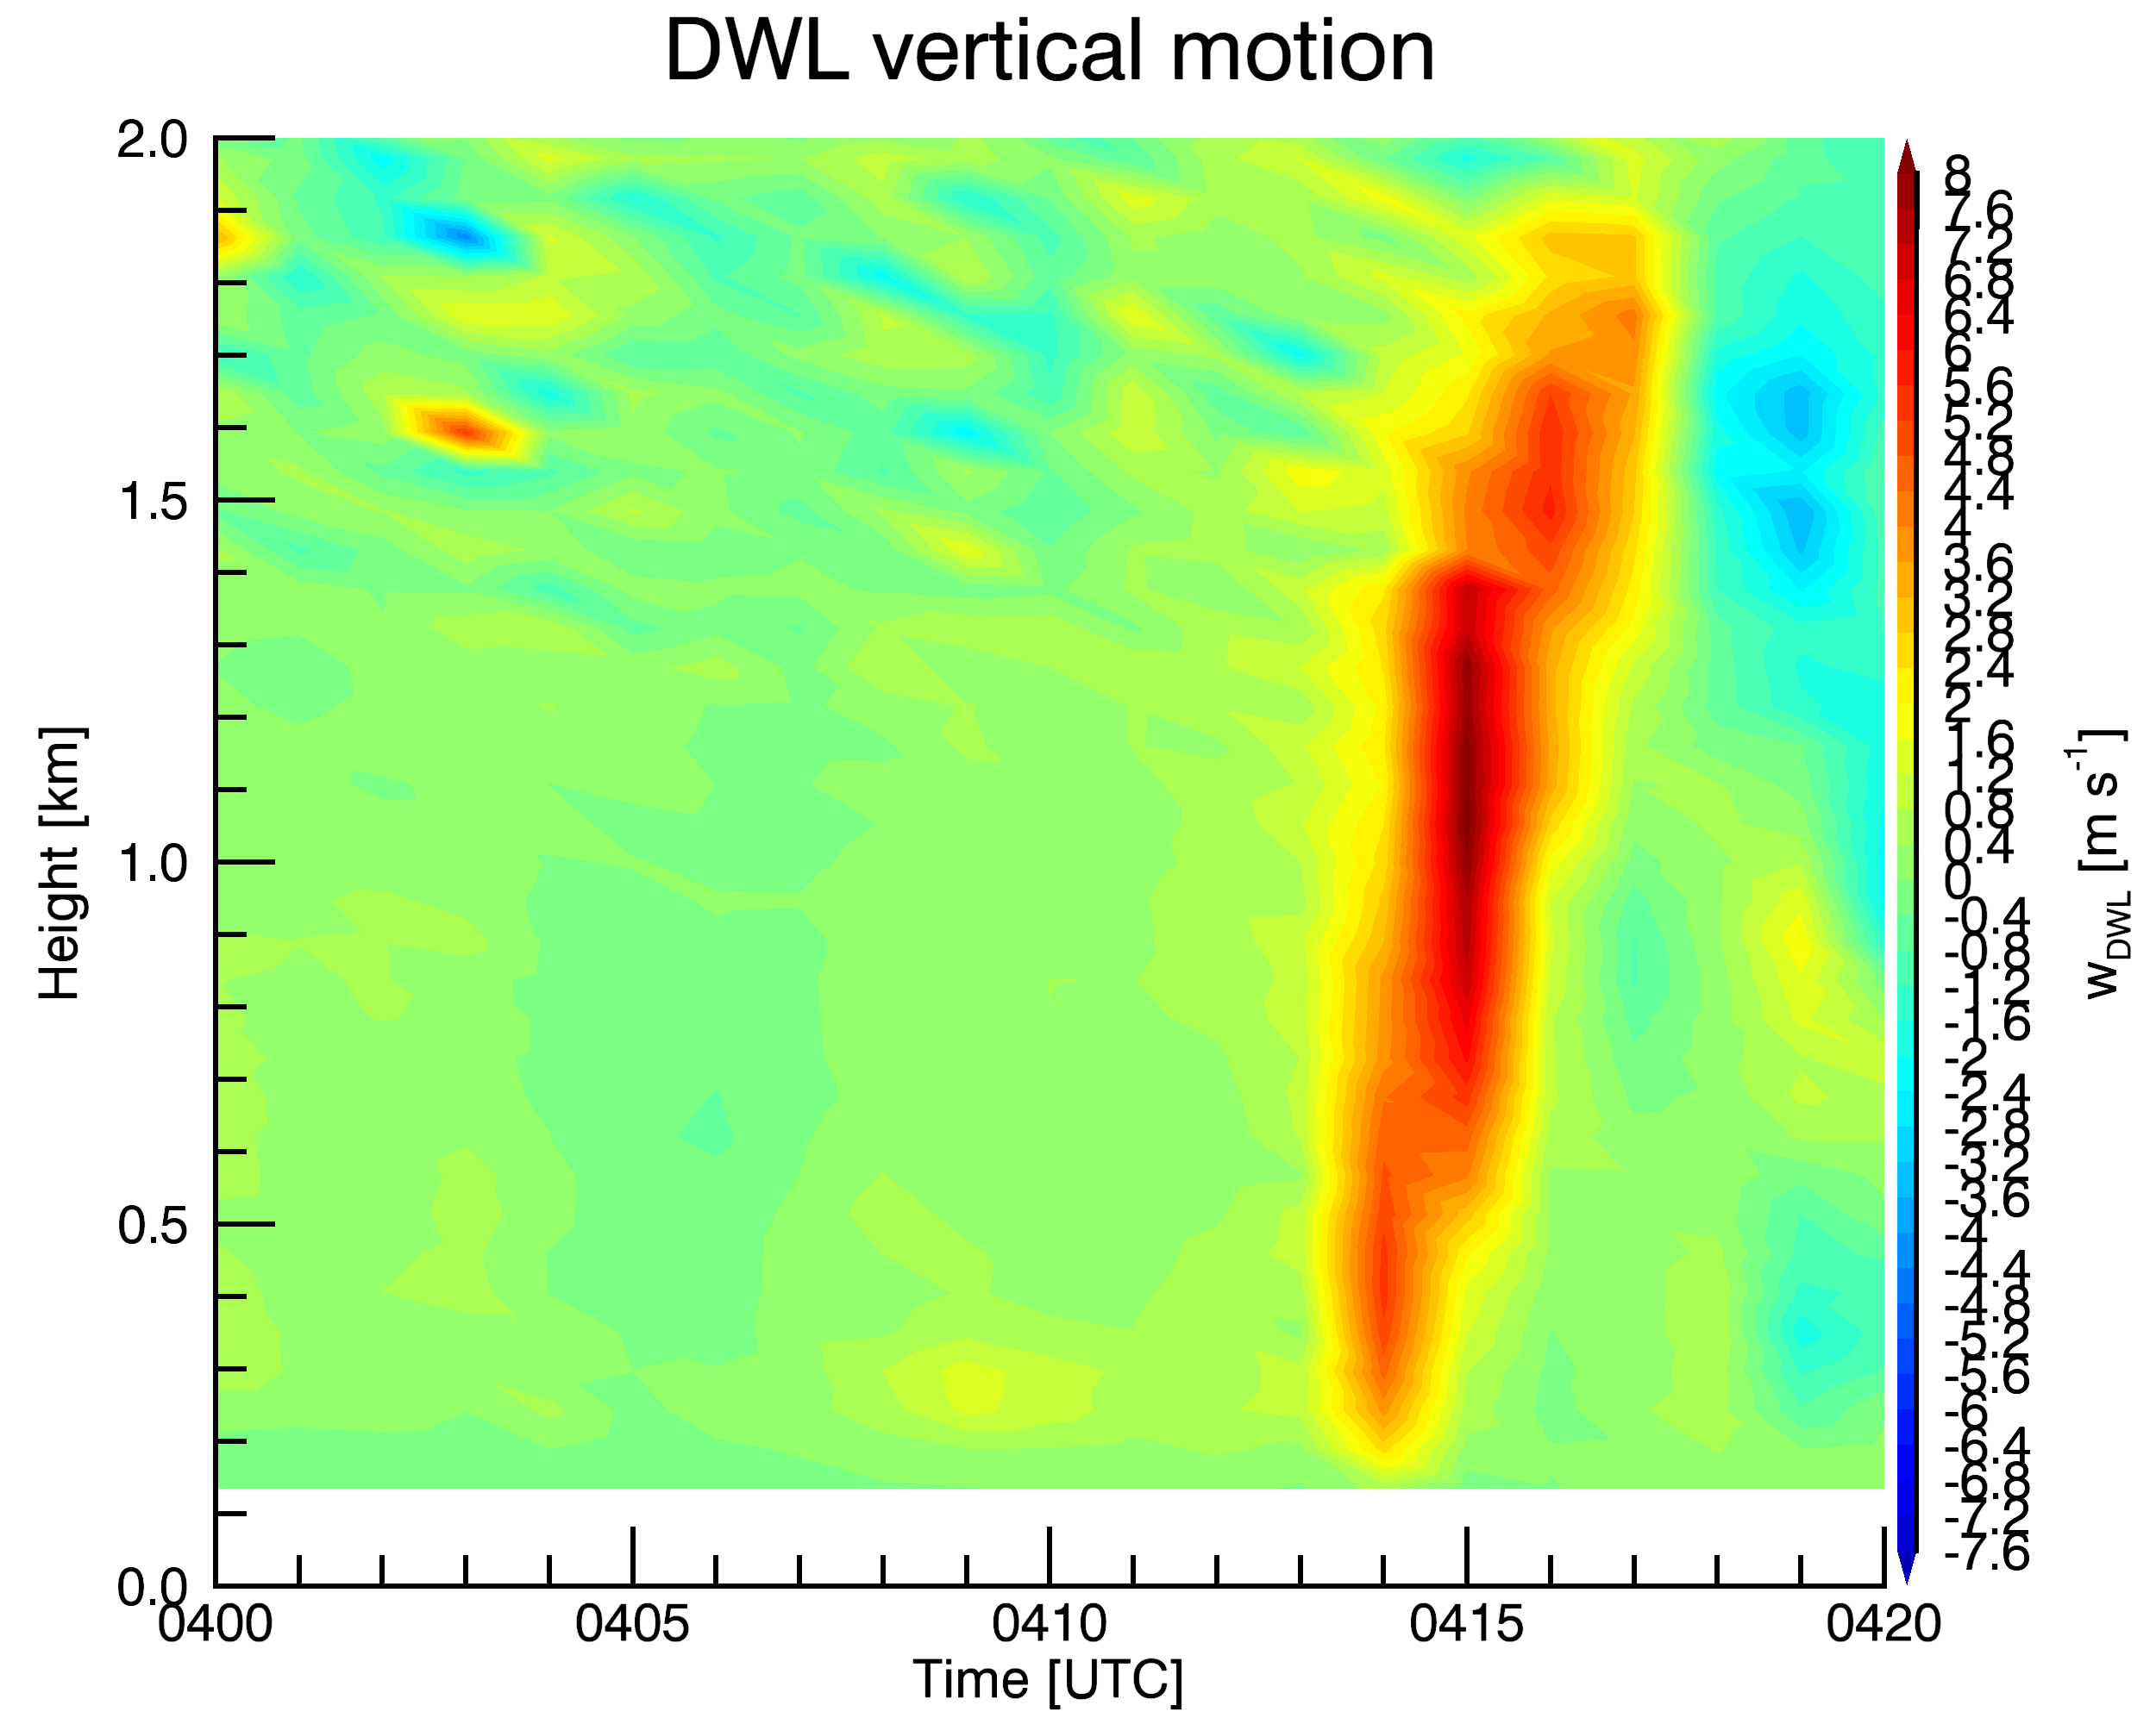
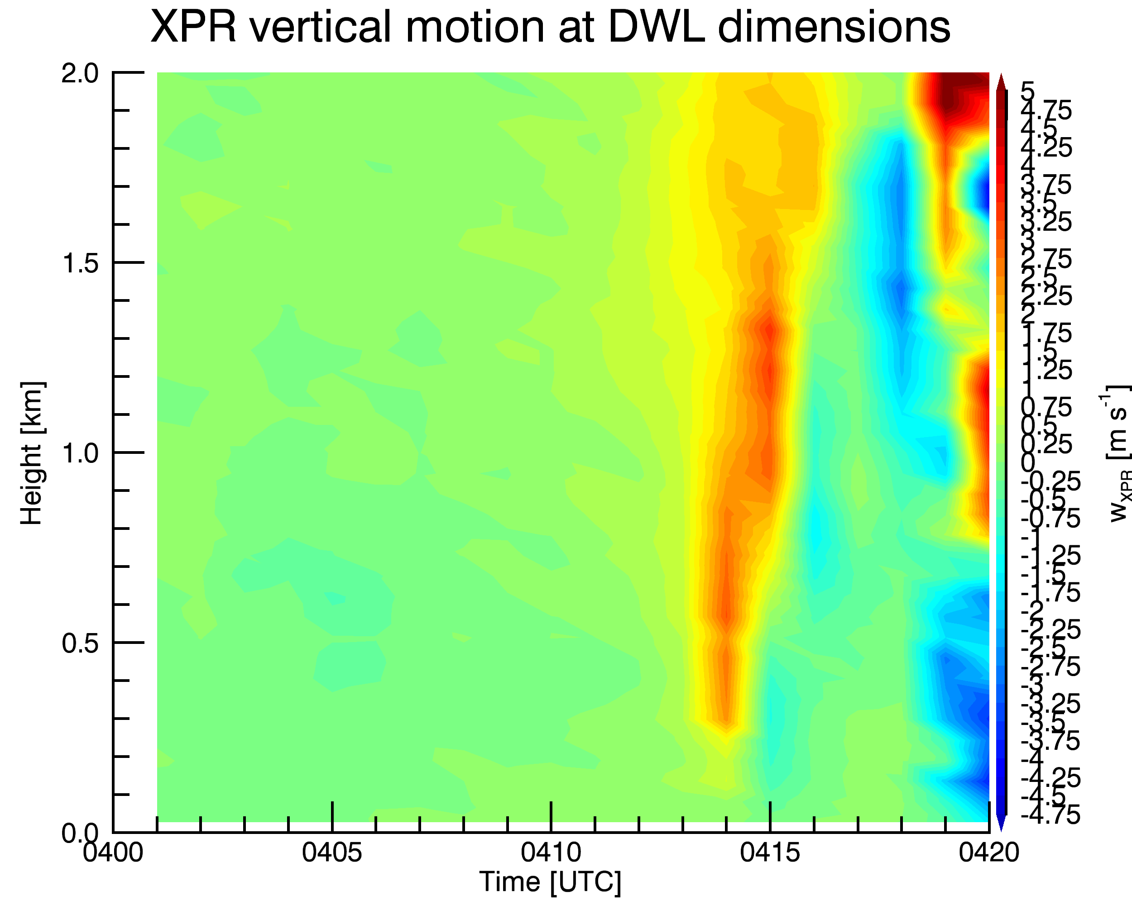
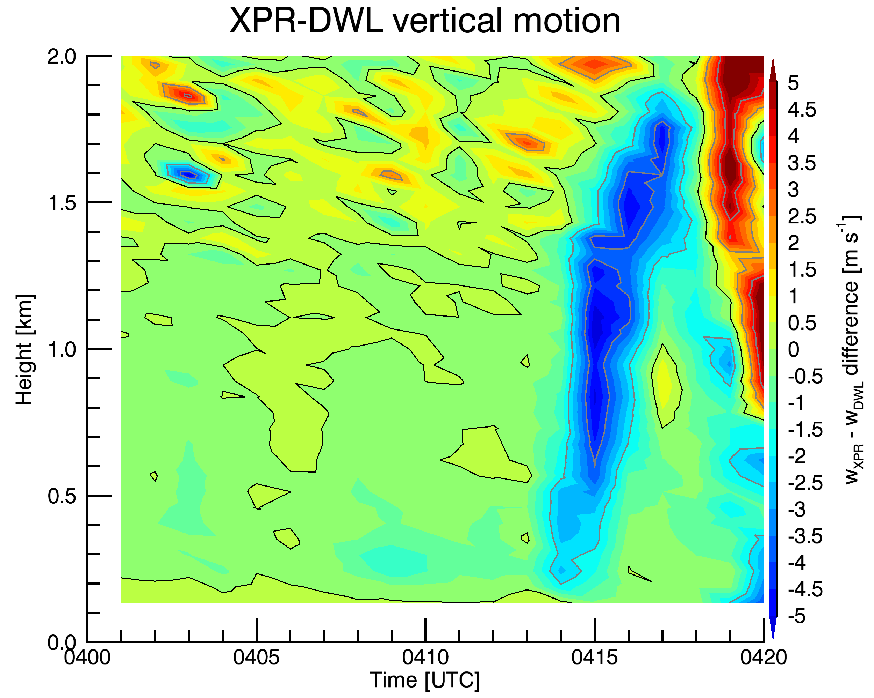
Comparison of DWL and XPR:
DWL w estimates are greater, difference exceeds 3 m s⁻¹ over a deep layer
Updraft shape and relative variations are similar
DWL w not affected by light rain
Note that the velocity scale differs

Slide 24
IOP 20 (7/6): MCS in SE SD
Participation as a collaborator
Two interesting events:
CI over MIPS
Passage of solitary wave (within the trailing stratiform region) over MIPS

Slide 25
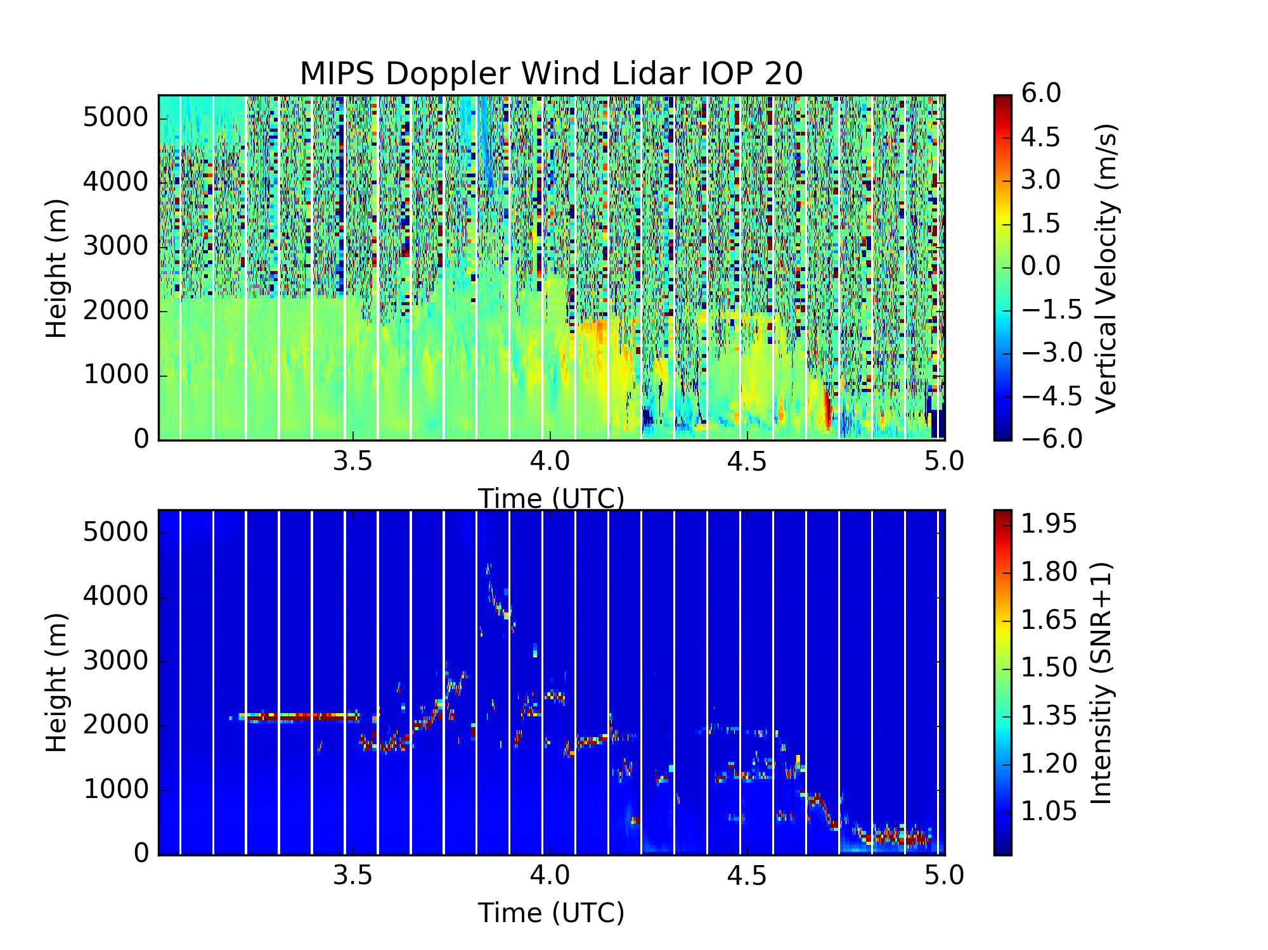
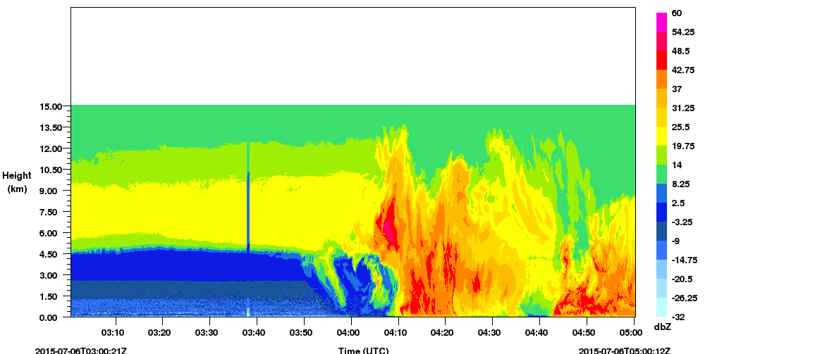
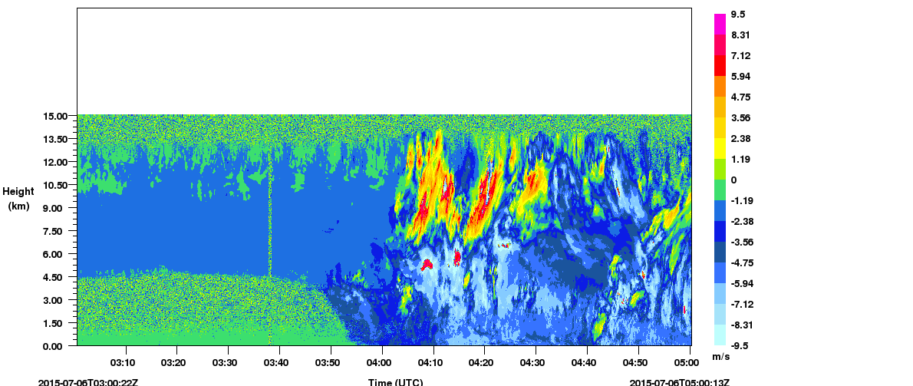
Convective Initiation Over MIPS During IOP 20
MIPS XPR – Reflectivity factor
Elevated ascent in region of weak Z_{e}
MIPS XPR – Vertical Velocity

Slide 26
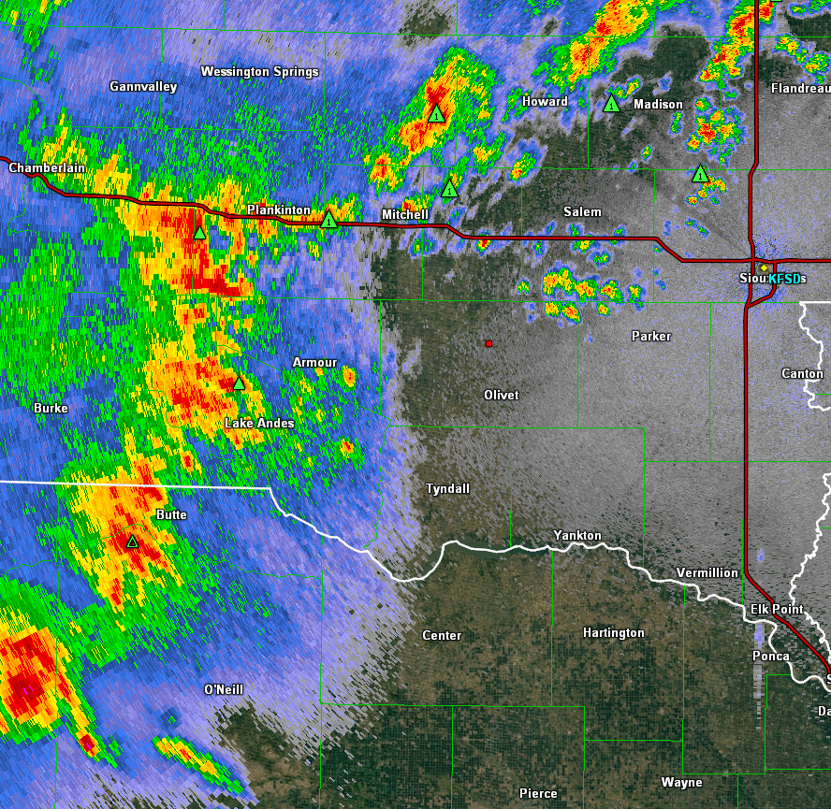
Convective Initiation Over MIPS During IOP 20
MIPS XPR - Reflectivity
Note elevated ascent in region of weak reflectivity
N
MIPS XPR – Vertical Velocity
50 km
MIPS Location

Slide 27
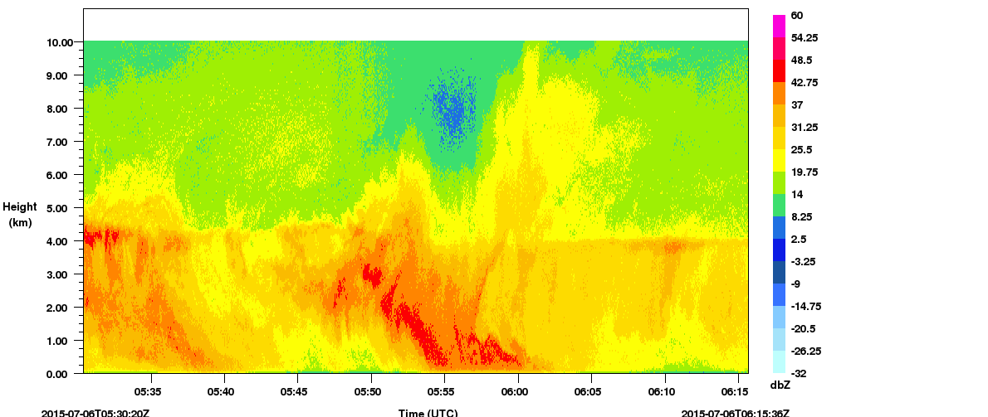
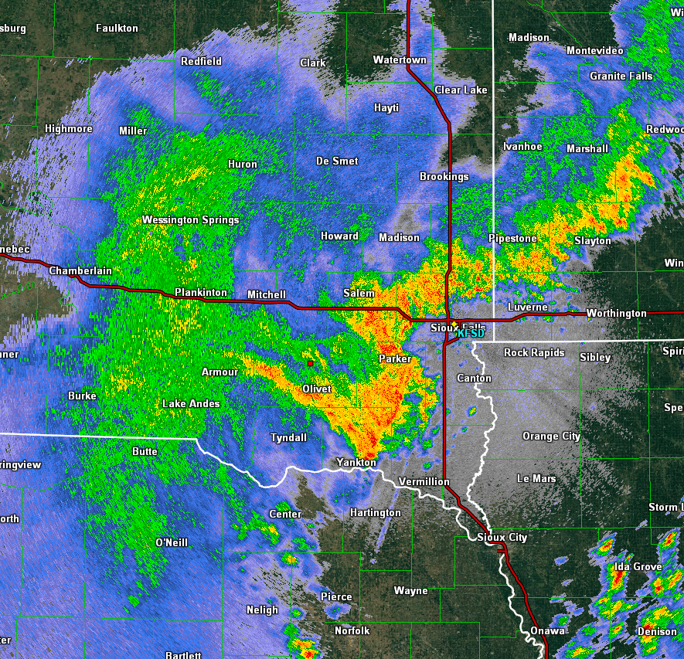
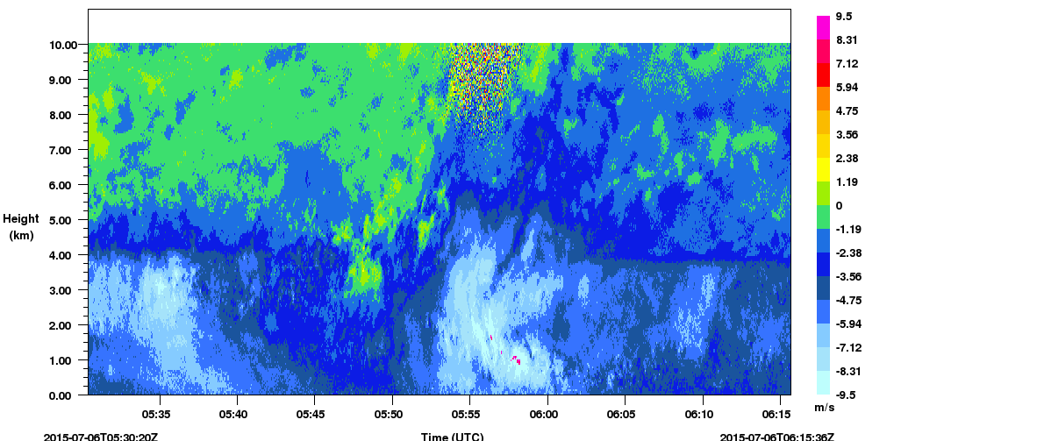
Solitary Wave Passage Over MIPS During IOP 20
UAH MIPS XPR - Reflectivity
N
UAH MIPS XPR – Vertical Velocity
MIPS Location
50 km

Slide 28
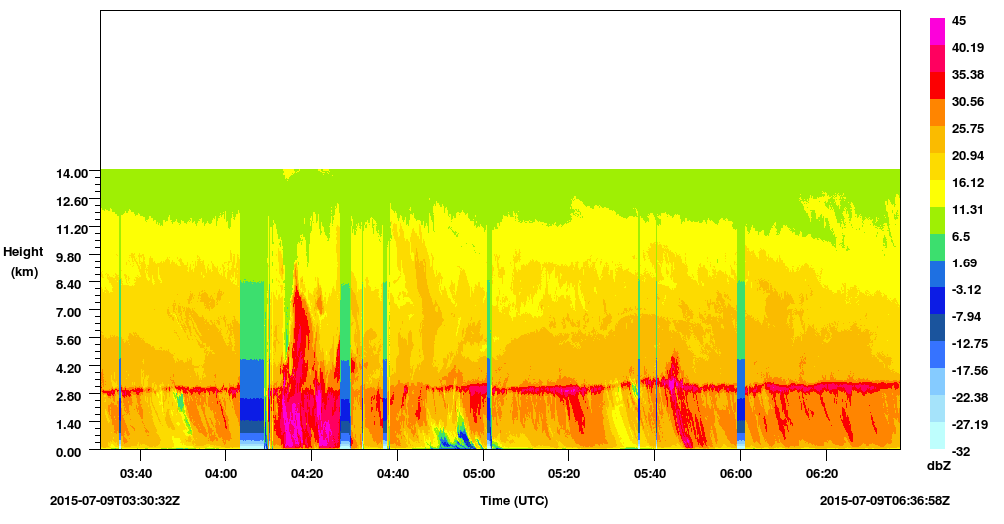
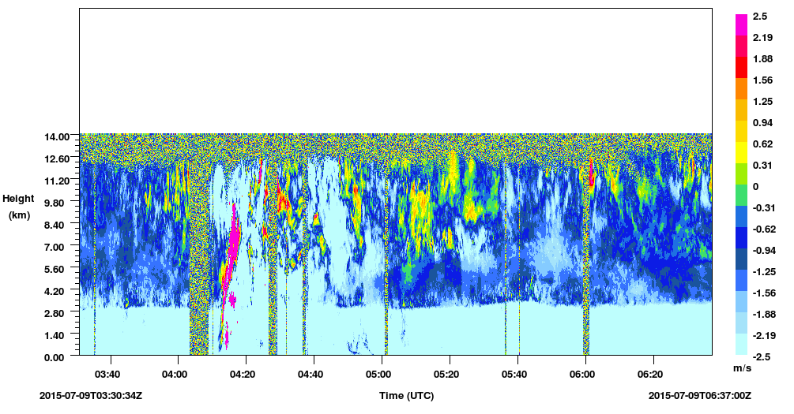
IOP 21 (7/9): QLCS in TX panhandle

