Slide 1
Nocturnal boundary-layer structure and evolution of the low-level jet during PECAN
Petra Klein,
Elizabeth Smith,, Dave Turner, Evgeni Fedorovich
Thanks also to:
Matt Carney, Josh Gebauer, Tim Bonin, and Jennifer Newman
Supported by NSF Award #1359698

Slide 2
Why are LLJs and NBL structure important?
Improved forecasts of near surface temperatures at night are important for transportation and agriculture
See e.g.: van der Velde et al. 2010; Cuxart and Jiménez 2011; Bartok et al. 2012; Prabha et al., 2011
Concentrations of near-surface ozone and other pollutants in urban and rural areas are affected by pollutant transport by accelerated winds above the surface in the NBL and the subsequent downward mixing
See e.g.: Banta et al. 1998; Zhang and Rao 1999; Reitebuch et al. 2000; Solomon et al. 2000; Salmond and McKendry, 2005, Klein et al. 2014
Wind energy forecasts require accurate predications of winds and turbulence across the rotor disk
See e.g.: Storm and Basu 2010; Banta et al. 2013
Role of LLJ in initiating nocturnal convection?

Slide 3
LLJ Formation
Blackadar Theory (1957):
A drastic decrease in turbulent mixing during the early evening leads to an inertial oscillation that is key mechanism for LLJ formation
Holton Theory (1967):
baroclinicity generated by sloping terrain causes LLJ formation
Both theories have deficiencies:
The inertial oscillation cannot explain the geographical preference of LLJs and does not match well with observed LLJ characteristics (Lundquist 2003; Shapiro and Fedorovich 2009), while the
terrain-associated baroclinicity theory cannot correctly reproduce the jet-like vertical profiles (Shapiro and Fedorovich 2009).
Shapiro et al. (2016) presented a unified theory
Talk by Alan Shapiro

Slide 4
Objectives of our Project
Can lidars and passive remote sensing instruments accurately measure the dynamic, turbulence and thermodynamic structure of the NBL?
What is the spatial variability of the LLJ?
What are important parameters that “control” the LLJ strength, nocturnal turbulent mixing and nocturnal inversion strength?
How important are slope effects in modulating strength and evolution of LLJs
Talk by Evgeni Fedorovich
What is the role of LLJs in initiation of nocturnal convection?
Talk by Josh Gebauer
How well do current models reproduce the dynamic, turbulence and thermodynamic structure of the NBL in presence of LLJs
Poster by Elizabeth Smith

Slide 5
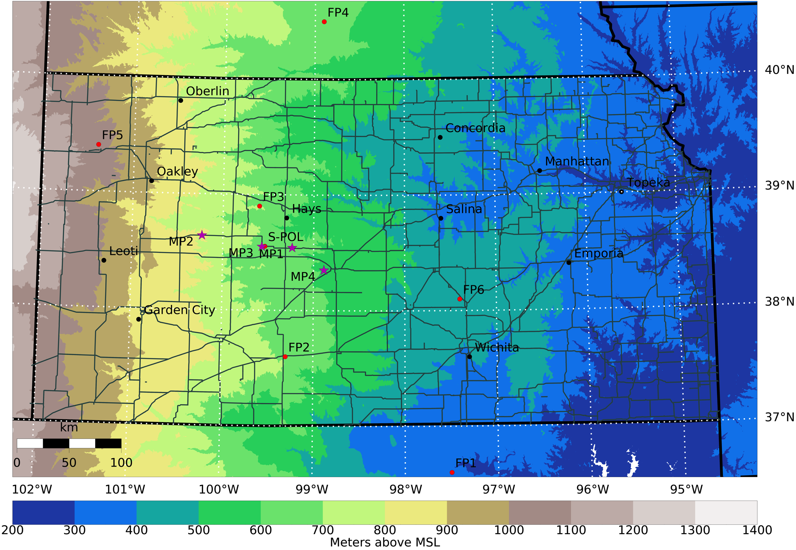
PECAN Domain and LLJ Studies
MP3: SPARC
MP1: CLAMPS
PECAN LLJ IOPs
ARM SGP site: LABLE

Slide 6
Updated AERI retrieval (R2.2)
AERI measures downwelling infrared radiance from 3-19 μm at high spectral resolution.
Profiles of temperature and water vapor are retrieved from these observations, as well as cloud properties and trace gas information. Two blackbody targets maintain calibration to better than 1%.
Retrieval: generally an ill-posed problem as different profiles can result in same radiance spectra
New retrieval developed by Dave Turner includes:
Logic to prevent supersaturation profiles above some height level (default is 0.3 km AGL)
Ability to include surface met data as additional observation
Ability to include NWP output from RAP or RUC as additional “observation” in the middle-to-upper troposphere
These changes helped by eliminating possible solutions in the ill-posed problem ➔algorithm finds a solution that is closer to the true state

Slide 7
Typical CLAMPS observations
Mean winds derived from DL PPI scans and VAD analysis
Time res. ~ 2.5 min
Vertical velocities from Doppler lidar zenith stares
Time res. ~ 5 s
Potential temperature computed from AERI retrievals
Time res. ~ 2 min

Slide 8
MP1 (CLAMPS): Comparison of 3 IOPs
Differences in timing of LLJ evolution, structure and strength exist but initial, daytime velocities are similar
LLJs appear to follow the isentropes
June 03
Sudden increase in LLJ thickness associated with strong upward vertical mixing
June 20
Periods of strong upward vertical mixing can again be noted, vertical mixing intensifies as jet continues to strengthen
June 22

Slide 9
MP1 (CLAMPS): Comp. of three 3 IOPs
Periods of mean upward vertical motions, are they real, or bias in lidar data? If yes, what causes this lift?
June 03
June 20
June 22
Quite strong vertical mixing in layer below jet nose at night, is it real, or noise in lidar data?

Slide 10
MP1 (CLAMPS): Comp. of IOPs - Radiosonde and Remote Sensing Observations

Slide 11
IOP12, June 20 MP1/MP3 Comparison
Sunset 0206 UTC
MP1: CLAMPS
MP3: SPARC
Generally very good agreement at the two sites

Slide 12
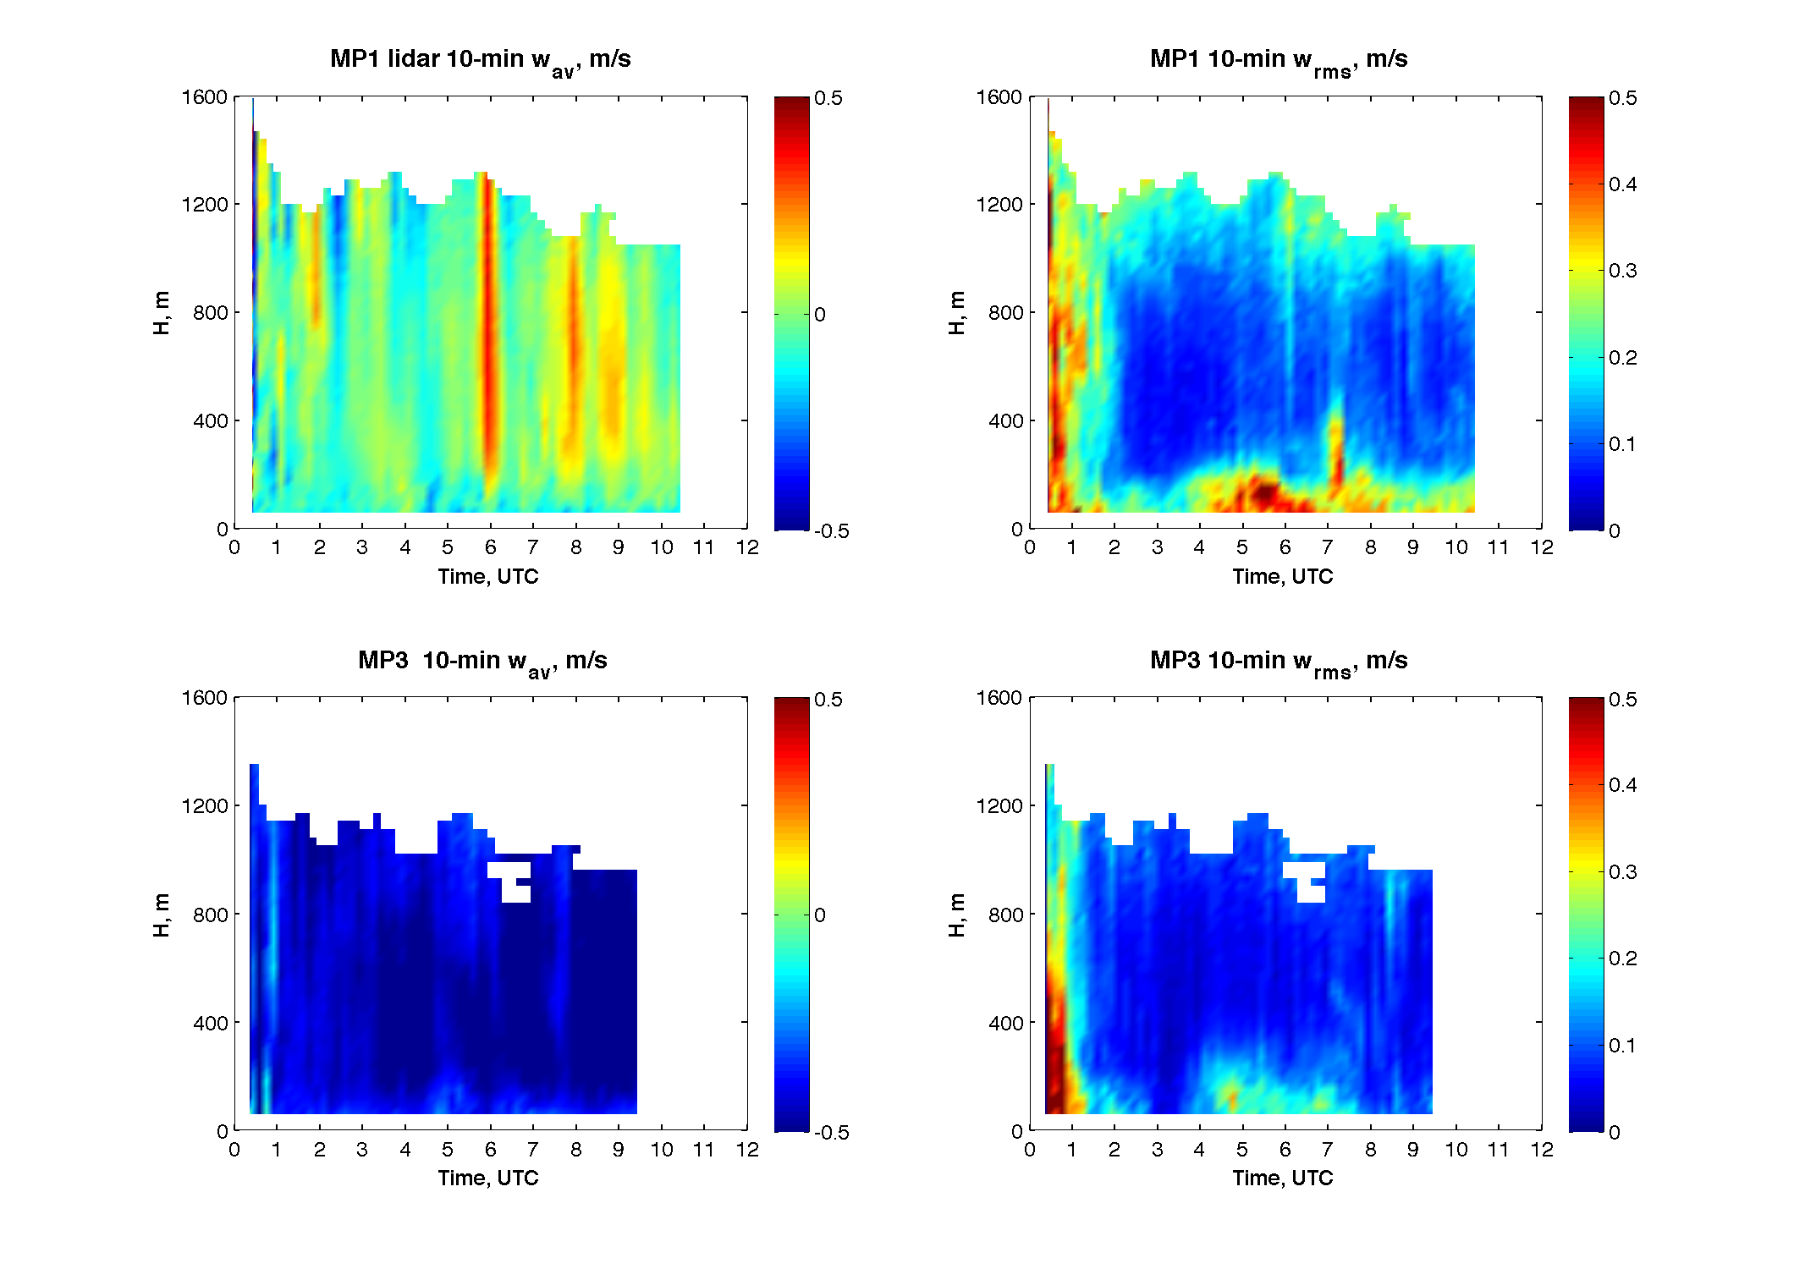
IOP12, June 20 MP1/MP3 Comparison
Sunset 0206 UTC
Clear differences in mean vertical wind speeds require further investigations

Slide 13
IOP12: Comparison with radiosondes
Profiles further confirm agreement between the lidar observations at the two sites and also with radiosondes
AERI profiles capture surface based inversion well, higher up differences still exist even with the updated retrieval
Standard deviations of vertical velocities also show differences possibly due to noise?
Lines: radiosondes, Diamonds: CLAMPS (MP1), Crosses: SPARC (MP3)

Slide 14
WRF model runs
Optimal configuration for simulating Great Plains Low Level Jet was identified based on
intensive studies with different grid spacing and different BL schemes
Model output was compared to LLJ observations collected during the Lower Atmospheric Boundary Layer Experiment (LABLE)
What appeared to work best?
4-km horizontal grid spacing,
40-m vertical grid spacing, and the QNSE PBL scheme.
Check poster by Elizabeth Smith for more details!

Slide 15
IOP12: Comparison with WRF output
WRF captures general LLJ and NBL evolution quite well but jet tends to be weaker
Lines: radiosondes, Circles: CLAMPS (MP1), Crosses: WRF

Slide 16
IOP12: Comparison with WRF output
WRF captures general LLJ and NBL evolution quite well
Lines: CLAMPS DL and AERI, Color: WRF

Slide 17
IOP13: Comparison with WRF output
Lines: CLAMPS DL and AERI, Color: WRF

Slide 18
Max and average WS below 1000 m
LLJ height (height of WS Maximum)
IOP 12
June 20
IOP 13
June 22

Slide 19
Conclusions
Combination of Lidars and AERI can provide detailed information about dynamic, thermodynamic and turbulence structure of the NBL and lead to new insights about development of LLJs
Initial analysis of PECAN LLJ observations shows
Good agreement among instruments and within LLJ domain
Vertical velocity measurements require further analysis
Bias detection and correction
Noise filtering
Comparison with WRF model output overall good
Please check also poster of Elizabeth Smith
Future analysis will utilize data from other fixed and mobile sites to better investigate the spatial LLJ evolution
Comparisons with other campaigns like LABLE which was conducted at the ARM site in 2012 and 2013 are also underway

