Slide 1
Atmospheric Surface Layer Turbulence and Profile Measurements from PECAN FP2 Site at Greensburg, Kansas
Qing Wang, R. Yamaguchi, R. J. Lind, M. K. Beall, G. R. Eberle
Meteorology Department, Naval Postgraduate School, Monterey, CA
John A. Kalogiros
National Observatory of Athens, Athens, Greece
R. Delgado, and Belay Demoz
University of Maryland, Baltimore County, Maryland
PECAN Science Workshop, Sept 19-21, 2016, Norman OK.
Notes:
The Naval Postgraduate School (NPS) made extensive boundary layer measurements at the PECAN FP1 site at Greensburg Kansas. This presentation focuses on the surface layer characteristics during the LLJ development using the NPS measurements. All authors from NPS participated in the field measurements; John Kalogiros from National Observatory of Athens helped with SODAR and Leosphere LIDAR data processing.
Belay Demoz from UMBC was the PI for rawinsonde launches at FP2, R. Delgado was the PI for the Leosphere LIDAR measurements. Both dataset were used to help identify the LLJ.

Slide 2
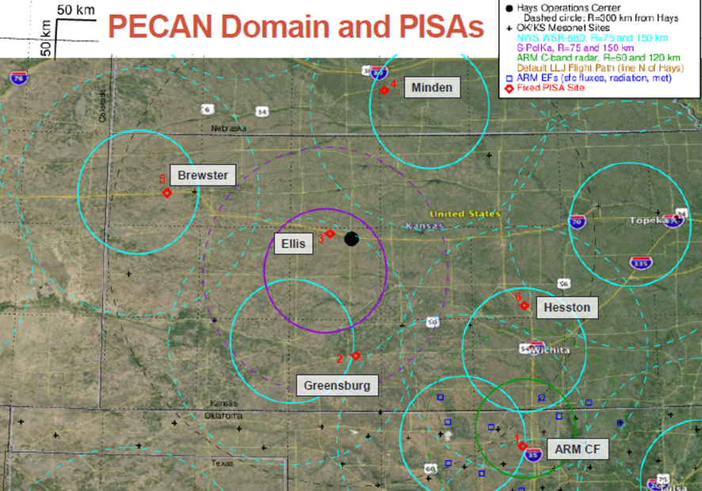
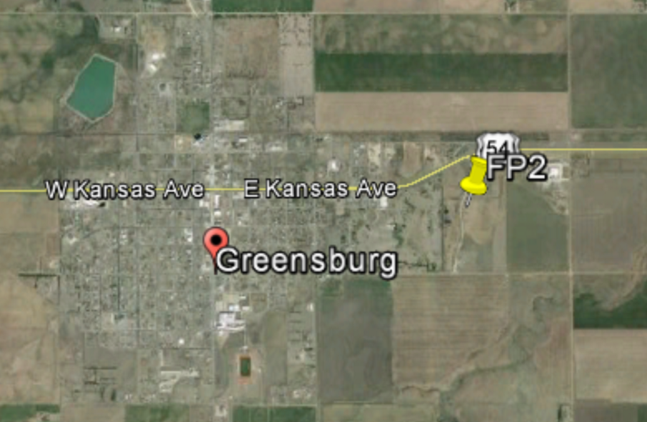
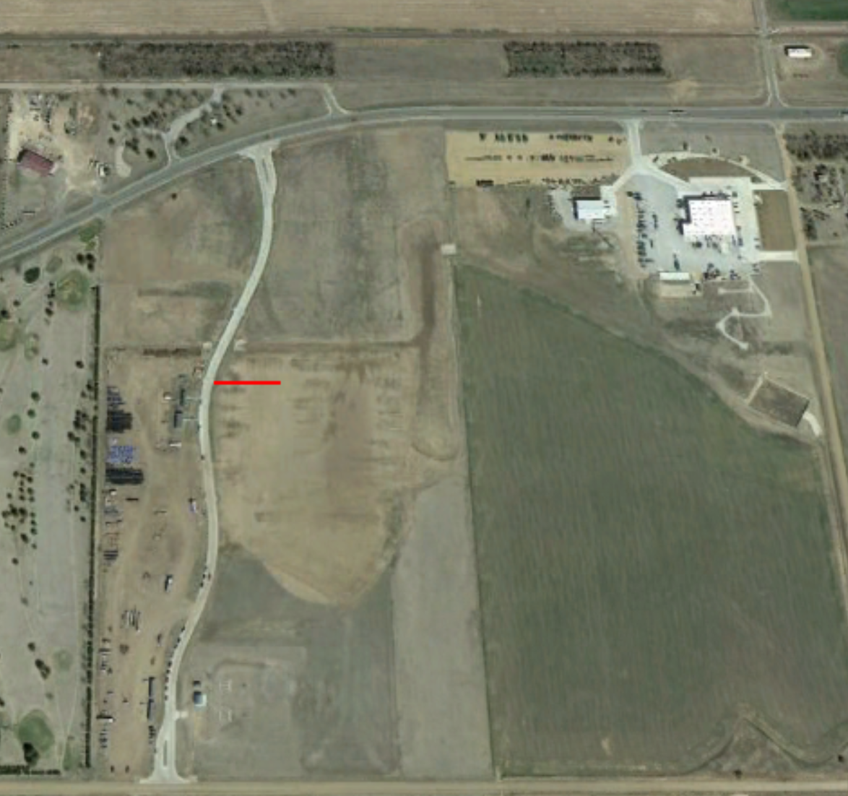
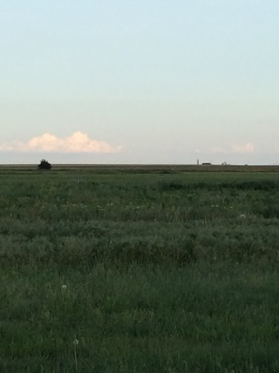
Greensburg KS is at the south west corner of the PECAN domain
FP2 site is on the east edge of the City of Greensburg and is well exposed to ambient environment away from the city for most wind directions.
NPS towers are at a
location with tall grass.
NASA/USMBC site
SODAR
16 m Main Tower
6 m flux tower
Ceilometer
3 m scalar tower
Tethered balloon ops
Notes:
Upper left: FP2 location relative to other PECAN sites
Upper right: The FP2 site relative to the city of Greensburg. The site is on the eastern edge of the city, in most of the dominant wind conditions south and south westerly) , the measurements are minimally affected by the tall structure on the city.
Lower right: a zoomed view of the FP2 site and the setup of the NPS measurement components: three towers of different heights, a SODAR, a tethered balloon system, and the laser ceilometer (for cloud base height detection).
Lower left (small picture): the grass field over which the meteorological measurements are made. The region can be considered horizontally homogeneous unless in westerly wind conditions.

Slide 3
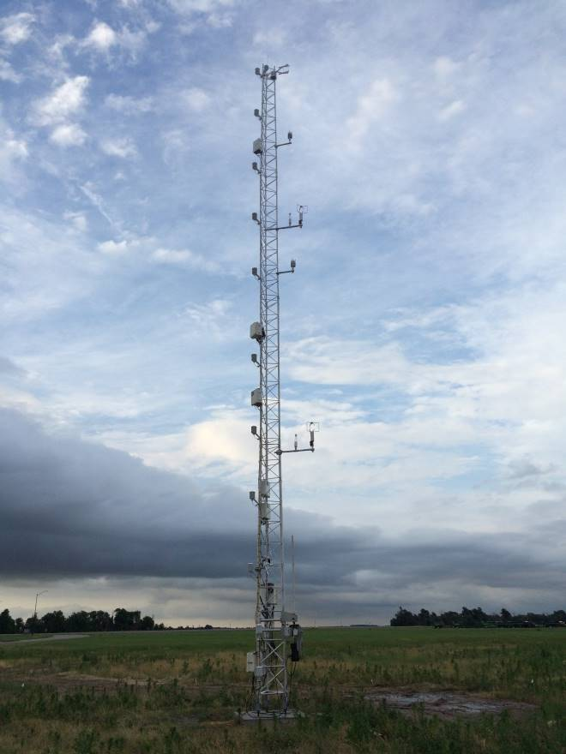
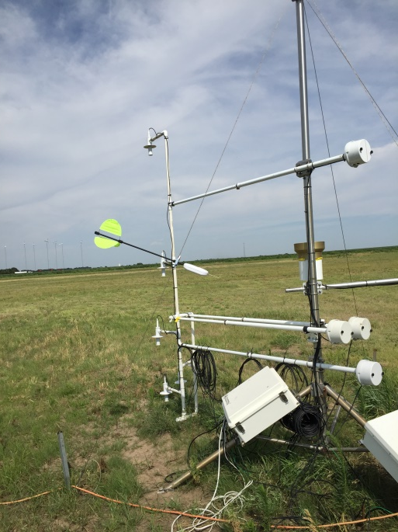
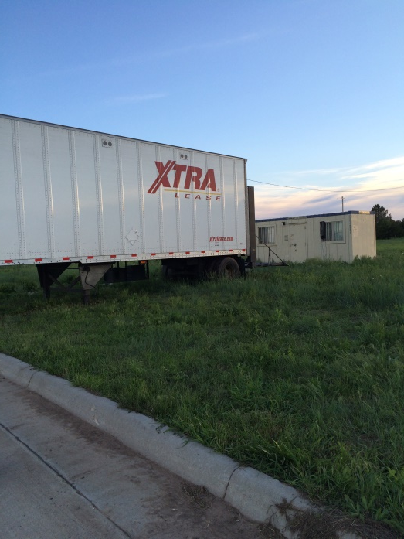
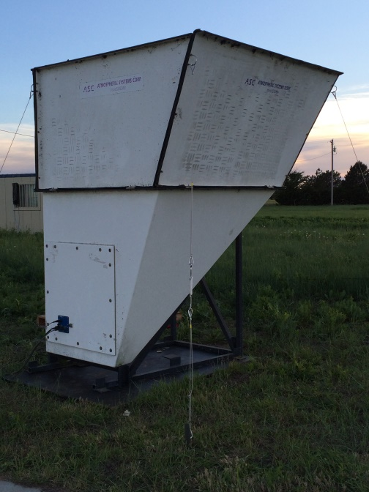
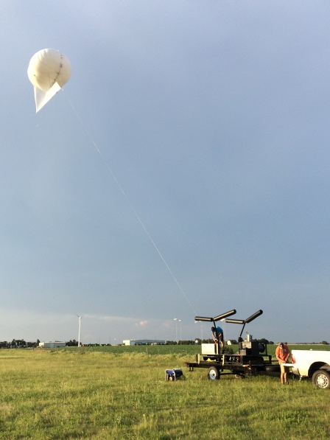
NPS Measurement Components at FP2
3-m scalar tripod
16-m main
mast
6-m tripod
Aspirated T/RH
3-m scalar tripod
storage
Tethersonde calibration
Office
Tethered balloon and mooring trailer
SODAR
Rawinsonde launches by UMBC (University of Maryland, Baltimore County) and NPS
Notes:
Pictures of all NPS components:
The 16 m high main tower, and the 6 m and 3 m supporting towers. 6 m flux tower has redundant turbulence measurements in the lowest two levels as the main tower, but the small tower sat on the grassland with no concrete base as with the main tower. It was intended for flux measurements at the lowest two levels. The 3-m scalar tower hosted the near surface scalar measurements with aspirated T/RH, solar and longwave radiation, 3-levels of soil temperature, and 2 level of soil moisture measurements. Again, the 3-m tower measurements are needed because of the heating effect of the 4x4 ft concrete base of the main tower. Results from all these sensors will be used for the analyses presented here.

Slide 4
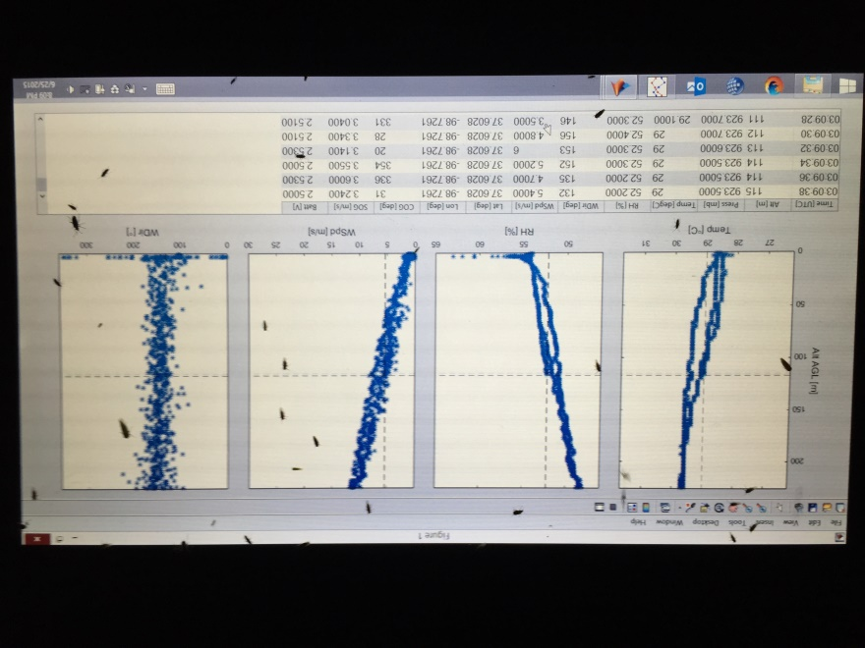
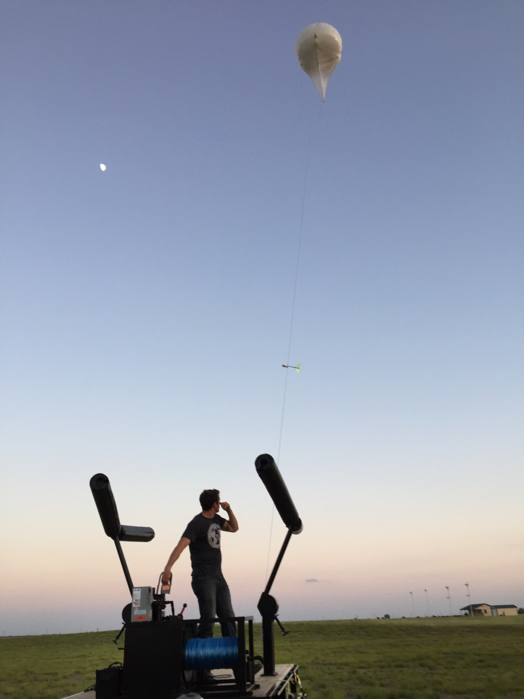
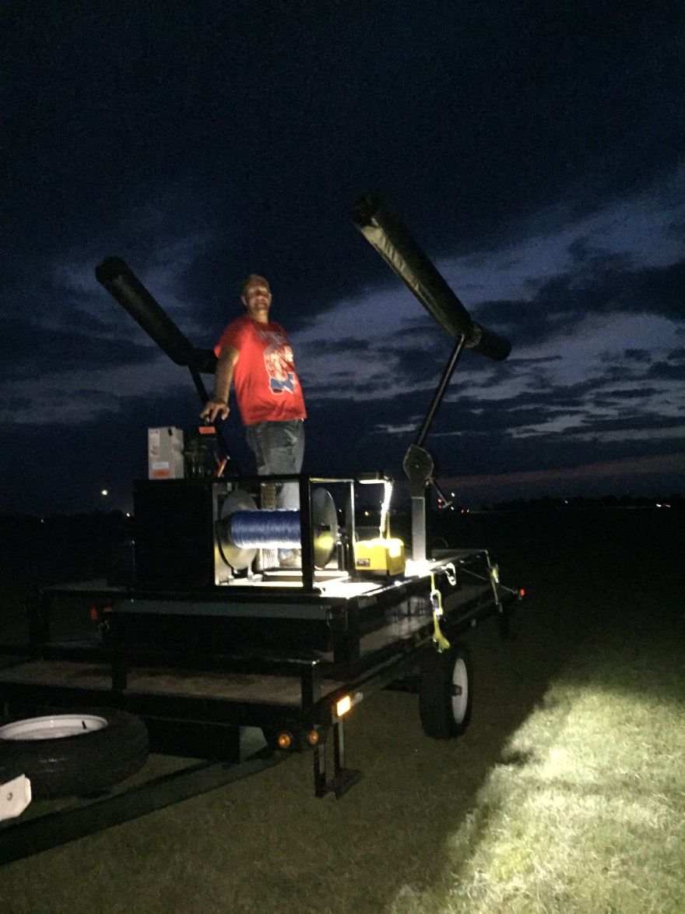
Dusk and night operations
Notes:
All NPS systems run continuously except for the tethered balloon ops and rawinsonde ops for a few days (mostly done by UMBC). Tethered balloon operations normally starts at around 2300 UTC (1800 CDT) and last to about 0300 or 0400 UTC (2200 or 2300 CDT). We initially used Anasphere SmartTether 8.0M flight module (pitot wind). Altitude ranges between 0-450 m. Tethered balloons of different sizes have been tested: 3.3 m3, 16 m3, and 34 m3. We settled to using the 16 m3 Helikite with 3 mm tetherline and the hydraulic winch on the trailer. We later found that the new SmartTether 8.0M had a very slow temperature and RH response and was not suitable for profiling measurements. Starting June 30, we added iMet radiosonde to the tetherline to get T/RH with 1 second respond time, while the SmartTether provided the wind measurements. The operation of the tethered balloon was limited to surface wind of about 10 m (higher wind aloft of course). We found the Helikite tethered balloon became unstable in stronger winds.
Mosquitoes and bugs were a major problem for night operation.

Slide 5
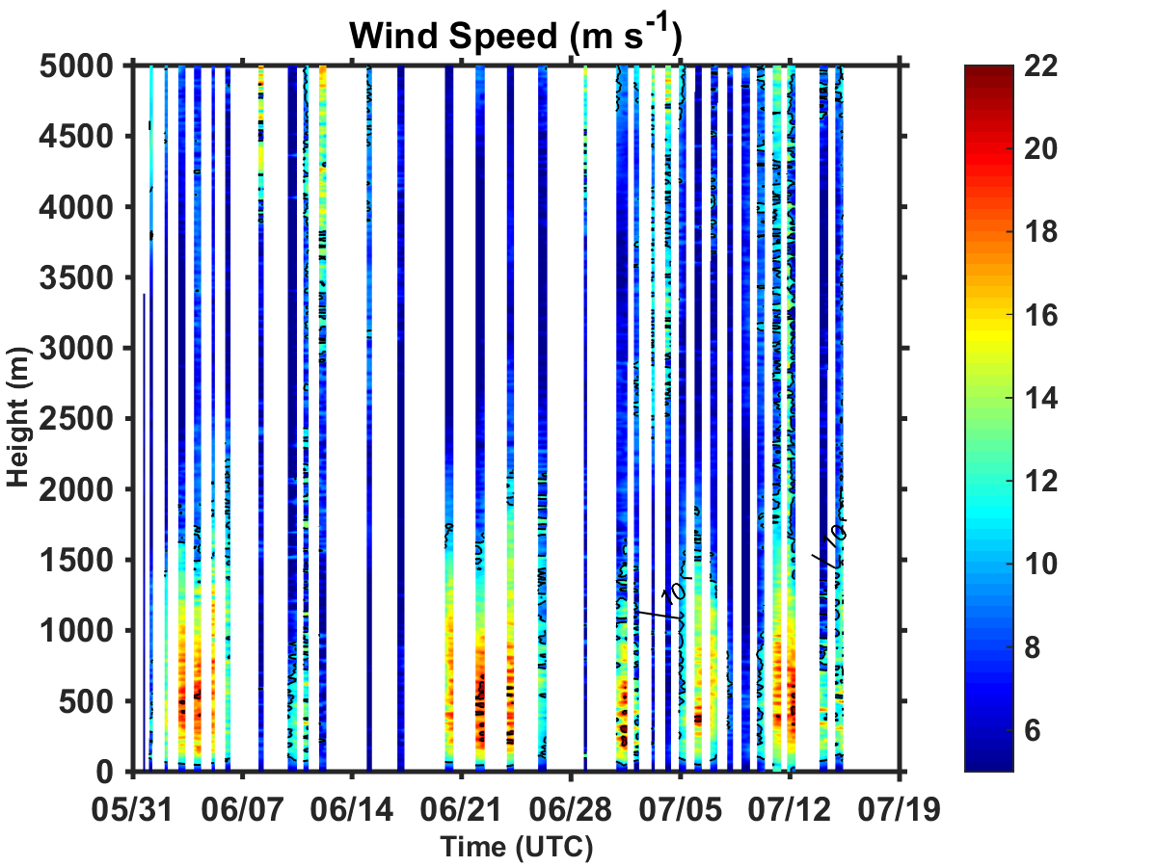
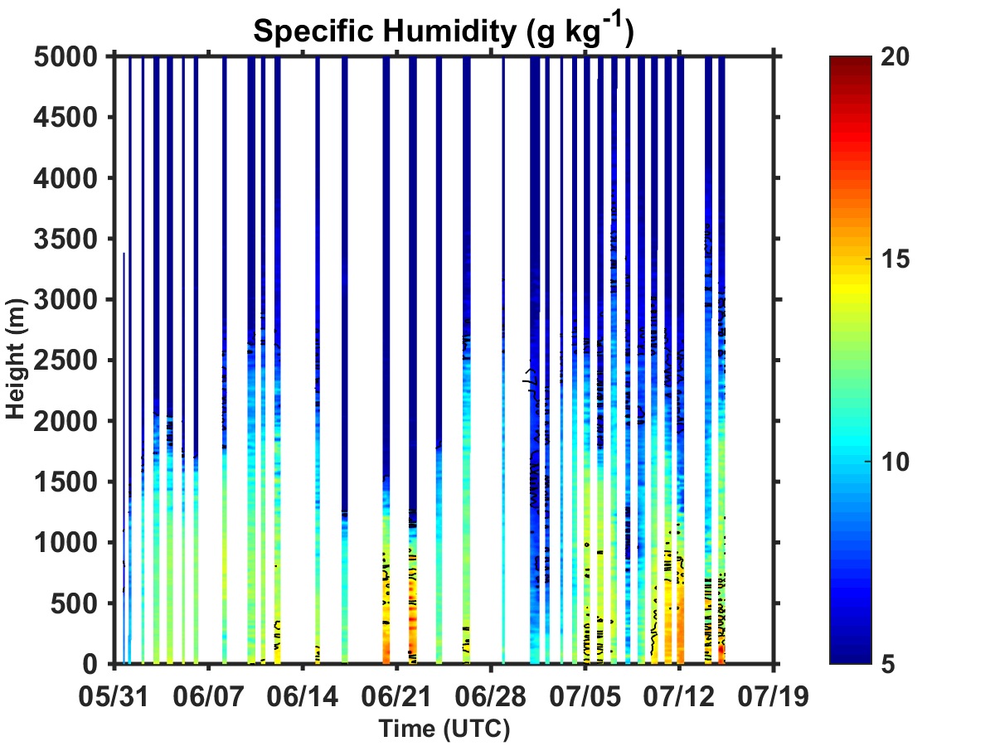
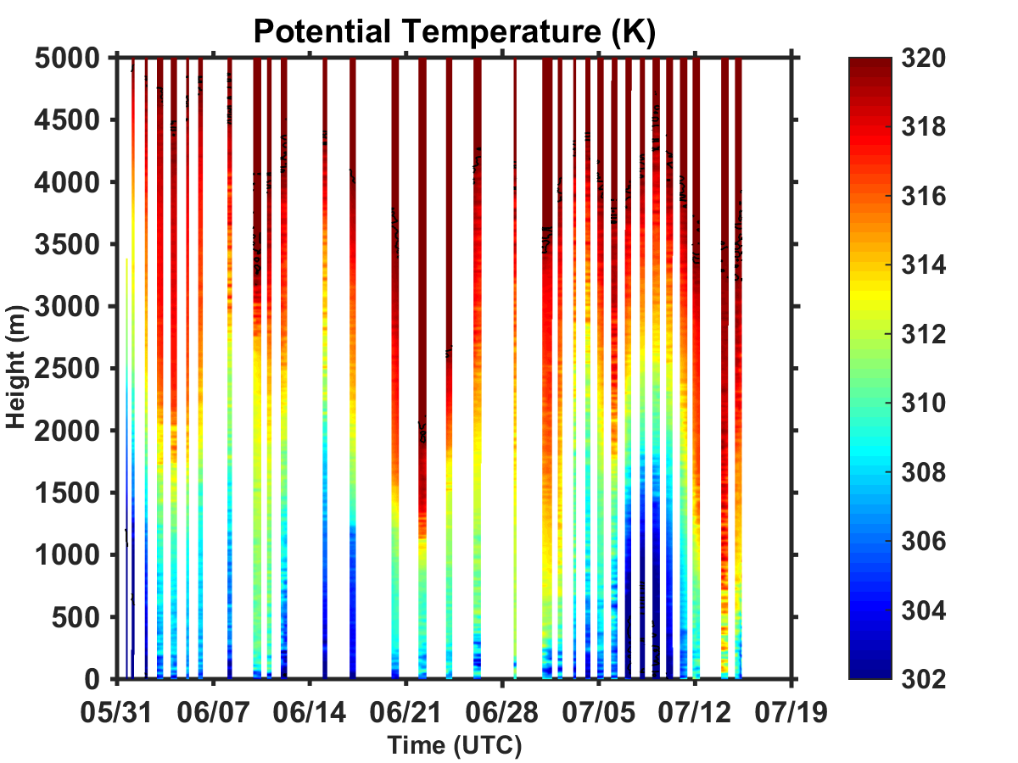
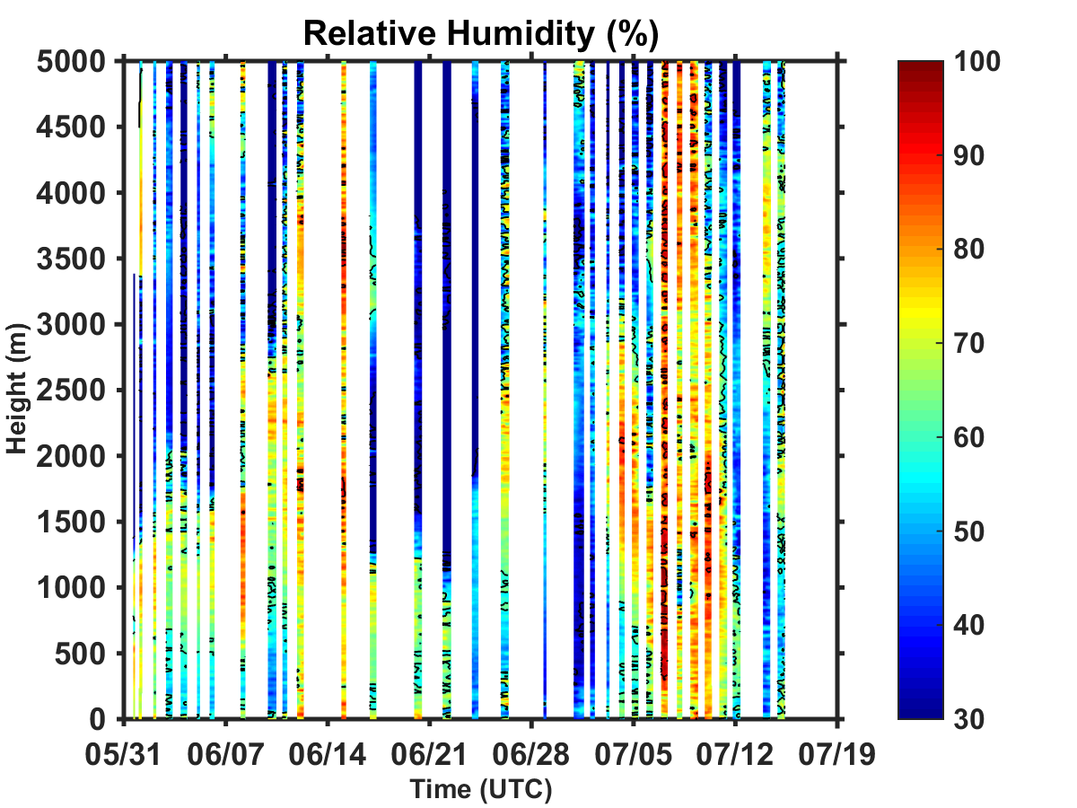
General Atmospheric Properties from UMBC/NPS Rawinsonde Measurements
LLJ top
Moist Layer
LLJ core
Cool Layer
Notes:
First, we’d like to show the general characteristics of the low level atmosphere during the measurement period as seen fro rawinsonde measurements made by the UMBC group at FP2. For the entire period of PECAN, LLJ jet core was at about 500 m, LLJ top was at about 1500 m. The layer below the LLJ top is generally moist and cool compared to the layer above. Note all soundings were nightime soundings. No diurnal variation can be seen in these figures.

Slide 6
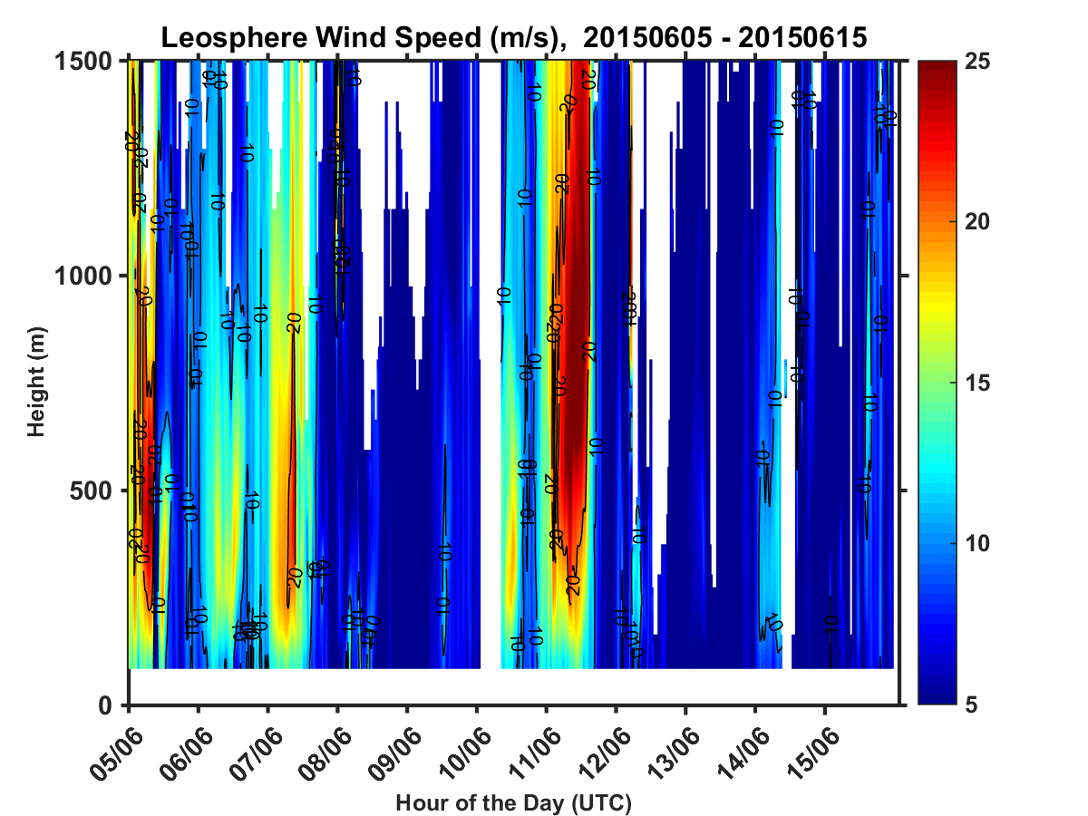
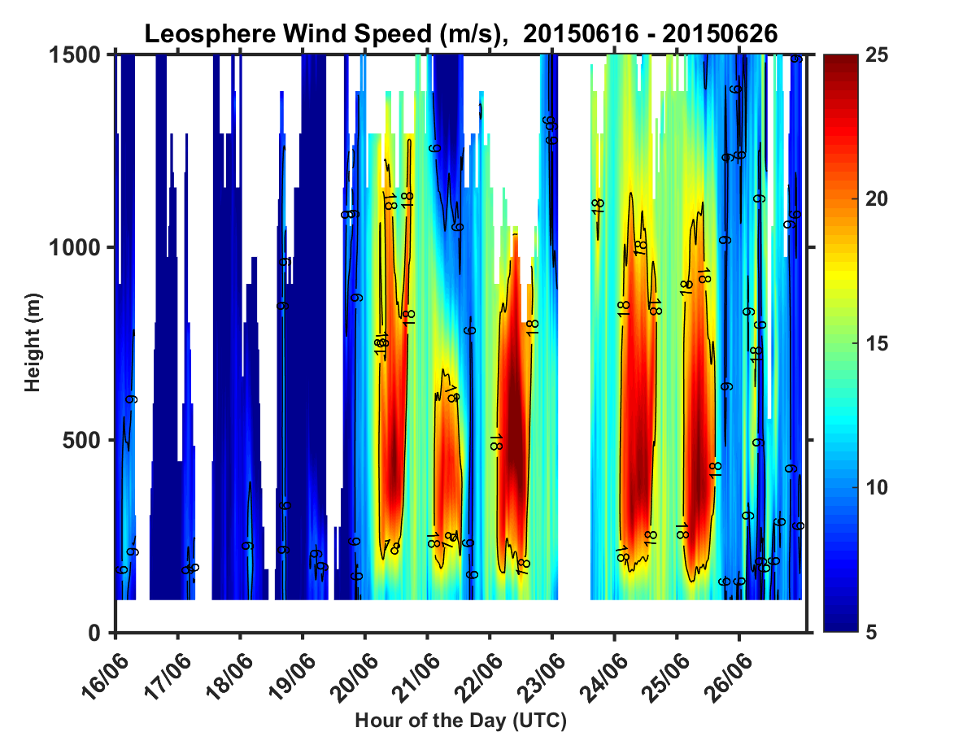
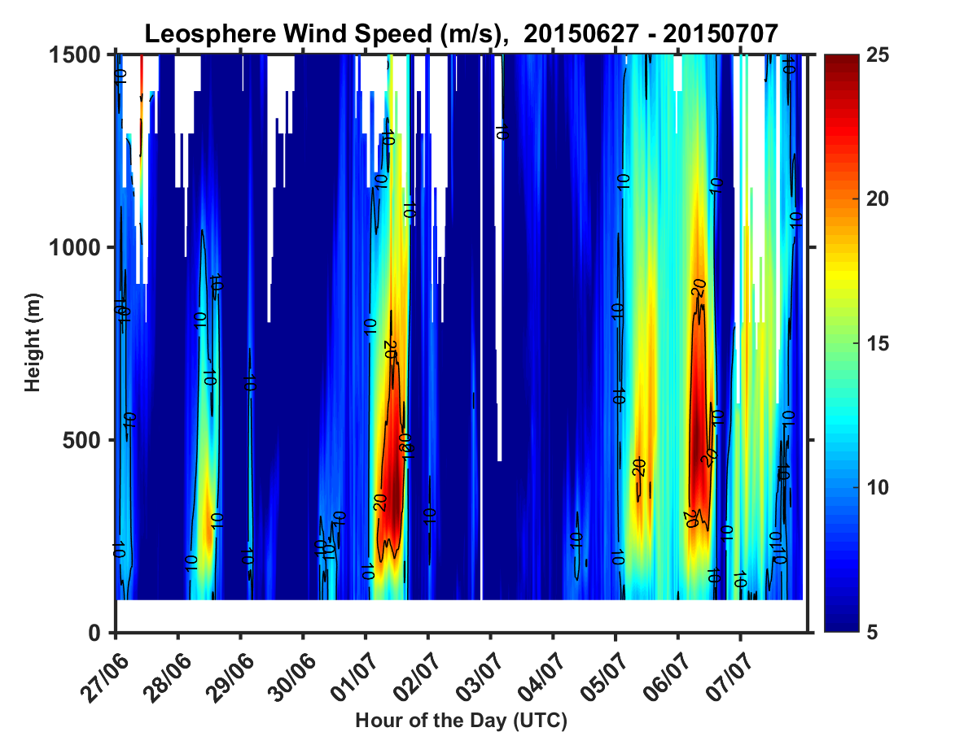
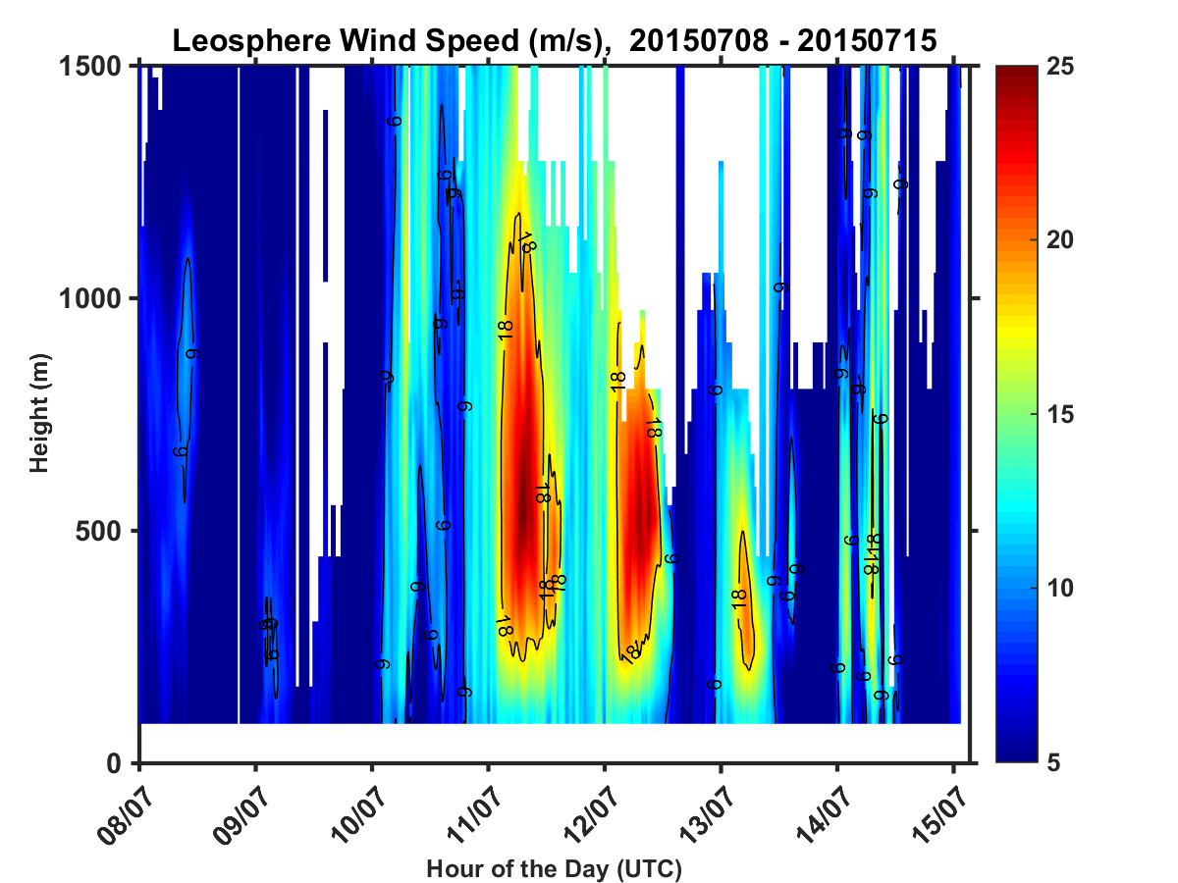
LLJ Observed During PECAN
Notes:
This slides shows the wind speed variation for the entire PECAN observation period made by the Leosphere wind lidar. The lidar monitored the wind profiles continuously throughout the day so that the diurnal variation of the wind field can be seen clearly. The days with a ret dot are the days considered low-level jet days, which will be used in the in the analyses to be shown later. A total of 19 days are identified.

Slide 7
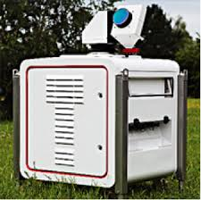
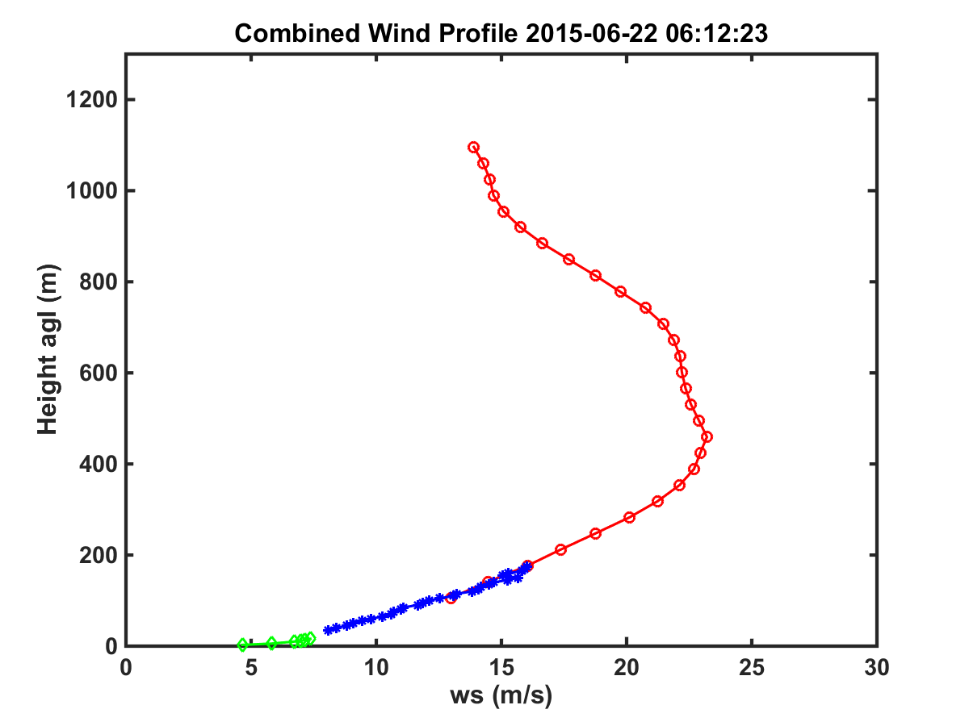
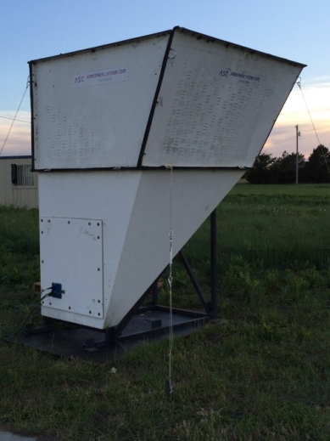
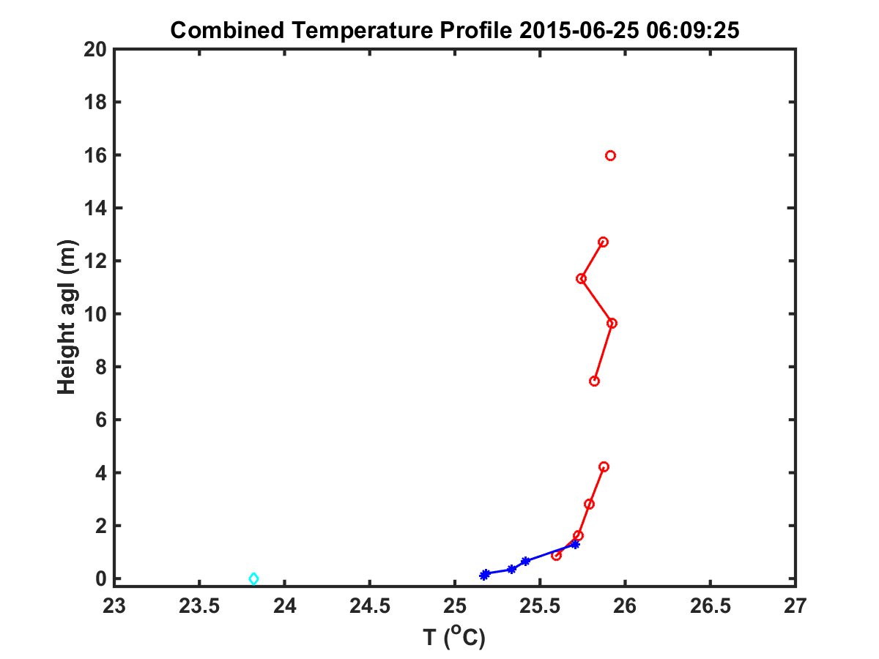
Blending of Measurements for LLJ study
Wind (continuous measurements):
16-m main
mast
6 levels below 16 m
25 to ~150 m, Δz=5 m
70 to ~1500 m, Δz=35 m
Thermodynamics (continuous measurements):
ΔT=T_{16m}-T_{0.11m}
ΔT > 0 : stable
ΔT < 0 : unstable
16-m main
mast
Surface temperature
11 levels T/RH below 16 m
6 levels T/RH below 2 m
Notes:
Since each instrument or platform has its own altitude range, we need to combine measurements from different sensors to obtain a complete picture of the LLJ characteristics and the meteorological parameters involved. For continuous wind measurements, the three components we used are the 16-m tower, the sodar, and the Leosphere operated by UMBC at the same site. We had 6 levels of mean wind measurements on the 16 m tower (2.8, 5.6, 10, 11.3, 14, and 16 m). The NPS SODAR made measurements between 25 and about 150 m at high vertical resolution of 5 m, and the LIDAR made measurements between 70 and about 1500 m with 35 m vertical resolution. The right figure shows an example of the combined wind profile from the surface to the top of the LIDaR measurements.
For continuous temperature profiles in the atmospheric surface layer, we used the data combined from the 16 m tower (11 levels) and the scalar tripod near by (6 levels temperature /RH between 11 cm agl and 2.5 agl). The scalar tripod was added because the 16 m tower had to be setup on a concrete pad for stability. The near surface measurements were thus affected by the concrete. The lowest level os measurements should thus com from the measurement based on the tripod. The IR irradiance measurements were used to derive the surface skin temperature shown in the temperature profile (cyan diamond).
The surface layer thermal stability can be represented by the temperature difference between the top level on the mast and the lowest air temperature measurements at 11 cm agl. We will use this quantity as a simple way to denote surface layer thermal stratification.

Slide 8
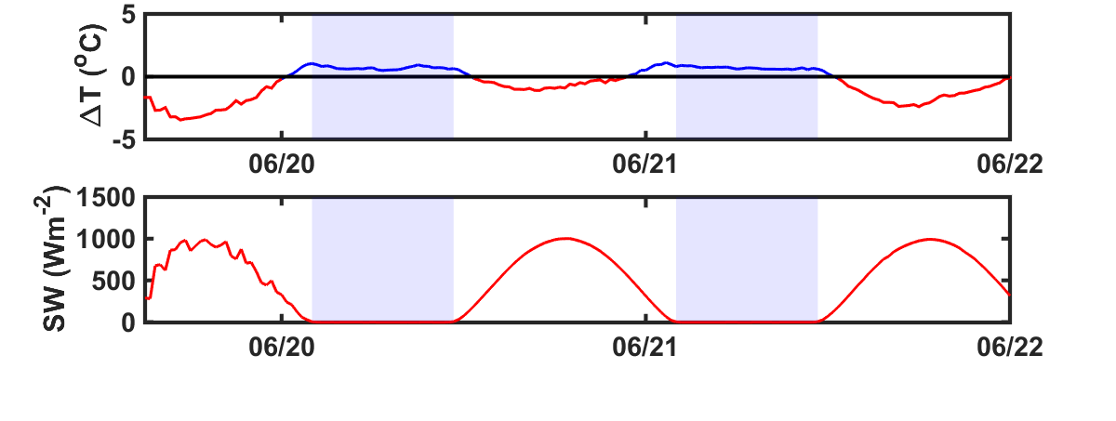
Surface Layer Thermal Stratification and Sunrise and Sunset time
ΔT > 0 : stable
ΔT < 0 : unstable
Greensburg KS in June/July :
Sunrise: 0620 CDT (1120 UTC)
Sunset: 2100 CDT (0200 UTC)
Solar downward irradiance measurement corresponds well with sunset and sunrise time.
Stable surface layer starts 1-2 hours before sunset and ends ~1 hours after sunrise.
Notes:
This slide shows the variation of surface layer thermal stratification in a three day period. Sunrise and sunset time correspond well with downward solar irradiance measurements (SW). As expected, we have unstable stratification during the day and stable stratification at night. However, if we strictly define ‘day’ and ‘night’ based on sunrise and sunset time, we can see there are substantial differences in time. In this example, the stable boundary layer is between 0030 and 1233 UTC on June 21, and 2250 June 21-1235 June 22, bordered by the line blue line. The surface layer becomes stable thermal stratification 1-2 hours before sunset and remains stable stratification for about 1 hour after sunrise. This difference may be affected by many factors including the amount of water vapor in the air and in the soil surface (which changes IR cooling). may explains that some of the LLJ were observed to develop before sunset.

Slide 9
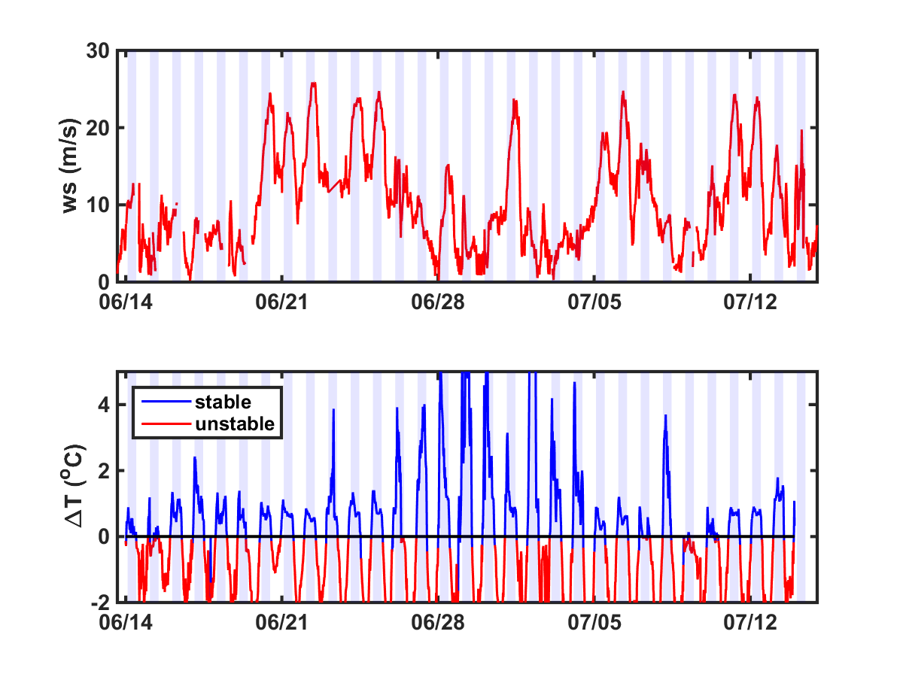
LLJ and Surface Layer Thermal Stratification (Night and Day)
ΔT > 0 : stable
ΔT < 0 : unstable
Nighttime strong wind between 425 m and 601 m LIDAR level corresponds
to weak ΔT (T₁₆-T_{0.11})
Notes:
This slide shows the mean wind between 425 – 601 m measured by the LIDAR to denote the strength of the wind. Higher values of this vertically averaged wind speed normally correspond to presence of LLJ. The bottom figure shows the temperature difference betwee 16 m and 0.11 cm level measured from the two towers. It is interesting to find that the LLJ cases mostly correspond to small deltaT, or less stable surface stratification. LLJ does not seem to present when deltaT is larger than nominally 2.

Slide 10
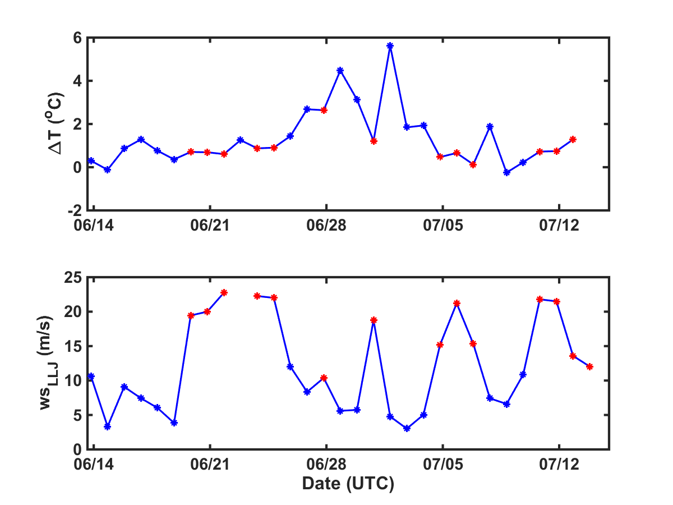
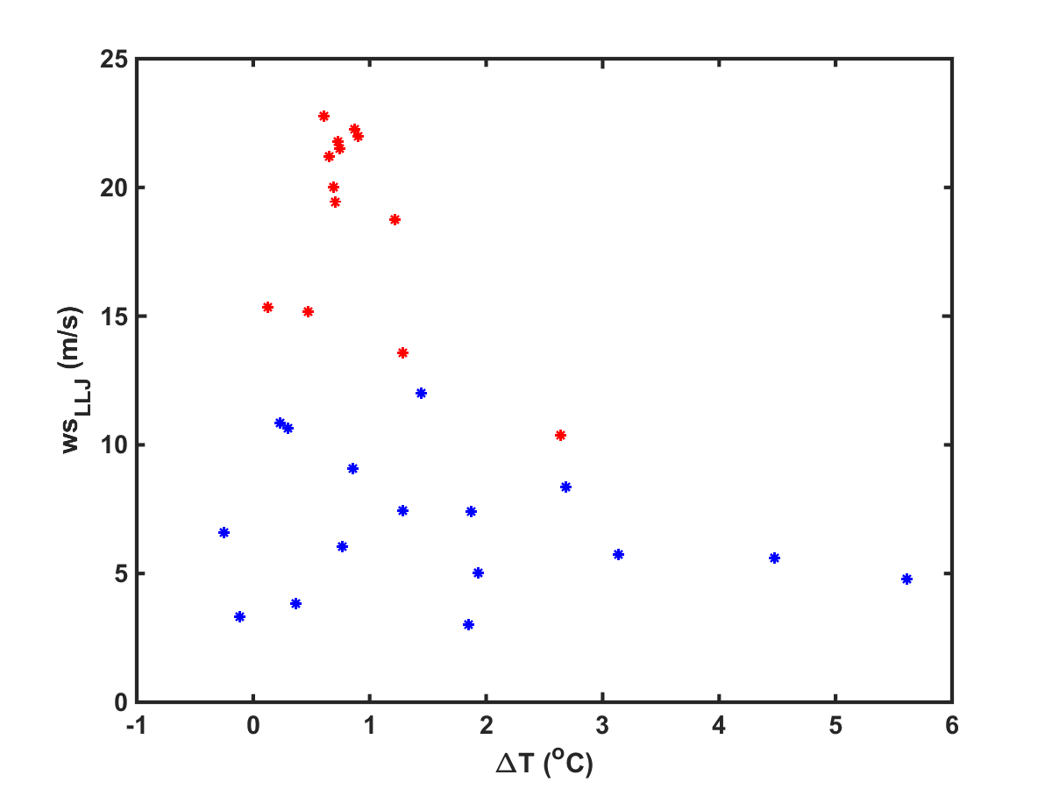
LLJ and Surface Layer Thermal Stratification (Night-Averaged Only)
ΔT: night time averaged temperature difference between 16 m and 0.11 m
WS_{LLJ}: nighttime averaged wind speed between 425 and 601 m from the Leosphere LIDAR
Strong LLJ occurs on nights with weak surface layer inversion.
Strong LLJ nights have ΔT generally less than 2, with one exception on June 28, the weakest observed LLJ in PECAN
Notes:
The LLJ and the night time stability are further examined in these figures. The left figure shows again the mean wind speed between 425m and 601m LIDAR levels, but was further averaged for each day at night between sunset and sunrise. This wind speed is referred to as the LLJ wind speed, which will be used to discuss the impact of LLJ on surface fluxes. The deltaT is also averaged through the night. Red symbols denote the LLJ cases identified earlier. The scatter plot shows clearly that all LLJ cases were found in weak inversion of the surface layer. The one exception (circled) is the weakest jet case as seen in the figure to the left.

Slide 11
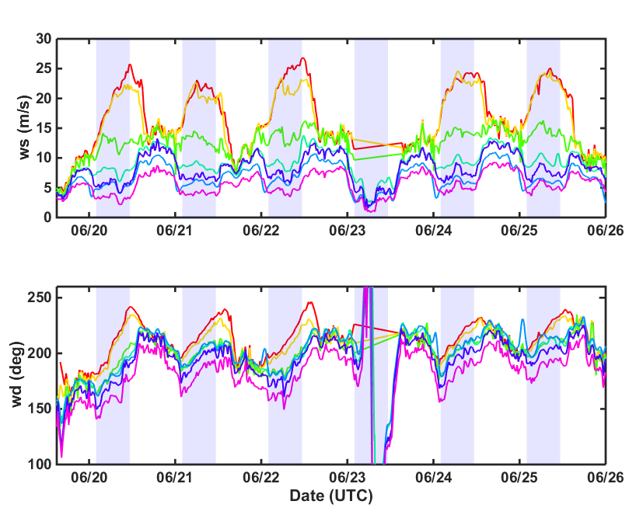
Altitude Variability in LLJ Wind
Surface layer wind speed and the upper layer wind are almost out of phase in their time evolution.
Surface layer wind direction follows the upper air trend well with the expected veering.
Notes:
We now would like to show the evolution of the LLJ at different height from the composite measurements from multiple sensors. This figures shows the time evolution of the mean wind at a few representative levels below 500 m. The top panel shows the wind speed, the low panel shows the wind direction. We chose to show June 20 to June 26 because of the multiple cases of LLJ during this period.
Here we first see the increase of wind speed above 300 m around sunset. On June 20, the increase of wind speed started before sunset. At 100m and 50 m level, the variation of wind speed is not significant. Close to the surface, we observed decrease of the wind speed at the onset of jet development. The increase in ws at the lower levels was much delayed. These few cases seem to show that the surface wind is nearly out of phase with the jet core level wind. We observed surface layer wind increased after or a little before sunrise when the jet core wind speed rapidly decreasing after sunrise.. During the daytime, the boundary layer above 100 m seems to be well mixed while there are still persistent wind shear in the low levels.
In wind direction, the surface wind seems to be in sync with the jet core wind with veering wind with height and with time persistently observed on all southeasterly LLJ days.
We are not clear yet on the explanation of the different ws behavior in the surface and aloft. It is also not clear what the altitude is for the separation. It is desirable to perform a momentum budget analysis.

Slide 12
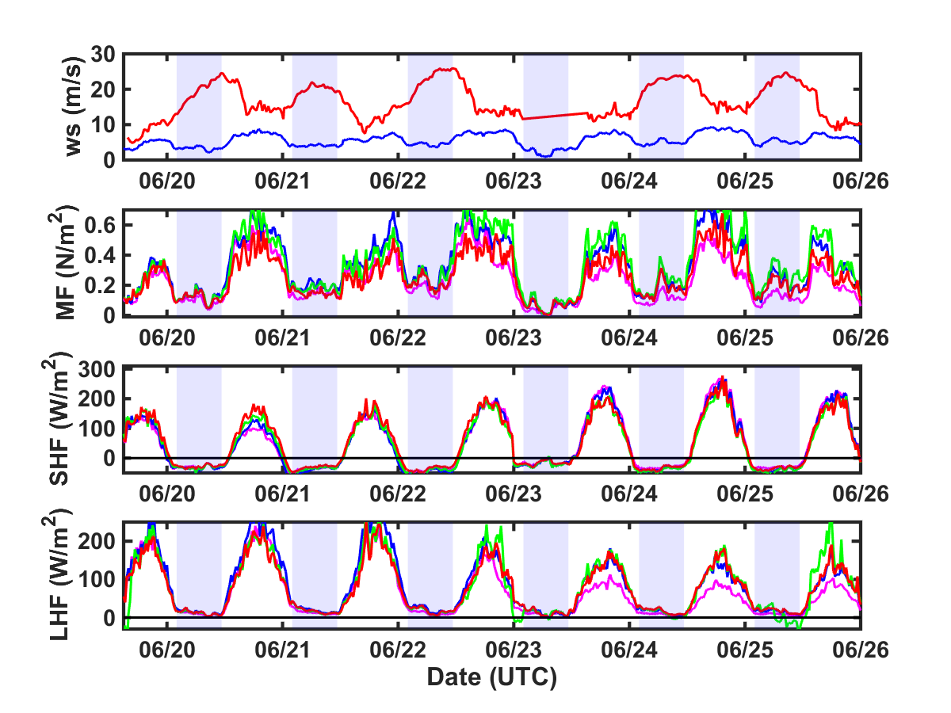
Overall Surface Flux Diurnal Variations
Notes:
NPS made high-rate turbulence measurements at four levels on the 16 m tower. This slide shows the variation of surface fluxes on momentum, sensible heat and latent heat flux on a few days with LLJ. THe full ranges of the three fluxes are shown here. The diurnal variations of all fluxes are clearly shown. As expected, the nighttime SHF are negative and in much smaller magnitude than the daytime SHF.

Slide 13
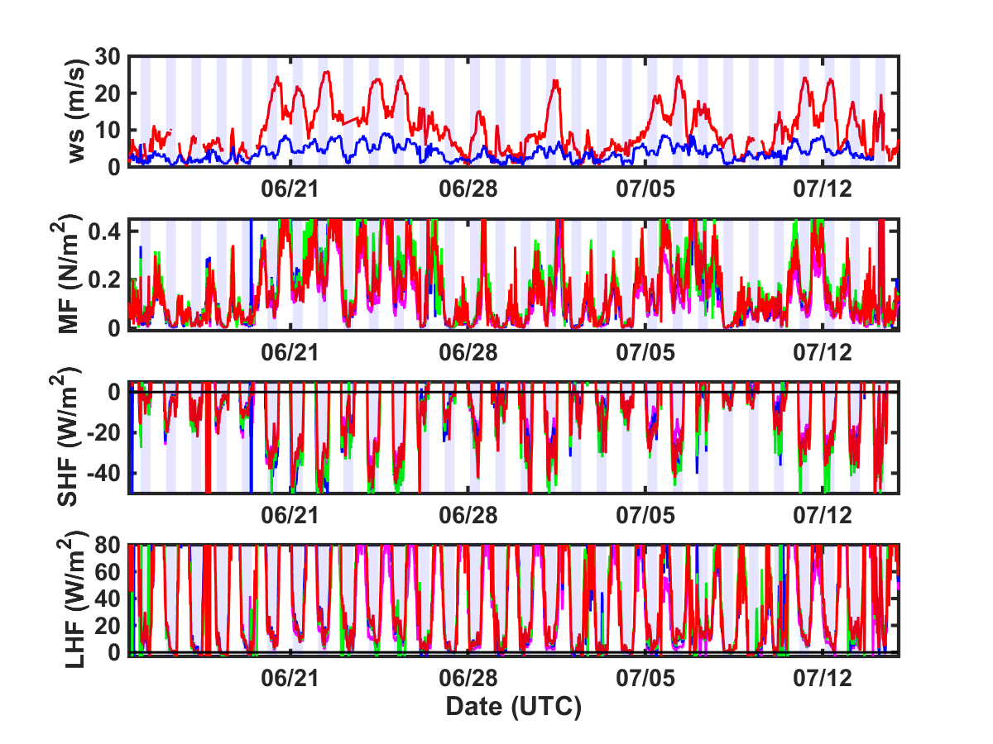
LLJ Development and Surface Fluxes
Flux enhancements on nights with LLJ
Notes:
This slide further shows a comparison of the surface fluxes on nights with and without LLJ.

Slide 14
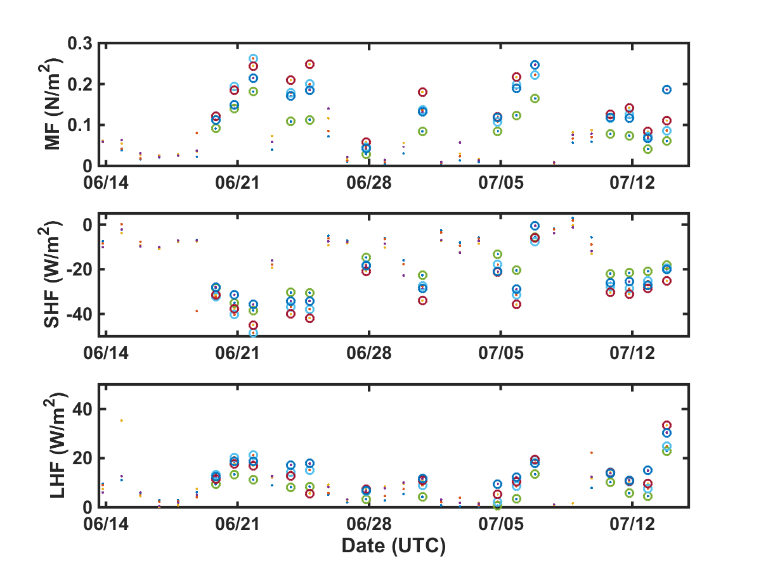
LLJ Development and Surface Fluxes
Nighttime averaged fluxes
Circles denote nights with LLJ, colors refer to different levels
Notes:
We now shows the nighttime mean fluxes only for easier comparison. Again, enhancement in all thress fluxes are apparent.

Slide 15
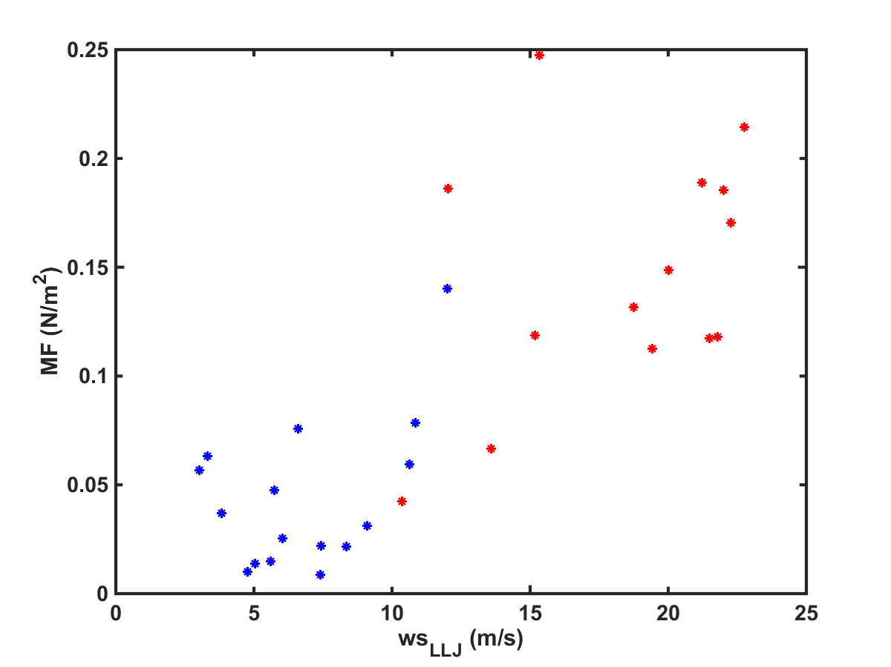
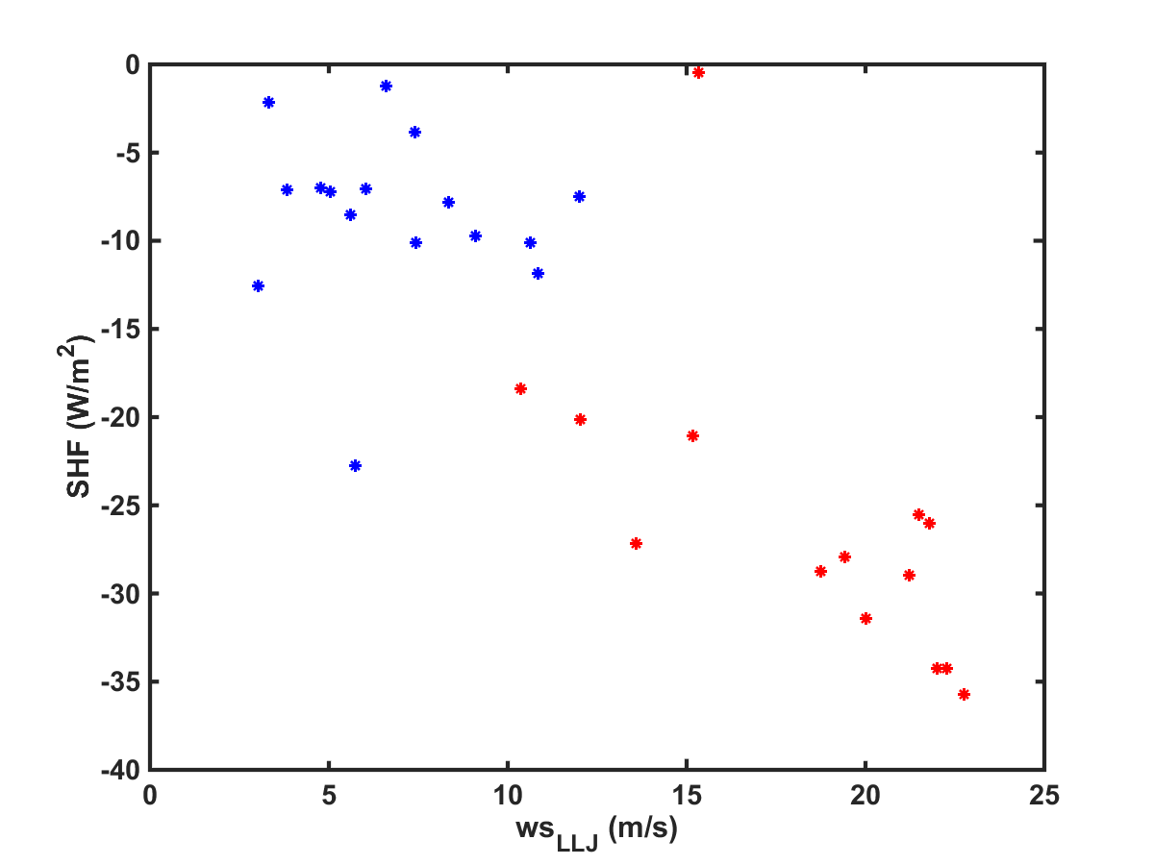
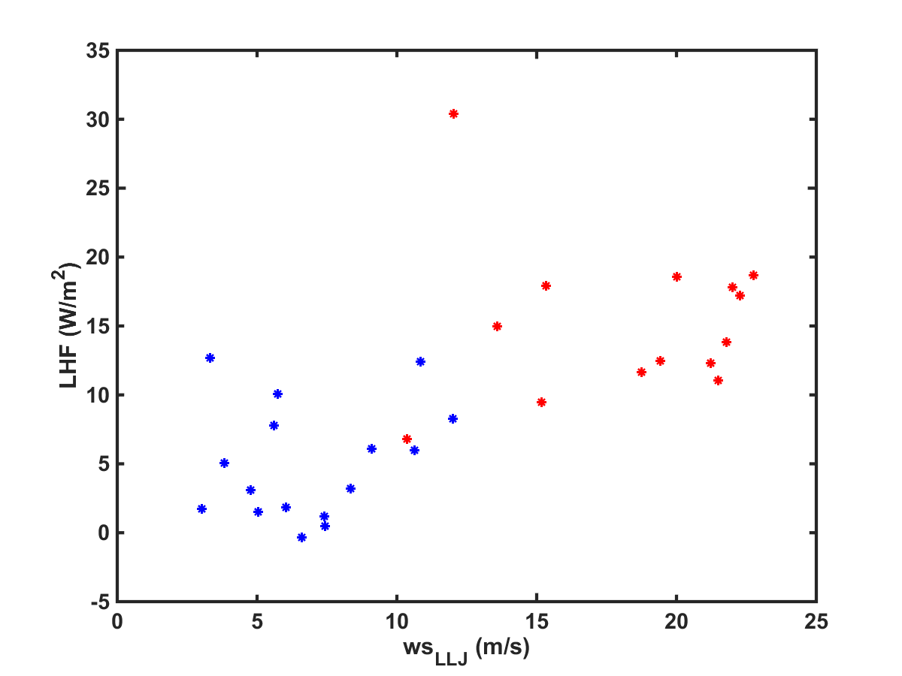
LLJ Development and Surface Fluxes
Blue non-LLJ case, red LLJ cases
The fluxes are from the lowest level on the 16 m tower.
Nighttime LLJ enhanced surface fluxes are apparent in these figures.
Notes:
This figure shows the scatter plot of the three fluxes as a function of the LLJ strength defined as the mean wind speed between 425 and 601 m and averaged throughout the nighttime. The magnitude of flux enhancement seem to be related to the strength of the LLJ.

Slide 16
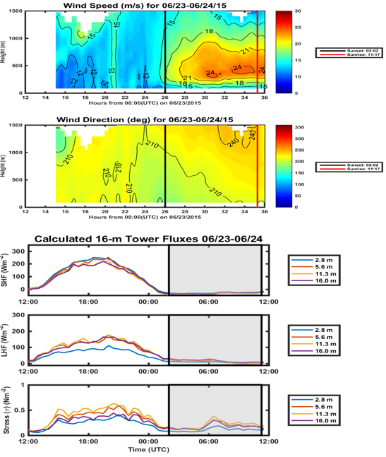
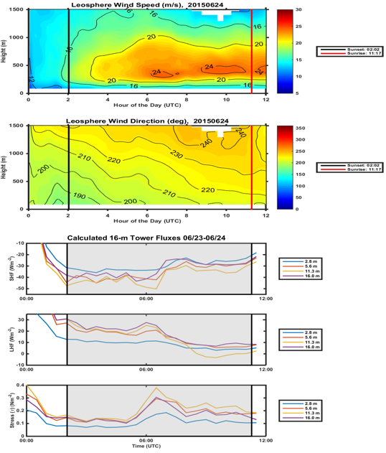
LLJ Development and Surface Fluxes
Notes:
This slide shows flux variations through the night in different stages of the LLJ using one example on June 24. The left figure shows the variation of surface fluxes for the entire day, while the left figure zooms into the night during the LLJ development. It is expected that the fluxes drops significantly from the daytime values due to the change of stability. However, the nighttime fluxes do show the change in surface fluxes in respond to different stages of the LLJ development. This subject will be studied in further detail.

Slide 17
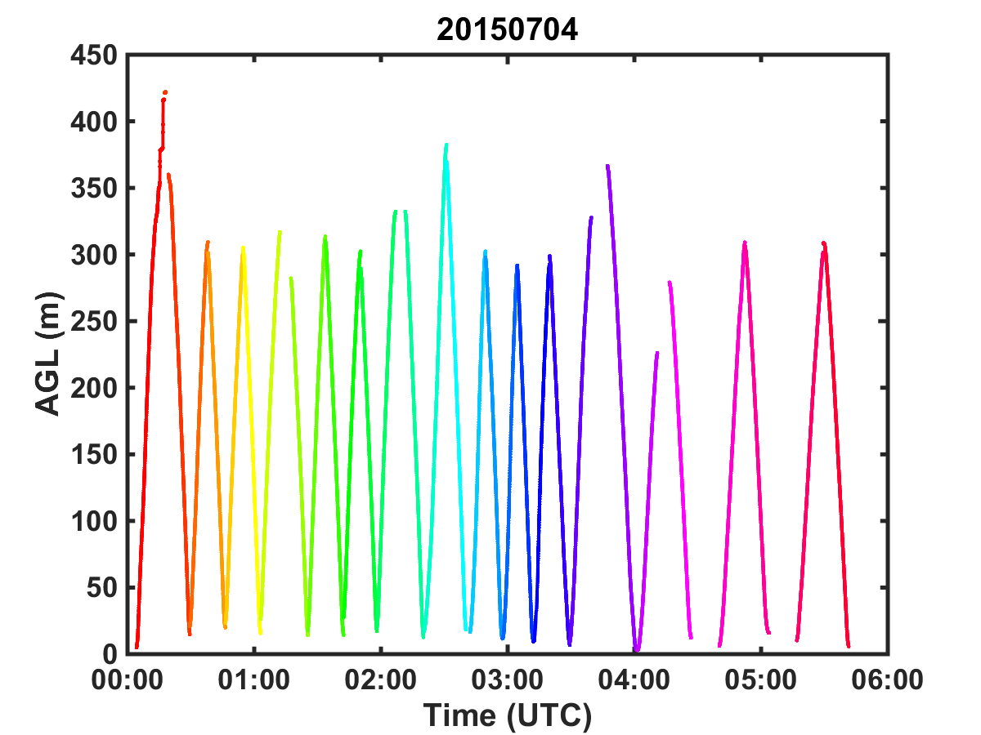
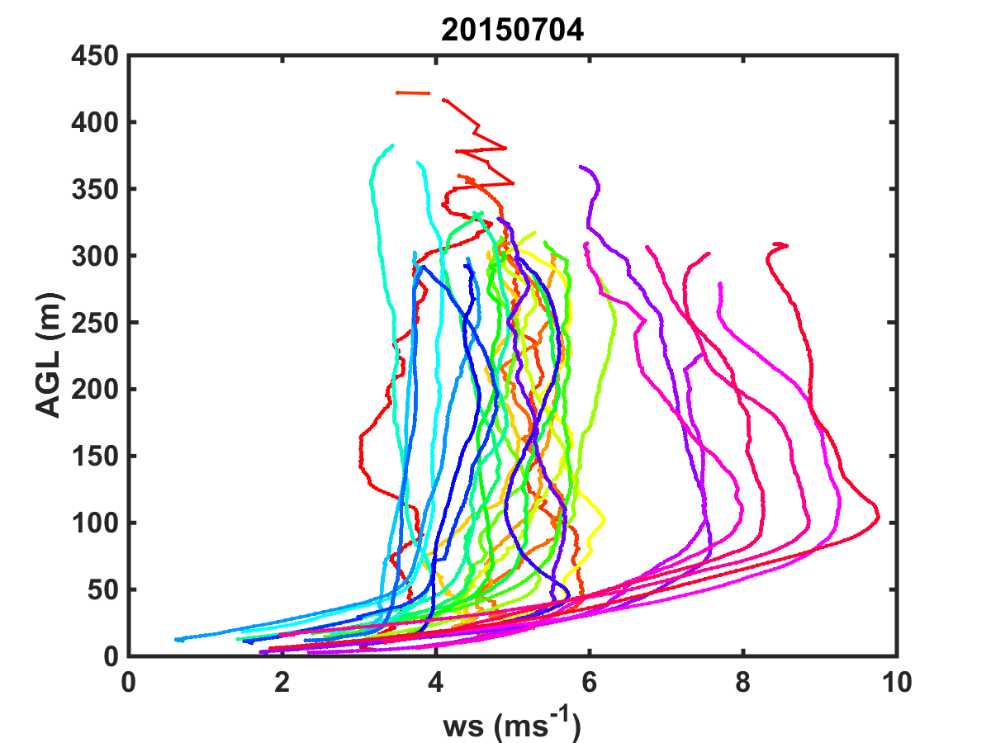
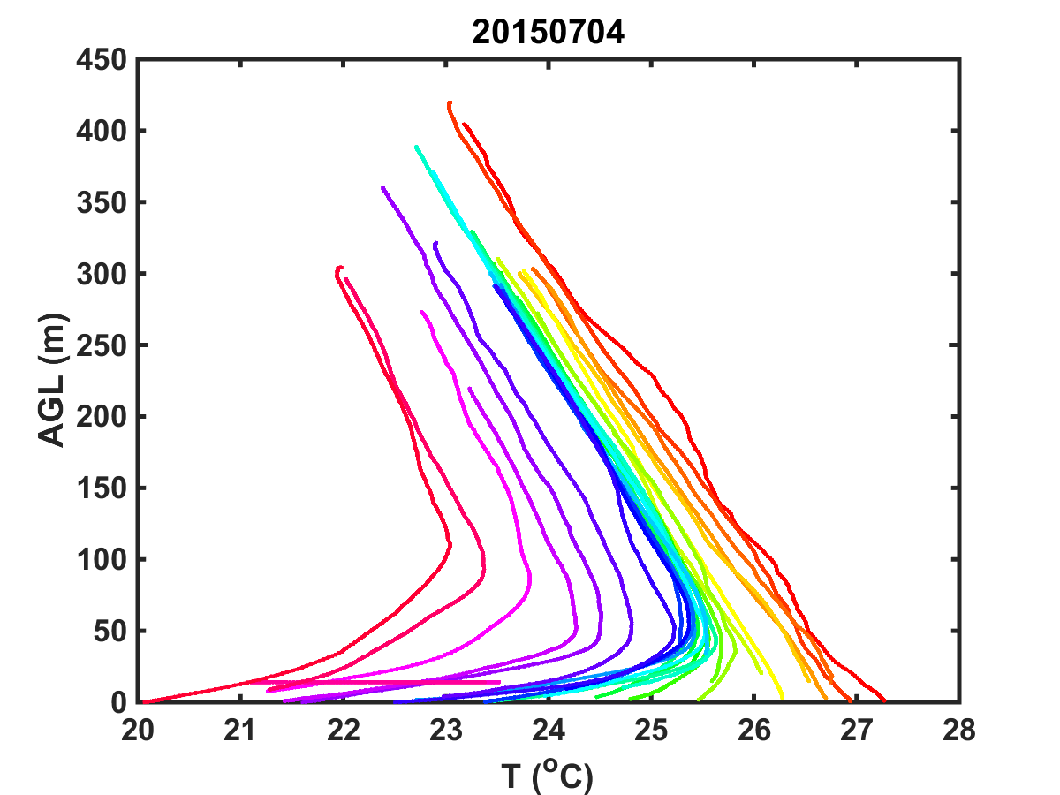
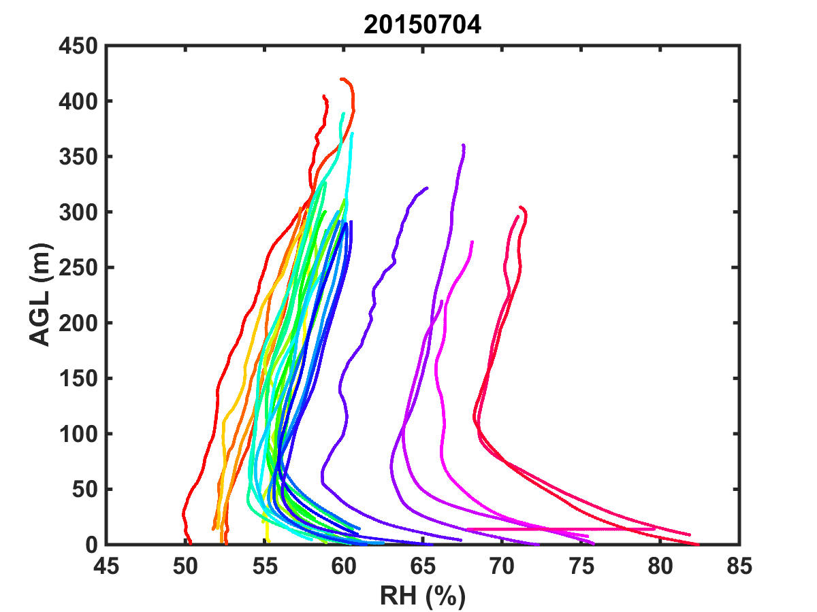
NPS Tethered Balloon Measurements of Evening Transition and LLJ Development
0100: unstable daytime convective BL to stable BL transition
0340: rapid development of LLJ
T decreases and RH increases as LLJ develops.
Time
Time
Slow evolution
Quick
evolution
Quick
evolution
Notes:
Now we’d like to show the temperature and humidity variability during nighttime wind deelopment seeing from the NPS tethered balloons. This is not a PECAN typical LLJ case, but the developement of the boundary layer wind and the corresponding variations in T/RH maybe helpful to our understanding of the nocturnal boundary layer. The NPS tethered system made continuous profiling on selected days from dusk to midnight to sample the boundary layer evolution of the boundary layer. Two transitions of the BL were identified: the unstable to stable BL transition at 0100 UTC (1900 CDT), and the rapid development of LLJ at 0340 (2240 CDT). Decrease of nighttime temperature is accompanied with the LLJ development resulting in rapid increase of RH in the BL. In this case, the height of the jet core corresponds well with the top of the stable layer at 100 m height.

Slide 18
Summary and Conclusions
NPS Meteorology Department successfully made extensive measurements at the FP2 Greensburg site with a combination of fixed level tower-based measurements and tethered balloon and SODAR profiling.
The combination of multiple measurements at the FP2 site is beneficial for obtaining a complete picture of BL and LLJ development.
LLJ tends to develop on nights with weak surface layer inversion.
The surface layer wind and in the upper level close to the jet core have nearly opposite trend in the evening development.
The development of the LLJ above enhances surface flux exchanges.
The tethered balloon measurements revealed rapid boundary layer temperature decrease and relative humidity increase during the nocturnal wind development.

