Slide 1




High-resolution EnKF Data Assimilation of Convection Initiation Processes
James Marquis (Univ. of Colorado – Boulder)
Glen Romine (NCAR)
Josh Wurman (CSWR)
Tammy Weckwerth (NCAR)
Jim Wilson (NCAR)
Supported by NSF: AGS-1541624

Slide 2
Sort-of knowns of nocturnal CI Unknowns
Detailed mesoscale environments surrounding events
Triggers of CI without neighboring convection
Non-convective sources of gravity waves
Roles of surface boundaries
Probably elevated
LLJ probably often plays a role (elevated mesoscale convergence)
Gravity waves are presumed to be a common trigger, often radiating from existing convection

Slide 3

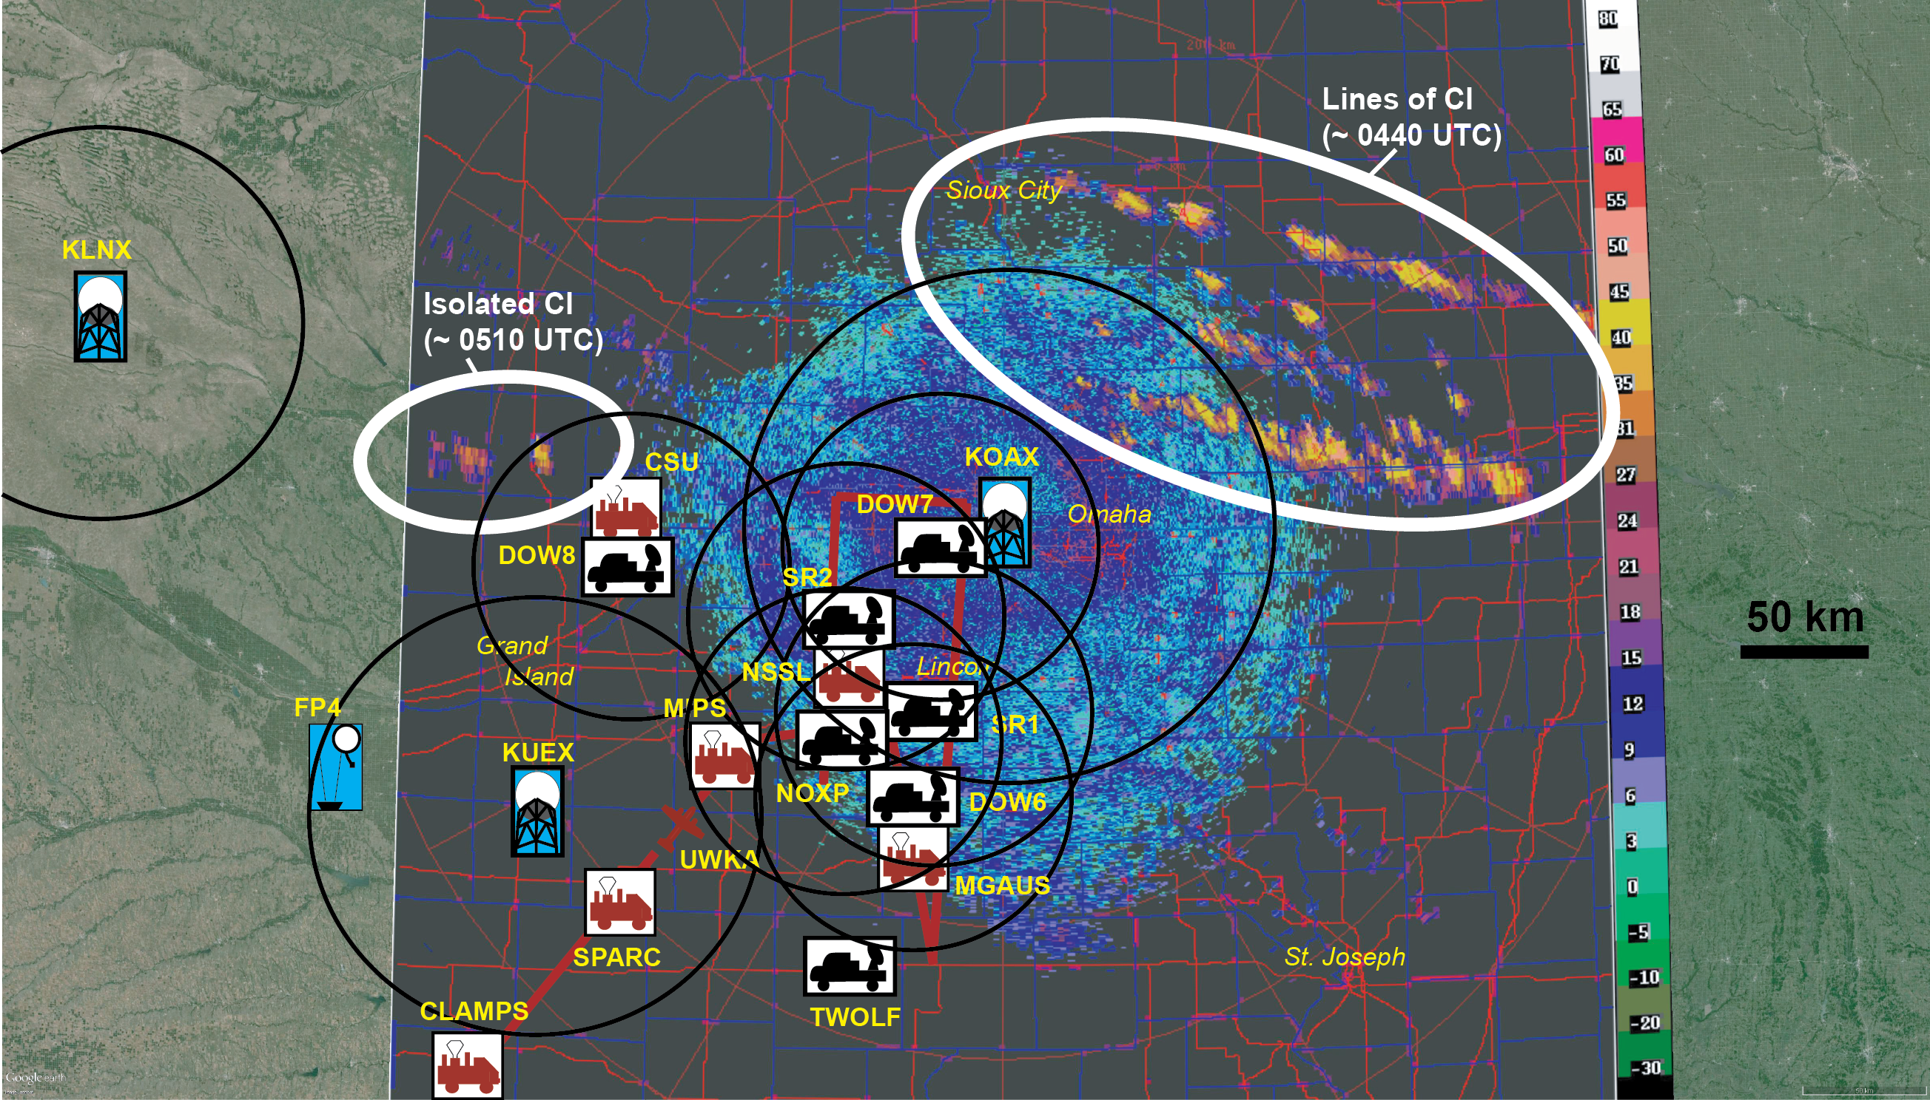
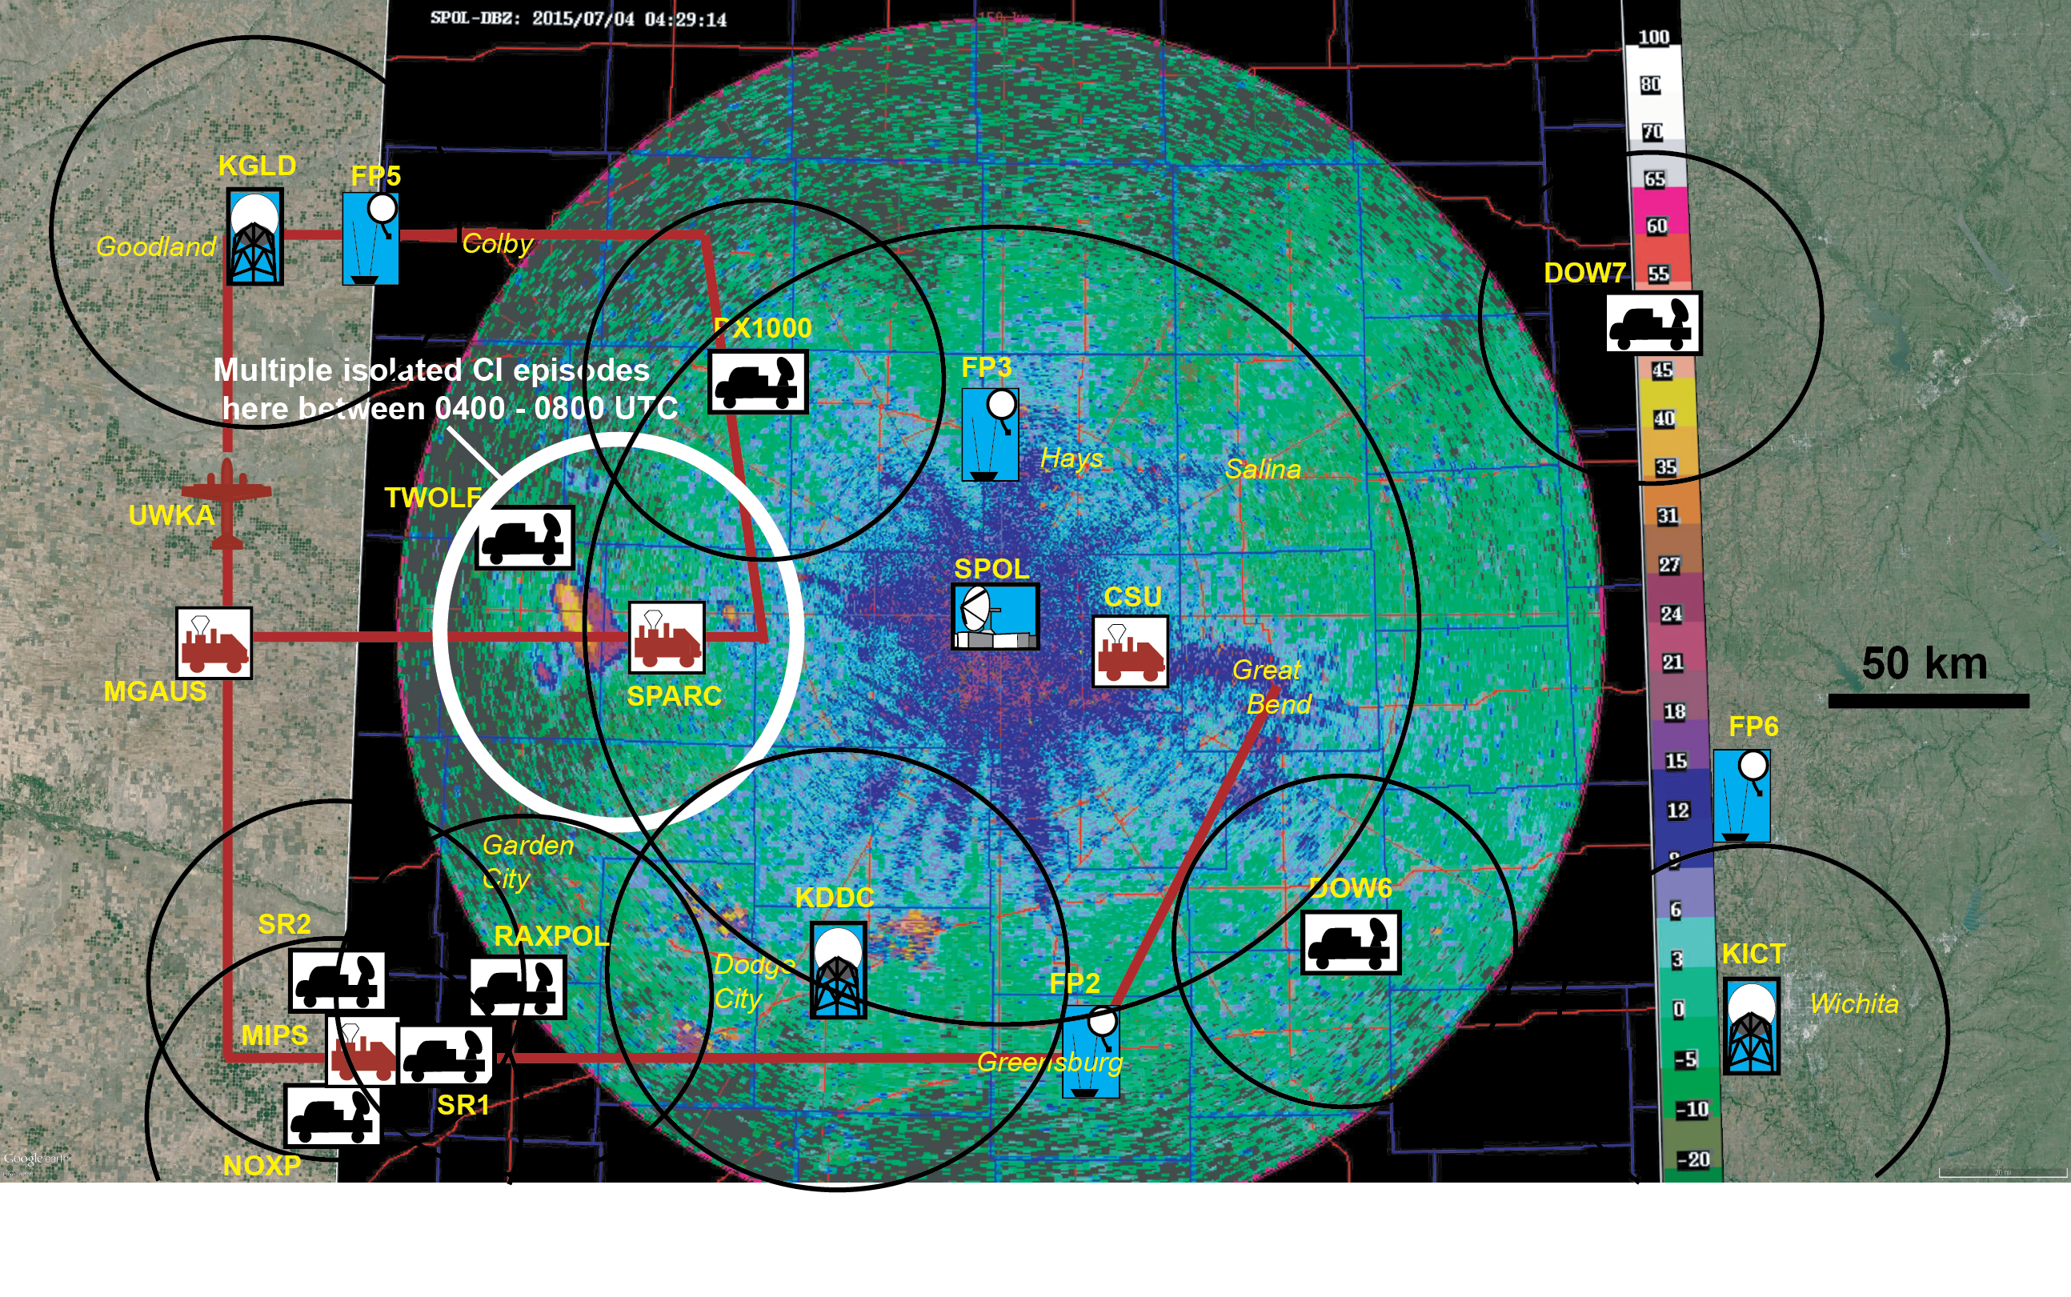
CI missions in PECAN
IOP 6: 7-8 June, Central KS
IOP14: 23-24 June, Southeast NE
IOP18: 3-4 July, Central KS
IOP22: 8-9 July, Southwest/central KS
IOP24: 9-10 July, Southwest/central KS
IOP26: 11-12 July, Central/West KS
IOP29: 13-14 July, West KS
IOP30: 14-15 July, Central KS
UFO2: 14 June, around Hays
UFO3: 19 June, around Hays
UFO6: 20-21 June, around Hays
UFO7: 29-30 June, around Hays
UFO9: 2-3 July, around Hays
UFO11: 7-8 July, around Hays
23-24 June
3-4 July
Notes:
8 CI or CI/LLJ-conjoined missions, with about 6 infamous unofficial ops which casually targeted unlikely CI around Hays.
Many of the (non-joint) CI missions spread out the assets, to supplement the routine observing network and to cast a large net to capture spotty initiation in relative forecast uncertainty.
[explain typical spatial coverage of maps for CI missions]

Slide 4
Motivation
Observations are geographically spaced out (radars, aircraft, PISAs, etc.).
There are several holes in the CI observing network we would like to fill.
EnKF DA is powerful tool for producing mesoscale and convective-scale 3/4D analyses for forecast sensitivity studies.
Ensemble DA analyses and forecasts that ingest PECAN data to fill holes in obs network and integrate into one analysis.
e.g., EnKF and dual-Doppler comparison of VORTEX2 supercell
Marquis et al. (2014)
Notes:
Rather than traditional use of da of forecast ics,

Slide 5
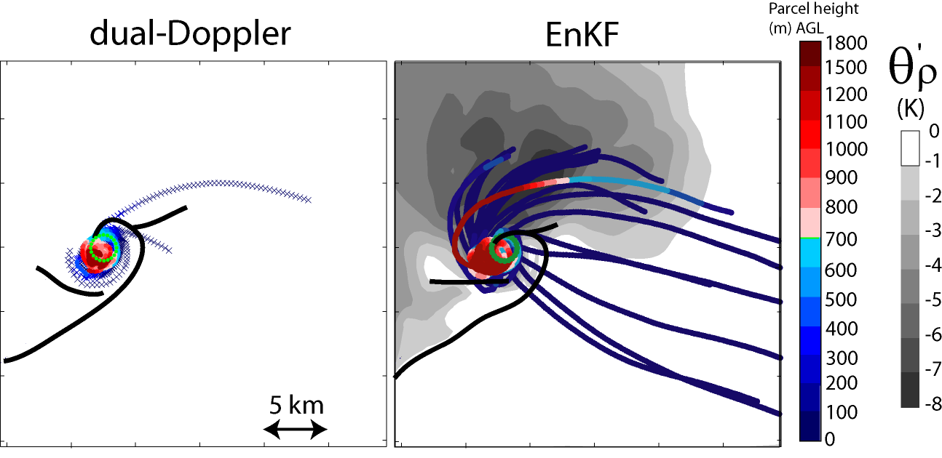
Planned Analysis
Using 4-D EnKF analyses:
Map 4-D mesocale thermodynamics: Moisture, CAPE, CIN, LFC, shear, wave parameters; transition to nocturnal boundary layer
Map possible triggering mechanisms: Surface/elevated boundaries, LLJ & mesoscale convergence, gravity waves, cold pool from other convection, etc.
Establish origins of air feeding convection:
Parcel trajectories using EnKF kinematic analyses in a supercell
  Parcel trajectories entering CI updrafts and surrounding non-updraft areas.
  Lagrangian thermodynamic & momentum forcings along them.
  Relate to triggering mechanisms/NBL
Marquis et al. (2014)

Slide 6
Planned Analysis
23-24 June
3-4 July
Questions:
1) What are relative roles of LLJ/frontal forcing?
2) Do shallow wave-like features play role in CI? Surface boundaries (radar fine-lines)?
3) What caused parallel bands of CI to the E but single line to W, with gap in the middle?
Questions:
Why are CI events so isolated and in the same
geographical region?
2) What is the trigger?
3) Do shallow wave-like features play role in CI?

Slide 7
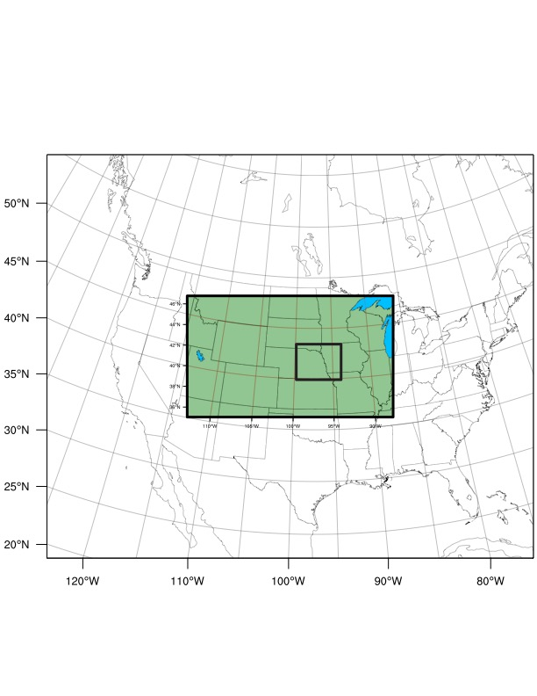

Experimental Design
23-24 June domains
Mesoscale
grid
WRF & DART, on Yellowstone supercomputer
WRF:
50 ensemble members
Multi-scale 1-way nest:
  3-km mesoscale grid; $≤$ 1-km storm-scale grid; 50 vert levels
ICs/LBCs from GFS analysis (0.25°),
Parameterizations: No convective, Thompson mp,
  RRTMG SW & LW, MYJ PBL, NOAH land-sfc.
Data assimilation:
Gaspari & Cohen (1999) localization – variable by observation type and grid spacing,
Observations smoothed/thinned prior to assimilation (25-50% density of model grid),
Adaptive Inflation
Storm-scale
grid

Slide 8
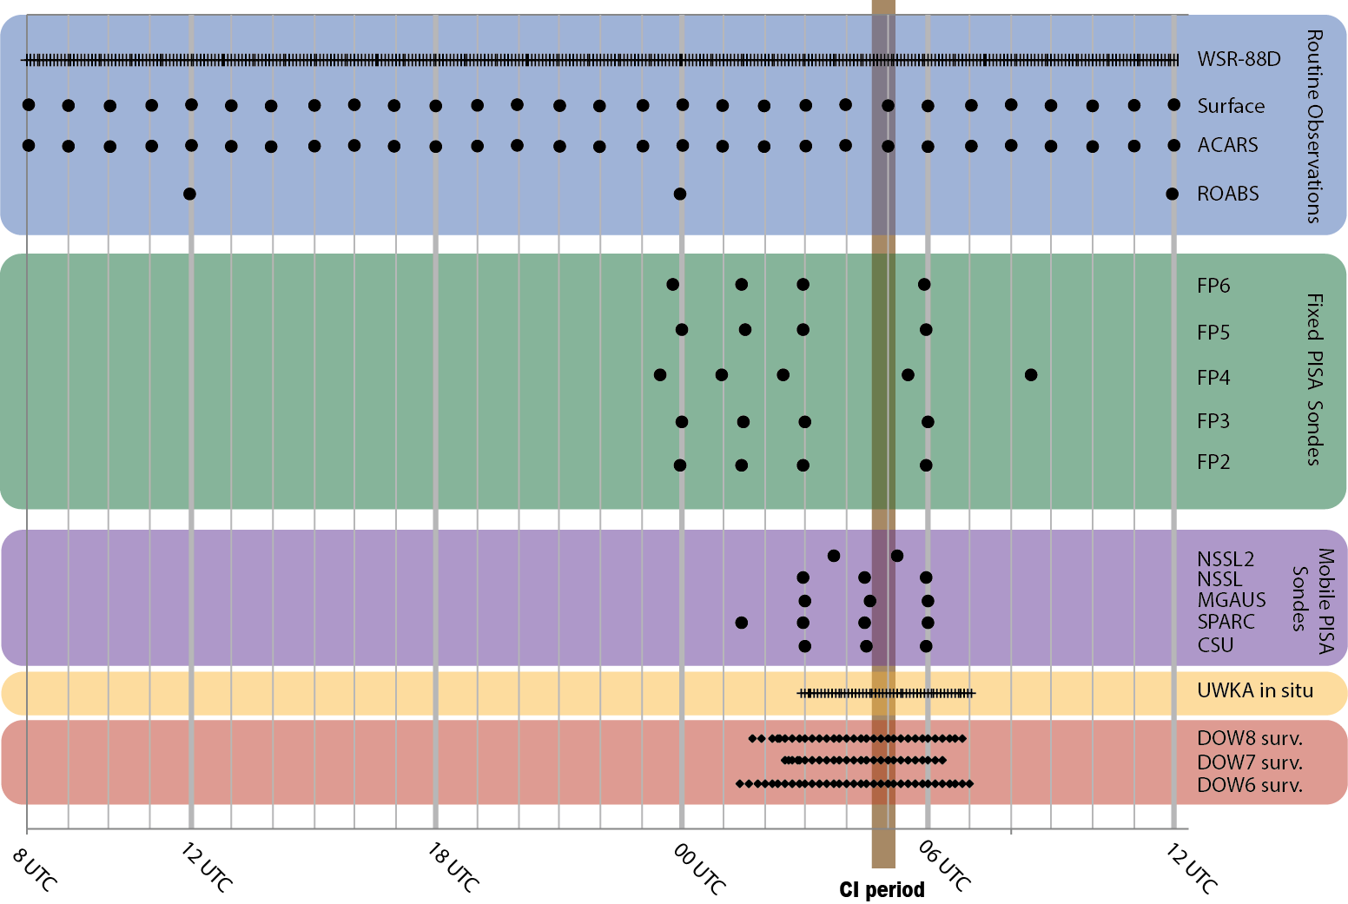
23-24 June; CI in SE Nebraska
DA to mesoscale grid
Hourly assimilation of:
  Surface met,
  AMDAR,
  RAOBS,
  Fixed PISAs (as available)
  WSR-88D reflectivity &
  velocity
  SPOL

Slide 9
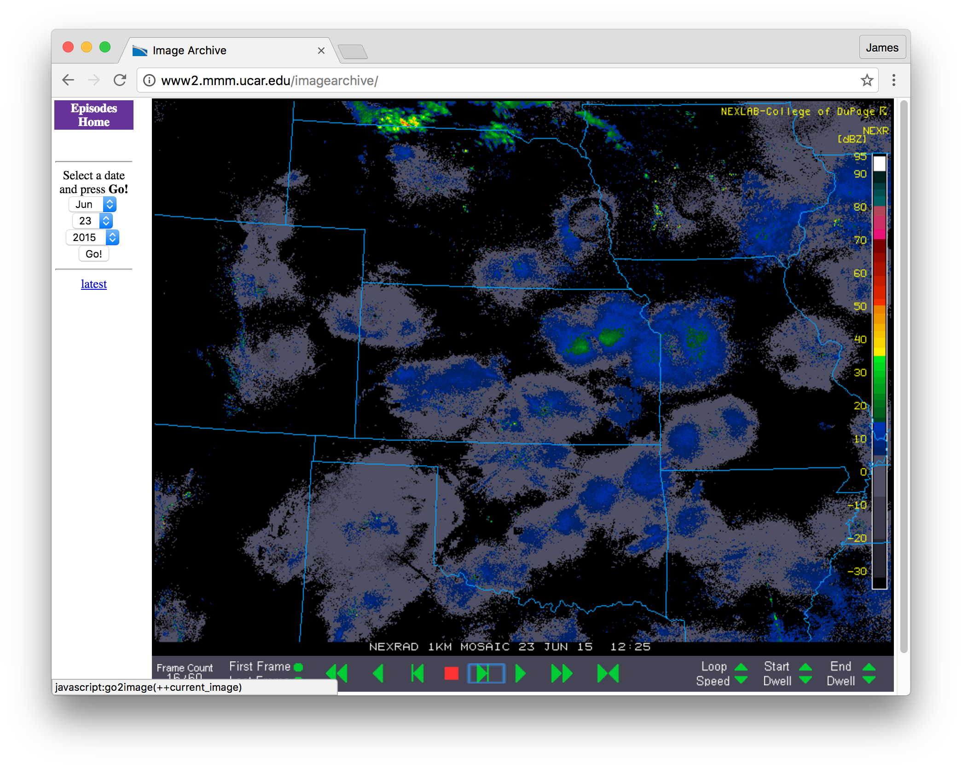
23 June, 1225 UTC
CI – 16.5 hr
23-24 June 88D reflectivity mosaic

Slide 10
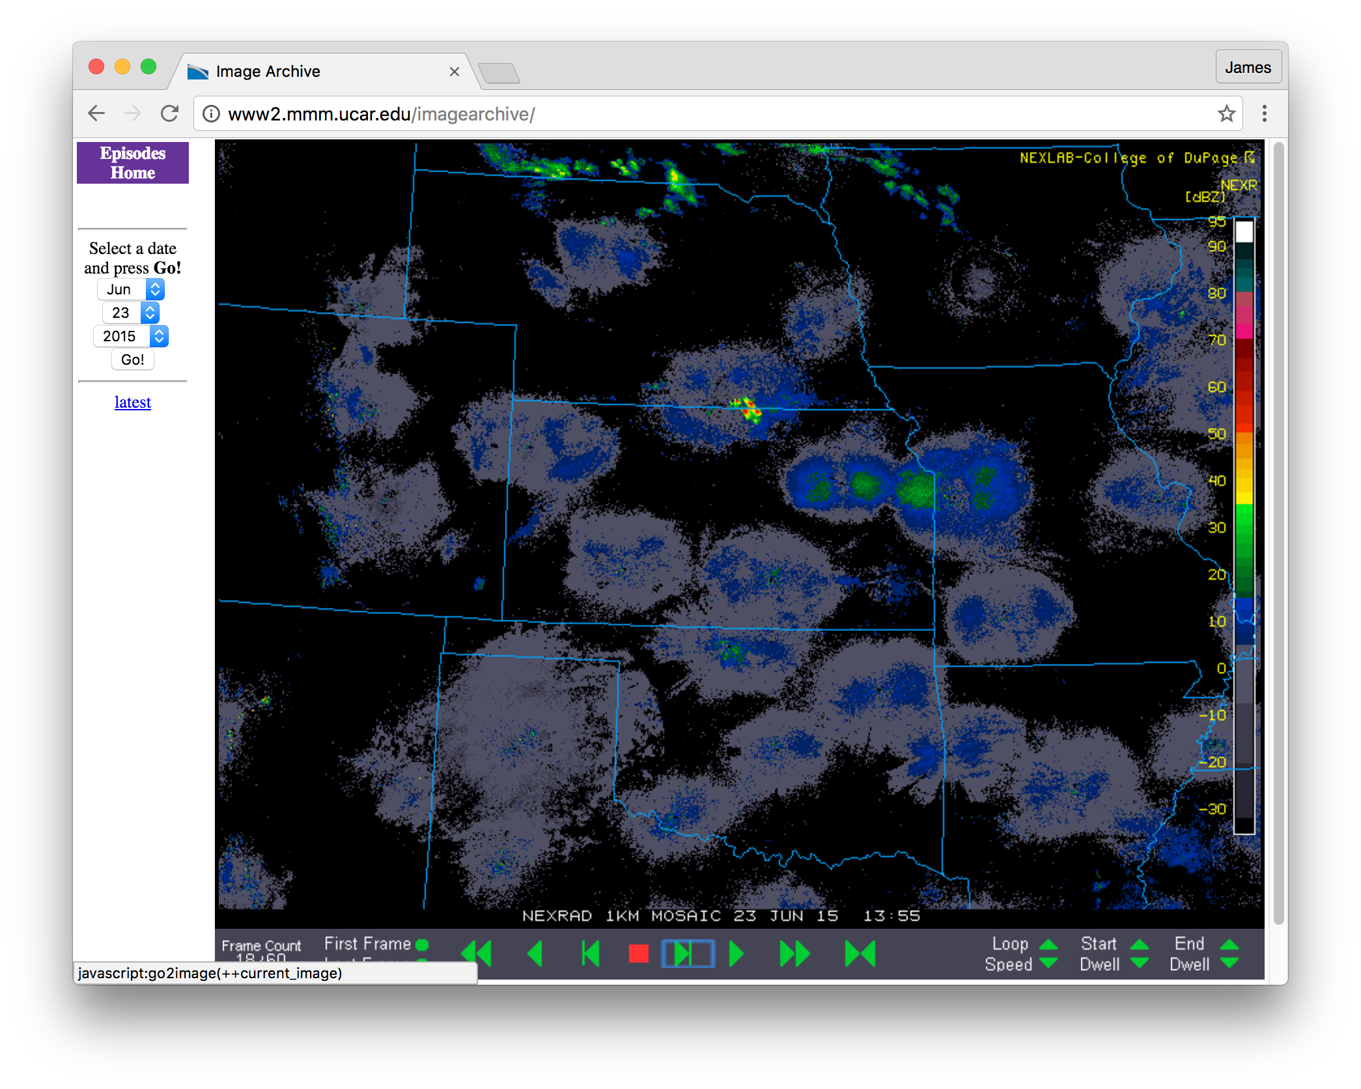
23 June, 1355 UTC
CI – 15 hr
Prior morning/afternoon’s
convection
23-24 June 88D reflectivity mosaic

Slide 11
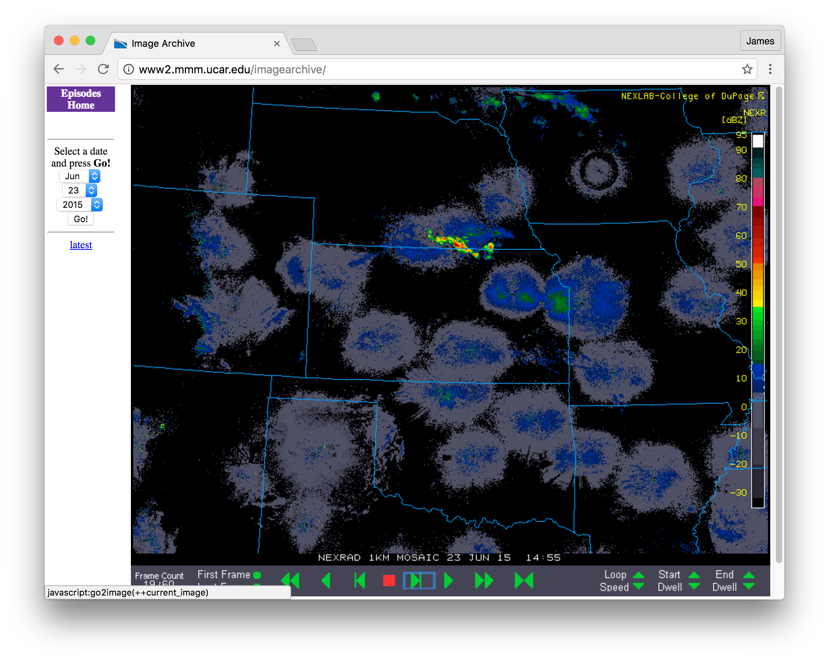
23 June, 1455 UTC
CI – 14 hr
Prior morning/afternoon’s
convection
23-24 June 88D reflectivity mosaic

Slide 12
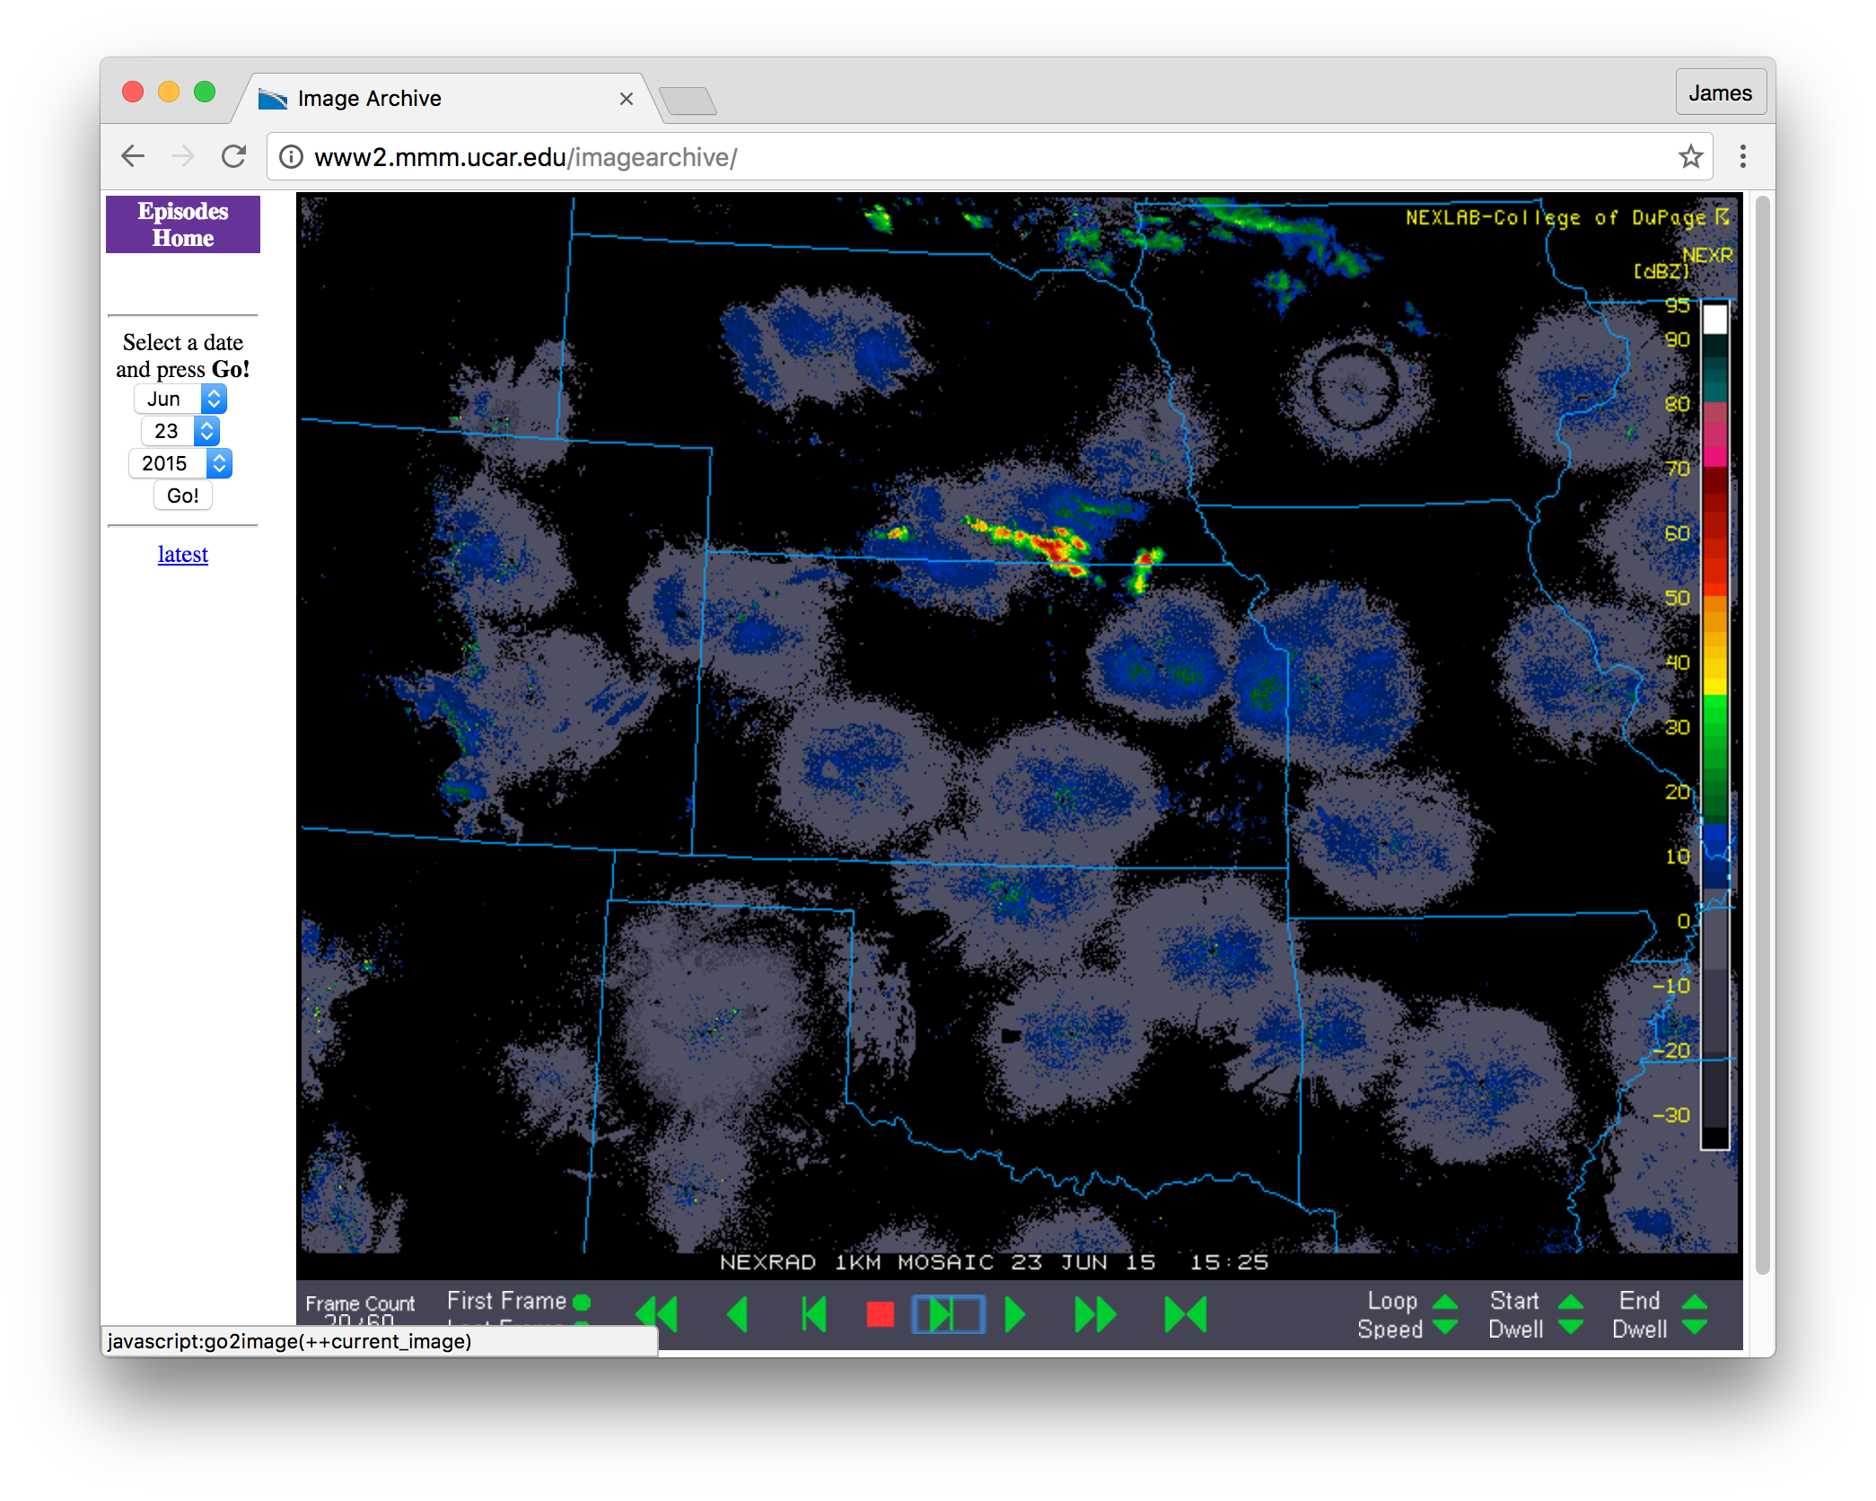
23 June, 1525 UTC
CI – 13.5 hr
Prior morning/afternoon’s
convection
23-24 June 88D reflectivity mosaic

Slide 13
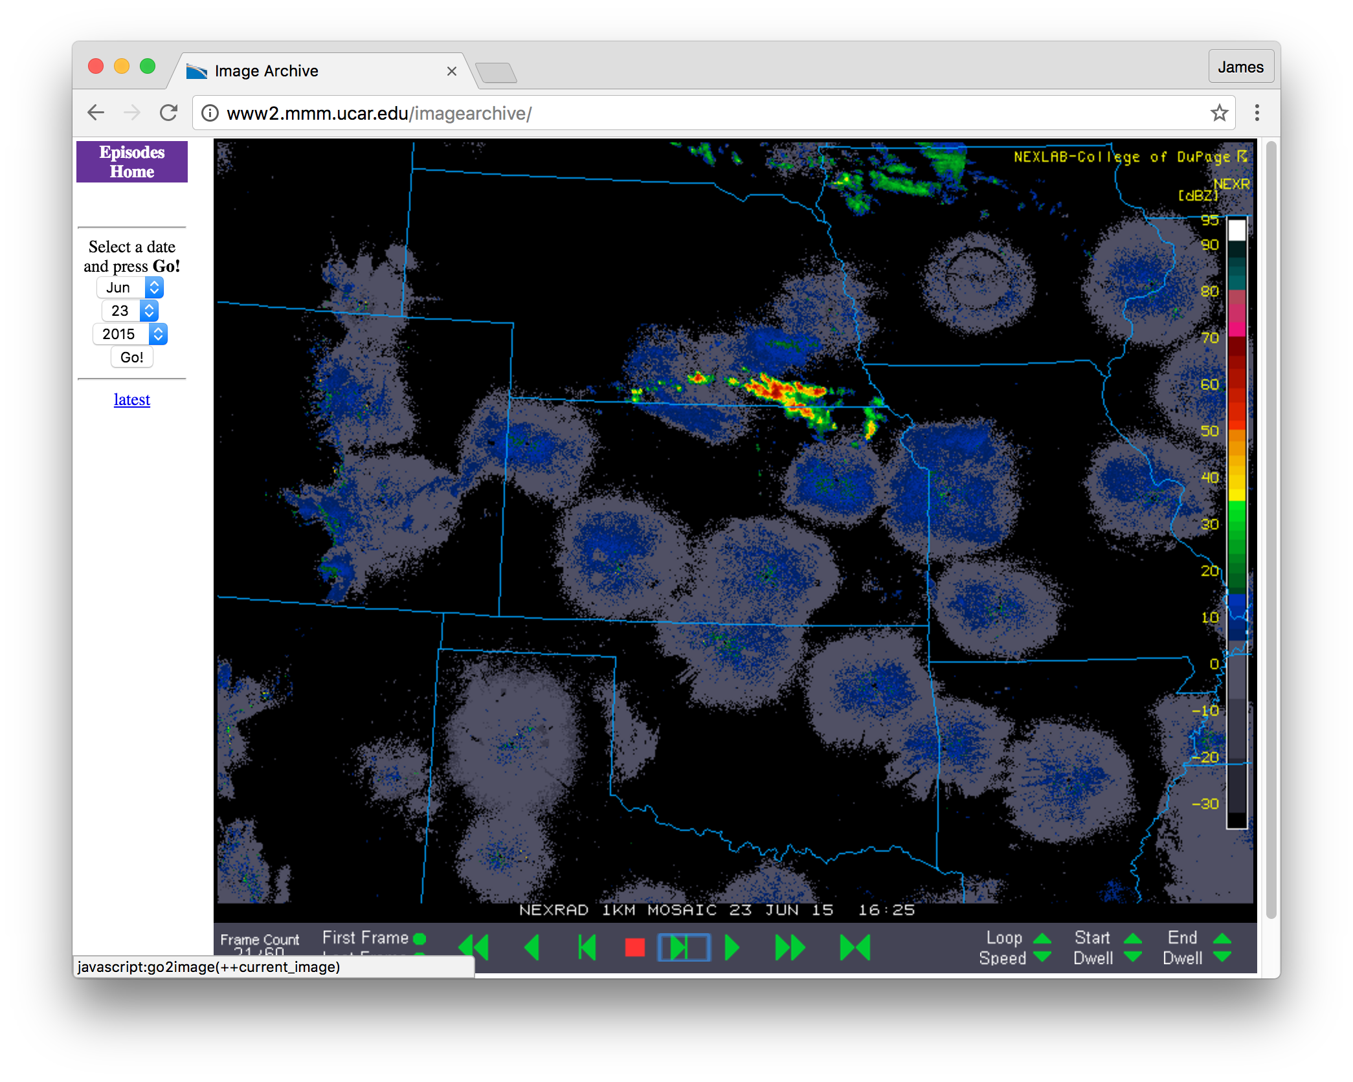
23 June, 1625 UTC
CI – 12.5 hr
23-24 June 88D reflectivity mosaic

Slide 14
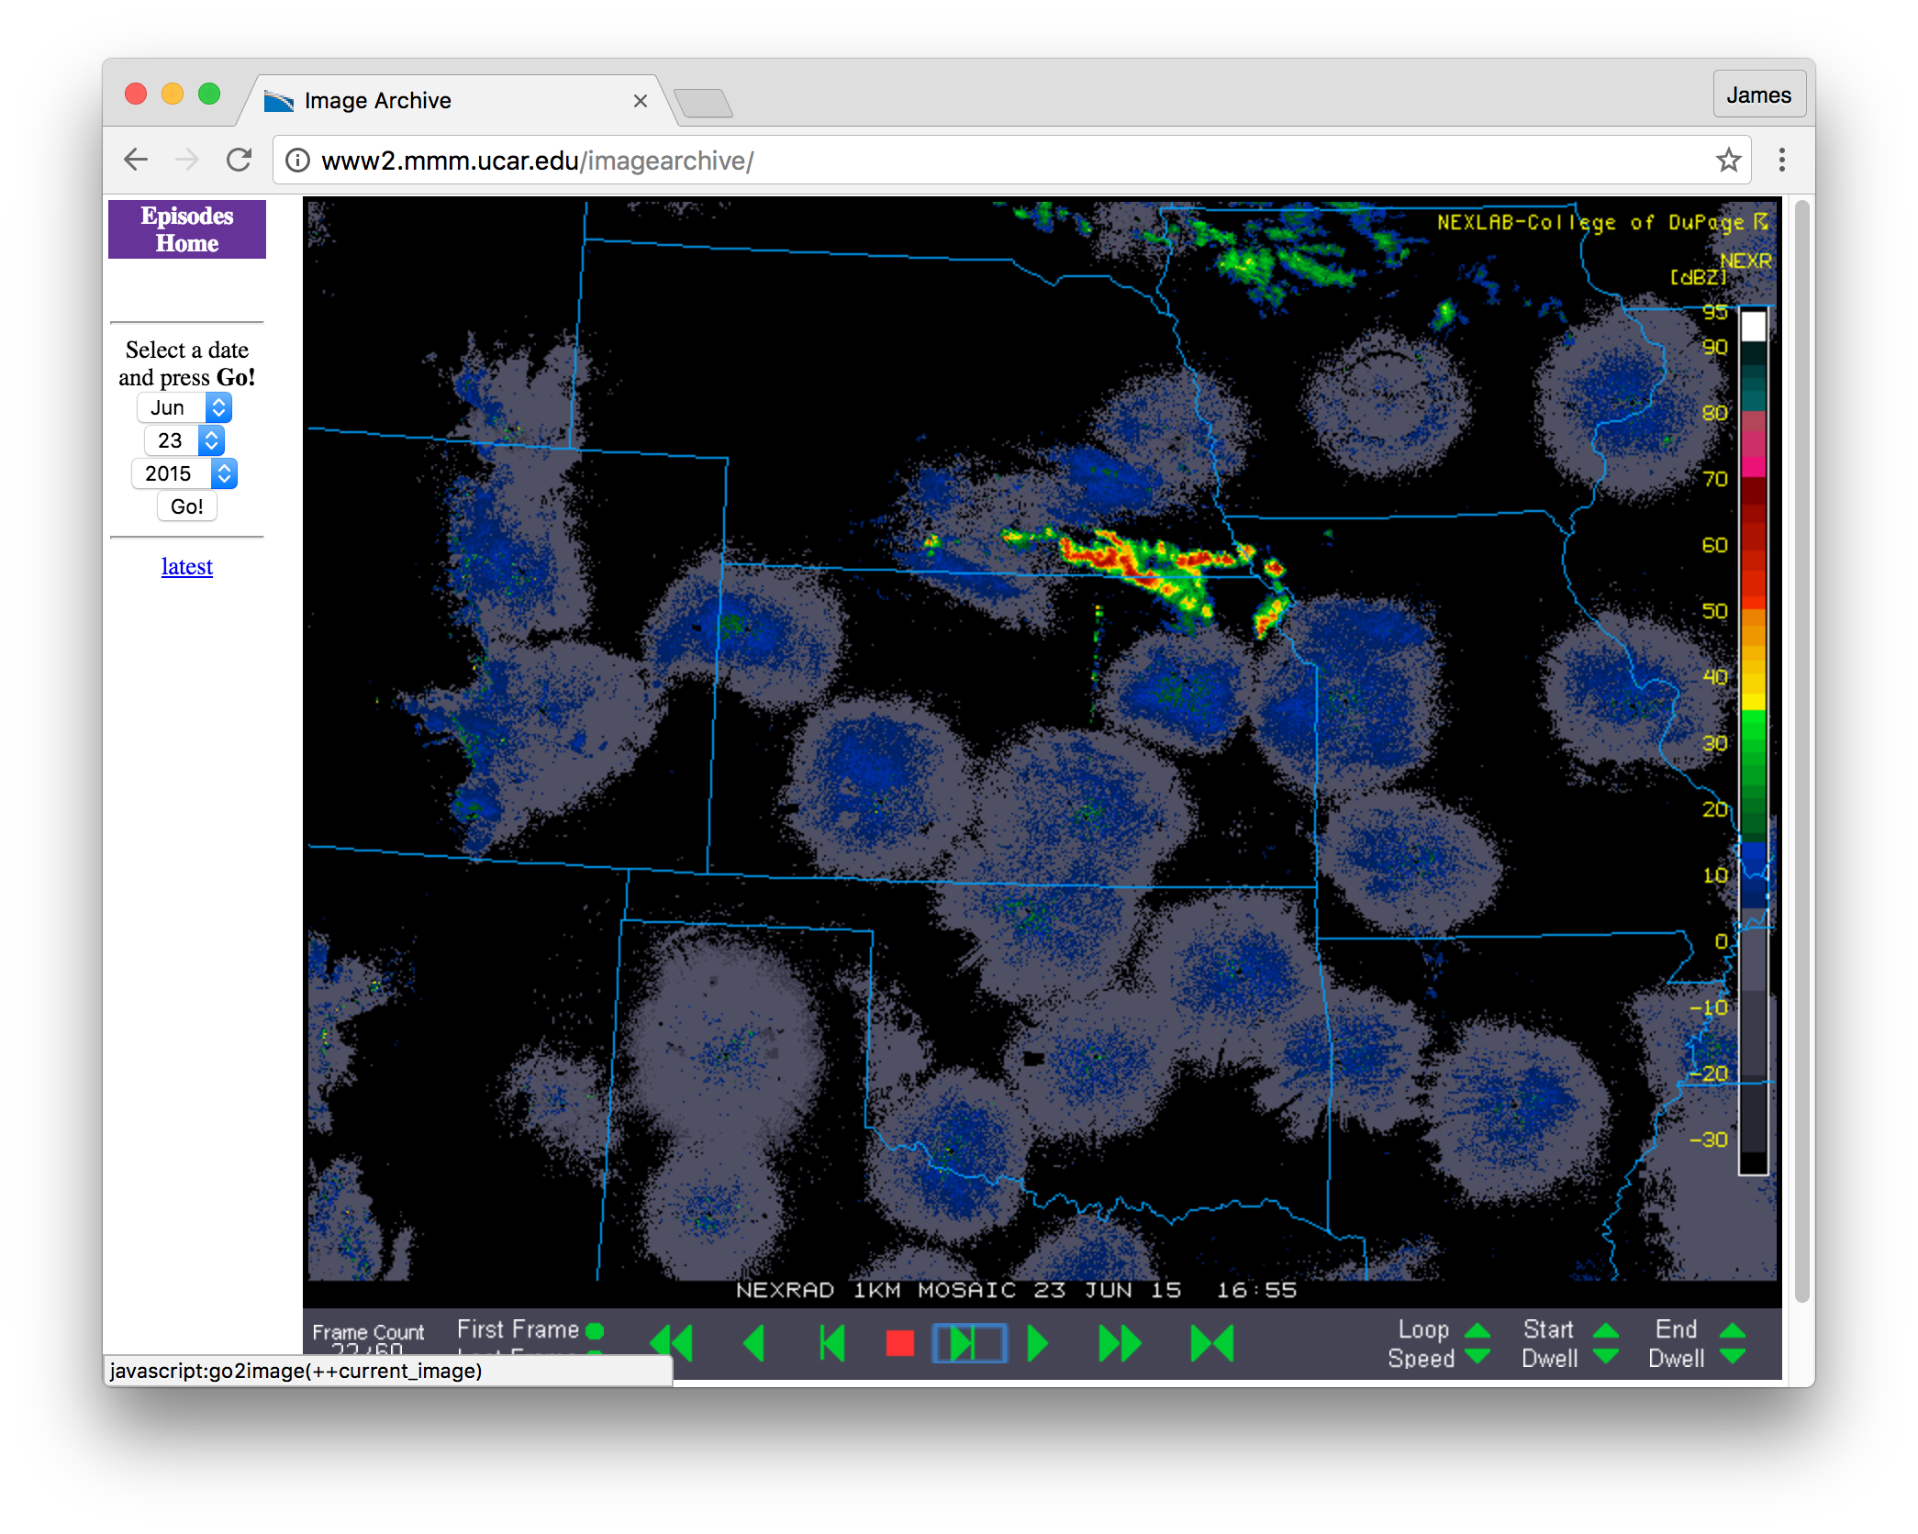
23 June, 1655 UTC
CI – 12 hr
23-24 June 88D reflectivity mosaic

Slide 15
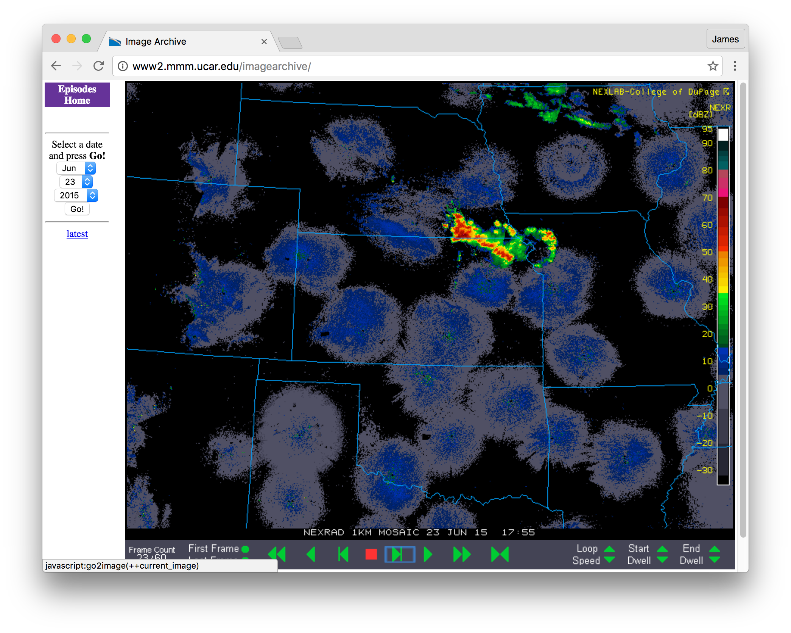
23 June, 1755 UTC
CI – 11 hr
23-24 June 88D reflectivity mosaic

Slide 16
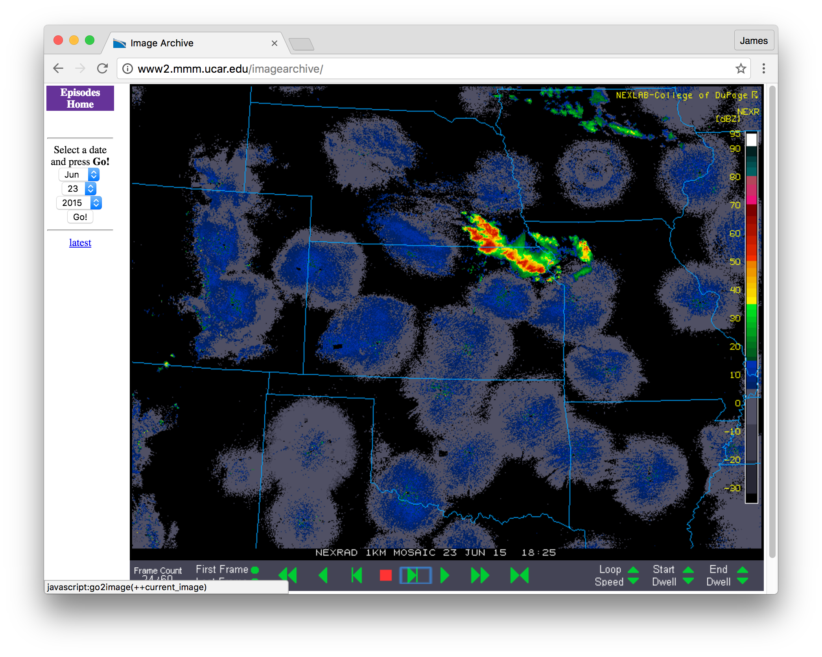
23 June, 1825 UTC
CI – 10.5 hr
23-24 June 88D reflectivity mosaic

Slide 17
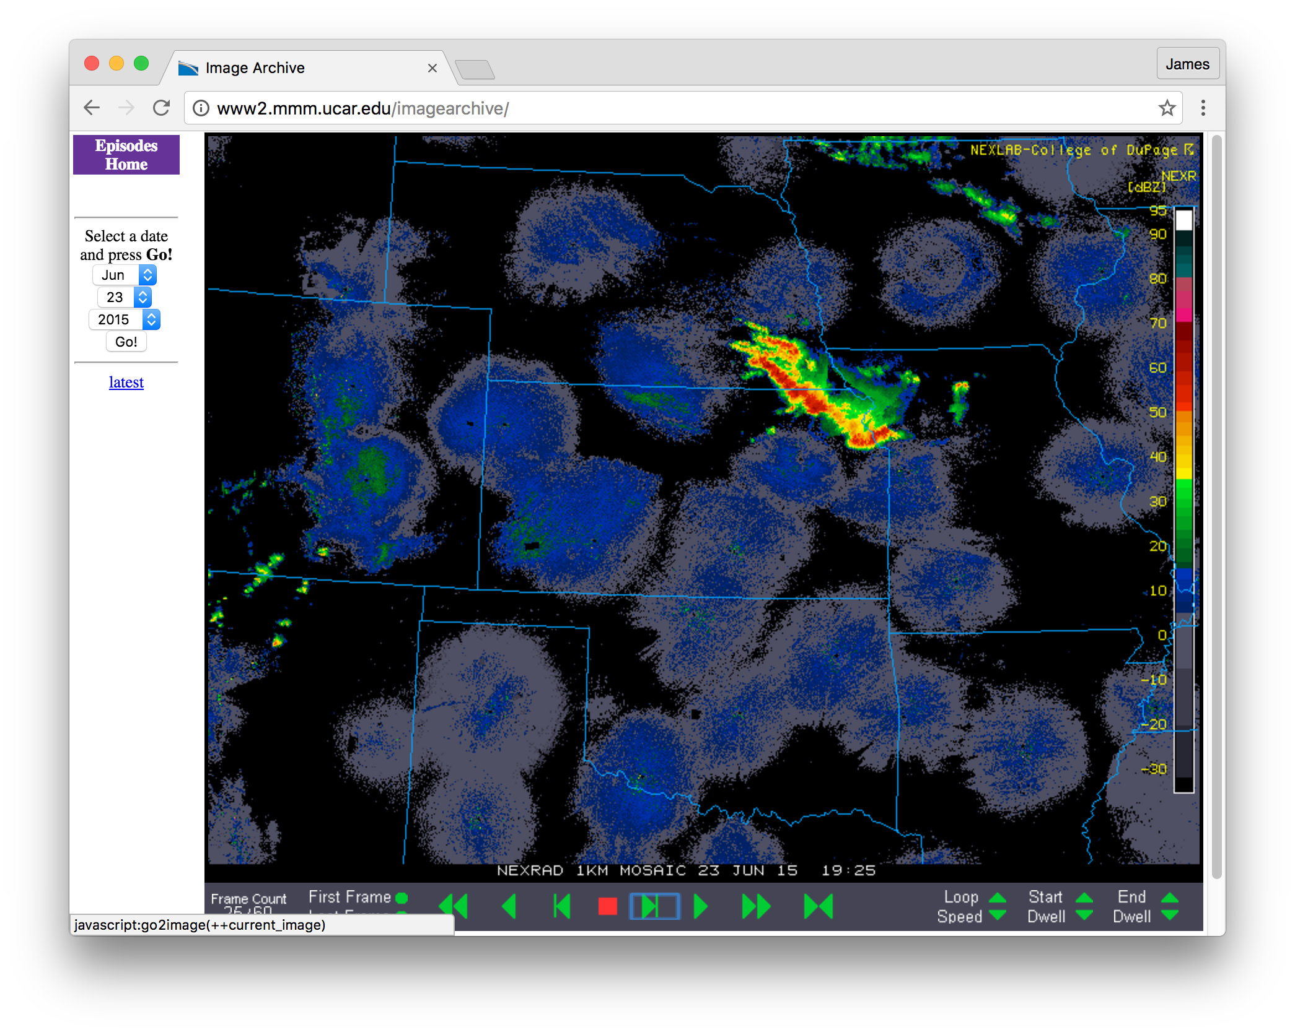
23 June, 1925 UTC
CI – 9.5 hr
23-24 June 88D reflectivity mosaic

Slide 18
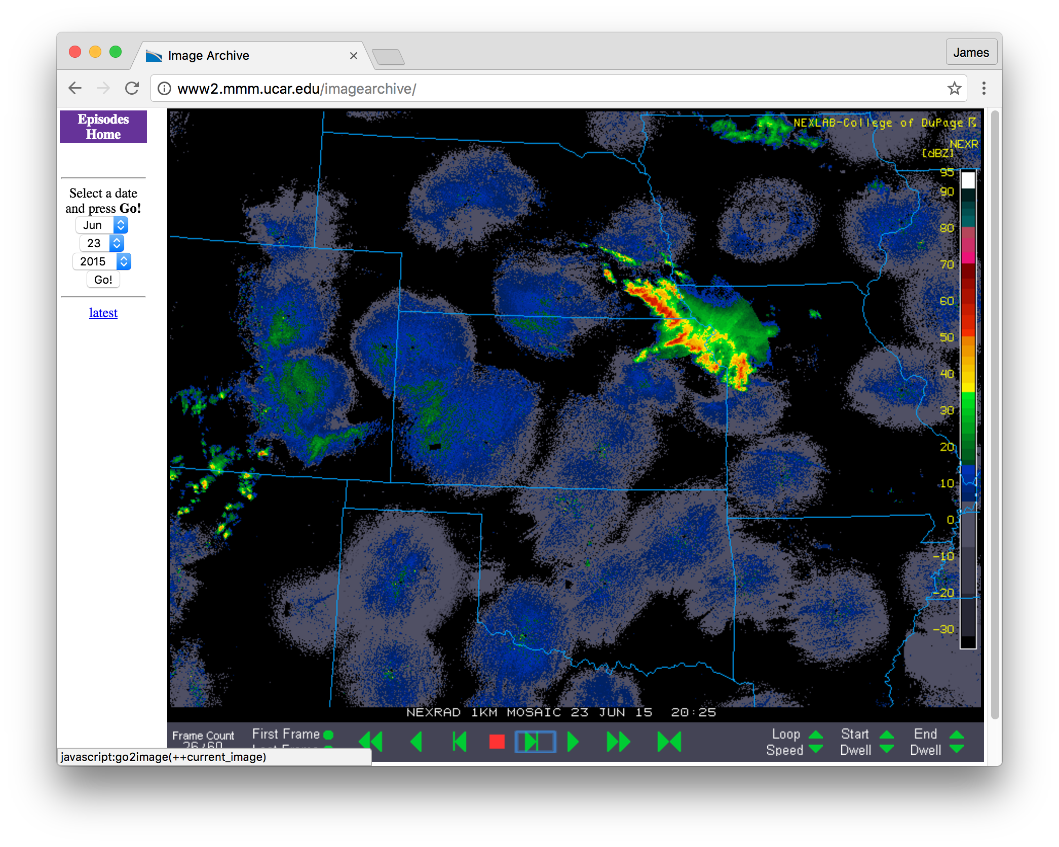
23 June, 2025 UTC
CI – 8.5 hr
23-24 June 88D reflectivity mosaic

Slide 19
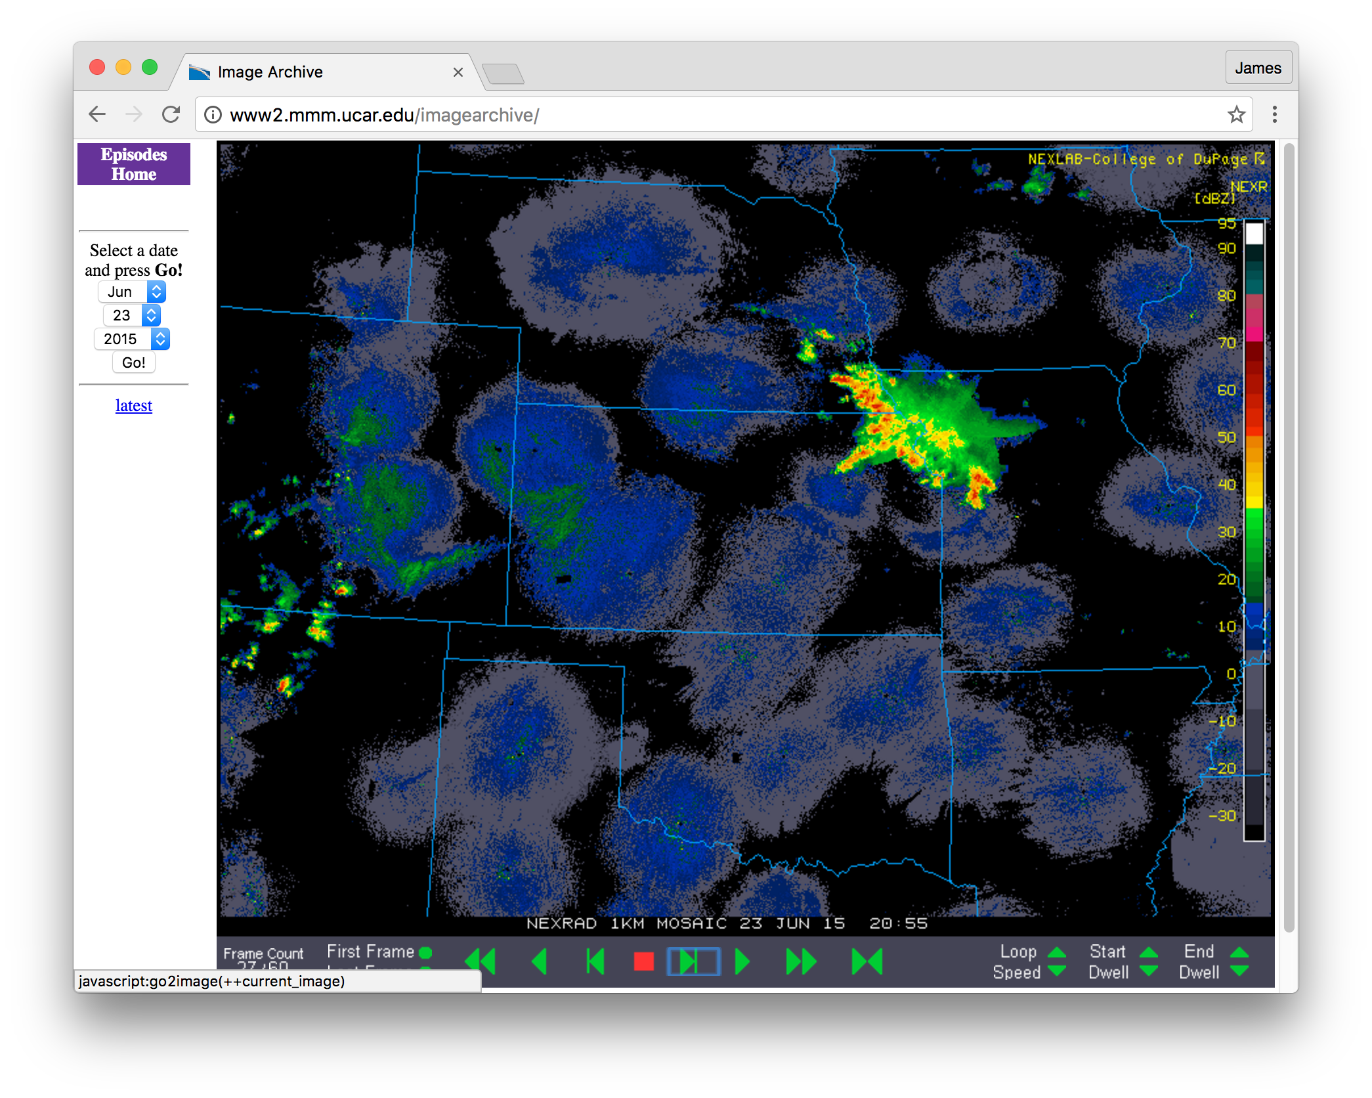
23 June, 2055 UTC
CI – 8 hr
23-24 June 88D reflectivity mosaic

Slide 20
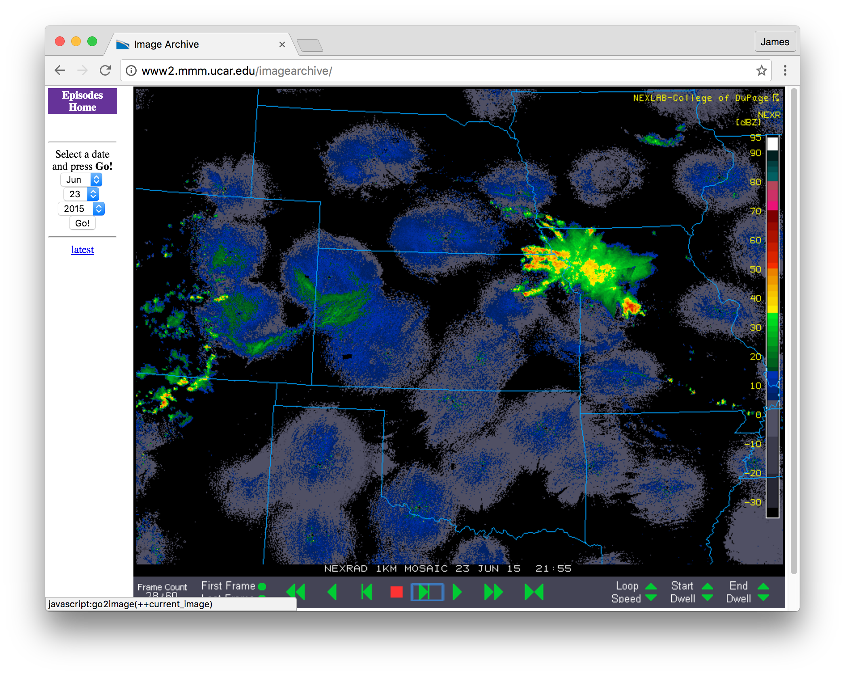
23 June, 2155 UTC
CI – 7 hr
23-24 June 88D reflectivity mosaic

Slide 21
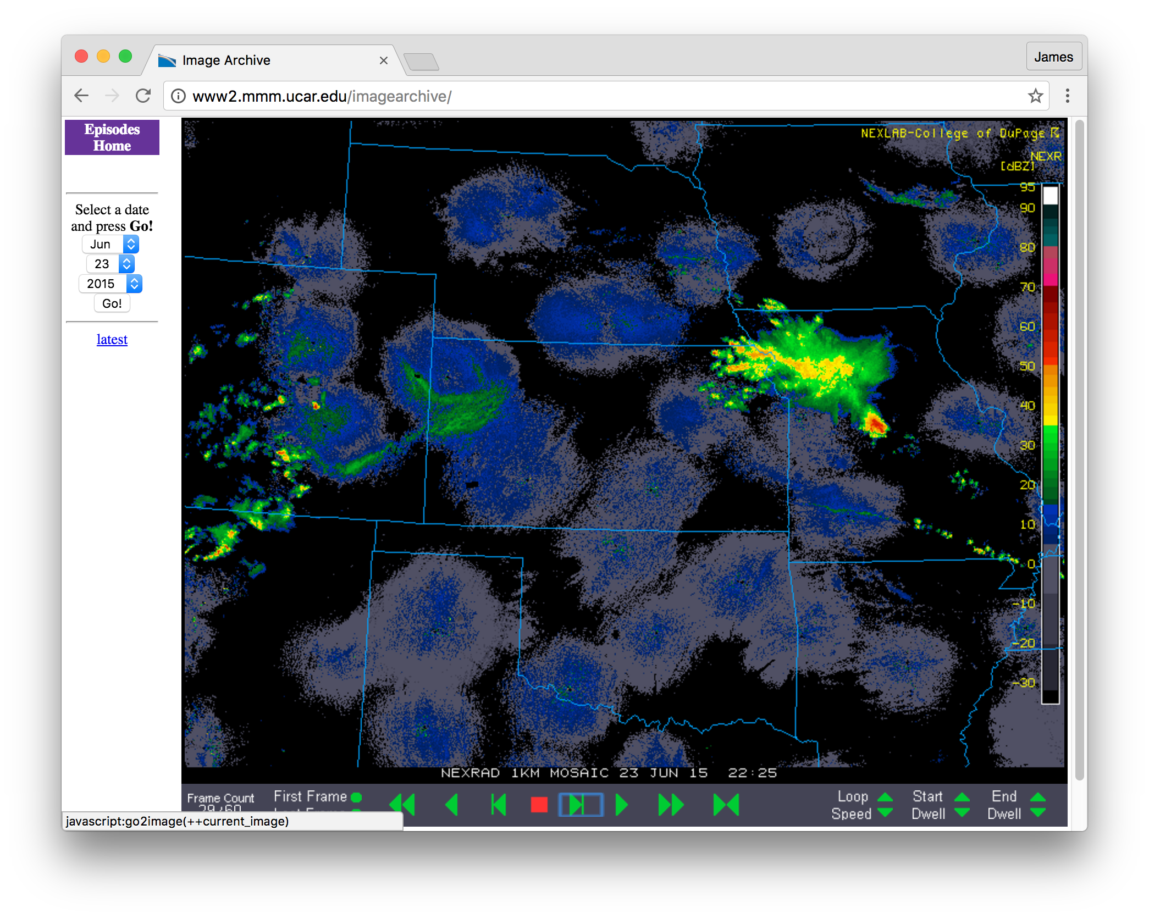
23 June, 2225 UTC
CI – 6.5 hr
23-24 June 88D reflectivity mosaic

Slide 22
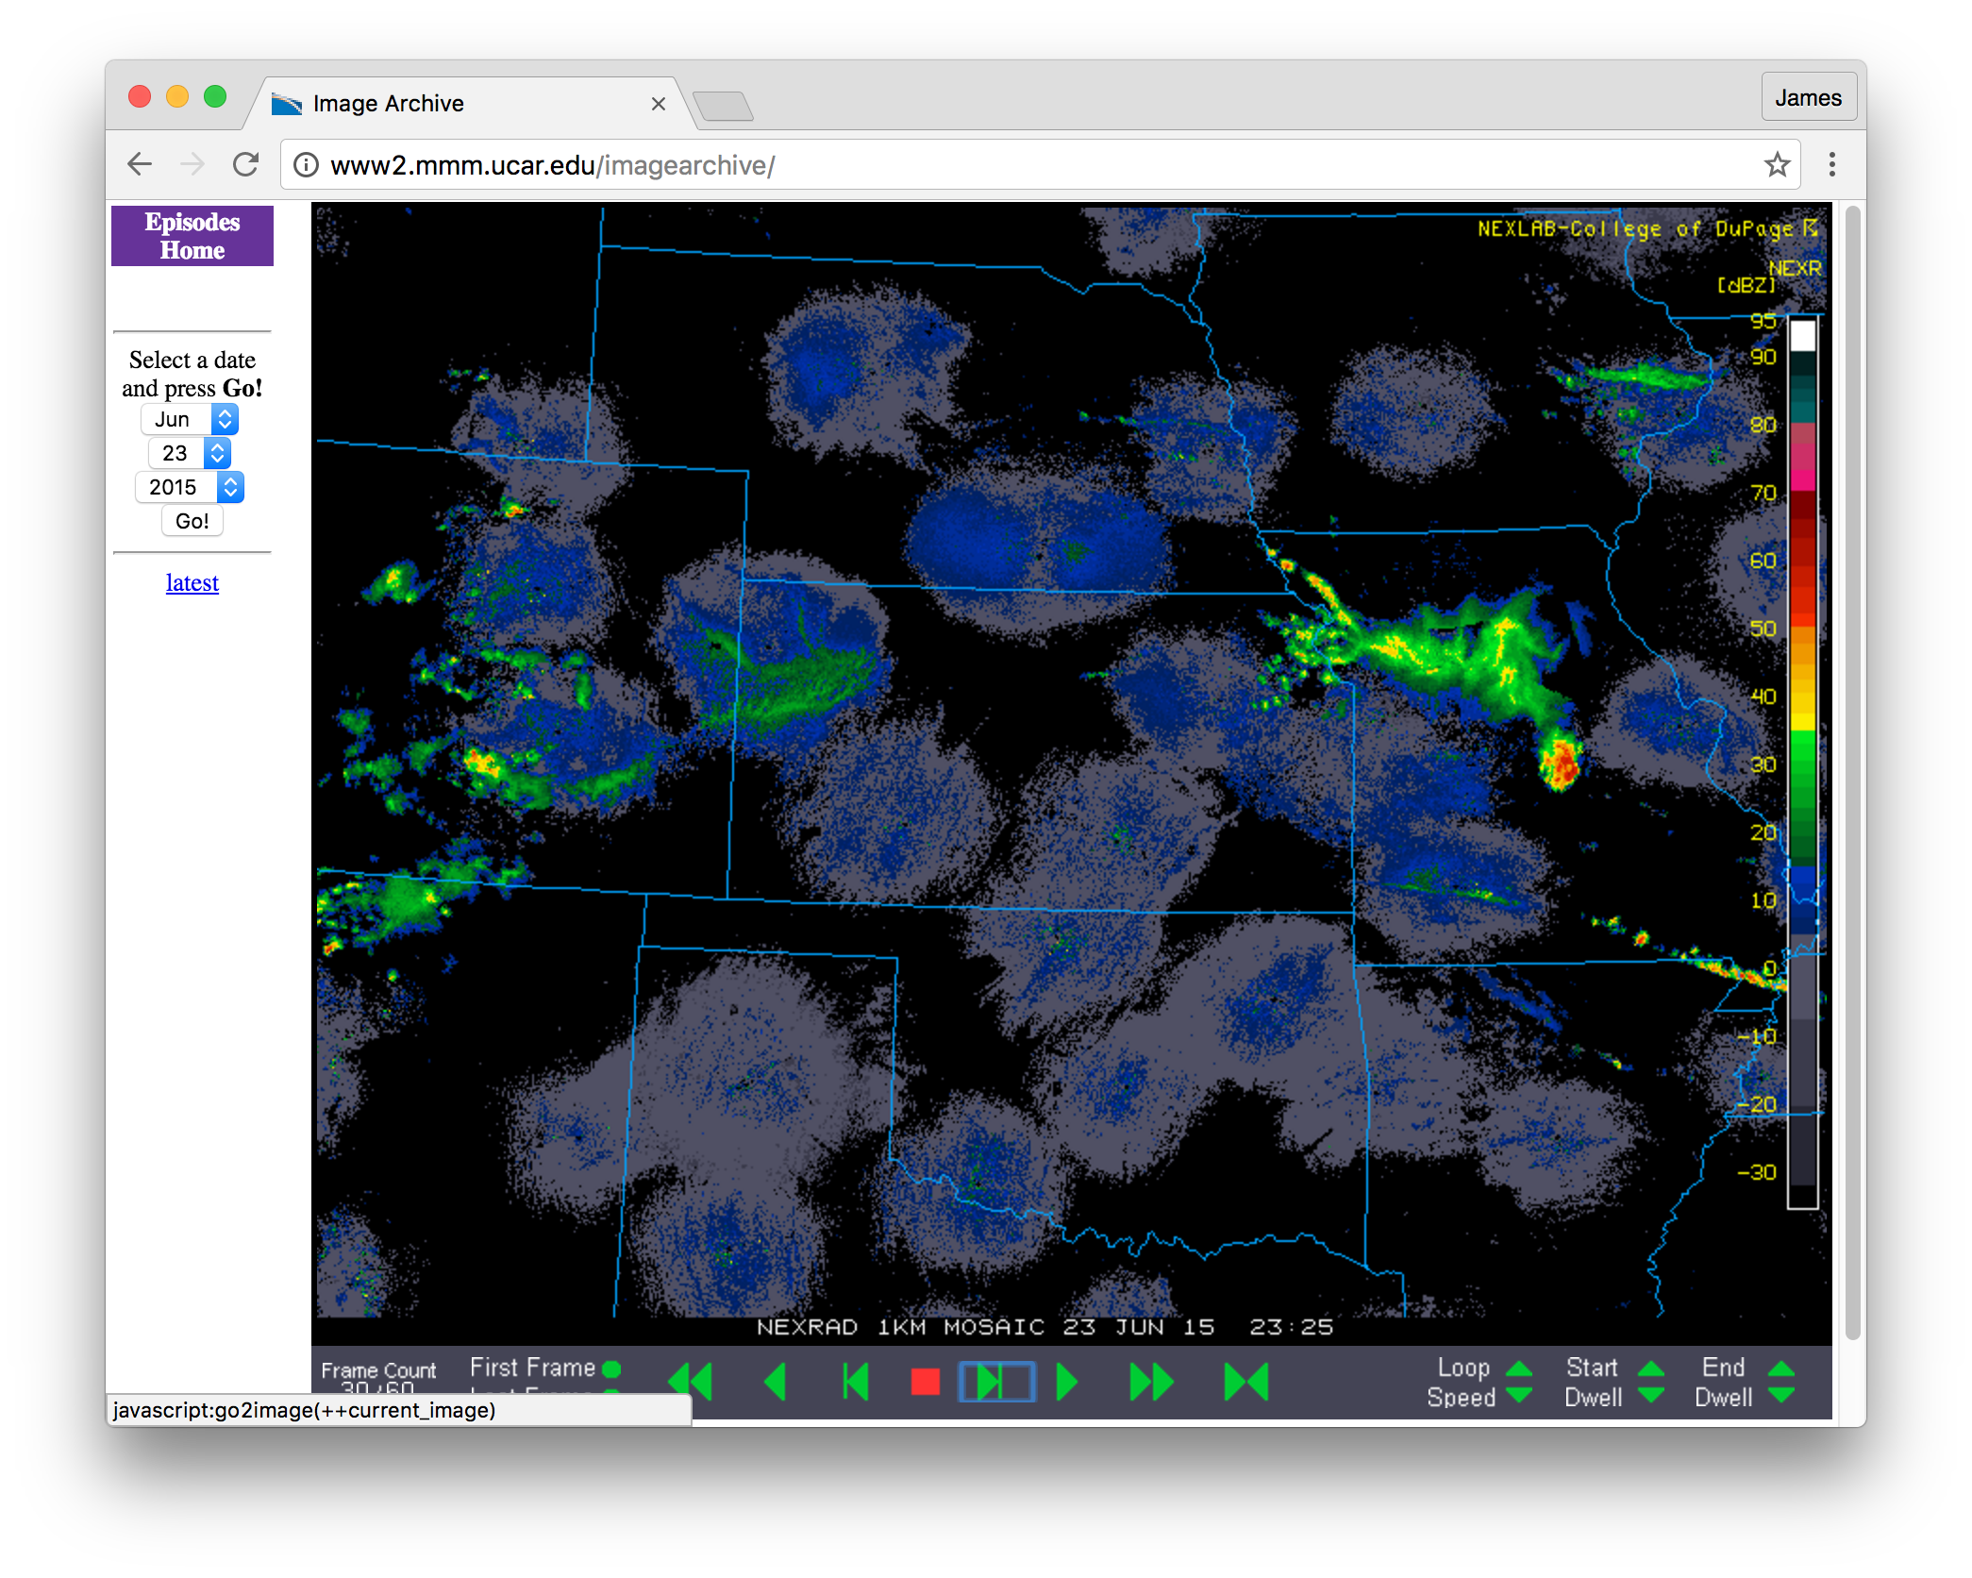
23 June, 2325 UTC
CI – 5.5 hr
23-24 June 88D reflectivity mosaic

Slide 23
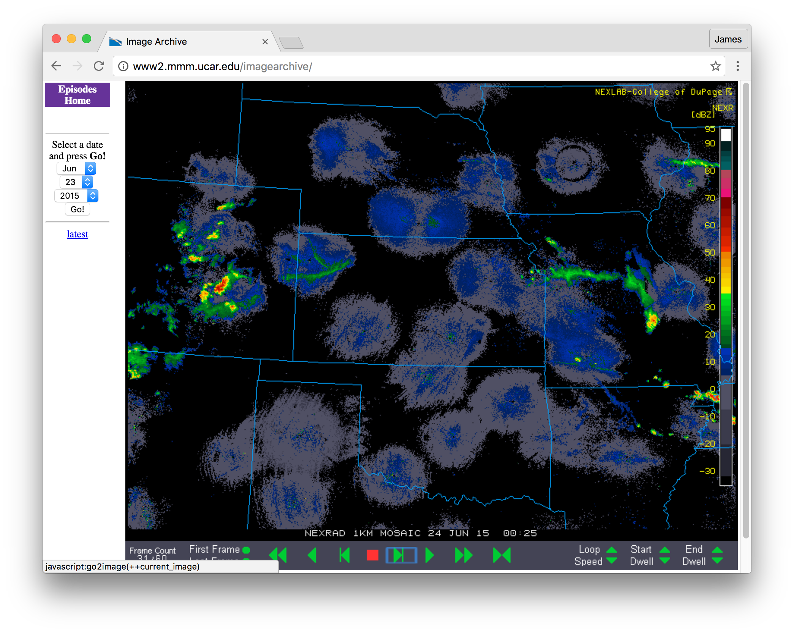
24 June, 0025 UTC
CI – 4.5 hr
23-24 June 88D reflectivity mosaic

Slide 24

24 June, 0055 UTC
CI – 4 hr
PECAN observations beginning
23-24 June 88D reflectivity mosaic

Slide 25
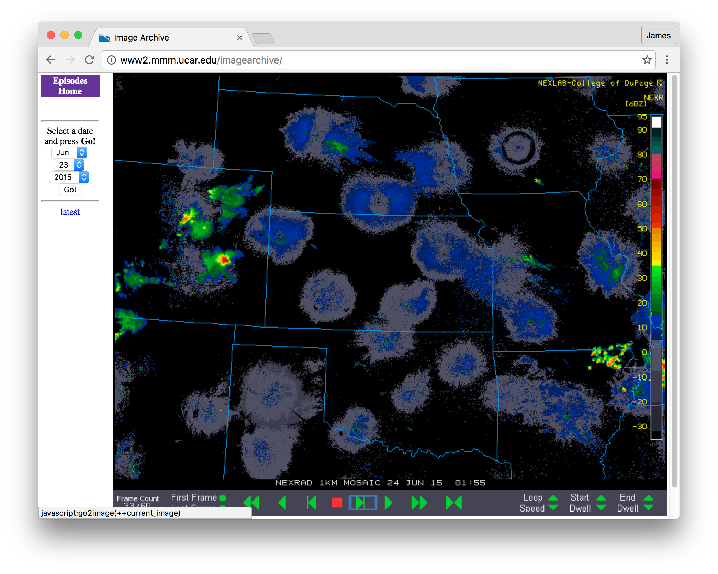
24 June, 0155 UTC
CI – 3 hr
PECAN deployment ongoing
23-24 June 88D reflectivity mosaic

Slide 26
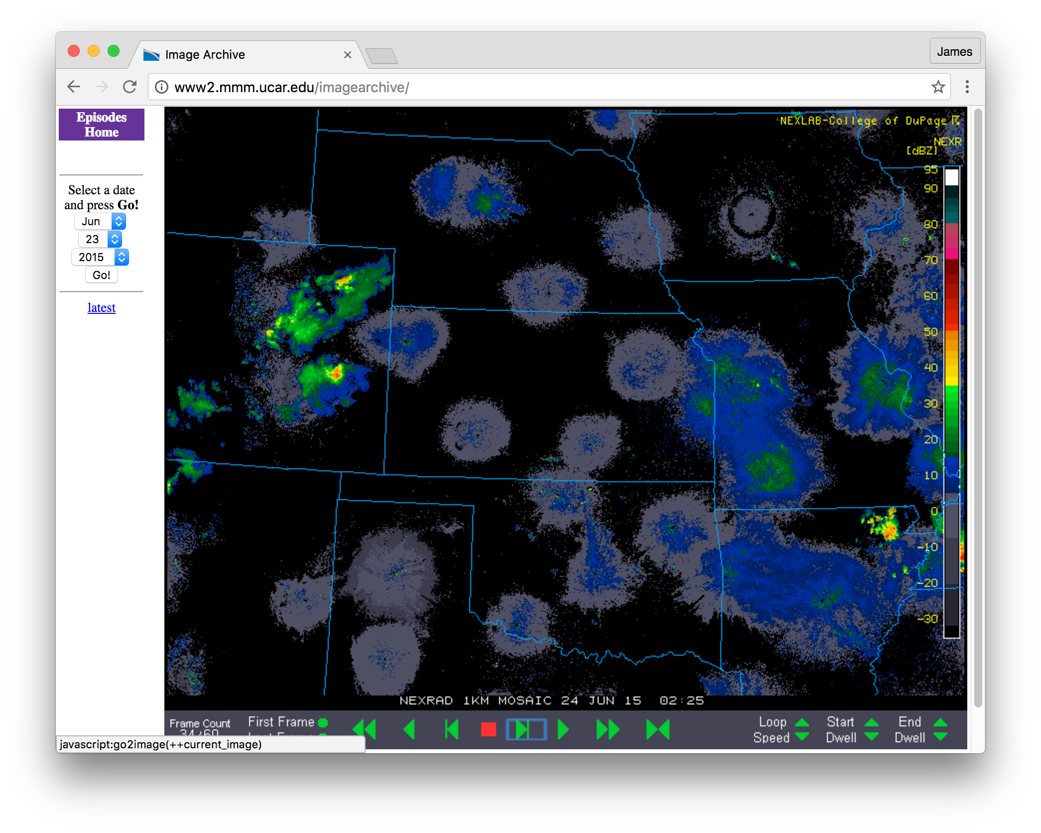
24 June, 0225 UTC
CI – 2.5 hr
PECAN deployment ongoing
23-24 June 88D reflectivity mosaic

Slide 27
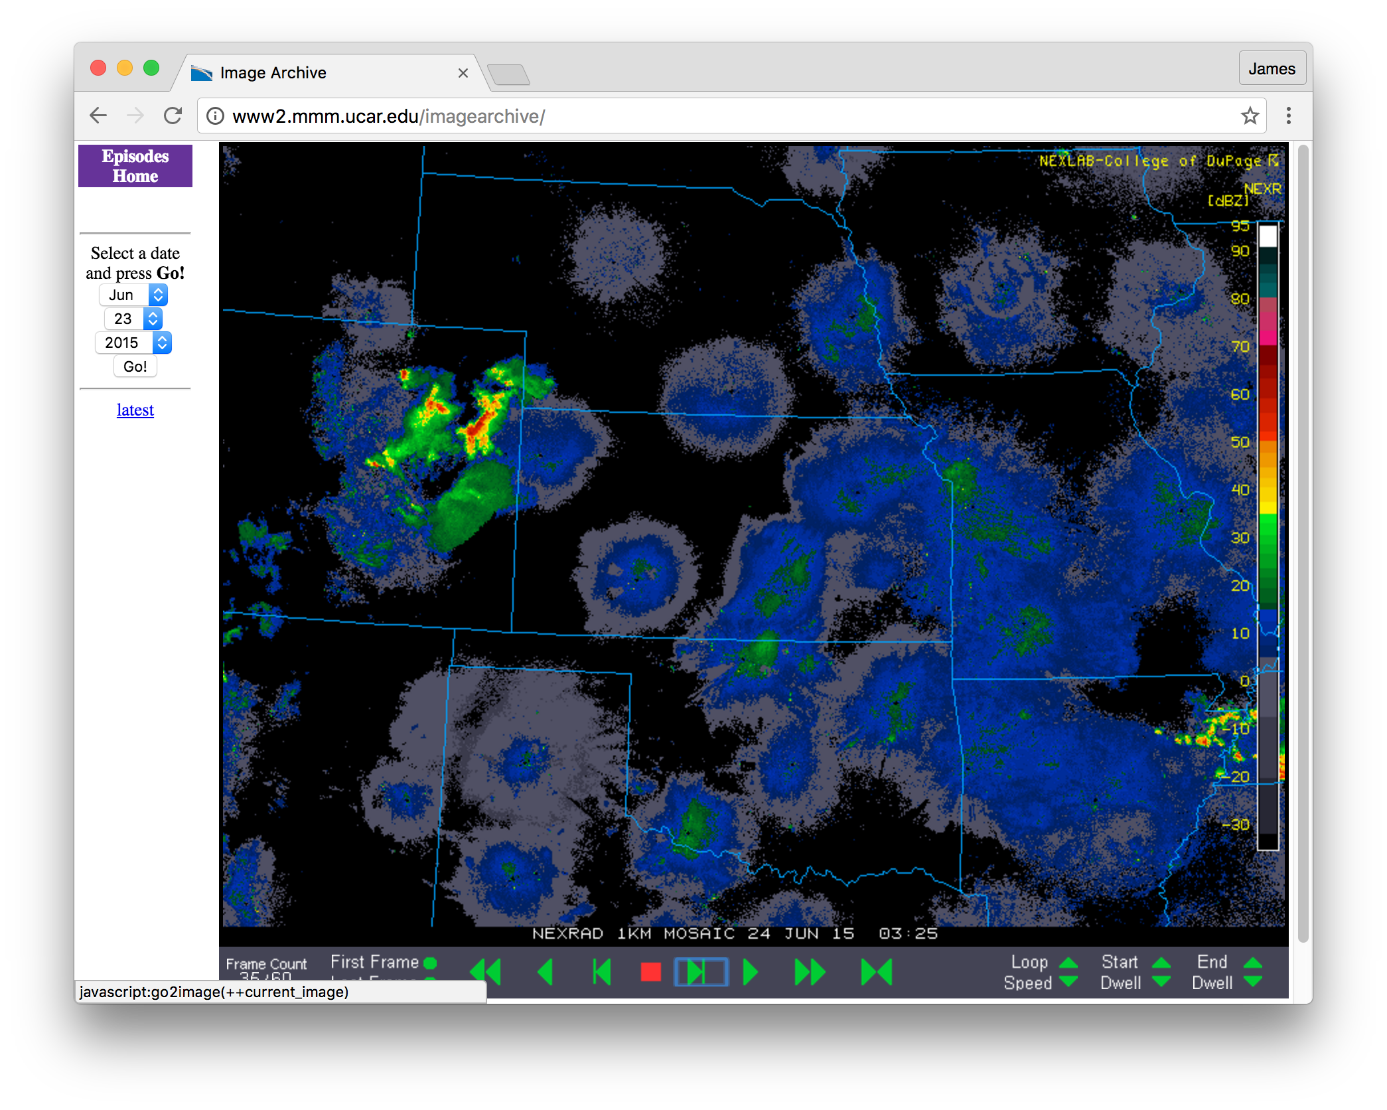
24 June, 0325 UTC
CI – 1.5 hr
PECAN deployment ongoing
23-24 June 88D reflectivity mosaic

Slide 28
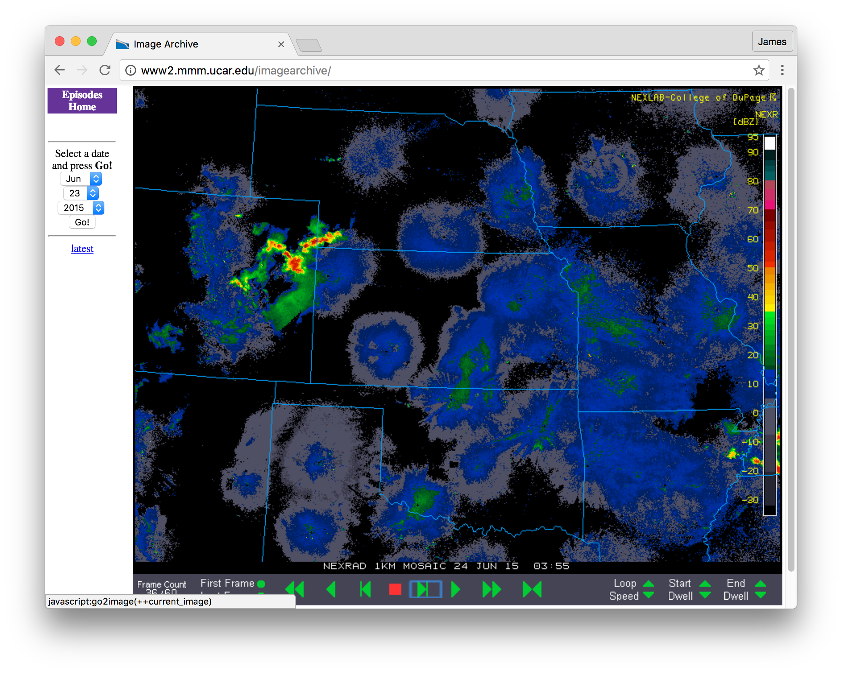
24 June, 0355 UTC
CI – 1 hr
PECAN deployment ongoing
23-24 June 88D reflectivity mosaic

Slide 29
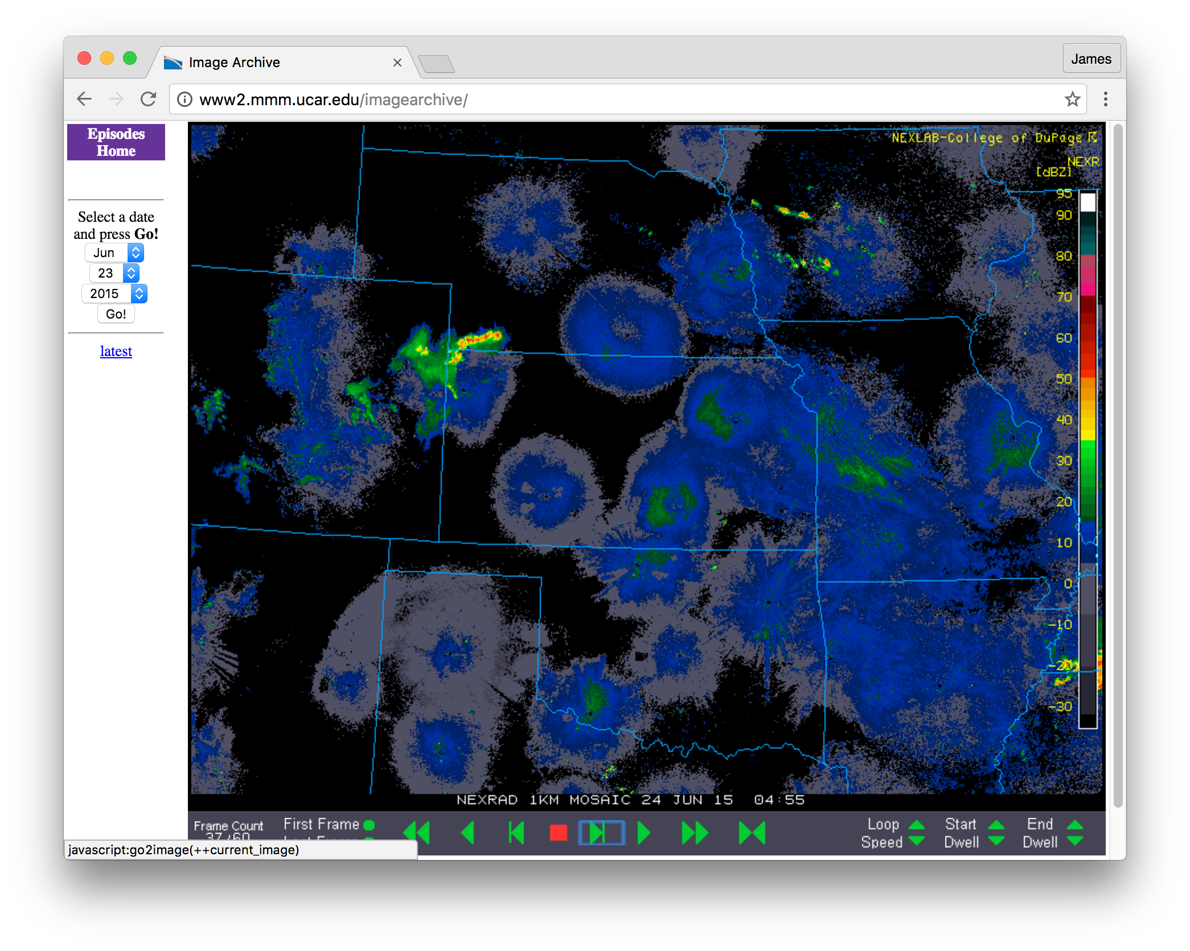
24 June, 0455 UTC
***CI***
PECAN deployment ongoing
Target CI
23-24 June 88D reflectivity mosaic

Slide 30
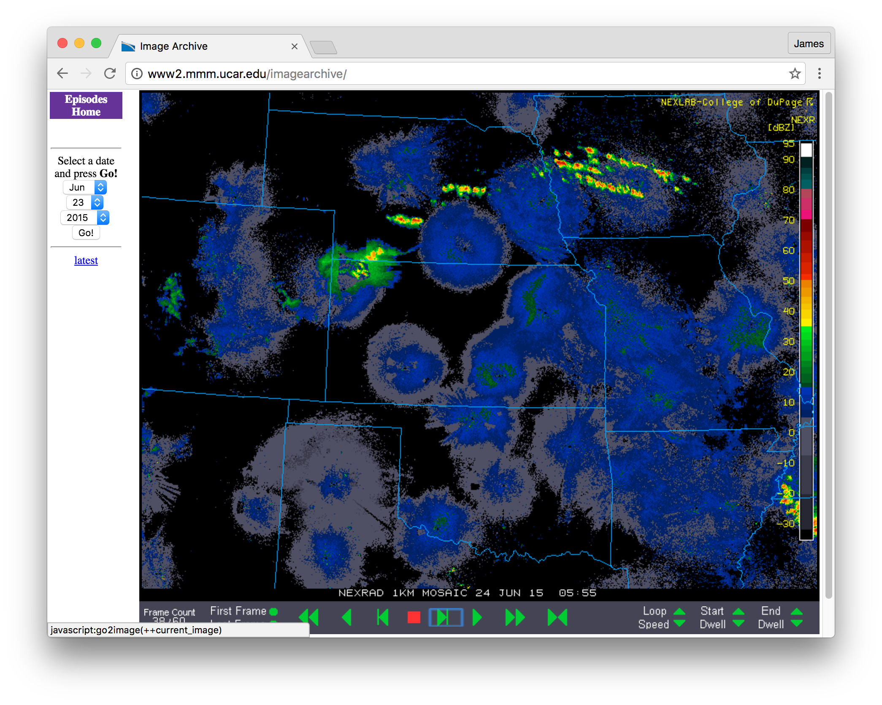
24 June, 0555 UTC
CI + 1 hr
PECAN deployment ongoing
23-24 June 88D reflectivity mosaic

Slide 31

24 June, 0625 UTC
CI + 1.5 hr
PECAN deployment ongoing
23-24 June 88D reflectivity mosaic

Slide 32
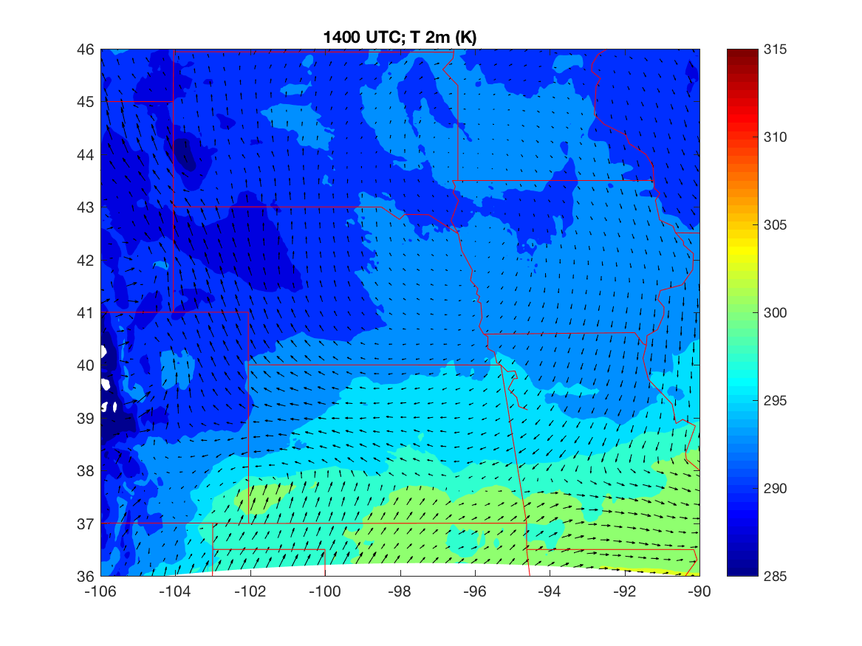
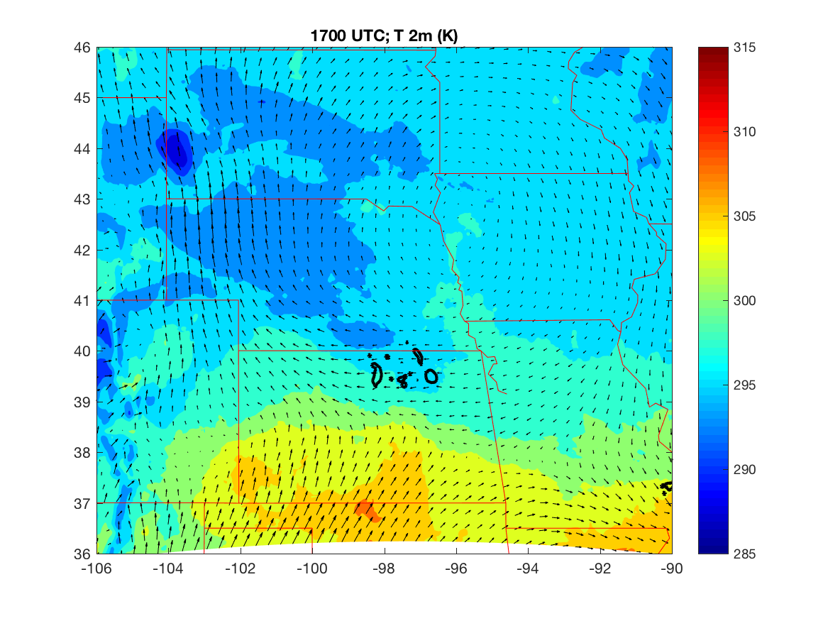
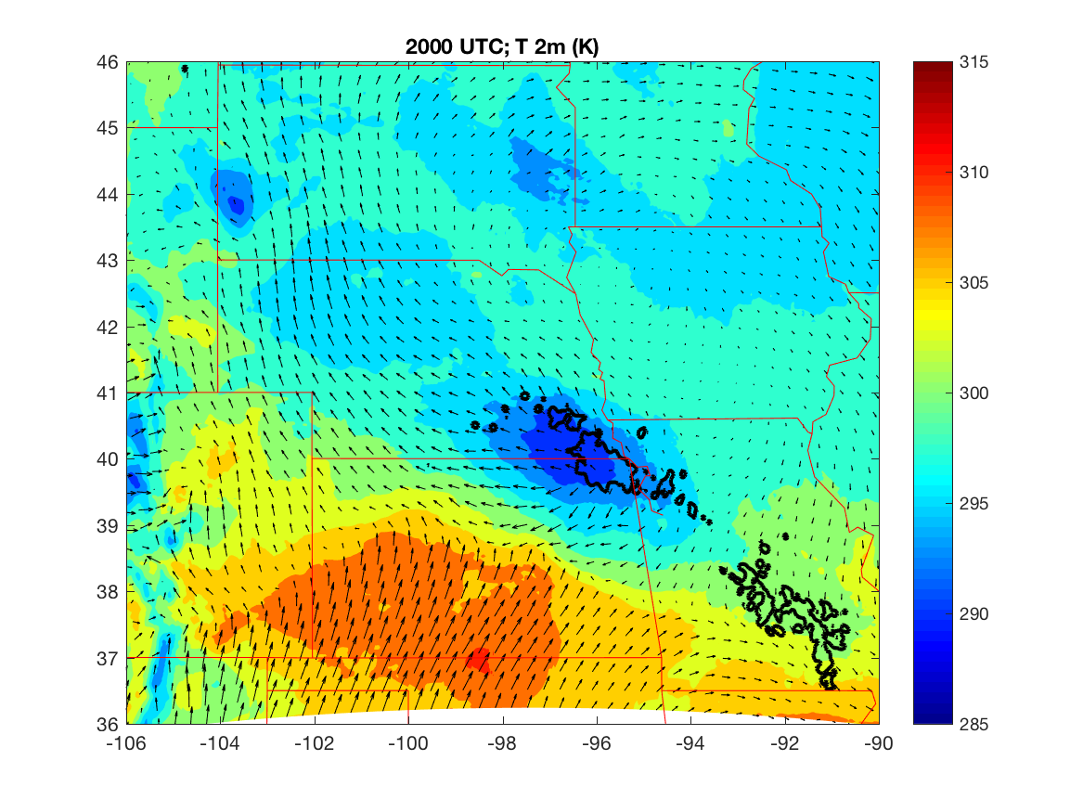
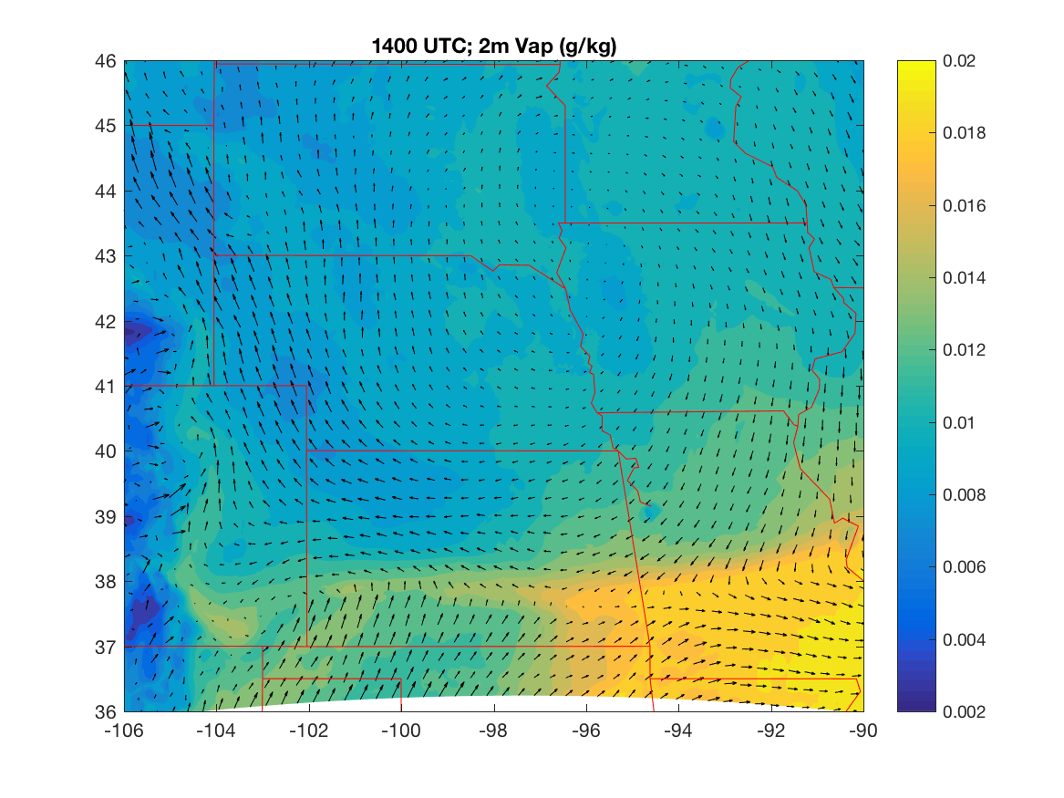
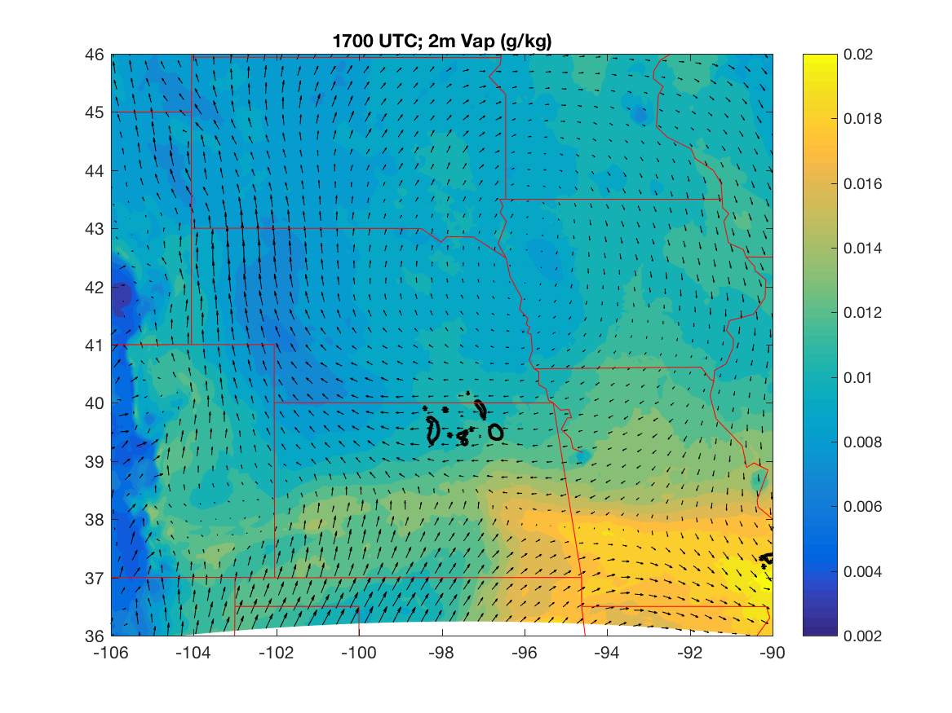
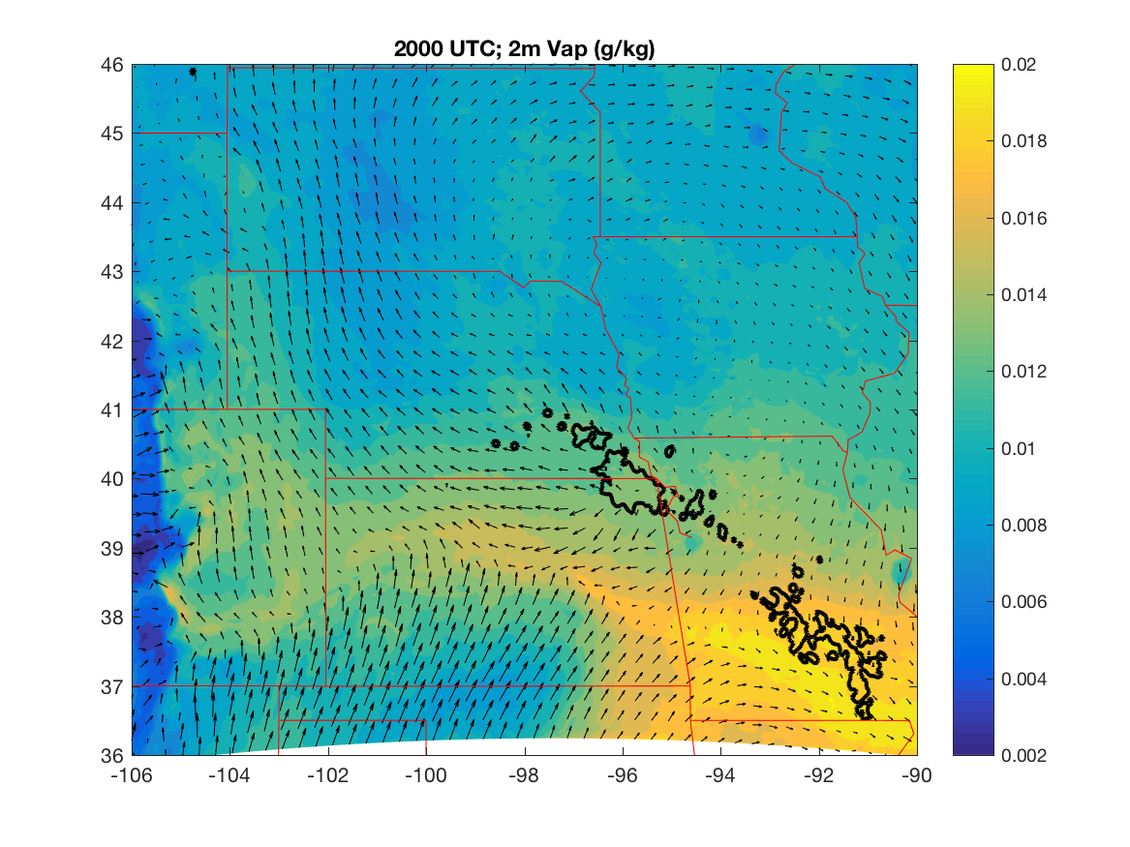
Preliminary mesoscale DA analyses
Hourly DA of routine surface, AMDAR, radiosonde to 3-km grid
CAVEAT: really really really really preliminary…. really
23(-24) June
1400 UTC (CI -15 hr)
1700 UTC (CI -12 hr)
2000 UTC (CI - 9 hr)
Low-level
T (K)
Lat
Precip
Low-level
Vap. Mix.
Ratio (kg/kg)
Lat
Precip
Lon
Lon

Slide 33
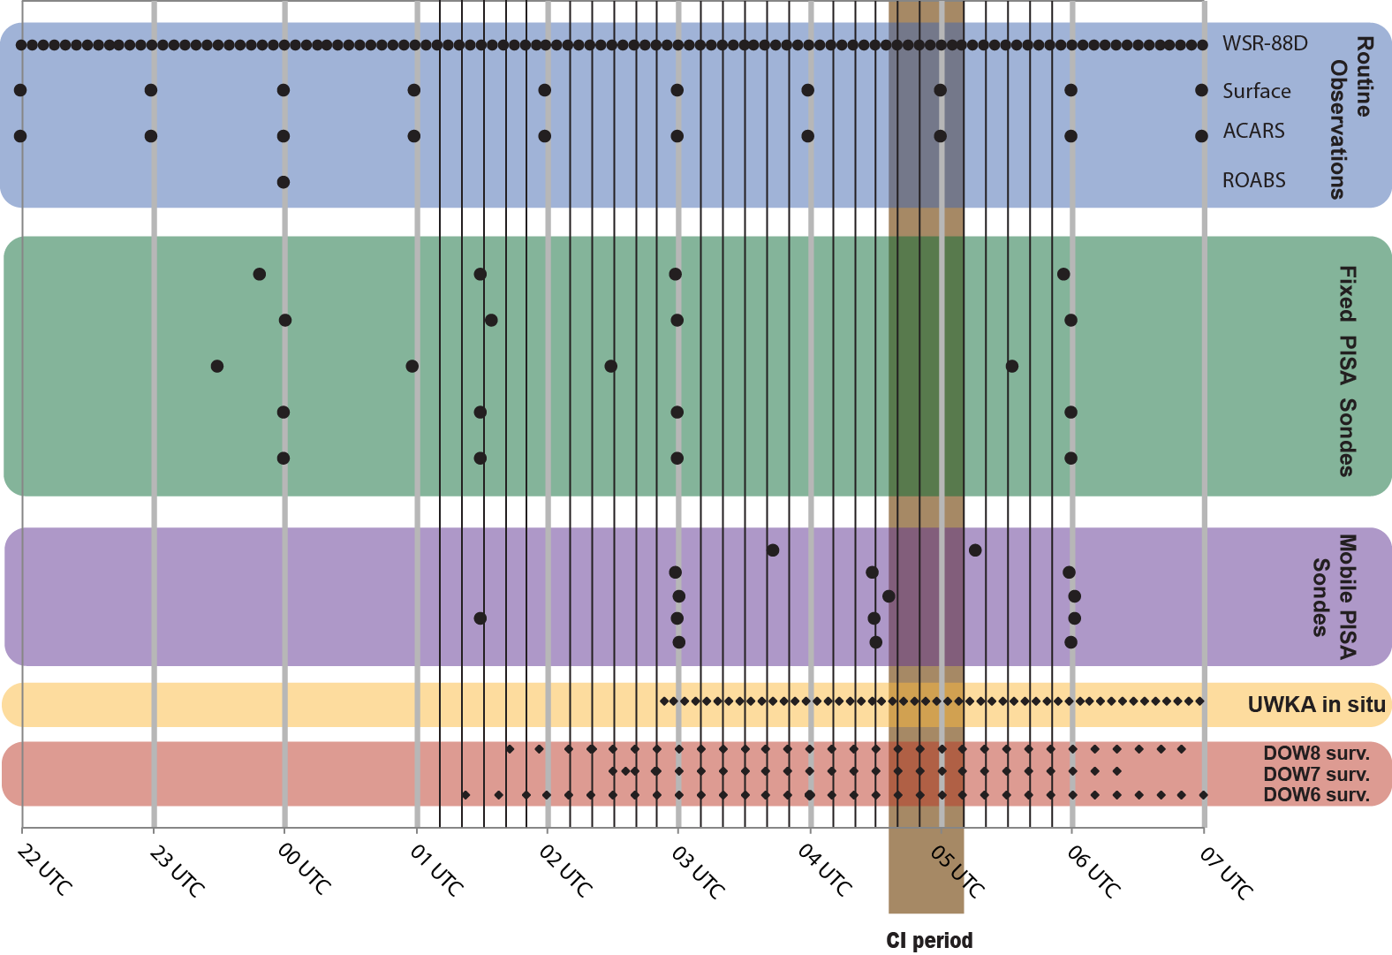
23-24 June; CI in SE Nebraska
DA to storm-scale grid
10-min assimilation of:
  Surface met
  AMDAR
  Fixed PISAs (if applicable)
  WSR-88D dBZ & velocity
  Mobile PISAs
  Mobile radar velocity
  UWKA aircraft in situ
  Mobile asset surface met

Slide 34
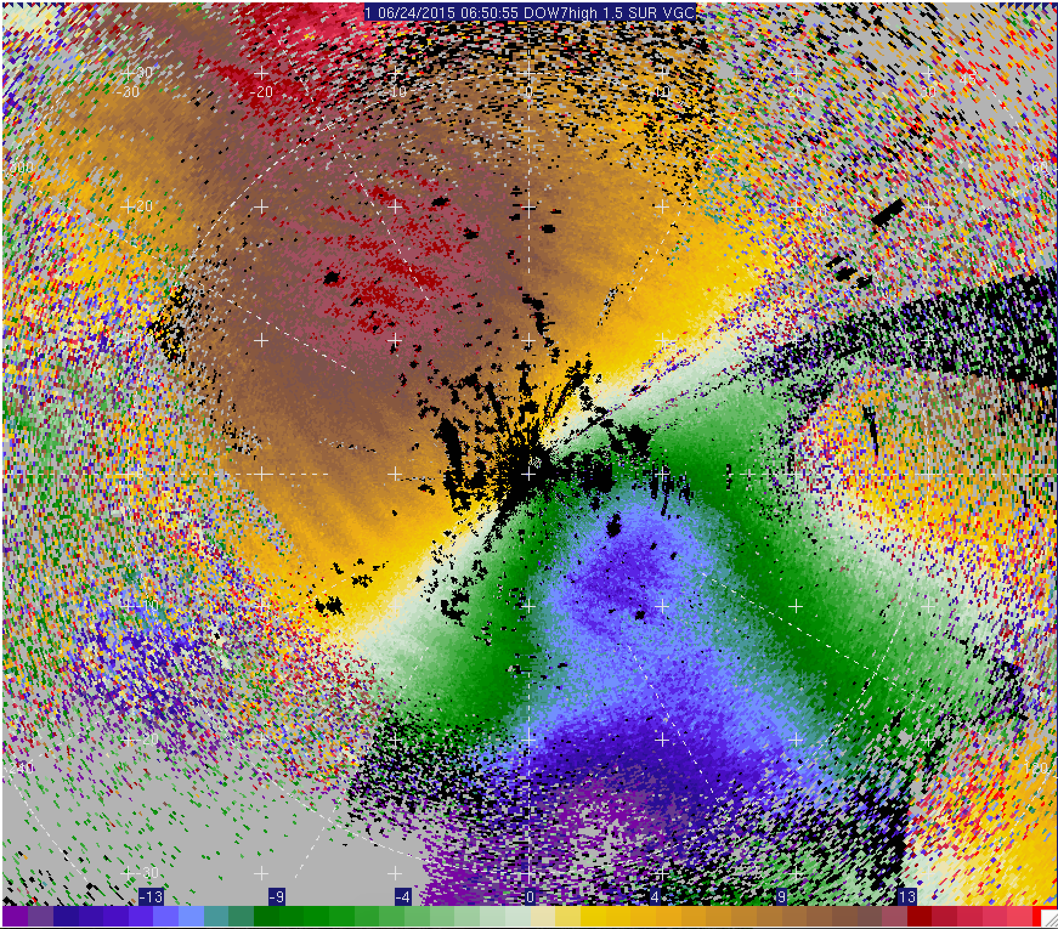
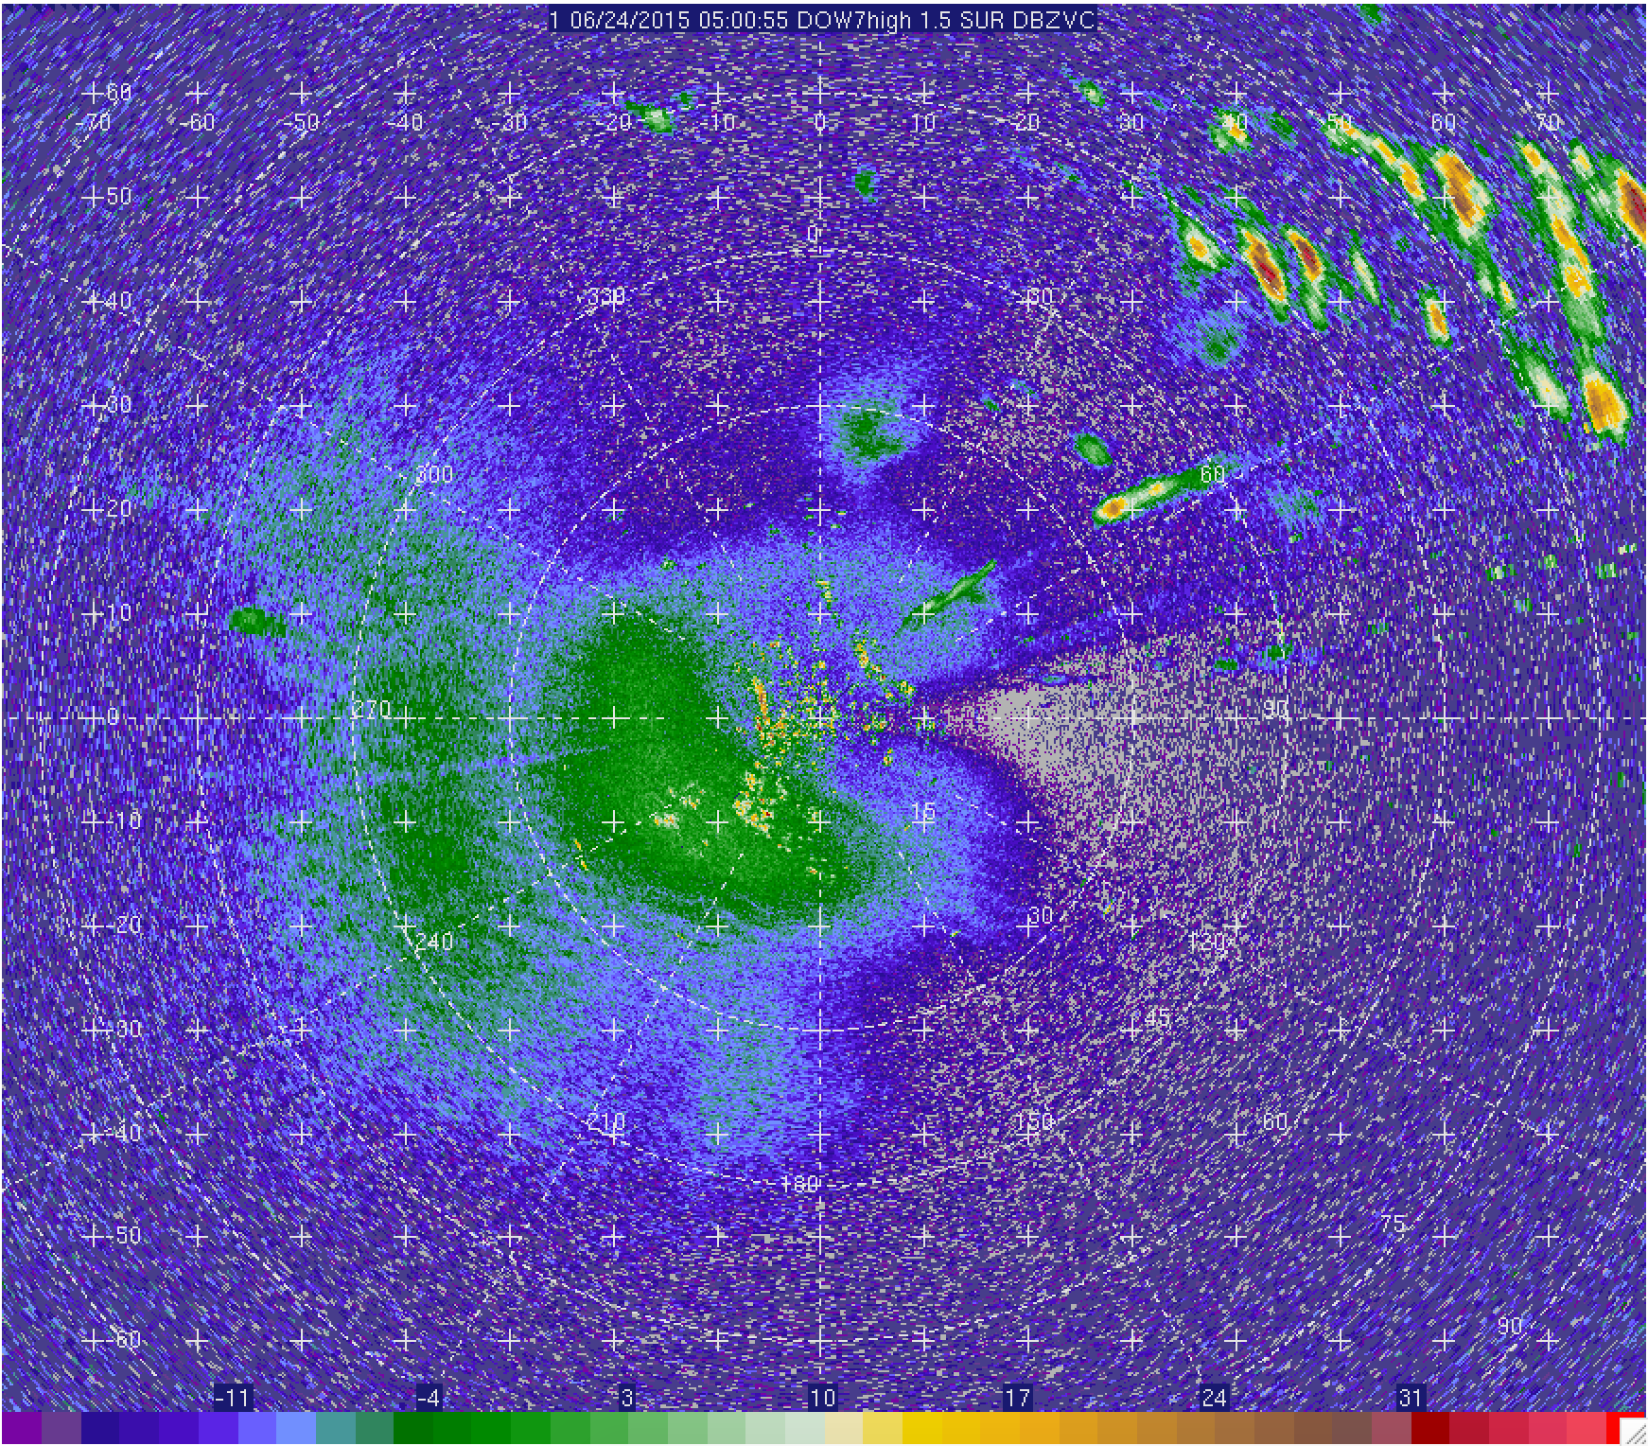
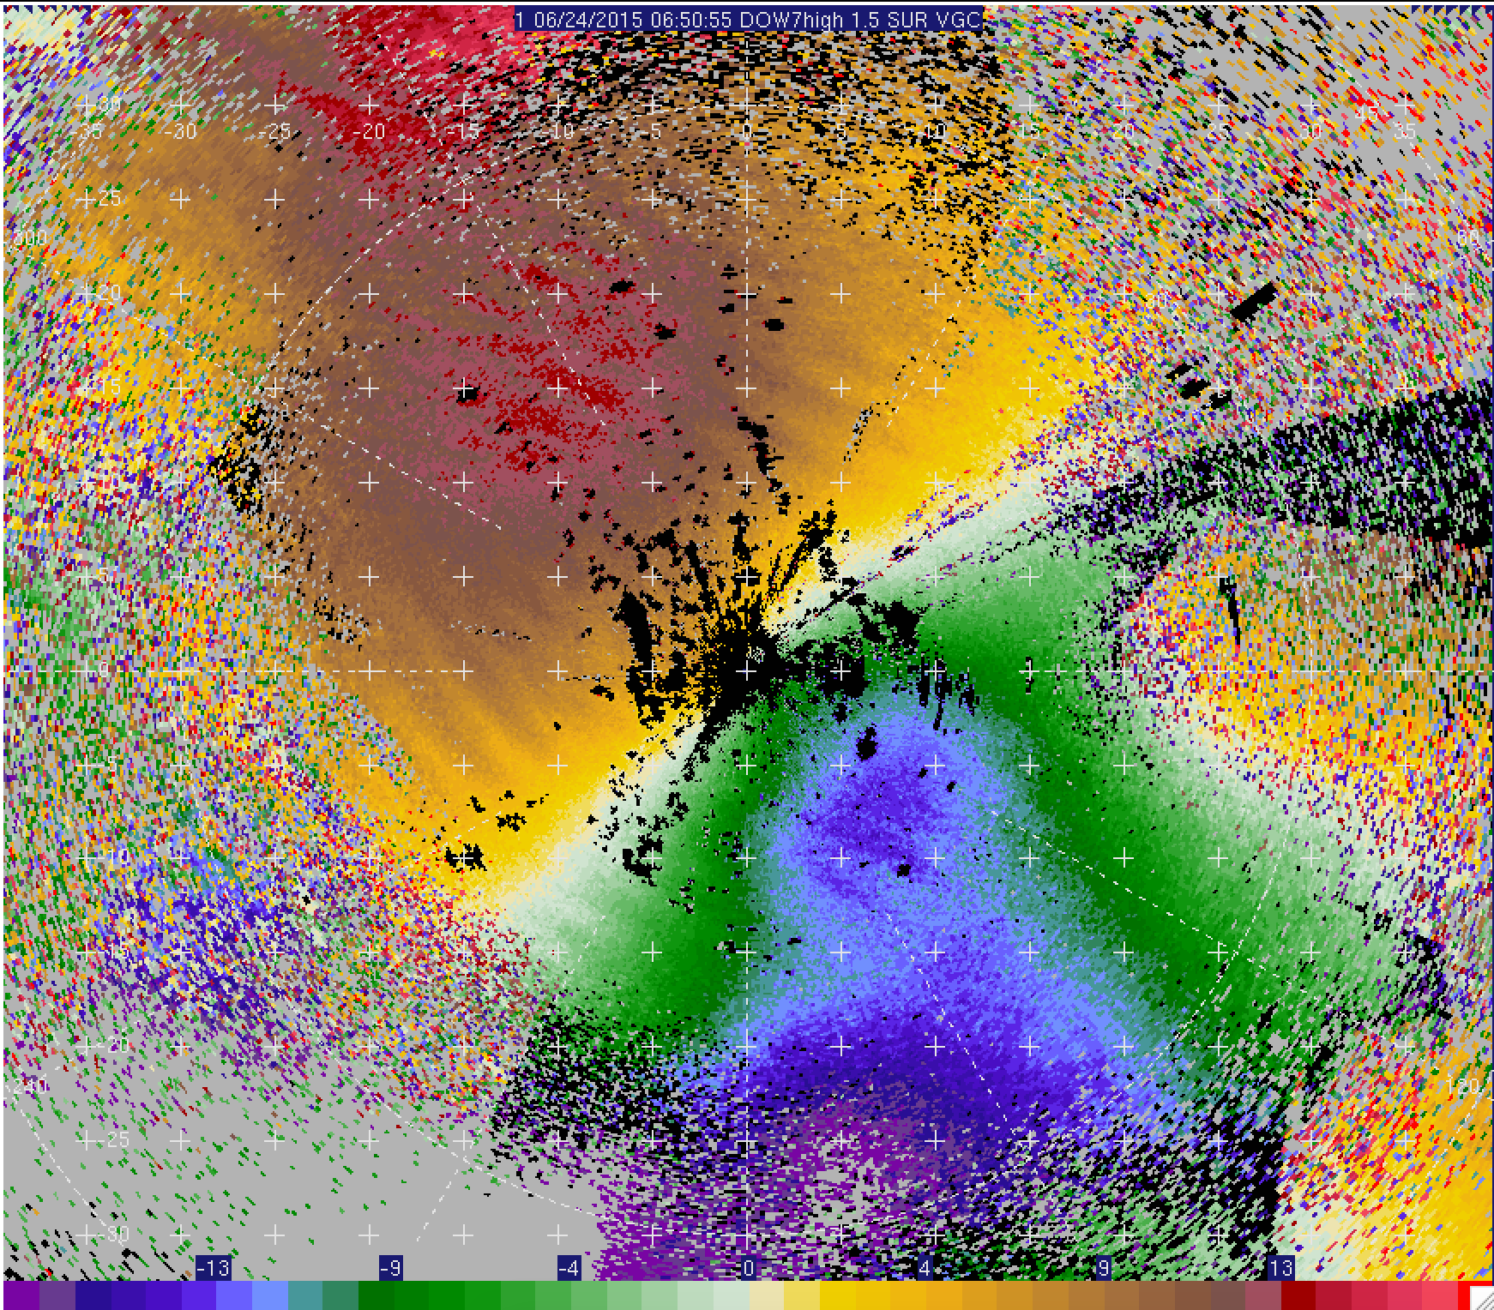

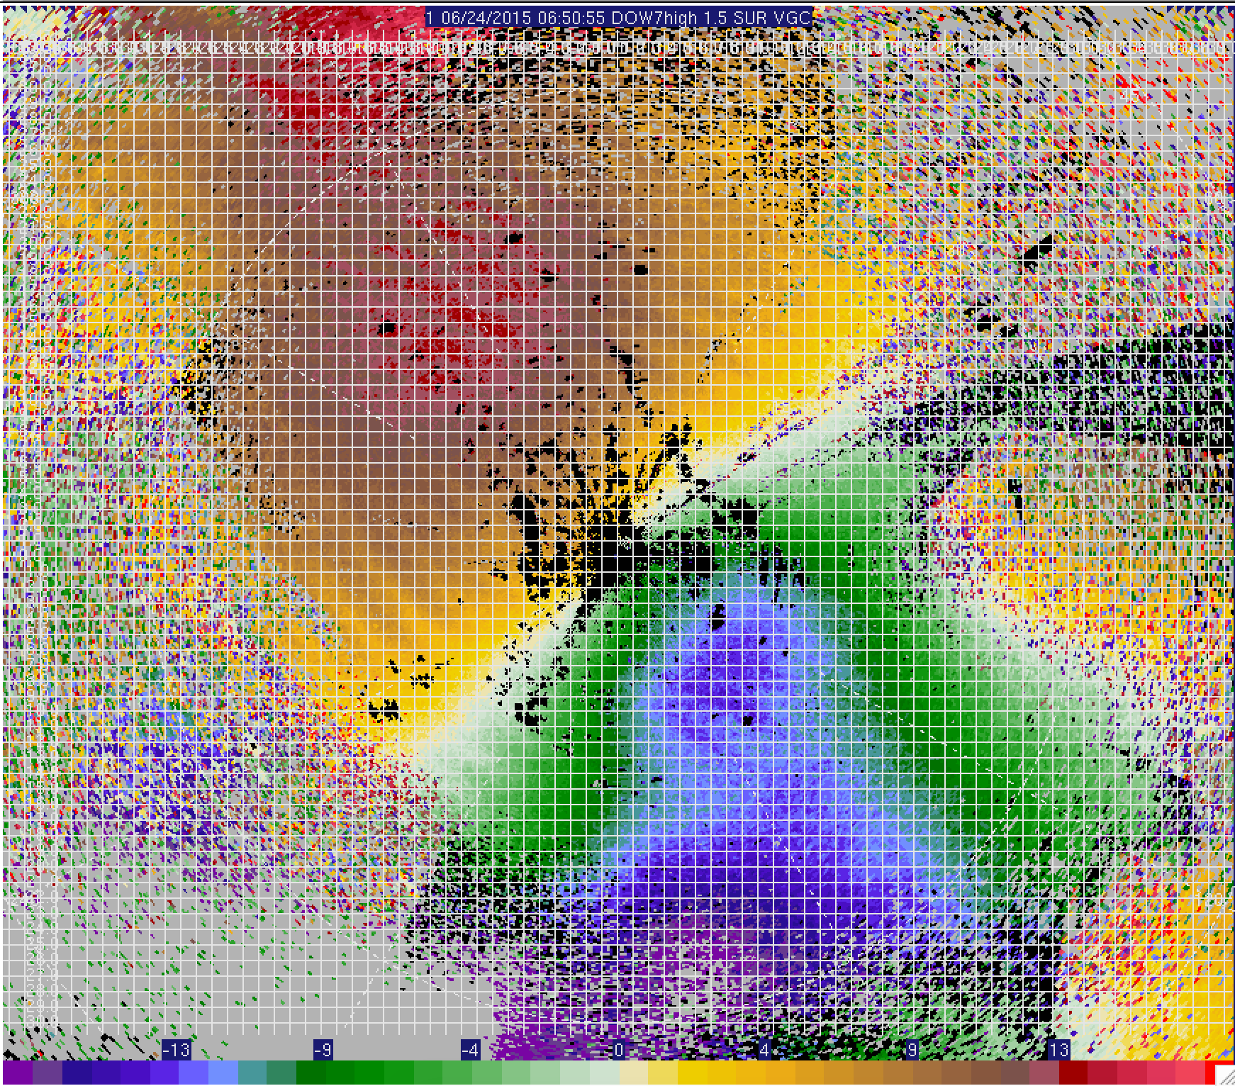
23-24 June; DOW7
Clear-air
signal
Target CI
10-km
5-km
2-km
Scale of obs appropriate for analyses
1-km

Slide 35
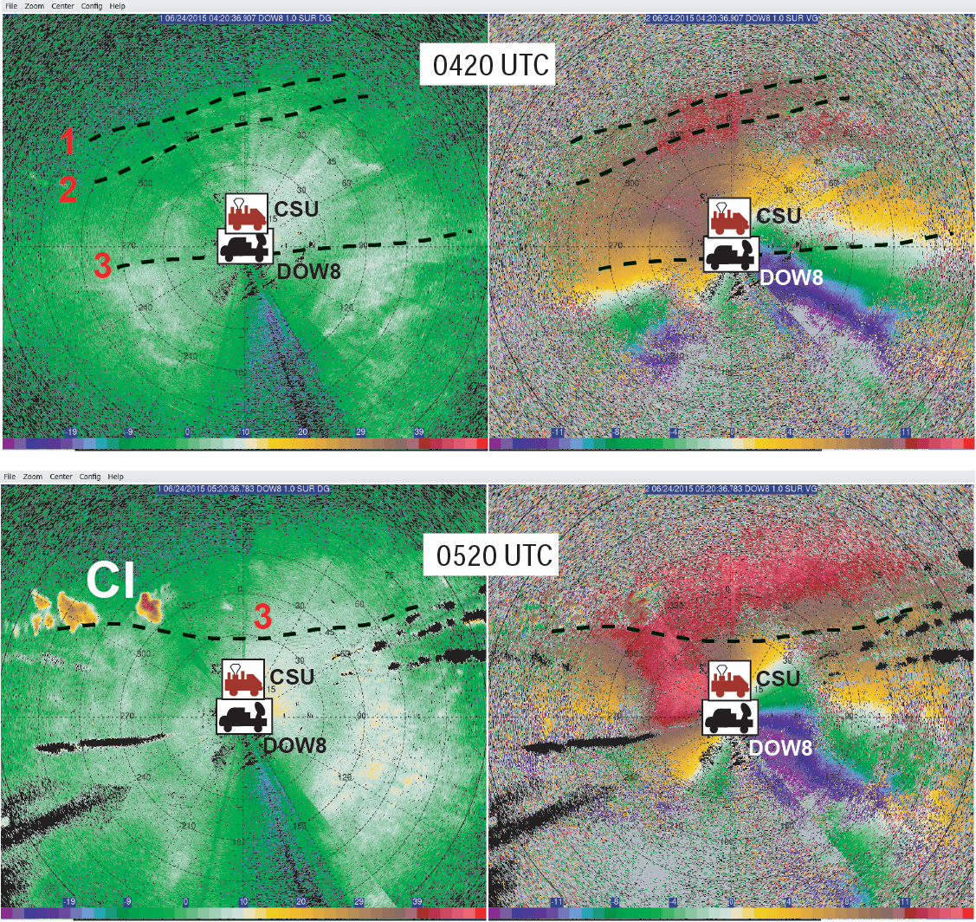
23-24 June
Fine-scale radar obs
Fine-scale boundaries possibly triggering CI?

Slide 36
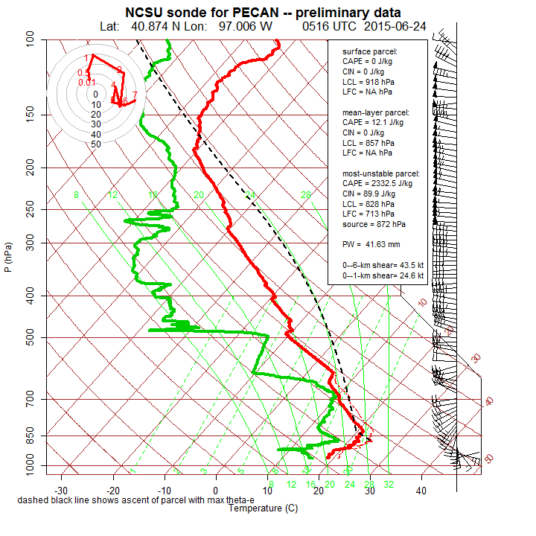
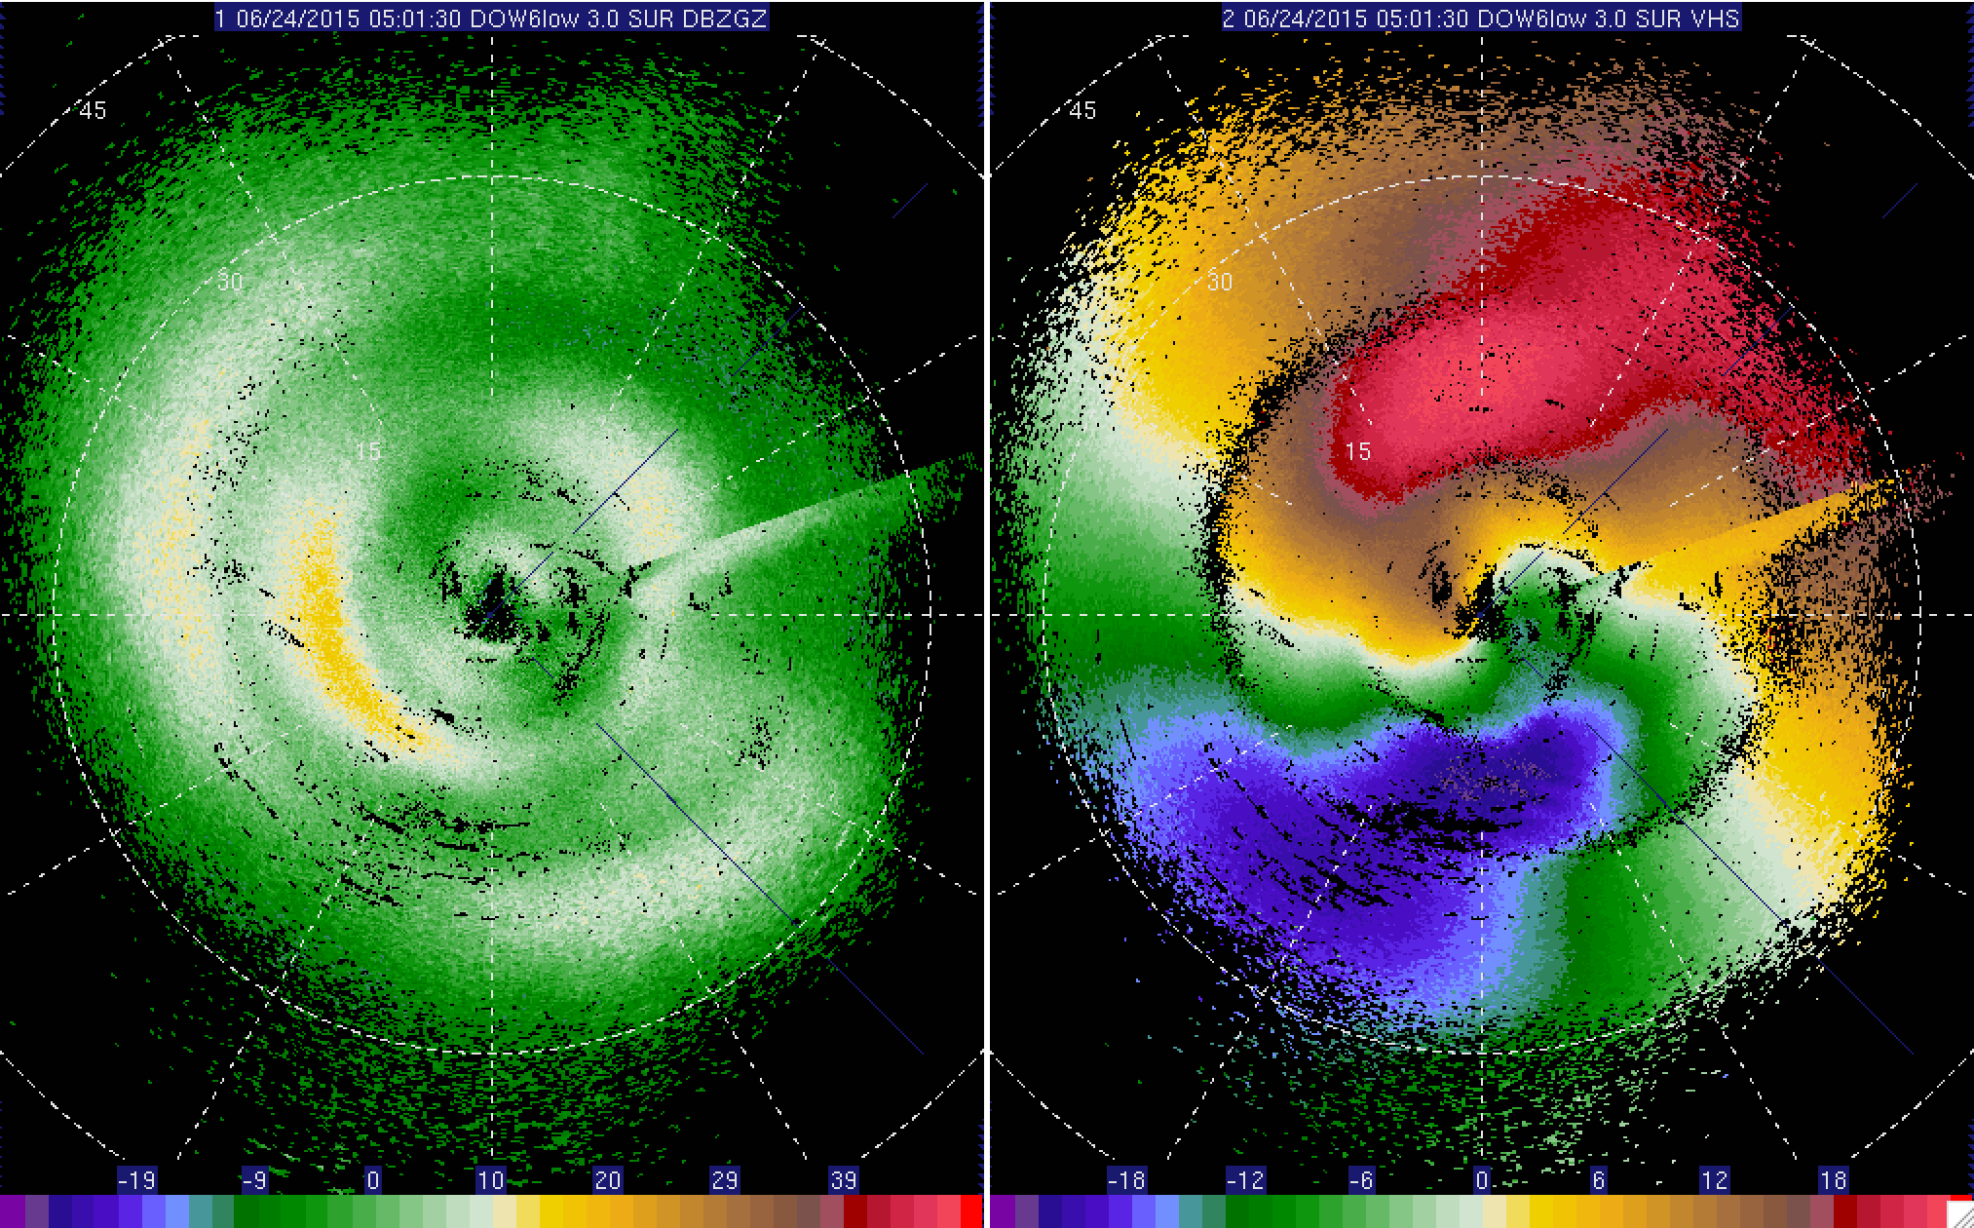
Fine-scale radar obs
23-24 June
Multiple shear zones seen by mobile radars
Z = 1000m
Z = 450m
Shear/air mass Layers:
Warm front?
Cold pool?
NBL?
LLJ?
Z = 900m

Slide 37
Future DA Goals
Very near future: WSR-88D, SPOL, and fixed PISA data to mesoscale grid.
Near future: Nest storm-scale grid and DA of mobile radars, Mobile PISAs, UWKA in situ, surface met.
Near-ish Future:
Explore impacts of assimilating:
  SPOL refractivity to mesoscale grid
  Fixed/Mobile PISA obs to storm-scale grid (10-min vs. 1.5-hr for sondes). DIAL, AERI, wind profiler data.

Slide 38
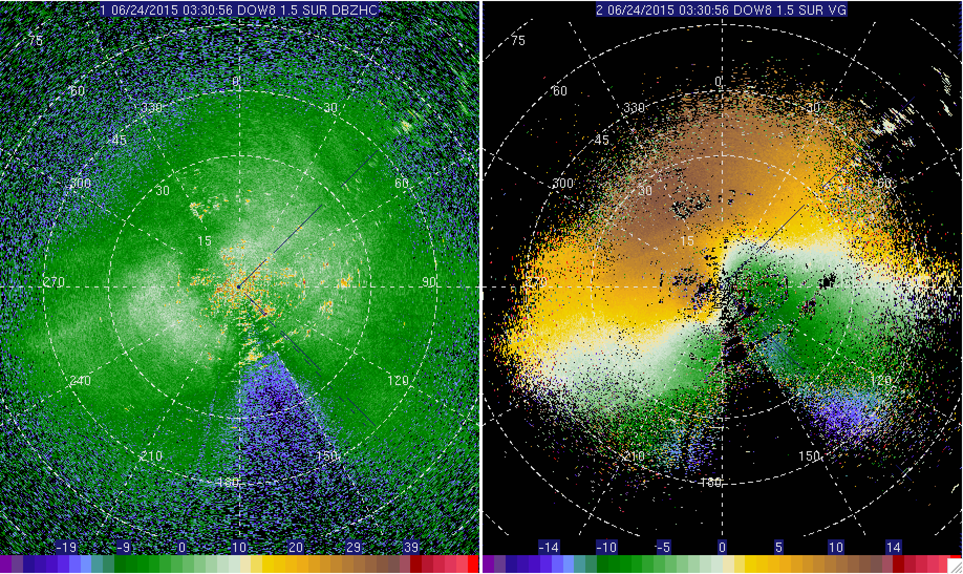
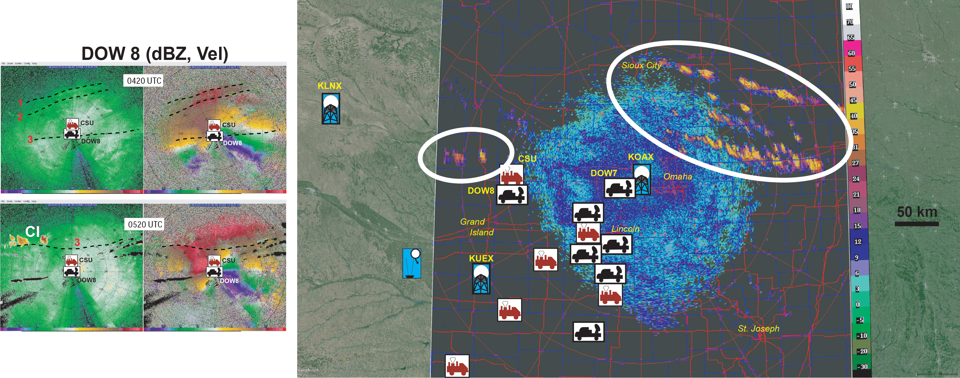
23-24 June

Slide 39
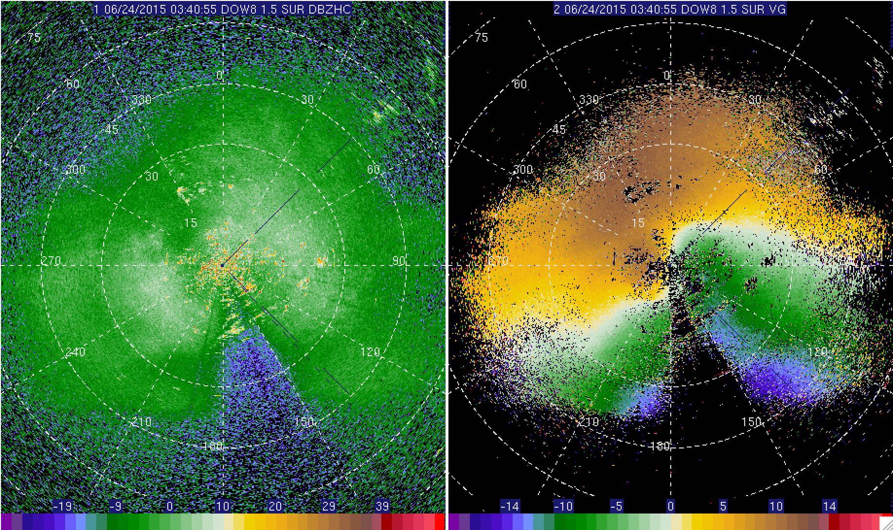
23-24 June

Slide 40
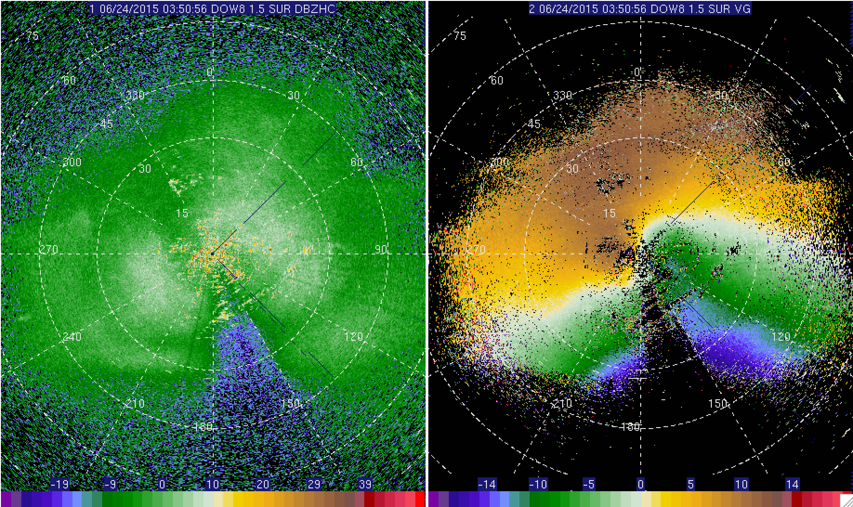
23-24 June

Slide 41
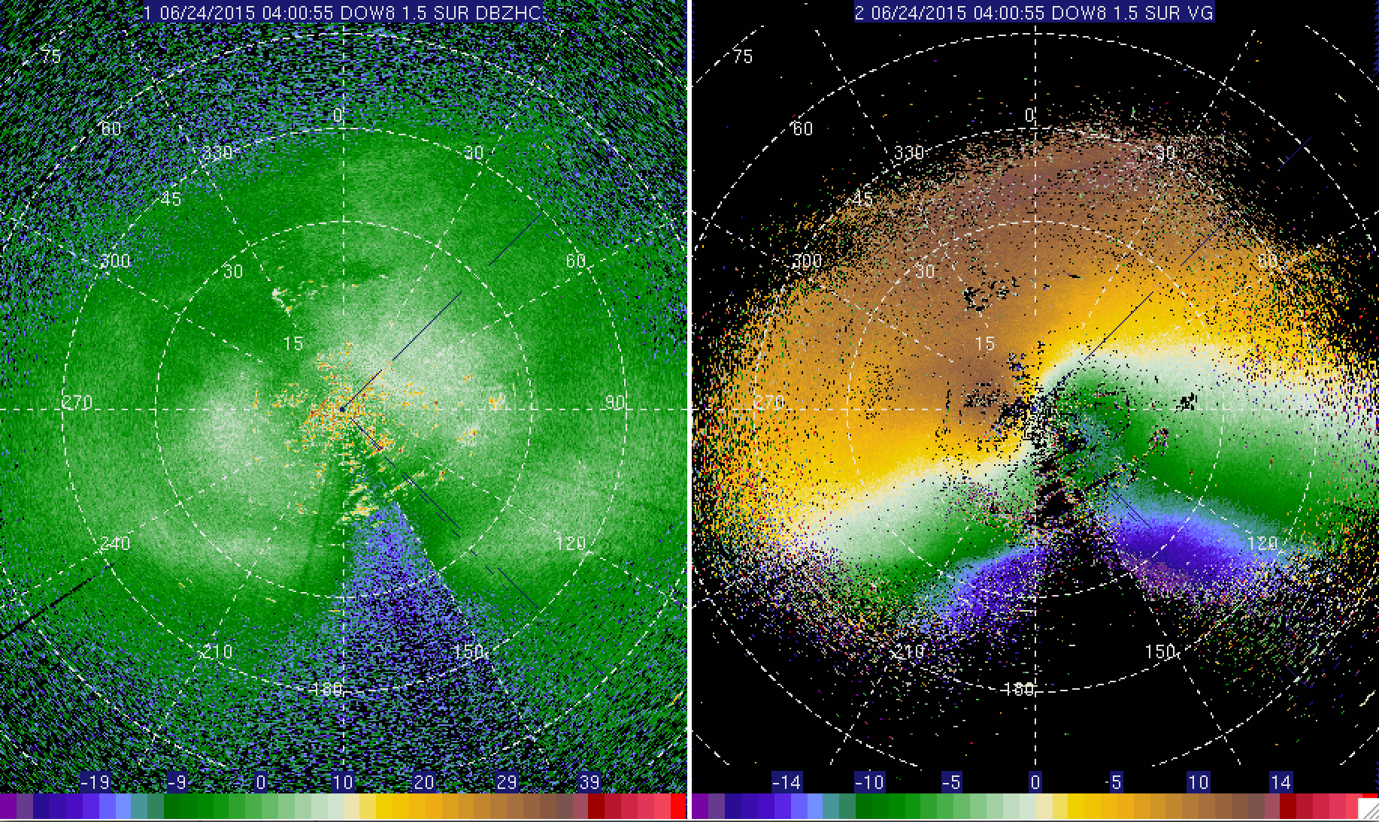
23-24 June

Slide 42
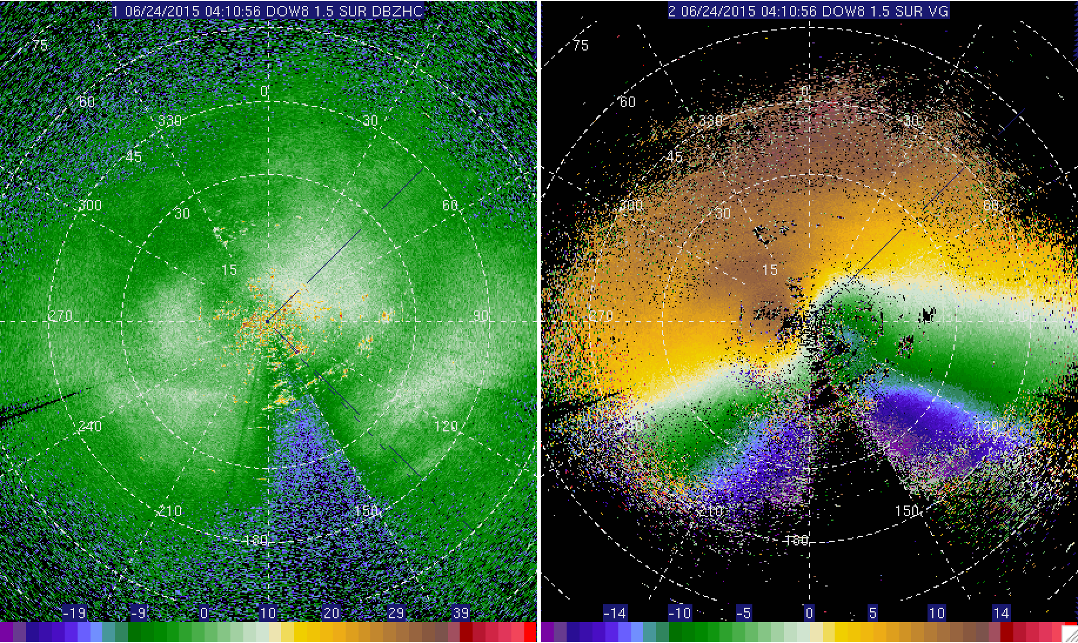
23-24 June

Slide 43
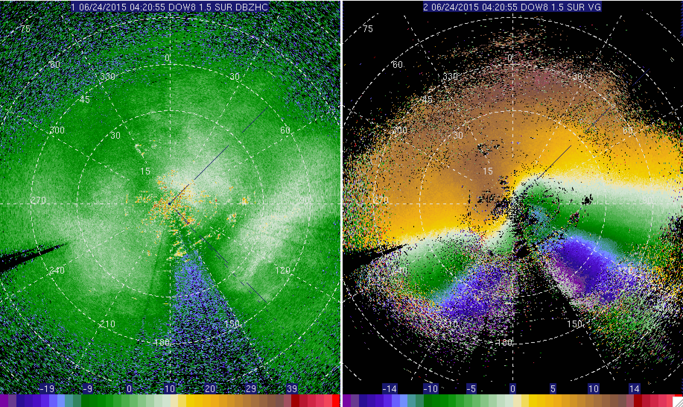
23-24 June

Slide 44
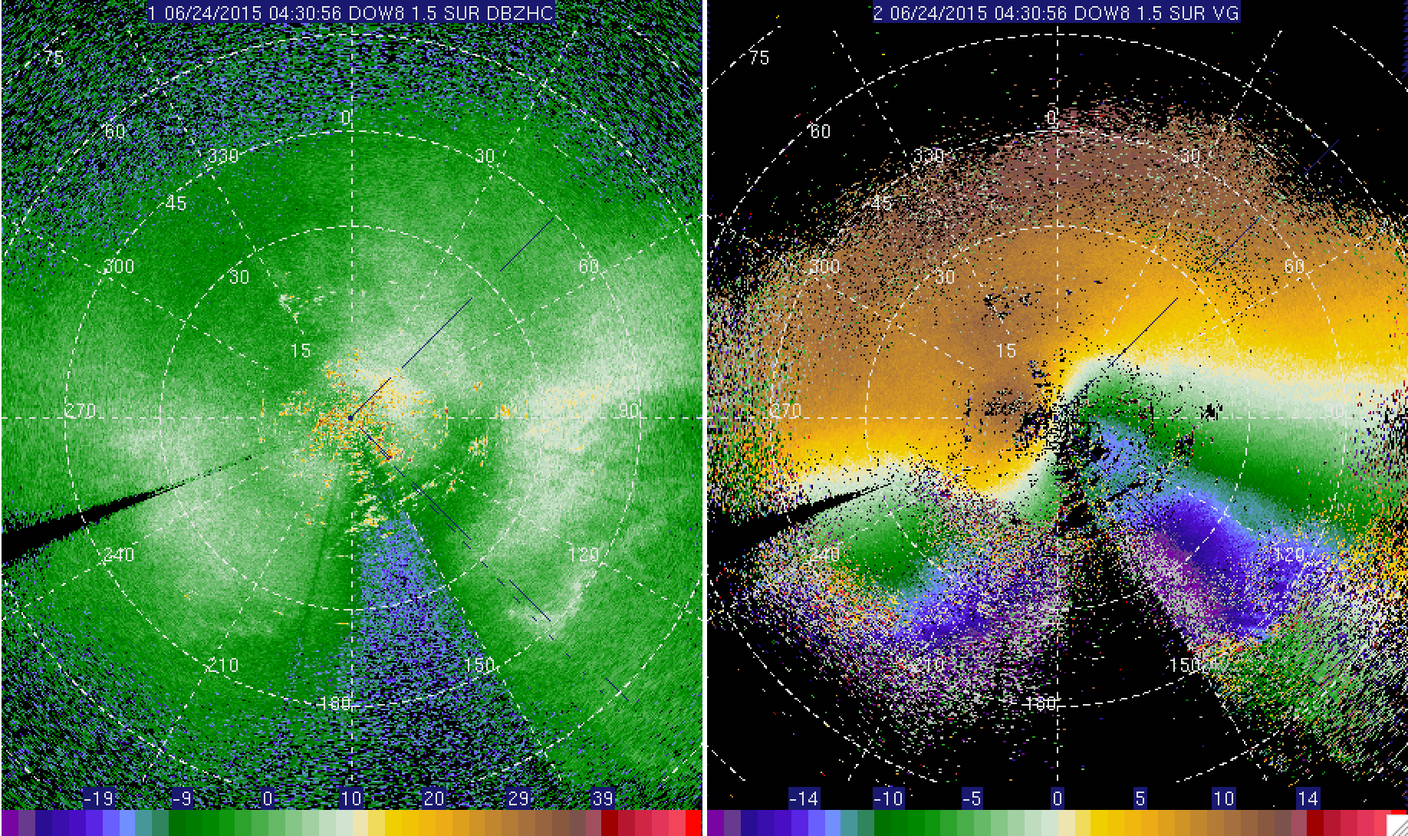
23-24 June

Slide 45
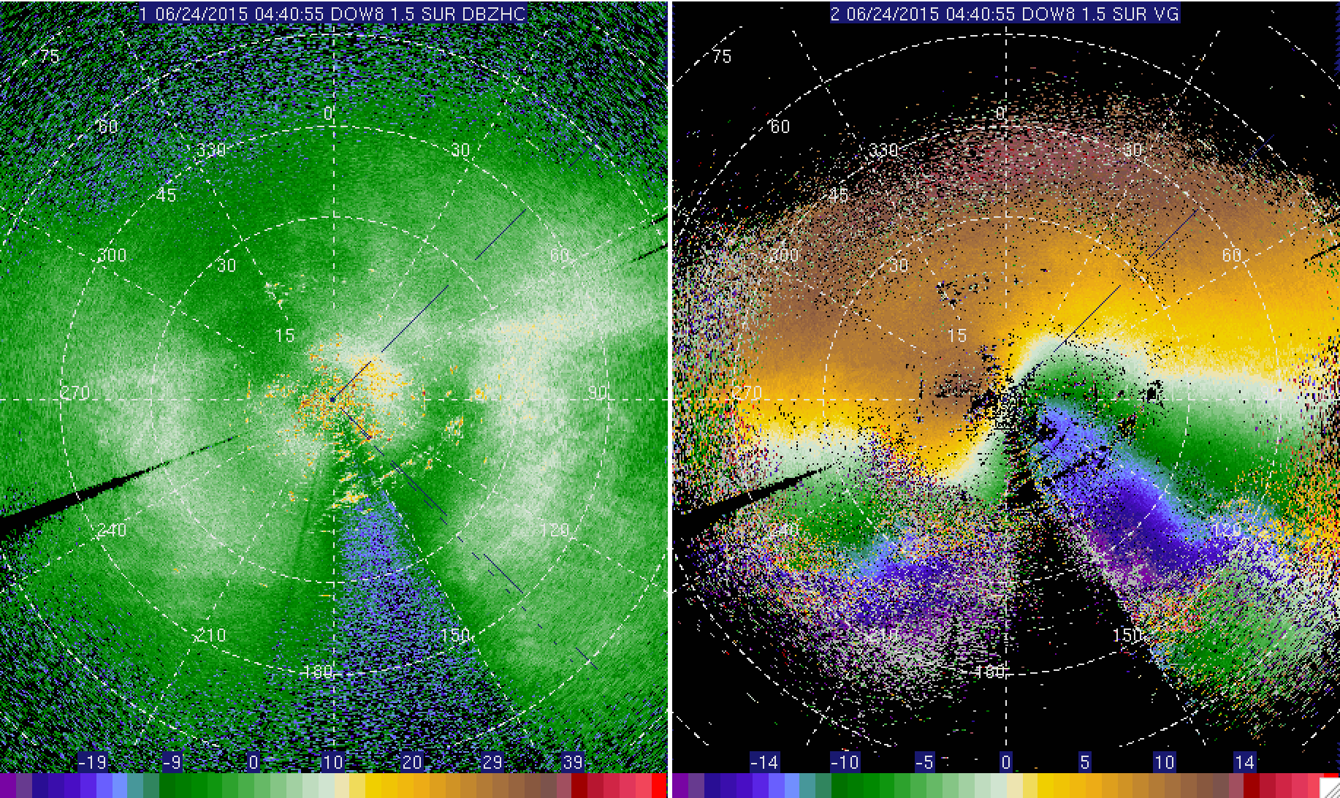
23-24 June

Slide 46

23-24 June

Slide 47

23-24 June

Slide 48

23-24 June

Slide 49

23-24 June

Slide 50

23-24 June

Slide 51

23-24 June

