Slide 1
Elevated Convection Initiation on 24 June 2015: A Case Study
Scott Kehler [M.Sc. Candidate]
John Hanesiak [Advisor]
Department of Environment and Geography
Centre for Earth Observation Science
University of Manitoba, Winnipeg, Manitoba, Canada

Slide 2
Overview
What happened on 24 June 2015?
What assets were deployed
Synoptic-scale overview
Structure of the warm front
Trajectories of parcels in the frontal zone
WRF Simulation
Early conclusions
Future Study

Slide 3
What Happened? Radar Loop
The Omaha Valley radar loop (OAX) from 0300 to 0800 UTC
Black star is the UW King Air
Red dots are MPs, a black circle appears when they launched a sonde

Slide 4
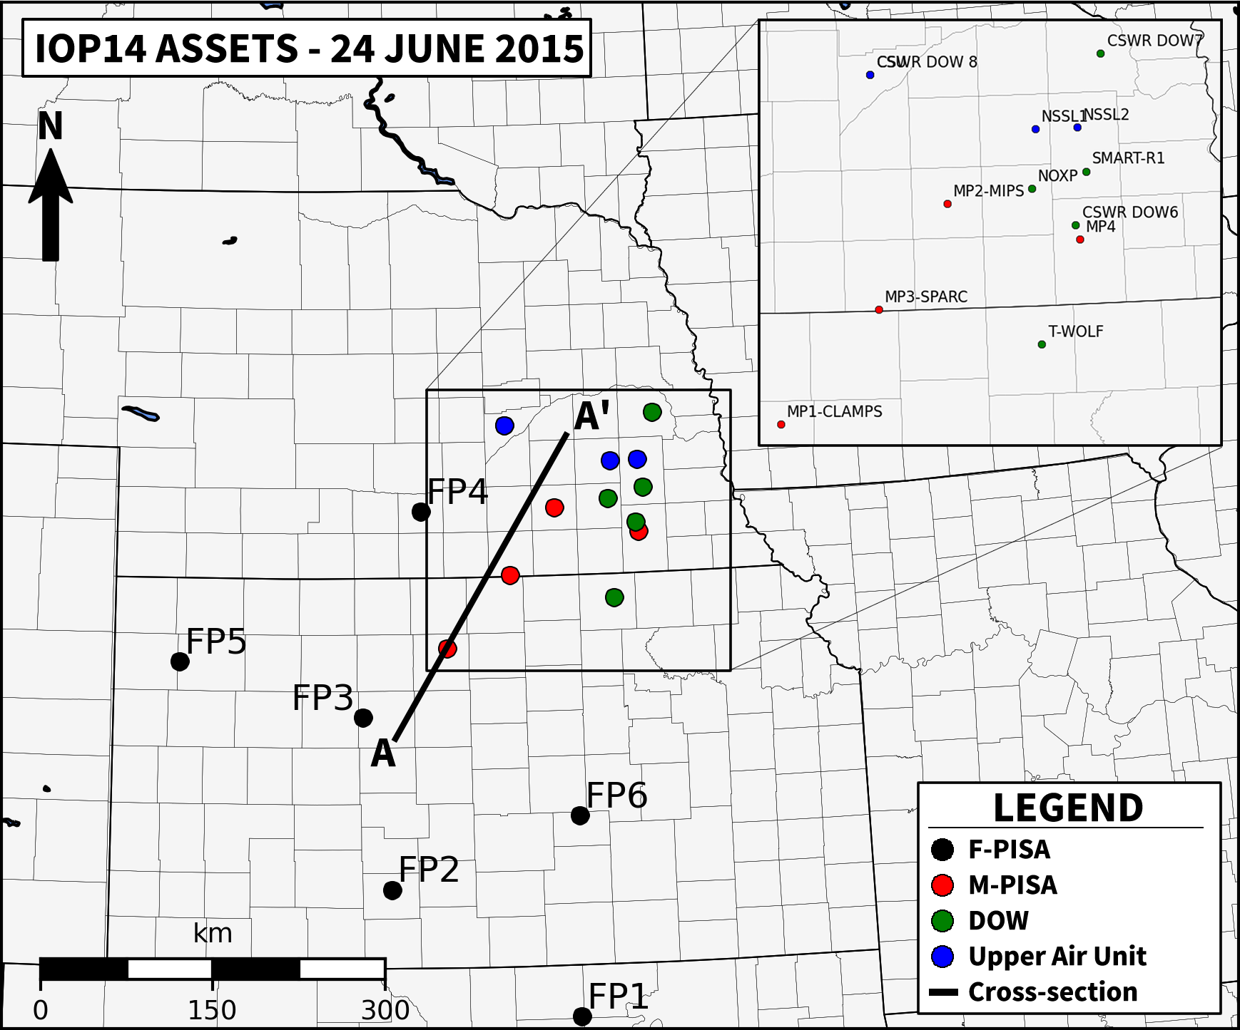
Asset Deployment
The line from A to A’ is the cross-section shown later using the rawinsondes launched by MPs along that line
Convection developed approximately within the red oval – no assets directly beneath the convection

Slide 5
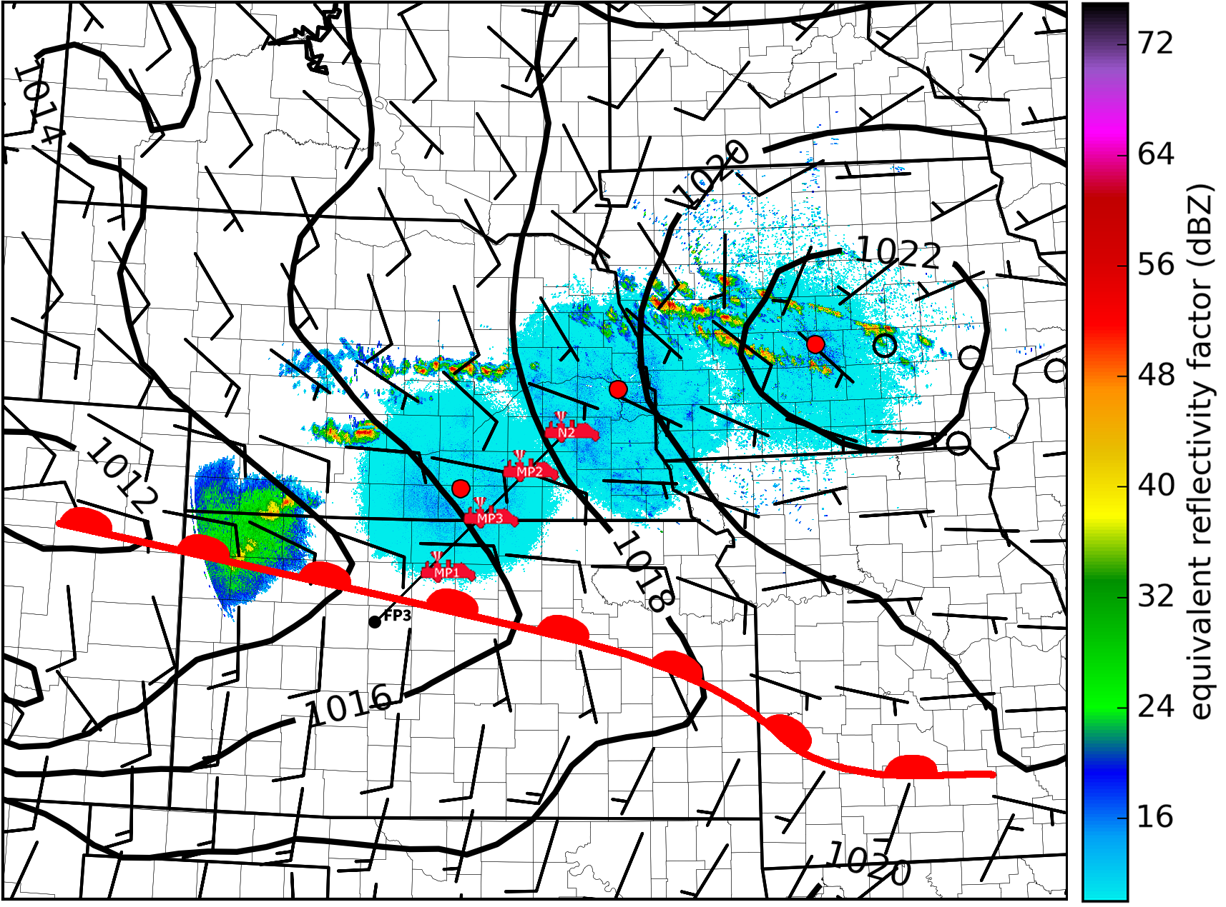
Surface Map
A warm front was located through Kansas at 0600 UTC
MPs were deployed along a line normal to the front
Convection initiated poleward of the front just before 0500 UTC
Surface Map at 0600 UTC

Slide 6
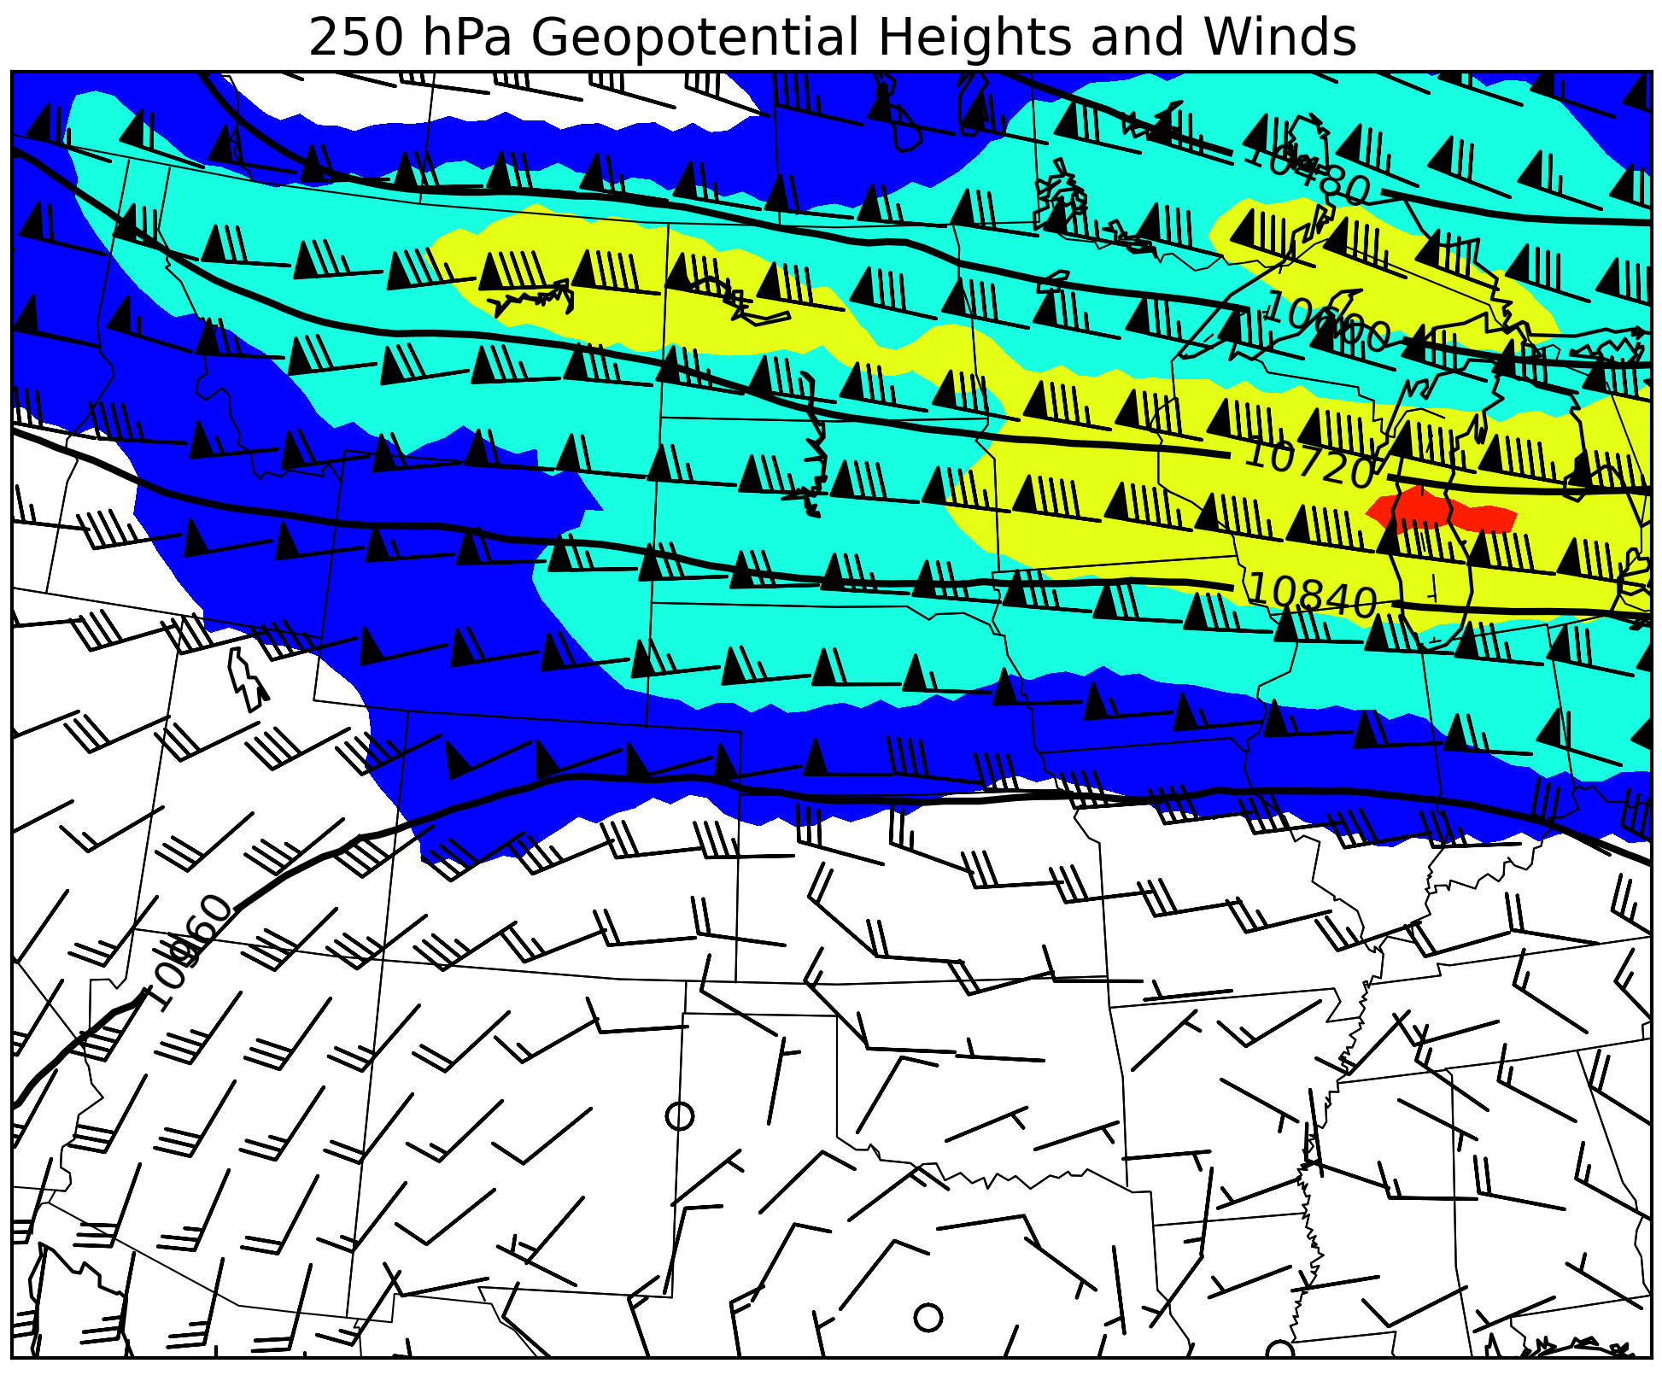
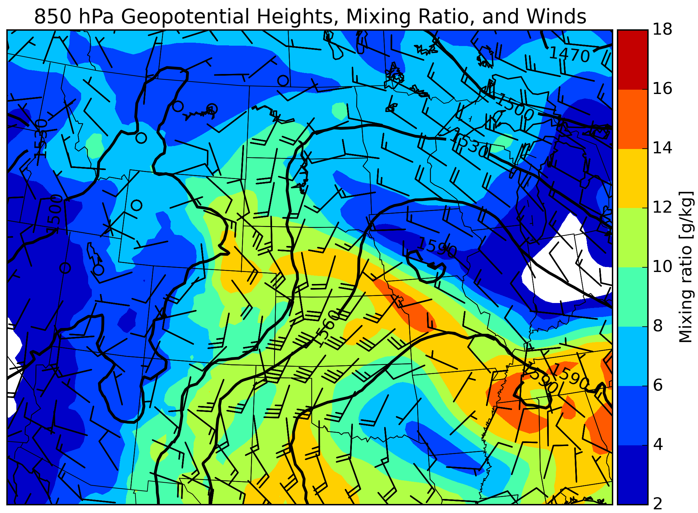
Synoptic-Scale Overview
Maps at 0600 UTC 24 June from the NARR (Mesinger 2006)
LLJ intersected the warm front at a right angle
Approximate surface warm front location at 0600 UTC in red

Slide 7
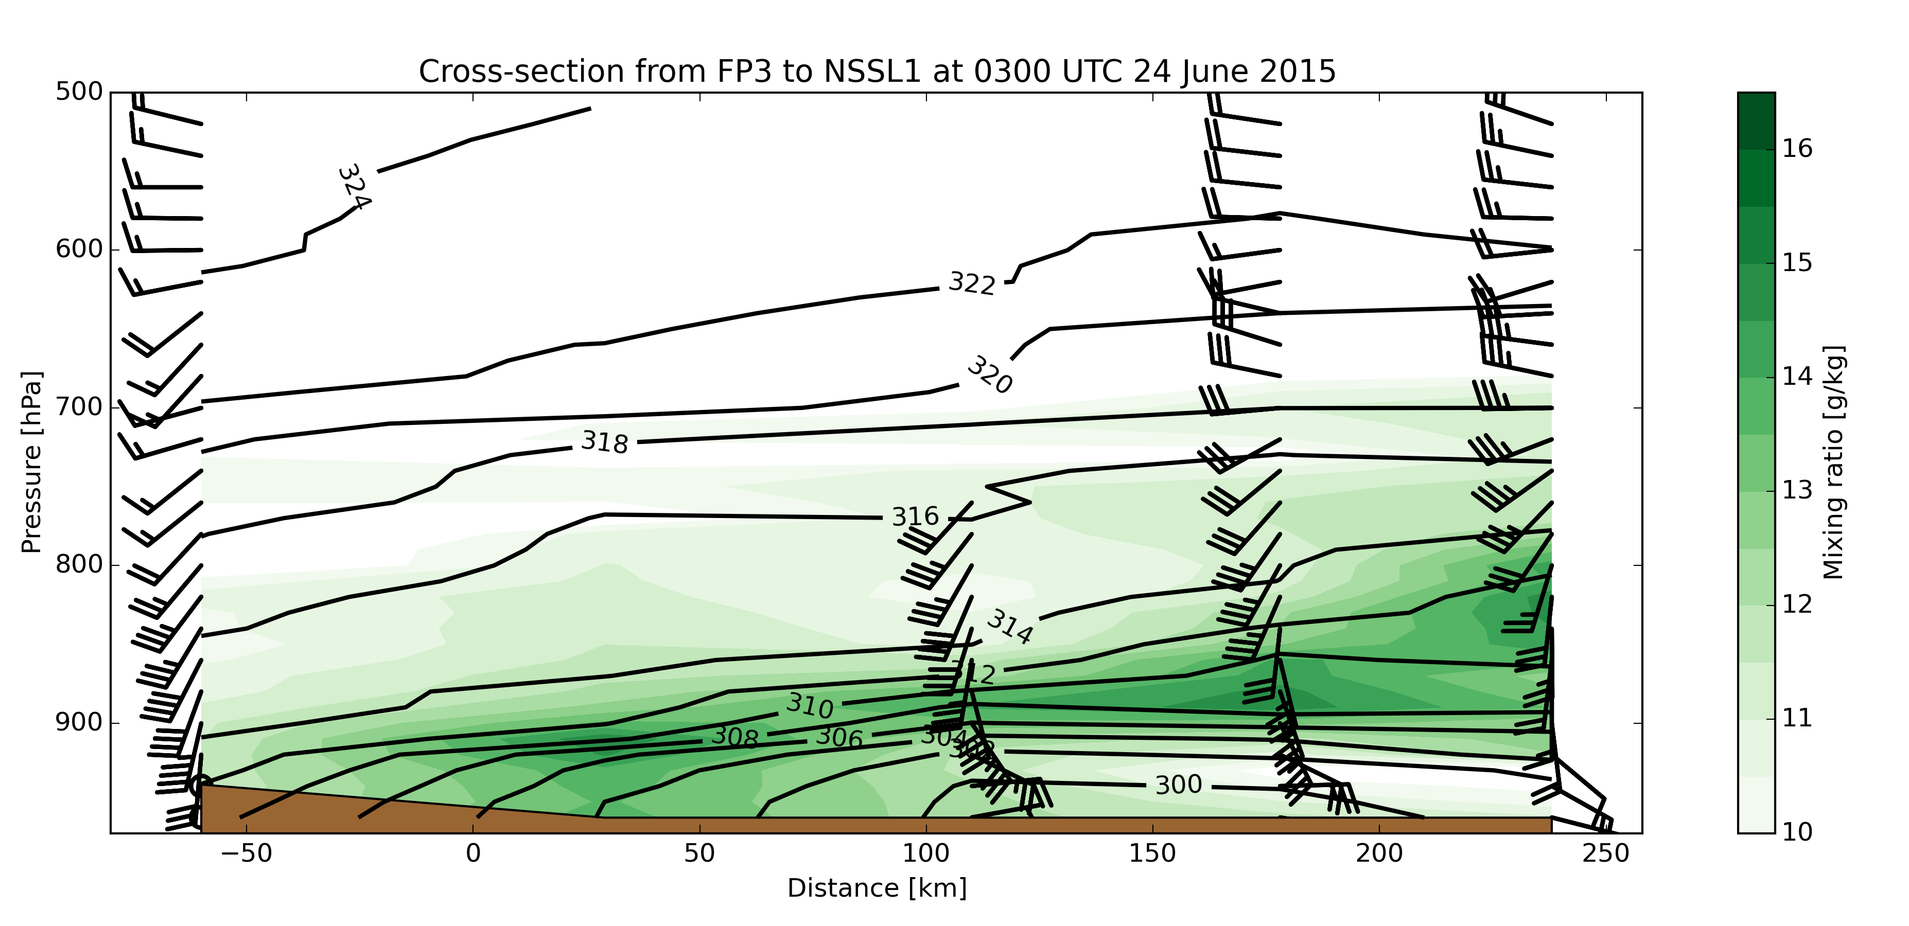
Frontal Structure – 0300 UTC
Cross-section at 0300 UTC along the line A to A’ shown previously (0 km is surface front location)
The frontal slope is 1:180 on average at this time
A narrow stream of moisture can already be seen along the frontal surface
Virtual potential temperature (solid black) and mixing ratio (shaded green)

Slide 8
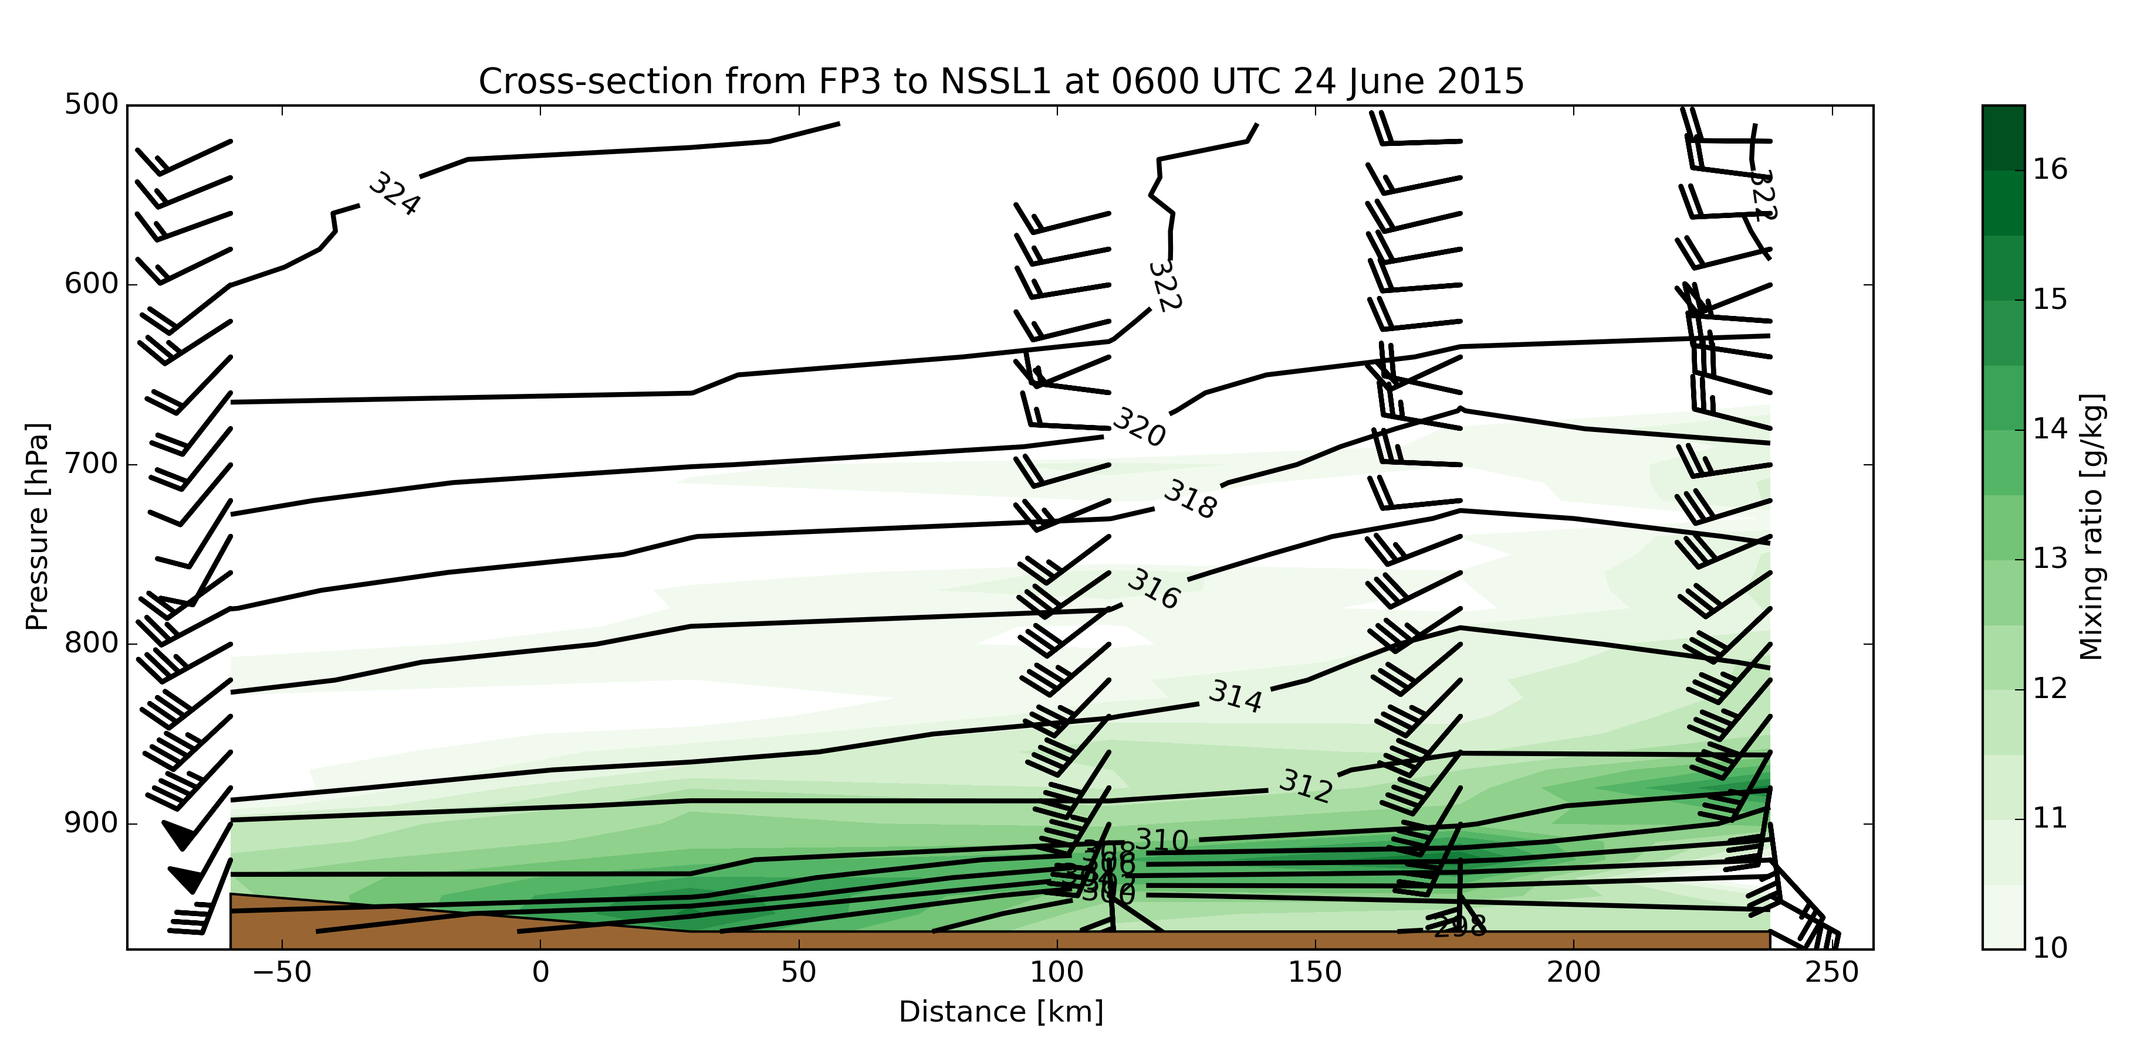
Frontal Structure – 0600 UTC
Cross-section at 0600 UTC along the line A to A’ shown previously (0 km is surface front location)
The frontal slope declined to 1:320 on average at this time (similar to Trier and Parsons 1993)
The stream of moisture narrows further and the vertical gradient in theta-v increases
UWKA transect from 0300 to 0345 UTC – also shows narrow moisture
Virtual potential temperature (solid black) and mixing ratio (shaded green)

Slide 9
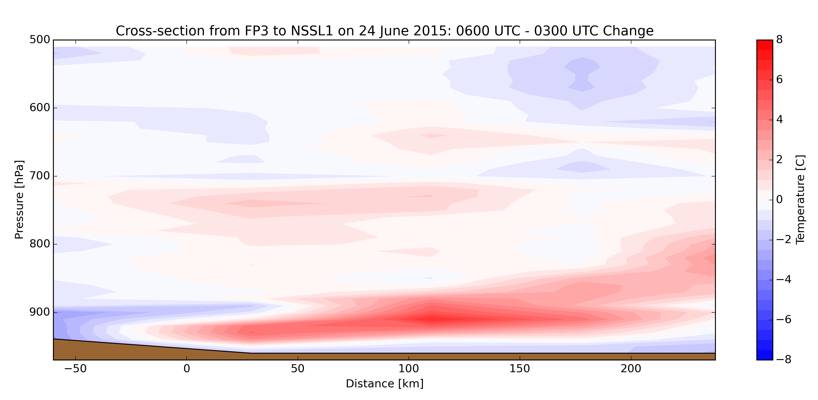
What Changed from 03 to 06 UTC?
Significant warm air advection occurred along the frontal surface between 0300 and 0600 UTC, increasing the vertical theta-v gradient
Nocturnal cooling also helped to tighten the gradient, as did moisture advection (since theta-v is a function of moisture and theta)
Temperature change along the cross-section (06-03 UTC)
Large temperature increase over 3-h period
Near-surface nocturnal cooling

Slide 10
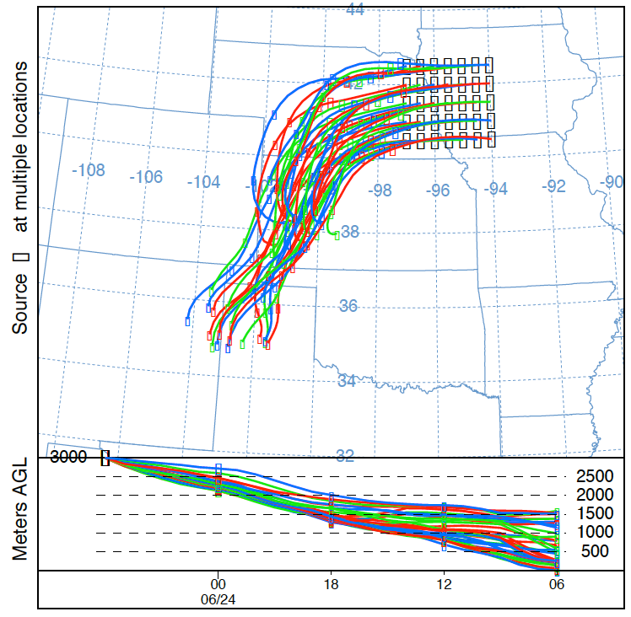
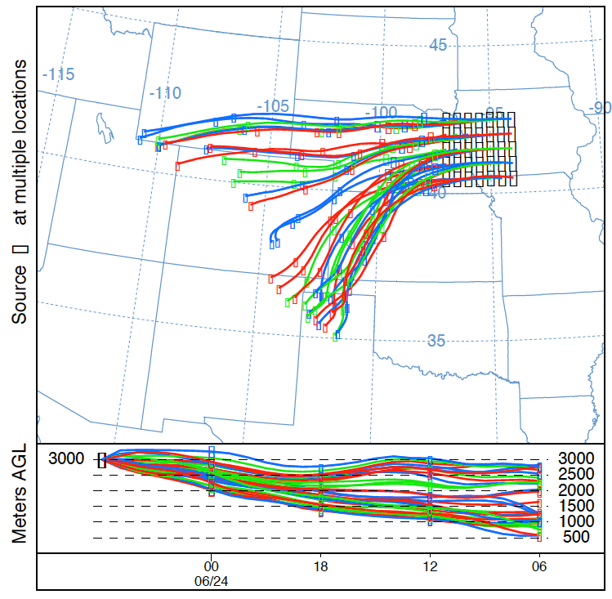
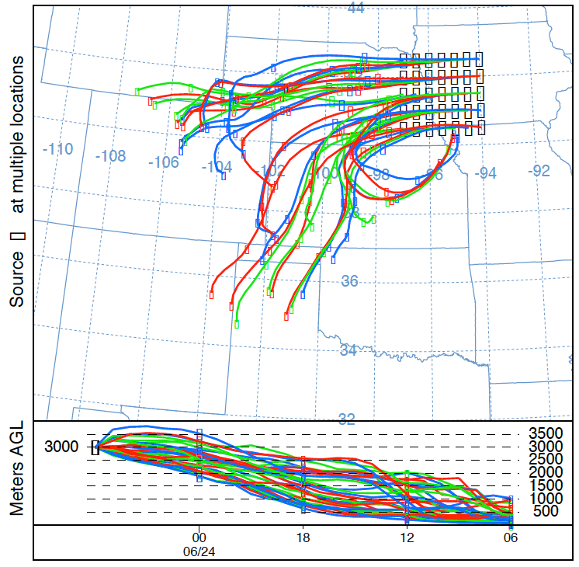
Parcel Trajectories
HYSPLIT (Draxler and Hess 1998; Stein et al. 2015) trajectories using the NARR dataset clearly show the parcels originated in the Texas/Oklahoma panhandles 24-h earlier
Some trajectories also came from northern Colorado/Wyoming, but did not contain significant moisture (moisture studied using sounding cross-sections)
Isentropic
Model VV
Divergence

Slide 11
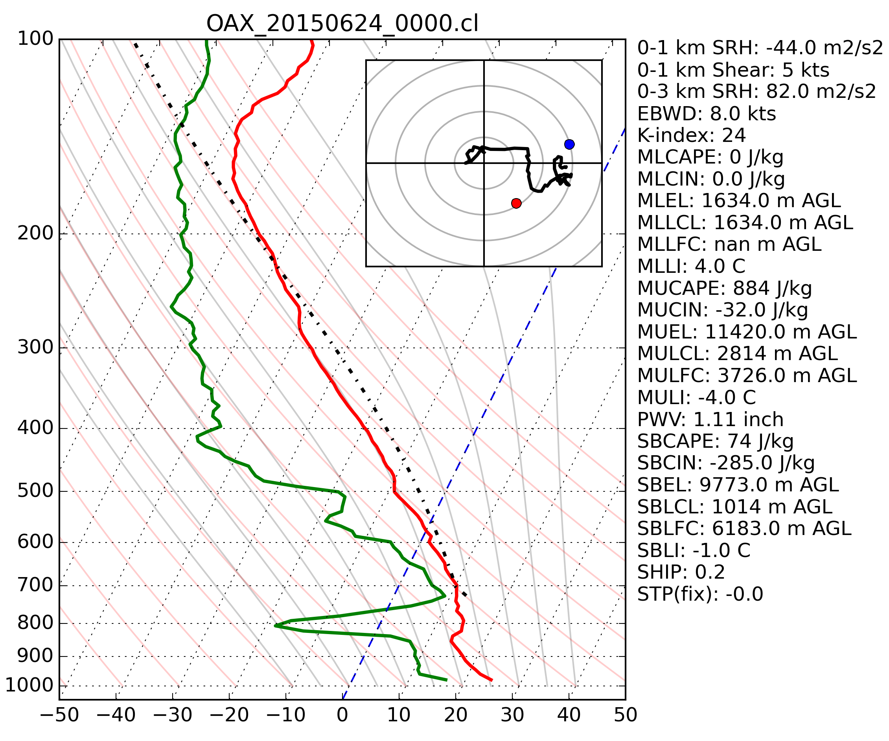
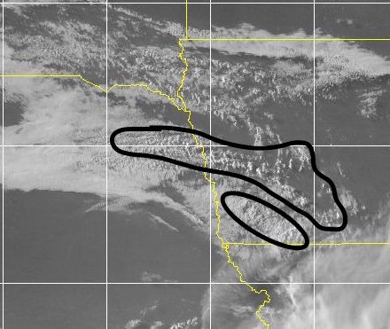
Conditions at 0000 UTC
Altocumulus castellanus clouds were widespread over eastern NE/western IA at 0000 UTC
The 0000 UTC sounding from Omaha showed that these clouds were rooted near 700 hPa
These clouds formed over western NE early on 23 June and migrated east during the day
Cloud deck being reinforced from the south by isentropic ascent of parcels on the frontal surface

Slide 12
Observed Vertical Velocities
Kinematic vertical velocities were calculated at three points, by creating triangles using the sounding array
Calculated by vertically integrating the continuity equation and using divergence of the wind field (see Bellamy 1949 and Davies-Jones 1993)
Surface and tropopause were assigned VVs of 0 to preserve mass continuity (Fankhauser 1969; OBrien 1970)
Maximum of -9 μb s⁻¹ at 0300 UTC to -12 μb s⁻¹ at 0600 UTC (at location of star)
Average isentropic vertical velocities ranged from -10 μb s⁻¹ at 0300 UTC to -8 μb s⁻¹ at 0600 UTC on 24 June in the warm frontal zone
Calculated using a simplified version of the isentropic vertical velocity equation where the only term is the advection of pressure
VV declined between 0300 and 0600 UTC due to frontal slope decreasing more than LLJ increased
Triangles (red/green/blue) used to compute divergence – VV calculations at location of star

Slide 13
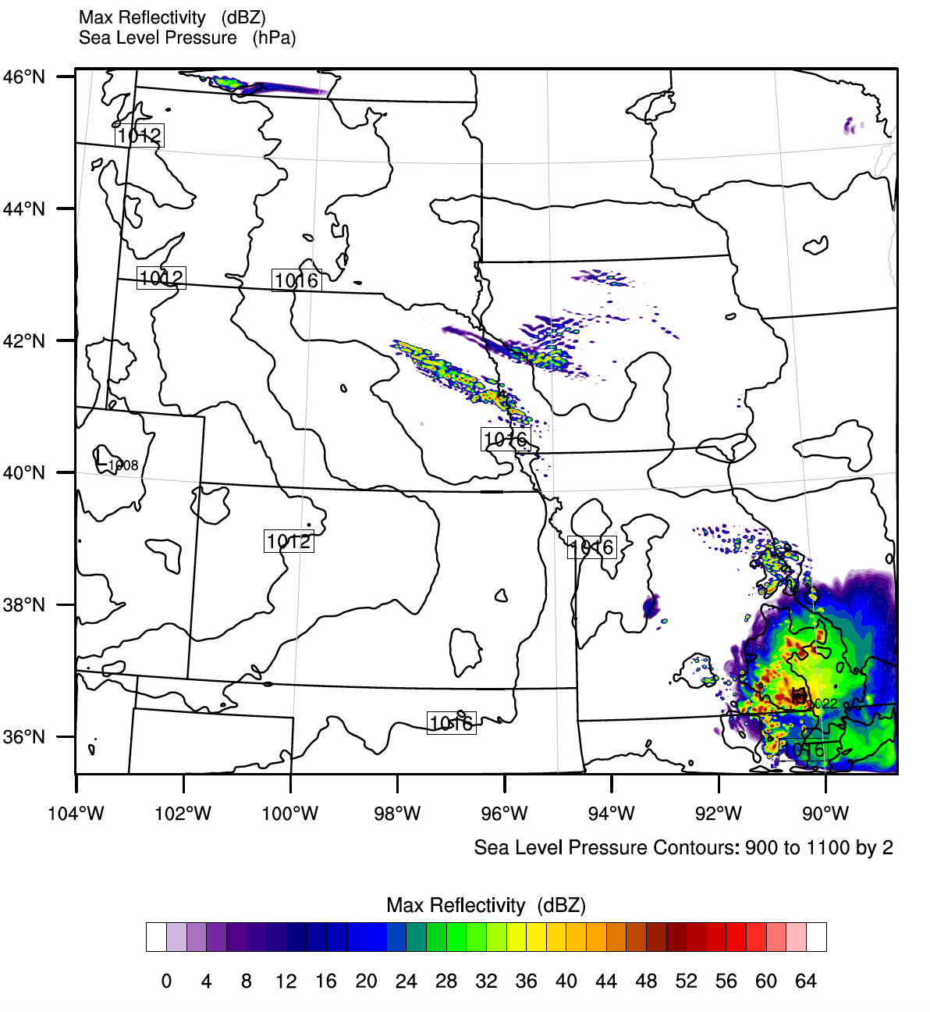
WRF Simulation
WRF-ARW run at the University of Manitoba
Single domain centred over eastern NE/western IA
Horizontal grid spacing 2 km
50 Vertical levels
700 x 600 grid (1400 km x 1200 km)
Adaptive time step of 6-24 s
Thompson microphysics
No cumulus parameterization
NARR used as IC/BC
Model experiments led to these settings being selected as optimal for this case – given available computing resources
CI at about the right time and location.
Warm front location also accurate
Simulated max reflectivity at 0500 UTC

Slide 14
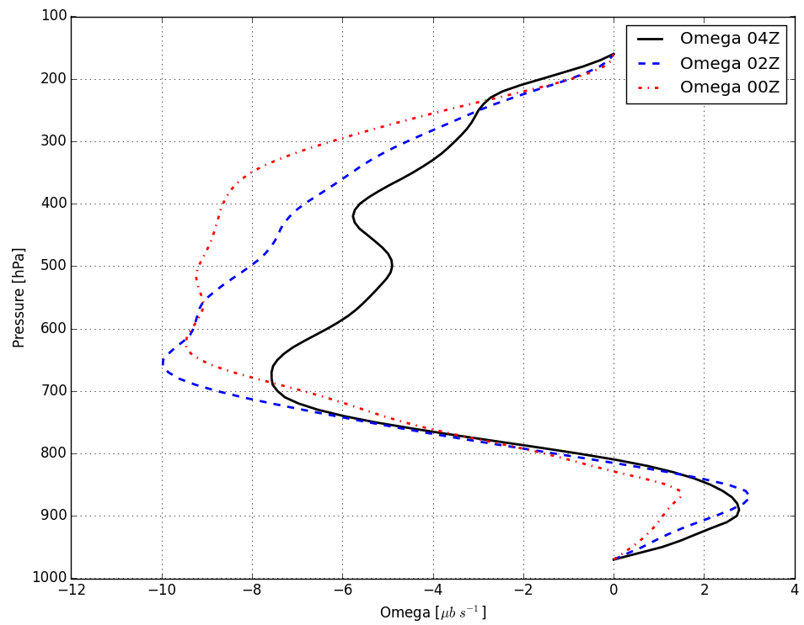
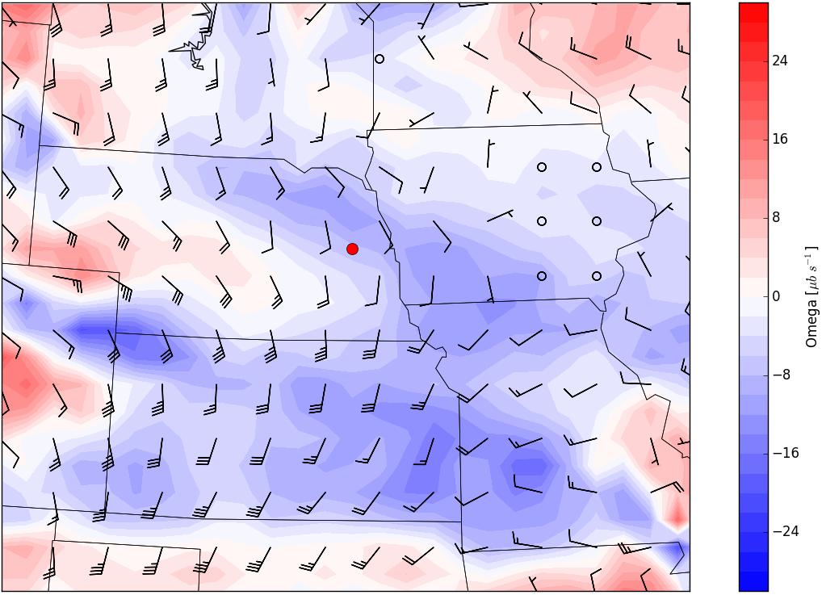
WRF Vertical Velocities
WRF Kinematic vertical velocities showed a maximum in ascent near where convection initiated – and near the level where elevated parcels were rooted (700 hPa)
VVs declined with time at the point shown below, but that is because the maximum shifted north between 0000 and 0400 UTC (as shown in the map of VVs)
Omega at 00, 02, 04Z at red pt
700 hPa VVs and 850 hPa Winds at 04Z

Slide 15
Early Conclusions
Elevated convection initiated from pre-existing ACC after sunset
The nocturnal LLJ increased ascent in two ways:
Parcels ascended the warm frontal surface more quickly
Convergence at the nose of the LLJ increased
These two mechanisms created ascent of a similar magnitude (roughly -10 μb s⁻¹) from 0300 to 0600 UTC
It has been subjectively observed that the presence of ACC in the late evening is an important precursor to later convection – because it indicates sufficient ascent and moisture/instability are in place for convection to develop
Stronger mesoscale ascent, which can help to initiate convection, occurs when the LLJ increases with nocturnal cooling

Slide 16
Future Study
Complete analysis of WRF simulation
Try to identify the factors that caused the moisture advection to occur in a narrow layer near/after sunset
Identify whether isentropic ascent or LLJ convergence was more important in triggering the convection (or other factors: e.g. frontogenesis)
Convection Banding
Why did convection initially form in preferred bands?
Was it a staircase structure (e.g. Locatelli and Hobbs 1987; Neiman et al. 1993) in the warm front or some sort of waves moving through the front or something else?
Apply this knowledge to a Canadian case
Studying a case of elevated CI in southern Manitoba on August 22, 2015 that produced softball-sized hail

Slide 17
Acknowledgements
Funding from
National Sciences and Engineering Research Council of Canada (NSERC) – Alexander Graham Bell Scholarship
Changing Cold Regions Network (CCRN; Canada)
Data from
Thanks to the students/scientists who stayed up late to launch sondes from MPs and FPs during PECAN
Thanks to the UW King Air Crew

Slide 18
References
Bellamy, J. C., 1949: Objective calculations of divergence, vertical velocity and vorticity. Bull. Amer. Meteor. Soc, 30, 45–49.
Davies-Jones, R., 1993: Useful formulas for computing divergence, vorticity, and their errors from thee or more stations. Mon. Wea. Rev, 121, 713–725.
Draxler, R. R., and G. D. Hess, 1998: An overview of the HYSPLIT_4 modelling system for trajectories, dispersion and deposition. Aust. Met. Mag, 47, 295–308.
Fankhauser, J. C., 1969: Convective processes resolved by a mesoscale rawinsonde network. J. Appl. Meteor. Climatol, 8, 778–798.
Locatelli, J. D., and P. V. Hobbs, 1987: The mesoscale and microscale structure and organization of clouds and precipitation in midlatitude cyclones. XIII: Structure of a warm front. J. Atmos. Sci. 44, 2290–2309.
Mesinger, F., and Coauthors, 2006: North American Regional Reanalysis. Bull. Amer. Meteor. Soc. 87, 343–360, doi:10.1175/BAMS-87-3-343.
Neiman, P. J., M. A. Shapiro, and L. S. Fedor, 1993: The life cycle of an extratropical marine cyclone. Part II: Mesoscale structure and diagnostics. Mon. Wea. Rev, 121, 2177–2199.
OBrien, J. J., 1970: Alternative solutions to the classical vertical velocity problem. J. Appl. Meteor. Climatol, 9, 197–203.
Stein, A. F., R. R. Draxler, G. D. Rolph, B. J. B. Stunder, M. D. Cohen, and F. Ngan, 2015: NOAA’s HYSPLIT Atmospheric Transport and Dispersion Modeling System. Bull. Amer. Meteor. Soc, 96, 2059–2077, doi:10.1175/BAMS-D-14-00110.1.
Trier, S. B., and D. B. Parsons, 1993: Evolution of Environmental Conditions Preceding the Development of a Nocturnal Mesoscale Convective Complex. Mon. Wea. Rev, 121, 1078–1098.

Slide 19
Thank-You!
Questions?

