Slide 1
Insights from AERIs during the PECAN campaign
Tim Wagner¹, David Loveless¹, Jon Gero¹, Denny Hackel¹, Dave Turner², Greg Blumberg³, Ken Cook⁴, Henry Downey¹, Wayne Feltz¹
Space Science and Engineering Center, Univ. of Wisconsin – Madison
National Severe Storms Laboratory
Cooperative Institute for Mesoscale Meteorological Studies
National Weather Service WFO Wichita

Slide 2
Greatest concentration of AERIs in history!
6 AERIs at the Fixed PISA sites plus SPARC and CLAMPS = 8 AERIs!
Retrieved temperature and moisture profiles a 5 min resolution available in PECAN and ARM archives.

Slide 3
FP1
FP2
FP3
FP4
FP5
FP6
SPARC
1 Jun 10 Jun 20 Jun 1 Jul 10 Jul

Slide 4
So what can we learn from all of these thermodynamic profiles?
I. Bores
II. Low Level Jet
III. 13 June Tornado

Slide 5
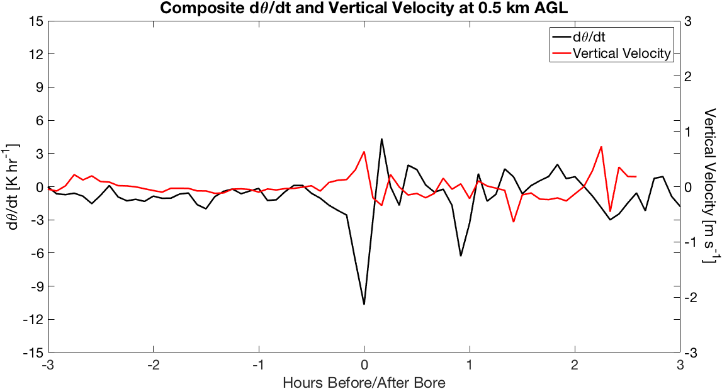
Bores

Slide 6
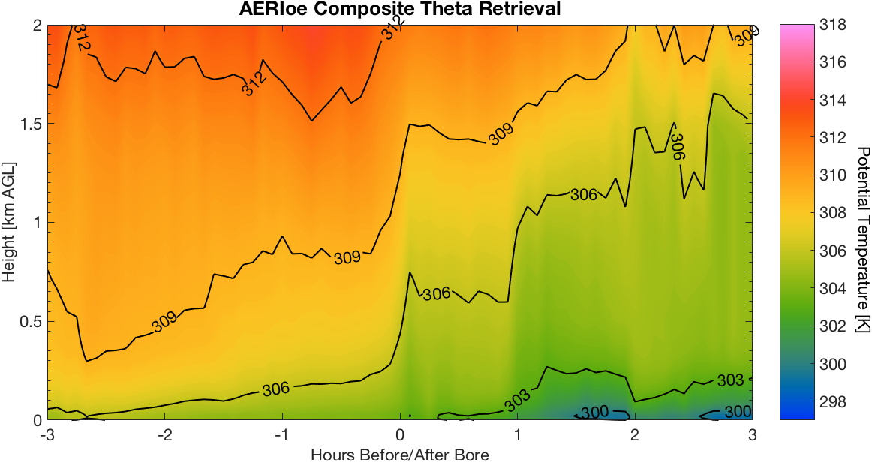
Bores

Slide 7
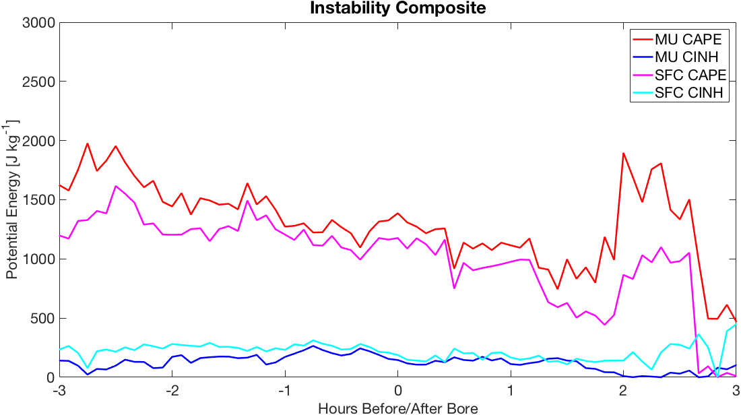
Bores

Slide 8
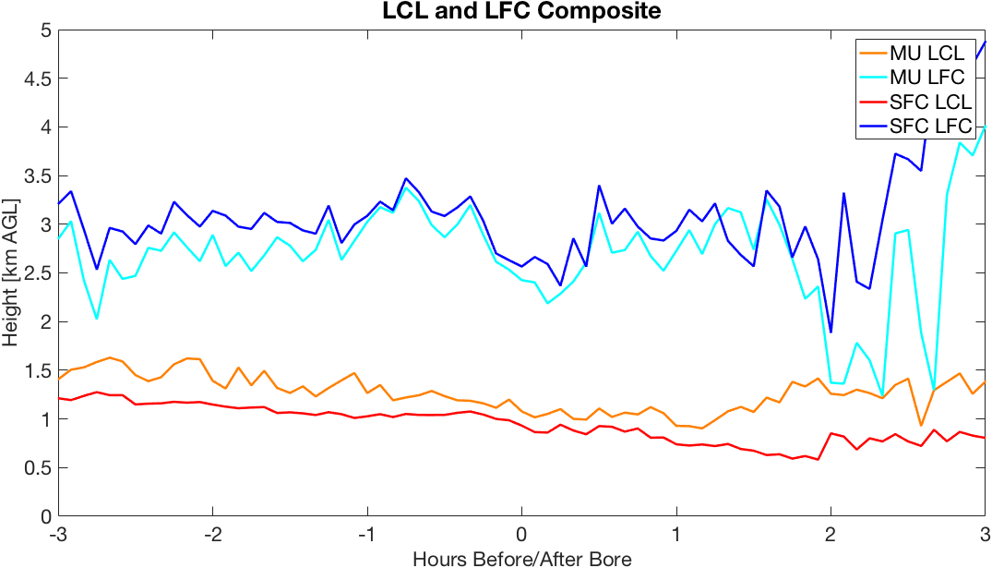
Bores

Slide 9
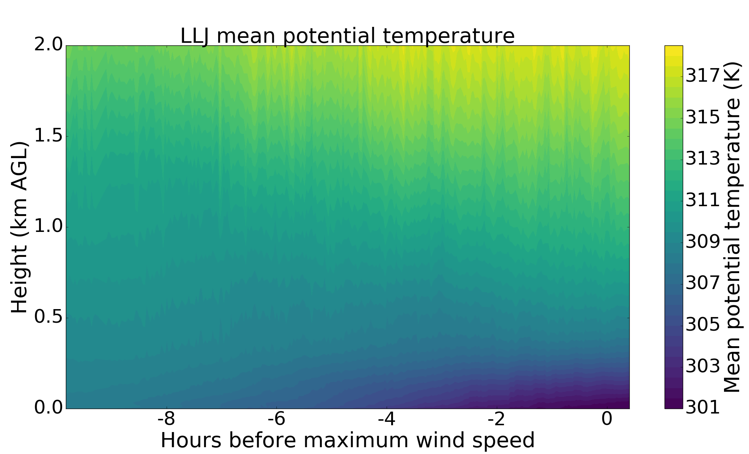
Low Level Jet

Slide 10
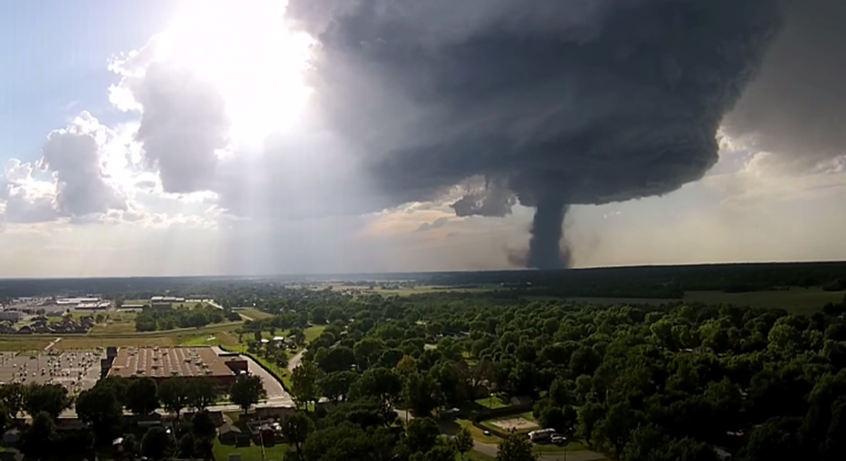
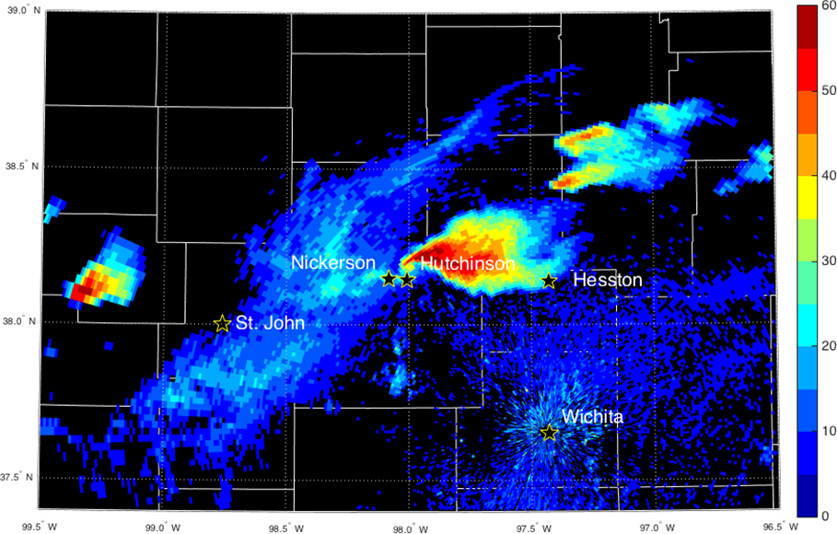
Tornado

Slide 11
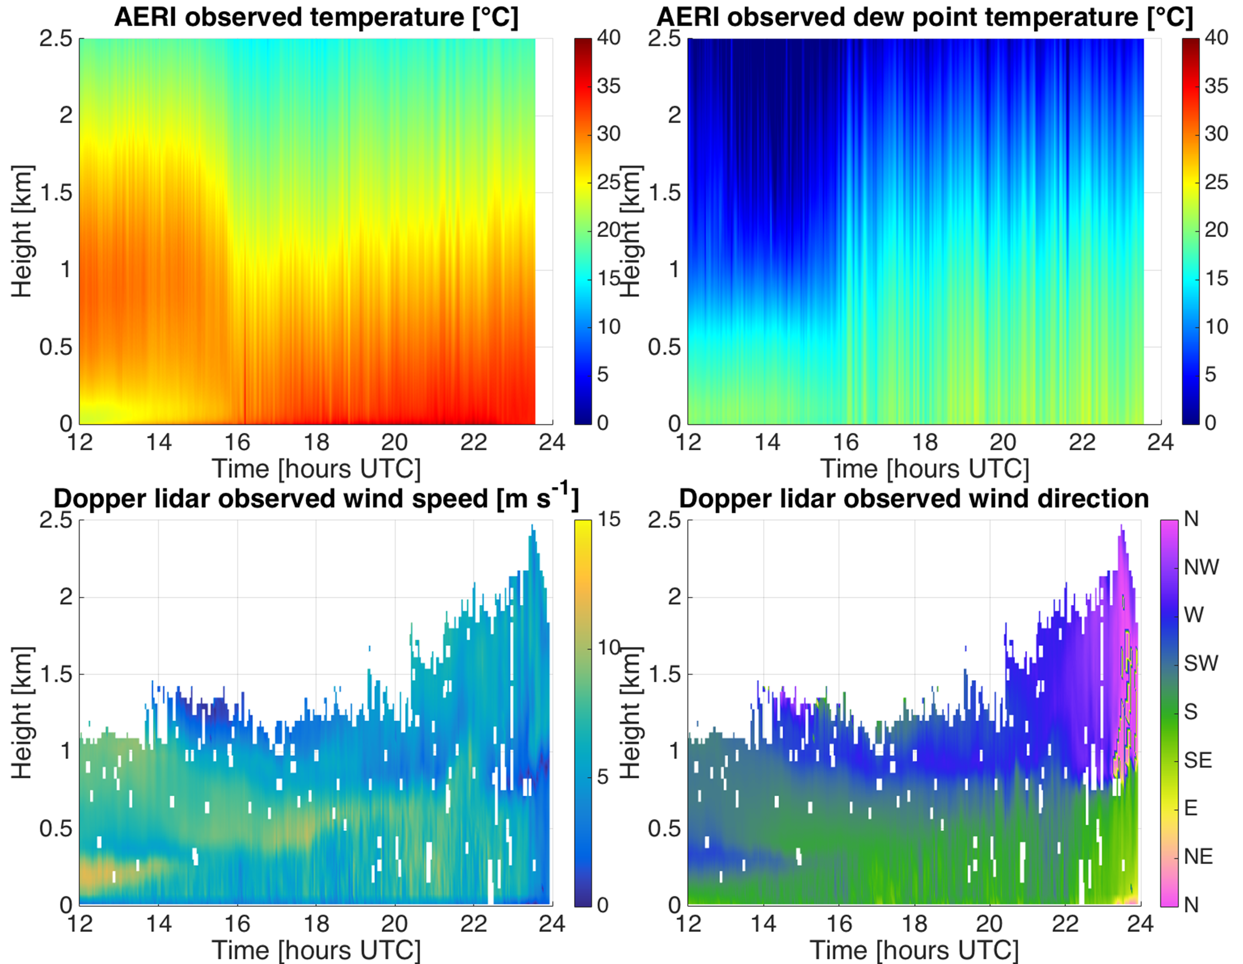
Tornado

Slide 12
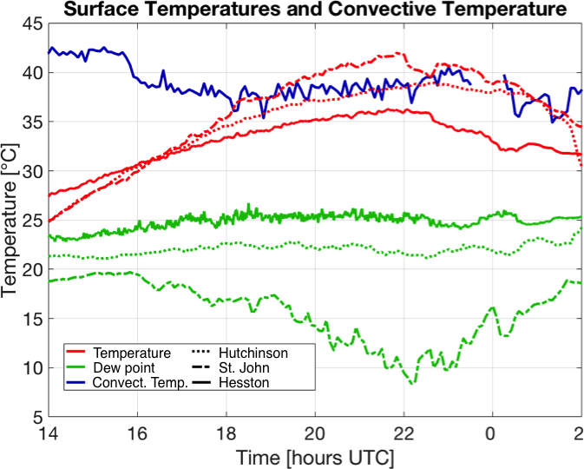
Tornado

Slide 13
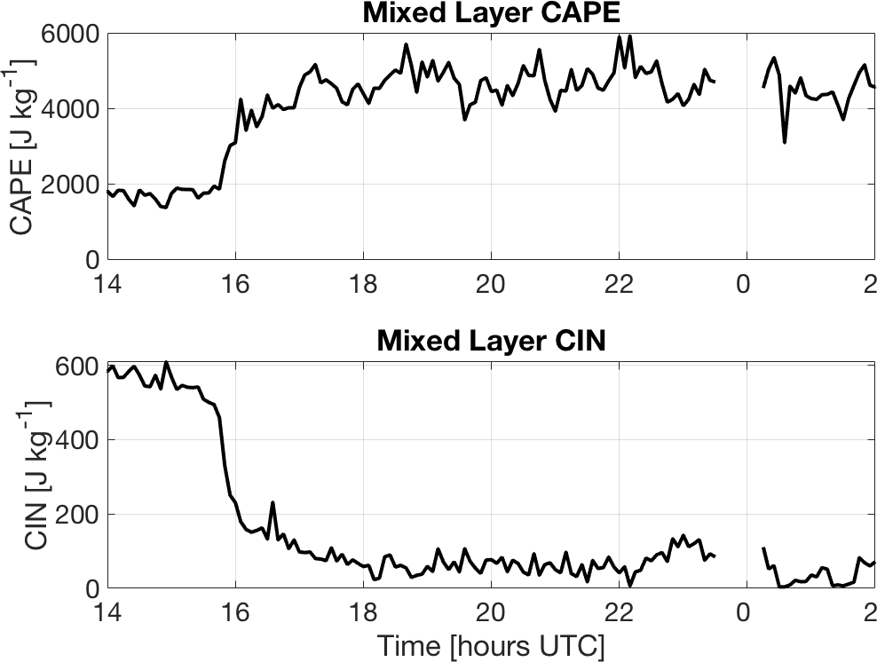
Tornado

Slide 14
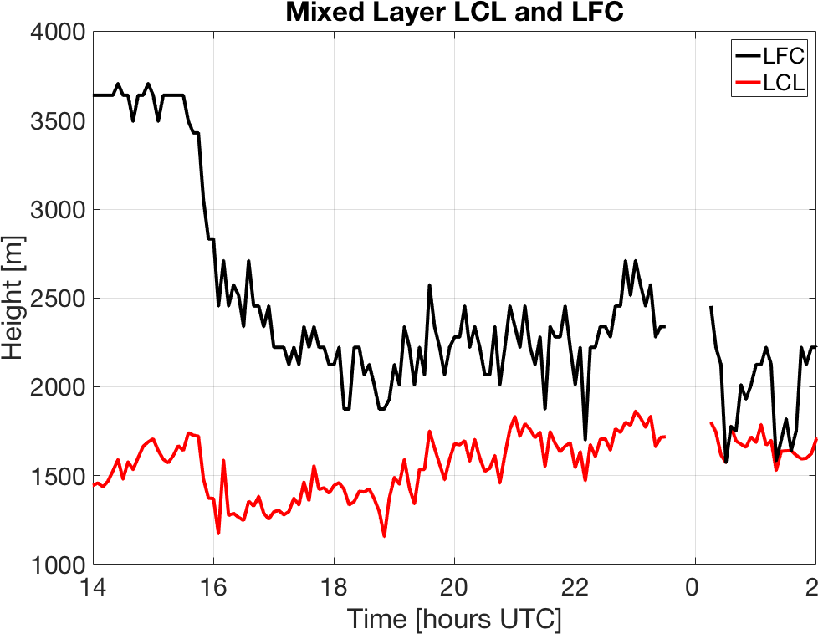
Tornado

Slide 15
Summary:
Bores show characteristic low level stable layer lifting coincident with vertical velocity spike
Low level jet cases show building stability throughout their development
Despite very low relative humidity, sufficient moisture existed for deep moist convection and supercell development
Thank You!
Photo by Jon Gero

