Slide 1

Why Does the Rain Fall on the Great Plains…….
David Parsons, Kevin Haghi, and Ben Blake
School of Meteorology

Slide 2
Why Does the Rain Fall on the Great Plains Mainly at Night?
David Parsons, Kevin Haghi, and Ben Blake
School of Meteorology

Slide 3
Acknowledgements
  Lillo and Parsons (2016) – Importance of representing convection systems to medium range, global NWP. In press Quart. J Roy. Meteor. Soc.
  Blake et al. (2016) – Modeling study. Submitted to Mon. Wea. Rev.
  Haghi et al. (2016) – Frequency of bores and their relationship to the environment and convective outflow. See talk and poster: Paper to be submitted
  Parsons et al. (2016) – Convective instability, LLJs and bores lifting. To be submitted

Slide 4
A Modest Proposal
  Summer, nocturnal convection over the Great Plains generates bores that are long-lived bores with relatively deep ascent.
  As the night progresses….
    Mesoscale convective systems (MCSs) will often transition from gust front-driven to “bore aided convection”.
    Strong bore ascent and “favorable” profiles of convective instability can lead to “bore maintained convection”.

Slide 6
Partially Blocked Regime
with a stable nocturnal boundary layer

Slide 7
Strong Bore Response

Slide 8

The Evidence
Observations show that convective outflows (density currents) commonly trigger bores as predicted by theory – Haghi et al. 2016
All hail, to one of the founding fathers
Of bores and convection, the voice in the
Wilderness, Steven “the wave” Koch

Slide 9
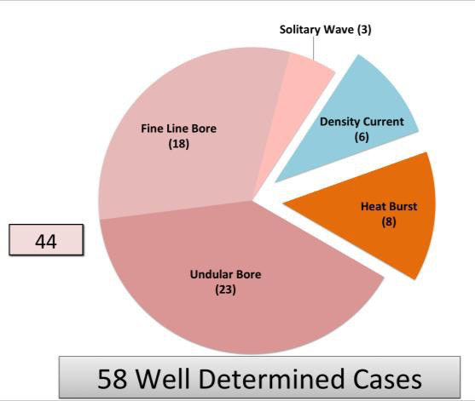
Convective triggers density currents that initiate bores.
Haghi et al. TBS

Slide 10
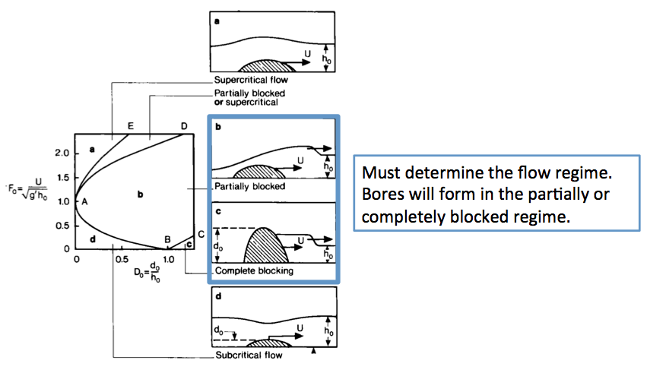
Flow Regimes can be predicted based on a
Froude number and a non-dimensional height
Adapted from Rottman and Simpson, 1989

Slide 12
See Baines;Rottman
and Simpson; Koch and other classic papers

Slide 13
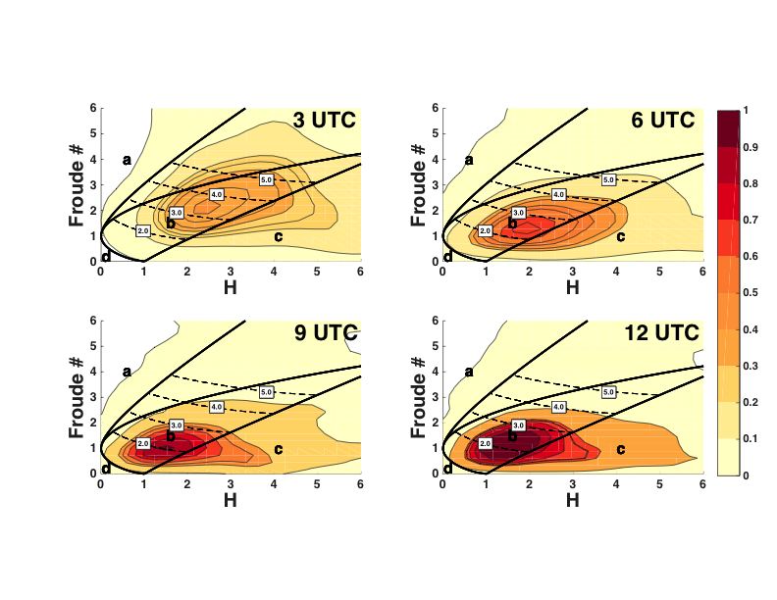
See Kevin Haghi, the newest “wave jockey” and voice in the wilderness

Slide 14
I know Kevin has a more recent figure, help, I can’t keep up

Slide 15
Partially Blocked Regime
with a stable nocturnal boundary layer

Slide 16
Summary So Far
Observations: Bores are commonly generated in this environment from nocturnal convection as expected in a partially blocked regime
In partially blocked regimes:
  Gust-front driven convection is “bore aided”, since the role of bores in a partially blocked flow regime is to allow air to flow up and over the cold pool

Slide 17
Evidence
Observations show bores are commonly triggered
Theory predicts partially blocked flow and the generation of bores
Does bore lifting matter? The lifting is substantial (approaching 1 km) and extends through the lower troposphere

Slide 18
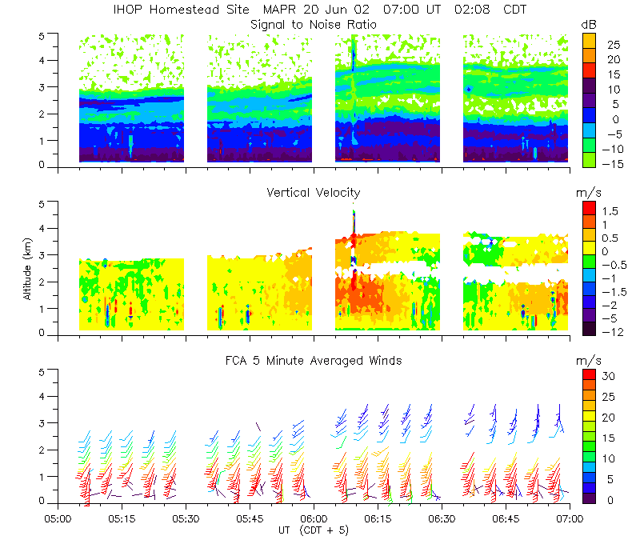
20 June (MAPR)
Post-bore height
Pre-bore height
Notes:
Bore in MAPR reflectivity, vertical motion and winds. The displacement of the layers at the leading edge of the bore is easily seen in the signal to noise ratio (clear air reflectivity).

Slide 20
Evidence
Observations show bores are commonly triggered as predicted by theory
Deep and substantial lifting occurs in a favorable CAPE/CIN layer associated with advection by the LLJ
The bore lifting is explained by the “curvature” of the wind profile defining the wave duct & the trapping layer is not being “infinite”

Slide 21
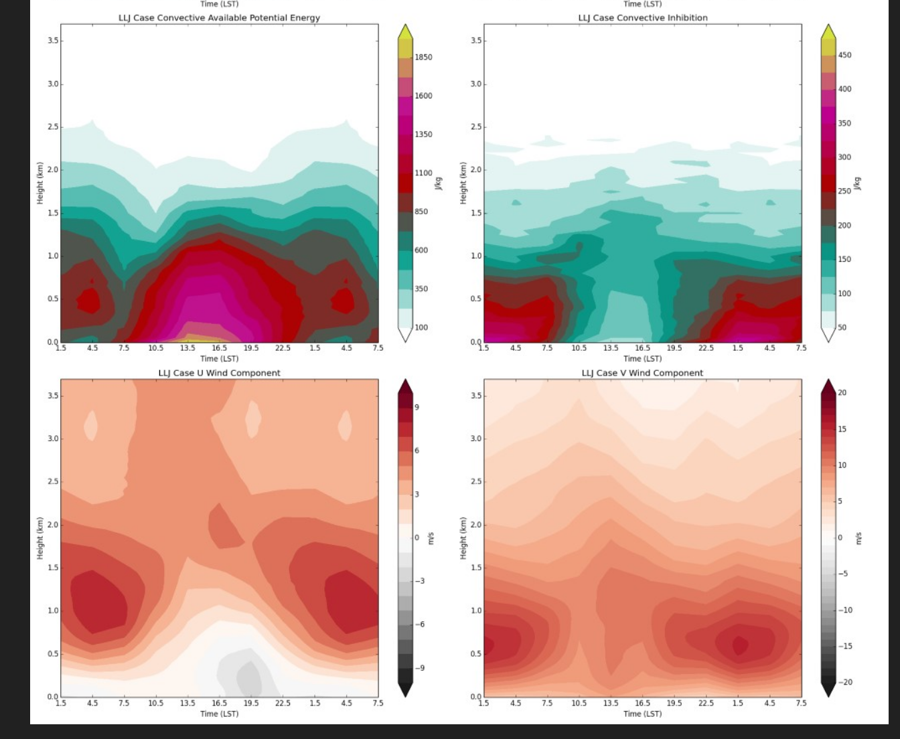
CAPE
CIN
U
V

Slide 22
CAPE
CIN
U
V
NOTE THE BEST LAYERS FOR NOCTURNAL CONVECTION

Slide 23
CAPE
CIN
U
V
NOTE THE BEST LAYERS FOR NOCTURNAL CONVECTION

Slide 24
CAPE
CIN
NOTE THE U AND V MAX
U
V

Slide 25
CAPE
CIN
NOTE THE U AND V MAX
U
V

Slide 26
CAPE
CIN
NOTE THE U AND V MAX: WHY??
SEE AN OU/BLISS TALKS & POSTERS
It is important for bores!!
U
V

Slide 27
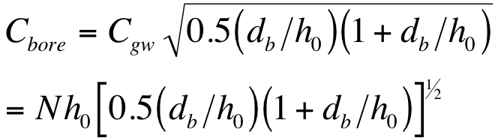
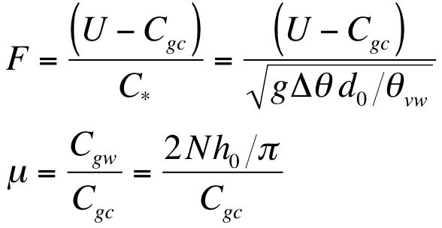
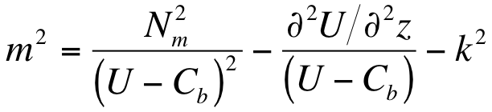
Theory
(Rottman and Simpson 1989; Haase and Smith 1989)
Bore speed of propagation
Two parameters determine whether a bore will be generated from an intrusive gravity current:
  μ > 0.7 is required for bore
  Solitary waves require large Froude Number
Vertical variation of the Scorer parameter determines likelihood of wave trapping
Adapted from S. Koch
Stability Curvature

Slide 28
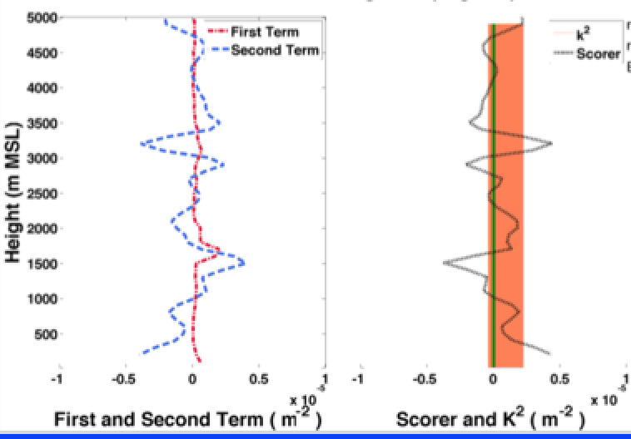
Curvature Defines the Duct:
Don’t Think of Bores as Trapped in the Stable Nocturnal Boundary Layer

Slide 29
Curvature Defines the Duct:
Don’t Think of Bores as Trapped in the Stable Nocturnal Boundary Layer
Curvature
Defines the
duct

Slide 30
CAPE
CIN
IMPLICATIONS OF THE U AND V MAXS:
THE WAVE DUCT VARIES WITH ORIENTATION
U
V

Slide 31
CAPE
CIN
Implications for ducting
U
V
Deeper, weaker
Shallow

Slide 32
The Evidence
Most observed density currents generate bores as predicted by theory in a partially blocked flow
The “curvature” of the jet creates a deep and favorable wave duct that varies with orientation with deep (lower troposphere) and substantial (~1 km) lifting. Expected from departures from the two-layer linear theory (se Kevin). The duct is deeper than the stable boundary layer
Modeling (Blake et al. 2016 – submitted) and observations show this lifting creating a favorable inflow toward the density current with greatly reduced CIN

Slide 33
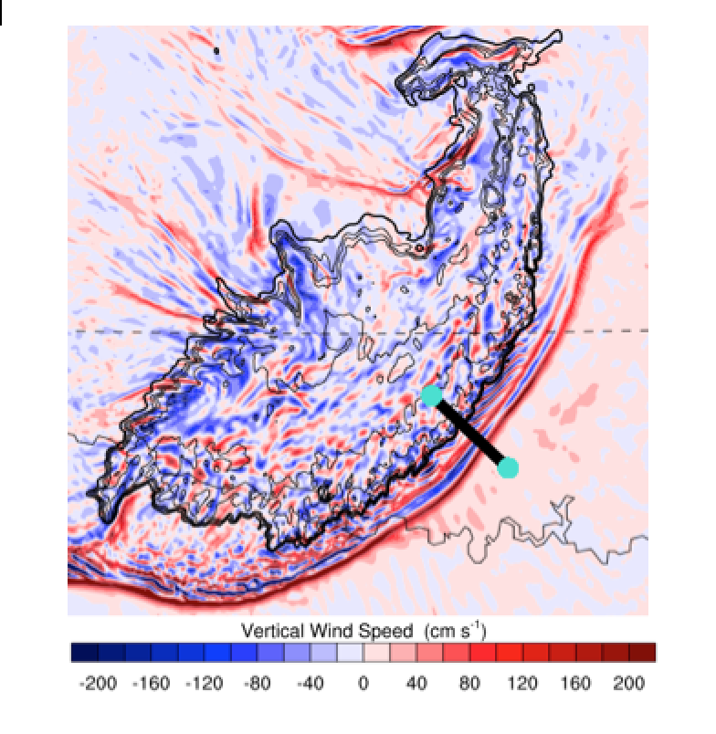
From Blake et al. (2016)

Slide 34

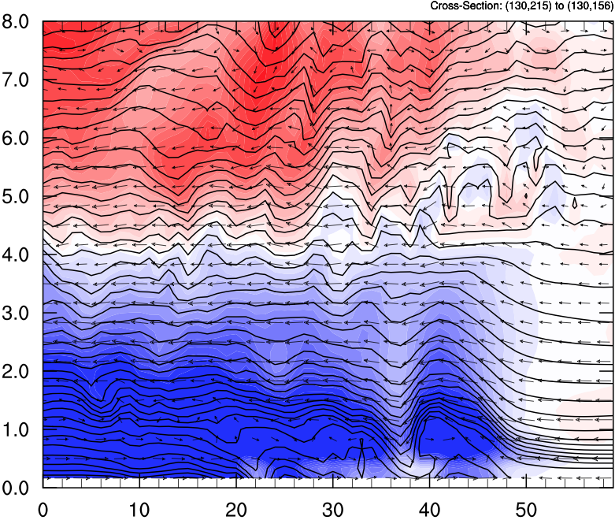
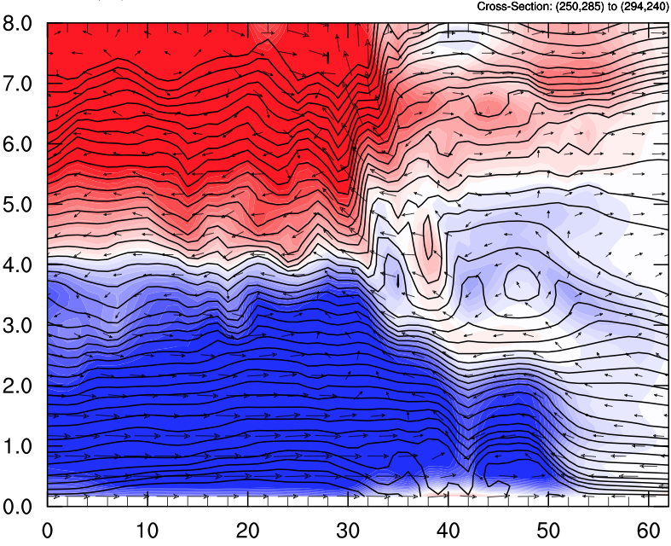


Elevated Buoyancy
1030 UTC
0º Region (South End) 315º Region (SE End)

Slide 35
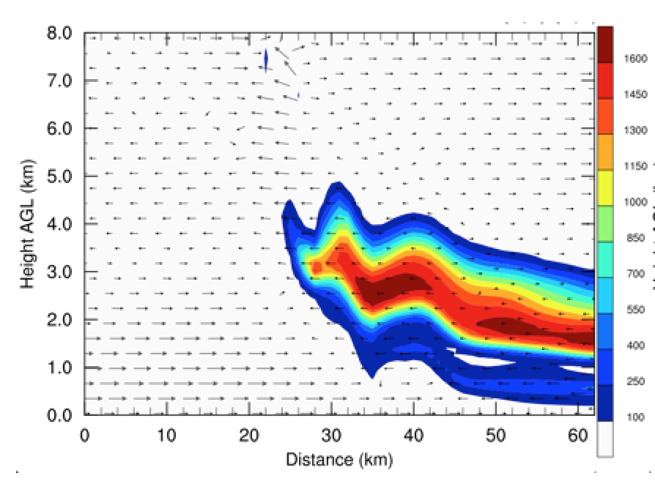
i
CAPE

Slide 36
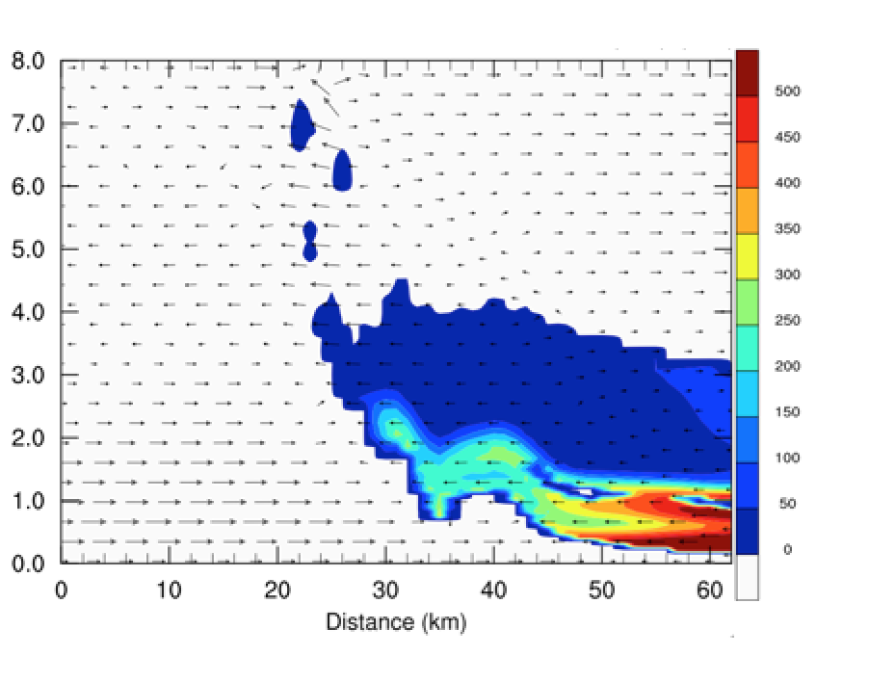
g
CIN

Slide 37
Conclusions
Critical role of LLJ in moisture advection/CAPE/CIN and creating deep, 3-D wave ducts allowing long-lived waves with deep, strong ascent
Daytime convection is often maintained by density currents (cold pools). As the night progesses, MCS become ” bore aided” or “bore maintained.” Later in the night when the kinematics suggest nocturnal MCS are cold pool-driven, the dynamics are often likely to “bore aided in partially blocked flow”.
“Bore-driven convection” is supported by previous idealized modeling by Parker and colleagues, but with some differences

Slide 38
What is next???
Explore this conceptual model with PECAN data
Currently working with the ECMWF to develop and test a convective parameterization.
See Kevin Haghi’s talk and poster for the careful details, thanks also to Ben Blake, Alan Shapiro, and Stephen Castleberry
See the OU BLISS talks for understanding the LLJ dynamics

